Slide 1

Machine Learning
CO-4: Demonstrate Neural Networks and Multi Layer Perceptrons

Slide 2
S.No | Course Outcome | Intended Learning Outcomes (ILO) | Knowledge Level of ILO | No. of Hours
1 | CO 4 | Discuss about The Brain And The Neuron : Hebb’s Rule | K1 | 1
2 |  | Illustrate The Brain And The Neuron :Mcculloch And Pitts Neurons Limitations Of The Mcculloch And Pitts Model | K2 | 2
3 |  | Illustrate Neural Networks, Perceptron :The Learning Rate Η,The Bias Input The Perceptron Learning Algorithm, An Example Of Perceptron Learning: Logic Functions Implementation | K2 | 3
4 |  | Discuss about Linear Separability | K2 | 2
5 |  | Discuss about Linear Regression | K2 | 2

Slide 3
THE BRAIN AND THE NEURON
In animals, learning occurs within the brain.
If we can understand how the brain works, then there might be things in there for us to copy and use for our machine learning systems.
While the brain is an impressively powerful and complicated system, the basic building blocks that it is made up of are fairly simple and easy to understand.
The animal mainly a human brain has hundreds of billions of cells called neurons.
Notes:
The computational cost of making the tree is fairly low, but the cost of using it is even lower: O(log N), where N is the number of datapoints.

Slide 4
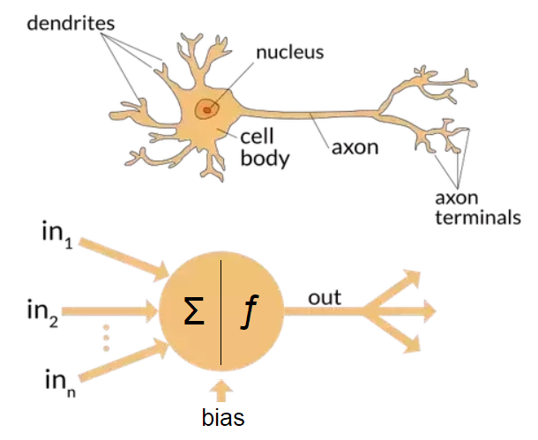
Each neuron comprises
a cell body responsible for processing information.
Dendrites take input from the other neurons.
Axon terminals gives processed output to other neurons

Slide 5
Hebb’s Rule
Hebb’s rule says that the changes in the strength of synaptic connections are proportionalto the correlation in the firing of the two connecting neurons.
So if two neurons consistentlyfire simultaneously, then any connection between them will change in strength, becoming stronger.
However, if the two neurons never fire simultaneously, the connection between them will die away.
The idea is that if two neurons both respond to something, then they should be connected.

Slide 6
Example
suppose that you have a neuron somewhere that recognises your grandmother (this will probably get input from lots of visual processing neurons, but don’t worry about that).
Now if your grandmother always gives you a chocolate bar when she comes to visit, then some neurons, which are happy because you like the taste of chocolate, will also be stimulated. Since these neurons fire at the same time, they will be connected together, and the connection will get stronger over time.
So eventually, the sight of your grandmother, even in a photo, will be enough to make you think of chocolate.
Sound familiar? Pavlov used this idea, called classical conditioning, to train his dogs so that when food was shown to the dogs and the bell was rung at the same time, the neurons for salivating over the food and hearing the bell fired simultaneously, and so became strongly connected.
Over time, the strength of the synapse between the neurons that responded to hearing the bell and those that caused the salivation reflex was enough that just hearing the bell caused the salivation neurons to fire in sympathy.
There are other names for this idea that synaptic connections between neurons and assemblies of neurons can be formed when they fire together and can become stronger.
It is also known as long-term potentiation and neural plasticity, and it does appear to have correlates in real brains.

Slide 7
McCulloch and Pitts Neurons
Studying neurons isn’t actually that easy. You need to be able to extract the neuron from the brain, and then keep it alive so that you can see how it reacts in controlled circumstances. Doing this takes a lot of care.
One of the problems is that neurons are generally quite small so getting electrodes into the synapses is difficult.
It has been done, though, using neurons from the giant squid, which has some neurons that are large enough to see. Hodgkin and Huxley did this in 1952, measuring and writing down differential equations that compute the membrane potential based on various chemical concentrations, something that earned them a Nobel prize.
We aren’t going to worry about that, instead, we’re going to look at a mathematical model of a neuron that was introduced in 1943.

Slide 8
The purpose of a mathematical model is that it extracts only the bare essentials required to accurately represent the entity being studied, removing all of the extraneous details.
McCulloch and Pitts produced a perfect example of this when they modelled a neuron as:
a set of weighted inputs wi that correspond to the synapses
an adder that sums the input signals (equivalent to the membrane of the cell thatcollects electrical charge)
an activation function (initially a threshold function) that decideswhether the neuron fires (‘spikes’) for the current inputs

Slide 9
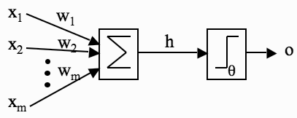
A picture of McCulloch and Pitts’ mathematical model of a neuron. The inputs X_{i} are multiplied by the weights w_{i} , and the neurons sum their values. If this sum is greater than the threshold θ then the neuron fires; otherwise it does not.

Slide 10


Functions used in McCulloh and pitts
Sum:(add up) All the inputs multiplied by their synaptic weights as
Activation function: The decision about whether or not to fire

Slide 11
Example:
I’ve assumed that there are m of them, where m = 3 in the example.
If the synaptic weights are w1 = 1, w2 = -0.5, w3 = -1, then the inputs to our model neuron are h = 1 × 1 + 0 × -0.5+0.5 × −1 = 1 + 0 + -0.5 = 0.5.
Now the neuron needs to decide if it is going to fire.
For a real neuron, this is a question of whether the membrane potential is above some threshold. We’ll pick a threshold value (labelled θ), say θ = 0 as an example.
Now, does our neuron fire? Well, h = 0.5 in the example, and 0.5 > 0, so the neuron does fire, and produces output 1. If the neuron did not fire, it would produce output 0.

Slide 12
Limitations of the McCulloch and Pitts Neuronal Model
Deals with only Boolean Inputs
Always Need to handcode the threshold
Always uses functions which are linearly seperable.

Slide 13
NEURAL NETWORKS
One thing that is probably fairly obvious is that one neuron isn’t that interesting.
It doesn’t do very much, except fire or not fire when we give it inputs. In fact, it doesn’t even learn.
If we feed in the same set of inputs over and over again, the output of the neuron never varies—it either fires or does not.
So to make the neuron a little more interesting we need to work out how to make it learn, and then we need to put sets of neurons together into neural networks so that they can do something useful.

Slide 14
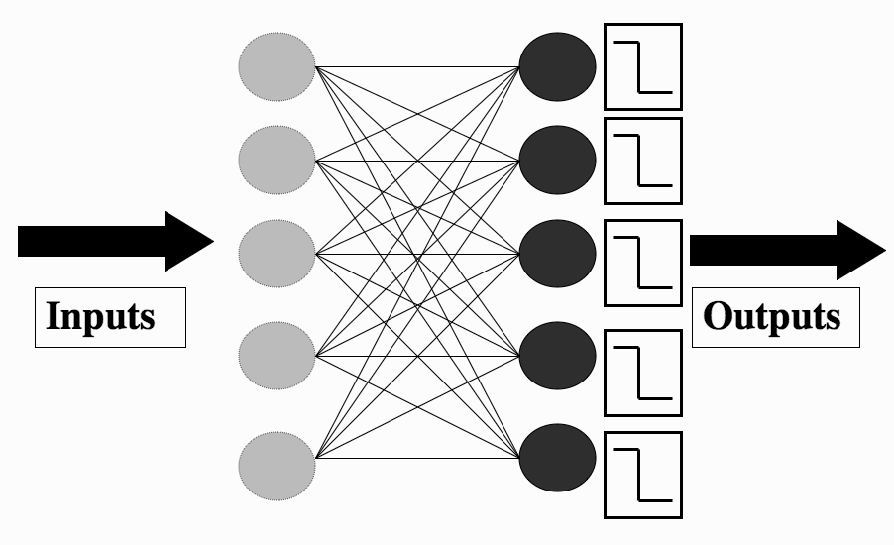
THE PERCEPTRON
The Perceptron is nothing more than a collection of McCulloch and Pitts neurons together with a set of inputs and some weights to fasten the inputs to the neurons.
The Figure dipicts The Perceptron network, consisting of a set of input nodes (left) connected to McCulloch and Pitts neurons using weighted connections.

Slide 15
Notice that the neurons in the Perceptron are completely independent of each other: it doesn’t matter to any neuron what the others are doing, it works out whether or not to fire by multiplying together its own weights and the input, adding them together, and comparing the result to its own threshold, regardless of what the other neurons are doing.
Even the weights that go into each neuron are separate for each one, so the only thing they share is the inputs, since every neuron sees all of the inputs to the network.
The number of inputs is the same as the number of neurons, but this does not have to be the case — in general there will be m inputs and n neurons.
The number of inputs is determined for us by the data, and so is the number of outputs, since we are doing supervised learning, so we want the Perceptron to learn to reproduce a particular target, that is, a pattern of firing and non-firing neurons for the given input.

Slide 16


Working :
set the values of the input nodes to match the elements of an input vector and then use the following Equations for each neuron.
We can do this for all of the neurons, and the result is a pattern of firing and non-firing neurons, which looks like a vector of 0s and 1s, so if there are 5 neurons, then a typical output pattern could be (0, 1, 0, 0, 1), which means that the second and fifth neurons fired and the others did not.

Slide 17
We compare that pattern to the target, which is our known correct answer for this input, to identify which neurons got the answer right, and which did not.
For a neuron that is correct, we are happy, but any neuron that fired when it shouldn’t have done, or failed to fire when it should, needs to have its weights changed.
how we should change the weight: ∆w_{ik} = -(y_{k} - t_{k}) × x_{i}
Where,
Error function:(y_{k} - t_{k}) (the difference between the output y_{k}, which is what the neuron did, and the target for that neuron, t_{k})
Now the new value of the weight is the old value plus this value.

Slide 18

Note that we haven’t said anything about changing the threshold value of the neuron.
To see how important this is, suppose that a particular input is 0. In that case, even if a neuron is wrong, changing the relevant weight doesn’t do anything (since anything times 0 is 0): we need to change the threshold.
This is done by multiplying the value above by a parameter called the learning rate, usually labelled as η.

Slide 19
The other thing that we need to realise now is that the network needs to be shown every training example several times. The first time the network might get some of the answers correct and some wrong; the next time it will hopefully improve, and eventually its performance will stop improving.
Working out how long to train the network for is not easy , but for now we will predefine the maximum number of iterations, T.
Of course, if the network got all of the inputs correct, then this would also be a good time to stop

Slide 20
The Learning Rate η:
The above equition tells us how to change the weights, with the parameter η controlling how much to change the weights by.
We could miss it out, which would be the same as setting it to 1. If we do that, then the weights change a lot whenever there is a wrong answer, which tends to make the network unstable, so that it never settles down.
The cost of having a small learning rate is that the weights need to see the inputs more often before they change significantly, so that the network takes longer to learn.

Slide 21
However, it will be more stable and resistant to noise (errors) and inaccuracies in the data.
We therefore use a moderate learning rate, typically 0.1 < η < 0.4, depending upon how much error we expect in the inputs.
It doesn’t matter for the Perceptron algorithm, but for many of the algorithms that we will see in the book, the learning rate is a crucial parameter.

Slide 22
The Bias Input:
When we discussed the McCulloch and Pitts neuron, we gave each neuron a firing threshold θ that determined what value it needed before it should fire.
This threshold should be adjustable, so that we can change the value that the neuron fires at.
Suppose that all of the inputs to a neuron are zero. Now it doesn’t matter what the weights are (since zero times anything equals zero), the only way that we can control whether the neuron fires or not is through the threshold.
If it wan’t adjustable and we wanted one neuron to fire when all the inputs to the network were zero, and another not to fire, then we would have a problem.
No matter what values of the weights were set, the two neurons would do the same thing since they had the same threshold and the inputs were all zero.

Slide 23
The trouble is that changing the threshold requires an extra parameter that we need to write code for, and it isn’t clear how we can do that in terms of the weight update that we worked out earlier.
Fortunately, there is a neat way around this problem. Suppose that we fix the value of the threshold for the neuron at zero.
Now, we add an extra input weight to the neuron, with the value of the input to that weight always being fixedWe include that weight in our update algorithm (like all the other weights), so we don’t need to think of anything new.
And the value of the weight will change to make the neuron fire or not fire, whichever is correct when an input of all zeros is given, since the input on that weight is always -1, even when all the other inputs are zero.
This input is called a bias node, and its weights are usually given a 0 subscript, so that the weight
connecting it to the j^{th} neuron is w_{0j}

Slide 24
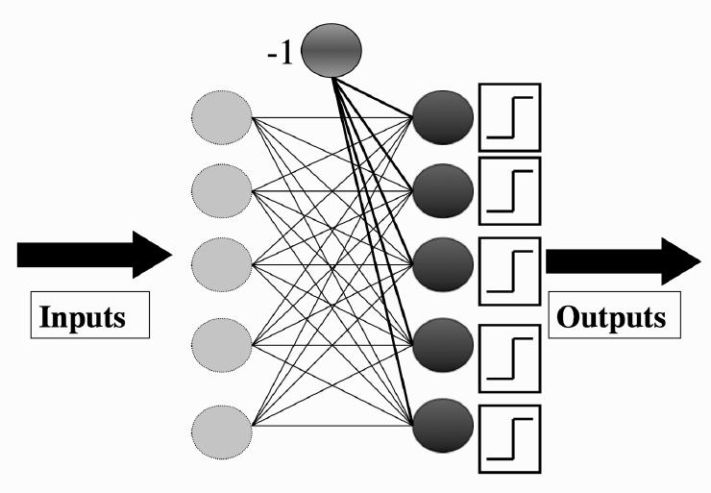
The Perceptron network showing the bias input.

Slide 25
The Perceptron Learning Algorithm:
We are now ready to write our first learning algorithm. It might be useful to keep above Figure (previous slide)in mind as you read the algorithm
The algorithm is separated into two parts: a training phase, and a recall phase. The recall phase is used after training, and it is the one that should be fast to use, since it will be used far more often than the training phase.
You can see that the training phase uses the recall equation, since it has to work out the activations of the neurons before the error can be calculated and the weights trained.

Slide 26
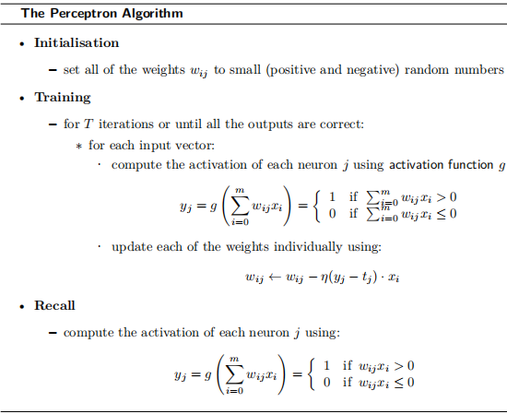

Slide 27
Computing the computational complexity of this algorithm is very easy.
The recall phase loops over the neurons, and within that loops over the inputs, so its complexity is O(mn).
The training part does this same thing, but does it for T iterations, so costs O(Tmn).

Slide 28
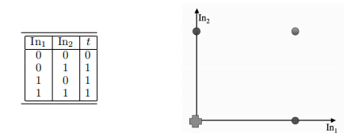
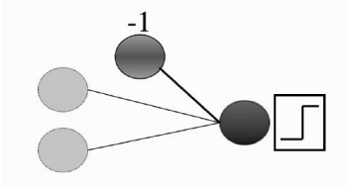
An Example of Perceptron Learning: Logic Functions
The example we are going to use is something very simple that you already know about, the logical OR. This obviously isn’t something that you actually need a neural network to learn about, but it does make a nice simple example.

Slide 29
As you can see from above Figure (previous slide) there are three weights.
The algorithm tells us to initialise the weights to small random numbers,
so we’ll pick w₀₁ = -0.05, w₁₁ = -0.02, w₂₁ = 0.02.
Now we feed in the first input, where both inputs are 0: (0, 1).
Remember that the input to the bias weight is always -1, so the value that reaches the neuron is -0.05× −1 +-0.02 × 0 + 0.02 × 0 = 0.05>0(threshold)
This value is above 1, so the neuron fires and the output is 1, which is incorrect according to the target.
The update rule tells us that we need to apply the following eq to each of the weights separately (we’ll pick a value of η = 0.25 for the example)

Slide 30


Now we feed in the next input (0, 1) and compute the output (check that you agree that the neuron does not fire, but that it should) and then apply the learning rule again:

Slide 31
For the (1, 0) input the answer is already correct (you should check that you agree with this), so we don’t have to update the weights at all, and the same is true for the (1, 1) input.
So now we’ve been through all of the inputs once. Unfortunately, that doesn’t mean we’ve finished not all the answers are correct yet.
We now need to start going through the inputs again, until the weights settle down and stop changing, which is what tells us that the algorithm has finished.
For real-world applications the weights may never stop changing, which is why you run the algorithm for some pre-set number of iterations, T.

Slide 32
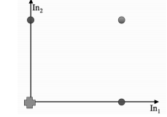
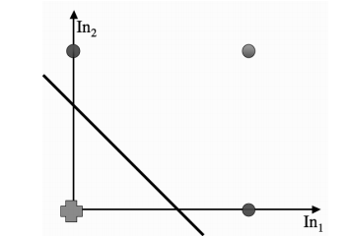
Linear Separability
What does the Perceptron actually compute? For our one output neuron example of the OR data it tries to separate out the cases where the neuron should fire from those where it shouldn’t.
Looking at the graph , you should be able to draw a straight line that separates out the crosses from the circles without difficulty

Slide 33
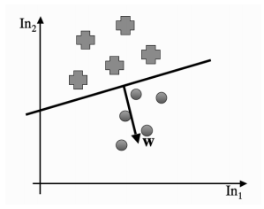
In fact, that is exactly what the Perceptron does: it tries to find a straight line (in 2D, a plane in 3D, and a hyperplane in higher dimensions) where the neuron fires on one side of the line, and doesn’t on the other.
This line is called the decision boundary or discriminant function.
Example

Slide 34

To see this, think about the matrix notation we used in the implementation, but consider just one input vector x.
The neuron fires if x·wT ≥ 0 (where w is the row of W that connects the inputs to one particular neuron; they are the same for the OR example, since there is only one neuron, and wT denotes the transpose of w and is used to make both of the vectors into column vectors)
The a · b notation describes the inner or scalar product between two vectors. It is computed by multiplying each element of the first vector by the matching element of the second and adding them all together.(a.b=||a||||b||.cos θ)
The boundary case is where we find an input vector x₁ that has x₁ · w_{T} = 0. Now suppose that we find another input vector x₂ that satisfies x₂ · w_{T} = 0. Putting these two equations together we get:

Slide 35
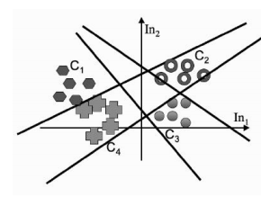
So given some data, and the associated target outputs, the Perceptron simply tries to find a straight line that divides the examples where each neuron fires from those where it does not.
This is great if that straight line exists, but is a bit of a problem otherwise.
The cases where there is a straight line are called linearly separable cases.
what happens when we have more than one output neuron.
The weights for each neuron separately describe a straight line, so by putting together several neurons we get several straight lines that each try to separate different parts of the space.

Slide 36
Linear Regression
As is common in statistics, we need to separate out regression problems, where we fit a line to data, from classification problems, where we find a line that separates out the classes, so that they can be distinguished.
However, it is common to turn classification problems into regression problems. This can be done in two ways.
First by introducing an indicator variable, which simply says which class each datapoint belongs to.
The problem is now to use the data to predict the indicator variable, which is a regression problem
The second approach is to do repeated regression, once for each class, with the indicator value being 1 for examples in the class and 0 for all of the others.
Since classification can be replaced by regression using these methods, we’ll think about regression here.

Slide 37
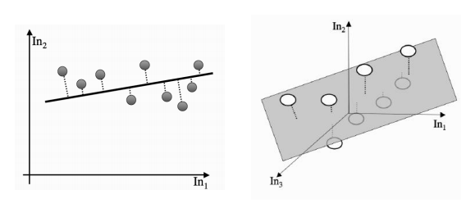
Linear regression in two and three dimensions.

Slide 38
The only real difference between the Perceptron and more statistical approaches is in the way that the problem is set up.
For regression we are making a prediction about an unknown value y (such as the indicator variable for classes or a future value of some data) by computing some function of known values x_{i} . We are thinking about straight lines, so the output y is going to be a sum of the xi values, each multiplied by a constant parameter:
The β_{i} define a straight line (plane in 3D, hyperplane in higher dimensions) that goes through (or at least near) the datapoints.
The question is how we define the line (plane or hyperplane in higher dimensions) that best fits the data.
The most common solution is to try to minimise the distance between each datapoint and the line that we fit. We can measure the distance between a point and a line by defining another line that goes through the point and hits the line

Slide 39


Now, we can try to minimise an error function that measures the sum of all these distances.
If we ignore the square roots, and just minimise the sum-of-squares of the errors, then we get the most common minimisation, which is known as least-squares optimisation.
What we are doing is choosing the parameters in order to minimise the squared difference between the prediction and the actual data value, summed over all of the datapoints. That is, we have:
This can be written in matrix form as:
where t is a column vector containing the targets and X is the matrix of input values (even including the bias inputs)

Slide 40

Computing the smallest value of this means differentiating it with respect to the (column) parameter vector β and setting the derivative to 0, which means that
which has the solution

