Slide 1

Machine Learning
CO-5: Dimensionality Reduction techniques

Slide 2
S.No | Course Outcome | Intended Learning Outcomes (ILO) | Knowledge Level of ILO | No. of Hours
1 | CO 5 | Discuss about Introduction to Dimensionality Reduction and Multi layer perceptron | K1 | 2
2 |  | Demonstrate Linear Discriminant Analysis (LDA) | K2 | 2
3 |  | Demonstrate Principal Components Analysis (PCA) , Kernel PCA | K2 | 2
4 |  | Discuss about Factor Analysis | K2 | 1
5 |  | Discuss about Independent Components Analysis (ICA) | K2 | 1
6 |  | Discuss about Locally Linear Embedding | K2 | 2

Slide 3
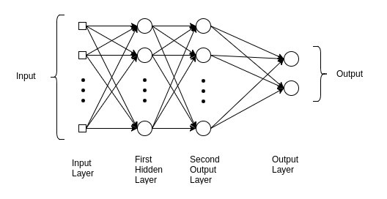
Multi Layer Perceptron
A multilayer perceptron (MLP) is a class of feedforward artificial neural network (ANN).
The term MLP is used ambiguously, sometimes loosely to any feedforward ANN, sometimes strictly to refer to networks composed of multiple layers of perceptrons
An MLP consists of at least three layers of nodes: an input layer, a hidden layer and an output layer. Except for the input nodes, each node is a neuron that uses a nonlinear activation function. MLP utilizes a supervised learning technique called backpropagation for training.
Its multiple layers and non-linear activation distinguish MLP from a linear perceptron. It can distinguish data that is not linearly separable

Slide 4
What is Dimensionality Reduction and Why?
The number of input features, variables, or columns present in a given dataset is known as dimensionality, and the process to reduce these features is called dimensionality reduction.
A dataset contains a huge number of input features in various cases, which makes the predictive modeling task more complicated. Because it is very difficult to visualize or make predictions for the training dataset with a high number of features, for such cases, dimensionality reduction techniques are required to use

Slide 5
Formal Definition
Dimensionality reduction technique: A way of converting the higher dimensions dataset into lesser dimensions dataset ensuring that it provides similar information
Where we use Dimensionality reduction techniques?
These techniques are widely used in machine learning for obtaining a better fit predictive model while solving the classification and regression problems.
It is commonly used in the fields that deal with high-dimensional data, such as
speech recognition
signal processing
bioinformatics
data visualization
noise reduction
cluster analysis

Slide 6
The Curse of Dimensionality
Handling the high-dimensional data is very difficult in practice, commonly known as the curse of dimensionality.
If the dimensionality of the input dataset increases, any machine learning algorithm and model becomes more complex.
As the number of features increases, the number of samples also gets increased proportionally, and the chance of overfitting also increases.
If the machine learning model is trained on high-dimensional data, it becomes overfitted and results in poor performance.
Hence, it is often required to reduce the number of features, which can be done with dimensionality reduction.

Slide 7
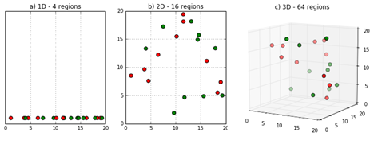

Slide 8
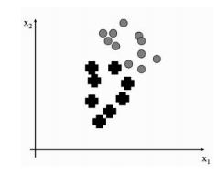
LINEAR DISCRIMINANT ANALYSIS (LDA)
Consider a simple two-dimensional dataset consisting of two classes.
We can compute various statistics about the data, but we will settle for the means of the two classes in the data, µ1 and µ2 , the mean of the entire dataset (µ), and the covariance of each class with itself , which is

Slide 9

The question is what we can do with these pieces of data??
The principal insight of LDA is that the covariance matrix can tell us about the scatter within a dataset, which is the amount of spread that there is within the data.
The way to find this scatter is to multiply the covariance by the p_{c}, the probability of the class
Adding the values of this for all of the classes gives us a measure of the within-class scatter of the dataset:

Slide 10

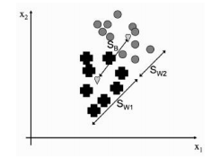
If our dataset is easy to separate into classes, then this within-class scatter should be small, so that each class is tightly clustered together.
However, to be able to separate the data, we also want the distance between the classes to be large.
This is known as the between-classes scatter and is a significantly simpler computation, simply looking at the difference in the means
The meanings of these two measurements is shown in the below Diagram

Slide 11
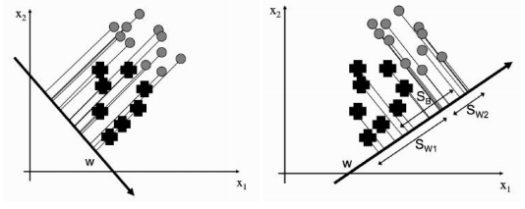
The argument about good separation suggests that datasets that are easy to separate into the different classes should have SB/SW as large as possible.
This seems perfectly reasonable, but it hasn’t told us anything about dimensionality reduction.
However, we can say that the rule about making SB/SW as large as possible is something that we want to be true for our data when we reduce the number of dimensions.

Slide 12
The above diagram shows two projections of the dataset onto a straight line.
For the projection on the left it is clear that we can’t separate out the two classes, while for the one on the right we can.
So we just need to find a way to compute a suitable projection.
We know that any line can be written as a vector w. The projection of the data for a datapoint x can be written as
This gives us a scalar that is the distance along the w vector that we need to go to find the projection of point x.
So we can compute the projection of our data along w for every point, and we will have projected our data onto a straight line, as is shown in the above examples

Slide 13




Since the mean can be treated as a datapoint, we can project that as well:
Now we just need to work out what happens to the within-class and between-class scatters.
Replacing x_{j} with w_{T} · x_{j} in Equations of S_{w} and S_{B} we can use some linear algebra
So our ratio of within-class and between-class scatter looks like
In order to find the maximum value of this with respect to w, we differentiate it and set the derivative equal to 0. This tells us that:
So we just need to solve this equation for w and we are done. We start with a little bit of rearranging to get:

Slide 14
PRINCIPAL COMPONENTS ANALYSIS (PCA)
Unlike LDA, these are designed for unlabelled data.
This does not stop them being used for labelled data, since the learning that takes place in the lower dimensional space can still use the target data, although it does mean that they miss out on any information that is contained in the targets.
The idea is that by finding particular sets of coordinate axes, it will become clear that some of the dimensions are not required.
This is demonstrated in below Figure which shows two versions of the iris dataset.

Slide 15
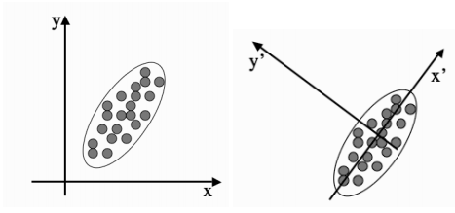
Two different sets of coordinate axes. The second consists of a rotation and translation of the first and was found using Principal Components Analysis.

Slide 16
The potential for dimensionality reduction is in the fact that the y dimension does not now demonstrate much variability, and so it might be possible to ignore it and use the x axis values alone without compromising the results of a learning algorithm.
In fact, it can make the results better, since we are often removing some of the noise in the data.
How to choose the axes??
The first method we are going to look at is Principal Components analysis (PCA).
The idea of a principal component is that it is a direction in the data with the largest variation.
The algorithm first centres the data by subtracting off the mean, and then chooses the direction with the largest variation and places an axis in that direction, and then looks at the variation that remains and finds another axis that is orthogonal to the first and covers as much of the remaining variation as possible.
It then iterates this until it has run out of possible axes.
The end result is that all the variation is along the axes of the coordinate set, and so the covariance matrix is diagonal—each new variable is uncorrelated with every variable except itself.

Slide 17

Some of the axes that are found last have very little variation, and so they can be removed without affecting the variability in the data.
Putting this in more formal terms, we have a data matrix X and we want to rotate it so that the data lies along the directions of maximum variation.
This means that we multiply our data matrix by a rotation matrix (often written as P^{T} ) so that
where P is chosen so that the covariance matrix of Y is diagonal, i.e.,

Slide 18
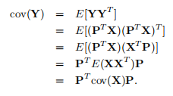
We can get a different handle on this by using some linear algebra and the definition of covariance to see that:
The two extra things that we needed to know were that
Therefore,

Slide 19


where there is one tricky fact, namely that for a rotation matrix
This just says that to invert a rotation we rotate in the opposite direction by the same amount that we rotated forwards.
As cov(Y) is diagonal, if we write P as a set of column vectors P = [p₁, p₂, . . . , p_{N} ] then:
which (by writing the λ variables in a matrix as
leads to a very interesting equation:

Slide 20
At first sight it doesn’t look very interesting, but the important thing is to realise that λ is a column vector, while Z is a full matrix, and it can be applied to each of the p_{i} vectors that make up P
Since λ is only a column vector, all it does is rescale the p_{i}s it cannot rotate it or do anything complicated like that.
So this tells us that somehow we have found a matrix P so that for the directions that P is written in, the matrix Z does not twist or rotate those directions, but just rescales them.
These directions are special enough that they have a name: they are eigenvectors, and the amount that they rescale the axes (the λs) by are known as eigenvalues.
All eigenvectors of a square symmetric matrix A are orthogonal to each other.
This tells us that the eigenvectors define a space. If we make a matrix E that contains the (normalised) eigenvectors of a matrix A as columns, then this matrix will take any vector and rotate it into what is known as the eigenspace.

Slide 21
Since E is a rotation matrix,
so that rotating the resultant vector back out of the eigenspace requires multiplying it by E^{T} , where by ‘normalised’,
So what should we do between rotating the vector into the eigenspace, and rotating it back out?
The answer is that we can stretch the vectors along the axes.
This is done by multiplying the vector by a diagonal matrix that has the eigenvalues along its diagonal, D. So we can decompose any square symmetric matrix A into the following set of matrices: A = EDE^{T} , and this is what we have done to our covariance matrix above. This is called the spectral decomposition.

Slide 22
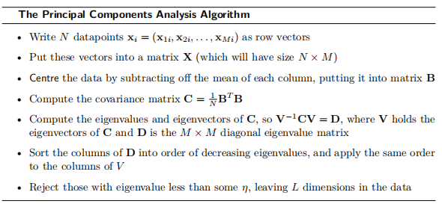

Slide 23

Kernel PCA(KPCA)
One problem with PCA is that it assumes that the directions of variation are all straight lines. This is often not true.
We can use the auto-associator with multiple hidden layers as just discussed, but there is a very nice extension to PCA that uses the kernel trick to get around this problem, just as the SVM got around it for the Perceptron.
Just as is done there, we apply a (possibly non-linear) function Φ(·),to each datapoint x that transforms the data into the kernel space, and then perform normal linear PCA in that space.
The covariance matrix is defined in the kernel space and is:

Slide 24



which produces the eigenvector equation:
where, are the eigenvectors of the original problem and the α_{j} will turn out to be the eigenvectors of the ‘kernelized’ problem
It is at this point that we can apply the kernel trick and produce an N × N matrix K, where:
Putting these together we get the equation NλKα = K²α, and we left-multiply by K⁻¹ to reduce it to Nλα = Kα. Computing the projection of a new point x into the kernel PCA space requires:

Slide 25
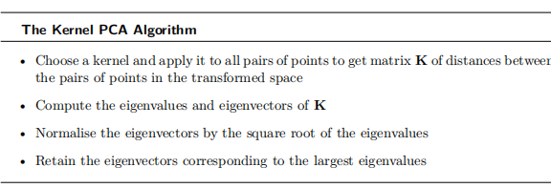

Slide 26
FACTOR ANALYSIS(FA)
The idea of factor analysis is to ask whether the data that is observed can be explained by a smaller number of uncorrelated factors or latent variables.
The assumption is that the data comes from some underlying data source (or set of data sources) that are not directly known.
The problem of factor analysis is to find those independent factors, and the noise that is inherent in the measurements of each factor.
Factor analysis is commonly used in psychology and other social sciences, and the factors are generally chosen to have some particular meanings: in psychology, they can be related to IQ and other tests

Slide 27

Suppose that we have a dataset in the usual N ×M matrix X, i.e., each row of X is an M dimensional datapoint, and X has covariance matrix Σ.
As, with PCA, we centre the data by subtracting off the mean of each variable (i.e., each column): b_{j} = x_{j} | µ_{j}, j = 1 . . . M,so that the mean E[b_{i}] = 0. Which we’ve done before, for example for the MLP and many times since.
We can write the model that we are assuming as:
where X are the observations and is the noise. Since the factors b_{i} that we want to find should be independent, so cov(b_{i}, b_{j} ) = 0 if i! = j.
Factor analysis takes explicit notice of the noise in the data, using the variable
In fact, it assumes that the noise is Gaussian with zero mean and some known variance: Ψ, with the variance of each element being Ψ_{i} = var( _{i}).

Slide 28
It also assumes that these noise measurements are independent of each other, which is equivalent to the assumption that the data come from a set of separate (independent) physical processes, and seems reasonable if we don’t know otherwise.
The covariance matrix of the original data, Σ, can now be broken down into cov(Wb + ) = WW^{T} + Ψ, where Ψ is the matrix of noise and we have used the fact that cov(b) = I since the factors are uncorrelated.
With all of that set up, the aim of factor analysis is to try to find a set of factor loadings W_{ij} and values for the variance of the noise parameters Ψ, so that the data in X can be reconstructed from the parameters, or so that we can perform dimensionality reduction.

Slide 29
INDEPENDENT COMPONENTS ANALYSIS (ICA)
There is a related approach to factor analysis that is known as Independent Components Analysis
When we looked at PCA above, the components were chosen so that they were orthogonal and uncorrelated (so that the covariance matrix was diagonal, i.e., so cov(b_{i}, b_{j} ) = 0 if i!= j).
If, instead, we require that the components are statistically independent (so that for E[b_{i}, b_{j} ] = E[b_{i}]E[b_{j} ] as well as the b_{i} being uncorrelated), then we get ICA.
The common motivation for ICA is the problem of blind source separation.

Slide 30
As with factor analysis, the assumption is that the data we see are actually created by a set of underlying physical processes that are independent.
The reason why the data we see are correlated is because of the way the outputs from different processes have been mixed together.
So given some data, we want to find a transformation that turns it into a mixture of independent sources or components.
The most popular way to describe blind source separation is known as the cocktail party problem.
If you are at a party, then your ears hear lots of different sounds coming from lots of different locations (different people talking, the clink of glasses, background music, etc.) but you are somehow able to focus on the voice of the people you are talking to, and can in fact separate out the sounds from all of the different sources even though they are mixed together.

Slide 31


We can measure the amount of independence between two variables by using the mutual information.
In fact, the most common approach is to use what is rather uglily known as negentropy: J(y) = H(z) -H(y), which maximises the deviations from Gaussianness (where H(·) is the entropy):

Slide 32

LOCALLY LINEAR EMBEDDING(LLE)
It is a popular method of computing dimensionality reduction.
It was introduced by Roweis and Saul in 2000.
The idea is to say that by making linear approximations we will make some errors, so we should make these errors as small as possible by making the patches small where there is lots of non-linearity in the data.
The error is known as the reconstruction error and is simply the sum-of-squares of the distance between the original point and its reconstruction:

Slide 33
The weights W_{ij} say how much effect the jth datapoint has on the reconstruction of the ith one.
The question is which points can be usefully used to reconstruct a particular datapoint.
If another point is a long way off, then it probably isn’t very useful: only those points that are close to the current datapoint (that are in its neighbourhood) are used.
There are two common ways to create neighbourhoods:
Points that are less than some predefined distance to the current point are neighbours (so we don’t know how many neighbours there are, but they are all close)
The k nearest points are neighbours (so we know how many there are, but some could be far away)

Slide 34

Solving for the weights W_{ij} is a least-squares problem, which we can simplify by enforcing the constraints that for any point x_{j} that is a long way from the current point x_{i}, W_{ij} = 0, and that .
This produces a reconstruction of the data, but it does not reduce the dimensionality at all.
For this we have to reapply the same basic cost function, but minimise it according to the positions y_{i} of the points in some lower dimensional space (dimension L):

