Slide 1

Machine Learning
CO-6: Clustering Algorithms

Slide 2
S.No | Course Outcome | Intended Learning Outcomes (ILO) | Knowledge Level of ILO | No. of Hours
1 | CO 6 | Discuss about Unsupervised Learning:The K-Means Algorithm | K2 | 2
2 |  | Illustrate K-Means Algorithm :Dealing With Noise, K-Means Neural Network | K2 | 2
3 |  | Illustrate Normalisation, Better Weight Update Rule | K2 | 1
4 |  | Demonstrate The Iris Data set ,Using Competitive Learning For Clustering | K2 | 2
5 |  | Discuss about Vector Quantisation | K2 | 1
6 |  | Discuss about The Self-Organising Feature Maps | K2 | 2

Slide 3
Introduction
Unsupervised learning is a conceptually different problem to supervised learning.
The supervised learning algorithms that we have discussed so far have aimed to minimise some external error criterion—mostly the sum-of-squares error—based on the difference between the targets and the outputs.
Calculating and minimising this error was possible because we had target data to calculate it from, which is not true for unsupervised learning.
This means that we need to find something else to drive the learning.

Slide 4
The problem is more general than sum-of-squares error: we can’t use any error criterion that relies on targets or other outside information (an external error criterion), we need to find something internal to the algorithm.
This means that the measure has to be independent of the task, because we can’t keep on changing the whole algorithm every time a new task is introduced.
In supervised learning the error criterion was task-specific, because it was based on the target data that we provided.
To see how to work out a general error criterion that we can use, we need to go back to some of the important concepts that were discussed in CO-1 : input space and weight space.
If two inputs are close together then it means that their vectors are similar, and so the distance between them is small
Then inputs that are close together are identified as being similar, so that they can be clustered, while inputs that are far apart are not clustered together.

Slide 5
We can extend this to the nodes of a network by aligning weight space with input space.
Now if the weight values of a node are similar to the elements of an input vector then that node should be a good match for the input, and any other inputs that are similar.
In order to start to see these ideas in practice we’ll look at a simple clustering algorithm, the k-Means Algorithm

Slide 6
THE K-MEANS ALGORITHM
If you have ever watched a group of tourists with a couple of tour guides who hold umbrellas up so that everybody can see them and follow them, then you have seen a dynamic version of the k-means algorithm.
Our version is simpler, because the data (playing the part of the tourists) does not move, only the tour guides.
Suppose that we want to divide our input data into k categories, where we know the value of k (for example, we have a set of medical test results from lots of people for three diseases, and we want to see how well the tests identify the three diseases).
We allocate k cluster centres to our input space, and we would like to position these centres so that there is one cluster centre in the middle of each cluster.

Slide 7
However, we don’t know where the clusters are, let alone where their ‘middle’ is, so we need an algorithm that will find them.
Learning algorithms generally try to minimise some sort of error, so we need to think of an error criterion that describes this aim.
The idea of the ‘middle’ is the first thing that we need to think about. How do we define the middle of a set of points?
There are actually two things that we need to define:
A distance measure: Meassure distances between points. It is often the normal Euclidean distance.
The mean average: Once we have a distance measure, we can compute the central point of a set of datapoints, which is the mean average

Slide 8
We can now think about a suitable way of positioning the cluster centres: we compute the mean point of each cluster, µ_{c}(i) , and put the cluster centre there.
This is equivalent to minimising the Euclidean distance (which is the sum-of-squares error again) from each datapoint to its cluster centre.
How do we decide which points belong to which clusters? It is important to decide, since we will use that to position the cluster centres.
The obvious thing is to associate each point with the cluster centre that it is closest too.
This might change as the algorithm iterates, but that’s fine.

Slide 9
Start by positioning the cluster centres randomly through the input space, since we don’t know where to put them, and then we update their positions according to the data.
Decide which cluster each datapoint belongs to by computing the distance between each datapoint and all of the cluster centres, and assigning it to the cluster that is the closest.
For all of the points that are assigned to a cluster, we then compute the mean of them, and move the cluster centre to that place.

Slide 11
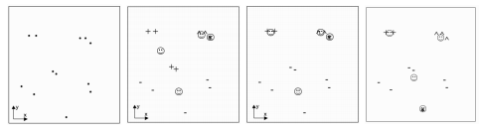
Let’s see show some data and some different ways to cluster that data computed by the k-means algorithm
Fig1: Left: A two-dimensional dataset. Right: Three possible ways to position 4 centres (drawn as faces) using the k-means algorithm, which is clearly susceptible to local minima.

Slide 12
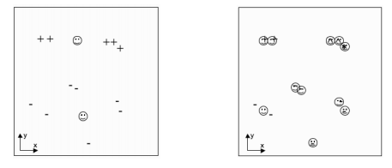
Fig 2: Left: A solution with only 2 classes, which does not match the data well. Right: A solution with 11 classes, showing severe overfitting.
From the above examples, It should be clear that the algorithm is susceptible to local minima: depending upon where the centres are initially positioned in the space, you can get very different solutions, and many of them look very unlikely to our eyes.

Slide 13
Fig 2 shows examples of what happens when you choose the number of centres wrongly.
There are certainly cases where we don’t know in advance how many clusters we will see in the data, but the k-means algorithm doesn’t deal with this at all well.
At the cost of significant extra computational expense, we can get around both of these problems by running the algorithm many different times.
To find a good local optimum (or even the global one) we use many different initial centre locations, and the solution that minimises the overall sum-of-squares error is likely to be the best one.
By running the algorithm with lots of different values of k, we can see which values give us the best solution.

Slide 14
Of course, we need to be careful with this.
If we still just measure the sum-of-squares error between each datapoint and its nearest cluster centre, then when we set k to be equal to the number of datapoints, we can position one centre on every datapoint, and the sum-of-squares error will be zero (in fact, this won’t happen, since the random initialisation will mean that several clusters will end up coinciding).
However, there is no generalisation in this solution: it is a case of serious overfitting.
However, by computing the error on a validation set and multiplying the error by k we can see something about the benefit of adding each extra cluster centre.

Slide 15
Dealing with Noise
There are lots of reasons for performing clustering, but one of the more common ones is to deal with noisy data readings.
These might be slightly corrupted, or occasionally just plain wrong. If we can choose the clusters correctly, then we have effectively removed the noise, because we replace each noisy datapoint by the cluster centre.
Unfortunately, the mean average, which is central to the k-means algorithm, is very susceptible to outliers, i.e., very noisy measurements.

Slide 16
One way to avoid the problem is to replace the mean average with the median, which is what is known as a robust statistic, meaning that it is not affected by outliers (the mean of (1, 2, 1, 2, 100) is 21.2, while the median is 2).
The only change that is needed to the algorithm is to replace the computation of the mean with the computation of the median.
This is computationally more expensive, as we’ve discussed previously, but it does remove noise effectively.

Slide 17
The k-Means Neural Network
The k-means algorithm clearly works, despite its problems with noise and the difficulty with choosing the number of clusters.
If we think about the cluster centres that we optimise the positions of as locations in weight space, then we could position neurons in those places and use neural network training.
The computation that happened in the k-means algorithm was that each input decided which cluster centre it was closest to by calculating the distance to all of the centres.
We could do this inside a neural network, too: the location of each neuron is its position in weight space, which matches the values of its weights.
So for each input, we just make the activation of a node be the distance between that node in weight space and the current input.
Then training is just moving the position of the node, which means adjusting the weights.

Slide 18
So, we can implement the k-means algorithm using a set of neurons.
We will use just one layer of neurons, together with some input nodes, and no bias node.
The first layer will be the inputs, which don’t do any computation, as usual, and the second layer will be a layer of competitive neurons, that is, neurons that ‘compete’ to fire, with only one of them actually succeeding.
Only one cluster centre can represent a particular input vector, and so we will choose the neuron with the highest activation h to be the one that fires.
This is known as winner-takes-all activation, and it is an example of competitive learning, since the set of neurons compete with each other to fire, with the winner being the one that best matches (i.e., is closest to) the input.

Slide 19
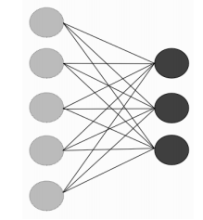

We will choose k neurons (for hopefully obvious reasons) and fully connect the inputs to the neurons, as usual
We will use neurons with a linear transfer function, computing the activation of the neurons as simply the product of the weights and inputs:

Slide 20
Providing that the inputs are normalised so that their absolute size is the same, this effectively measures the distance between the input vector and the cluster centre represented by that neuron, with larger numbers (higher activations) meaning that the two points are closer together.
So the winning neuron is the one that is closest to the current input.
How can we then change the position of that neuron in weight space, that is, how do we update its weights?
In the k-means algorithm that was described earlier it was easy: we just set the cluster centre to be the mean of all the datapoints that were assigned to that centre.
However, when we do neural network training, we often feed in just one input vector at a time and change the weights (that is, we use the algorithm on-line, rather than batch).

Slide 21
We therefore do not know the mean because we don’t know about all the datapoints, just the current one.
So we approximate it by moving the winning neuron closer to the current input, making that centre even more likely to be the best match next time that input is seen.
This corresponds to:
However, this is not good enough. To see why not, let’s get back to that question of normalisation.

Slide 22
Normalisation
Suppose that the weights of all the neurons are small (maybe less than 1) except for those to one particular neuron.
We’ll make those weights be 10 for the example.
If an input vector with values (0.2, 0.2, -0.1) is presented, and it happens to be an exact match for one of the neurons, then the activation of that neuron will be
0.2×0.2+ 0.2×0.2+-0.1×−0.1 = 0.09.
The other neurons are not perfect matches, so their activations should all be less.
However, consider the neuron with large weights. Its activation will be
10×0.2+10×0.2+10×−0.1 = 3
So it will be the winner.

Slide 23
Thus, we can only compare activations if we know that the weights for all of the neurons are the same size.
We do this by insisting that the weight vector is normalised so that the distance between the vector and the origin (the point (0, 0, . . . 0)) is one.
This means that all of the neurons are positioned on the unit hypersphere,when we talked about the curse of dimensionality: it is the set of all points that are distance one from the origin, so it is a circle in 2D, a sphere in 3D , and a hypersphere in higher dimensions.
Computing this normalisation,we are normalising the total Euclidean distance from the origin, and the sum and division are row-wise rather than column-wise, which means that the matrix has to be transposed before and after the division
The neuronal activation can be written as:

Slide 24
A Better Weight Update Rule
The weight update rule given in below lets the weights grow without any bound, so that they do not lie on the unit hypersphere any more.
If we normalise the inputs as well, which certainly seems reasonable, then we can use the following weight update rule:
which has the effect of moving the weight wij directly towards the current input. Remember that the only weights that we are updating are those of the winning unit

Slide 25
For many of our supervised learning algorithms we minimised the sum-of-squares difference between the output and the target.
This was a global error criterion that affected all of the weights together. Now we are minimising a function that is effectively independent in each weight.
So the minimisation that we are doing is actually more complicated, even though it doesn’t look it.
This makes it very difficult to analyse the behaviour of the algorithm, which is a general problem for competitive learning algorithms.
However, they do tend to work well.
Now that we have a weight update rule that works, we can consider the entire algorithm for the on-line k-means network

Slide 27
Using Competitive Learning for Clustering
Deciding which cluster any datapoint belongs to is now an easy task: we present it to the trained algorithm and look what is activated.
If we don’t have any target data, then the problem is finished.
However, for many problems we might want to interpret the best matching cluster as a class label (alternatively, a set of cluster centres could all correspond to one class).
This is fine, since if we have target data we can match the output classes to the targets, provided that we are a bit careful: there is no reason why the order of the nodes in the network should match the order in the data, since the algorithm knows nothing about that order.
For that reason, when assigning class labels to the outputs, you need to check which numbers match up carefully, or the results will look a lot worse than they actually are.

Slide 28
There is an alternative solution to this problem of assigning labels, and it is one that we have seen before.
The k-means part positions the RBFs(Radial Basis Function Networks) in the input space, so that they represent the input data well.
A Perceptron is then used on top of this in order to provide the match to the outputs in the supervised learning part of the network. Since this is now supervised learning, it ensures that the output categories match the target data classes.
It also means that you can use lots of clusters in the k-means network without having to work out which datapoints belong to which cluster, since the Perceptron will do this for you.

Slide 29
VECTOR QUANTISATION
We’ve already discussed using competitive learning for removing noise.
There is a related application, data compression, which is used both for storing data and for the transmission of speech and image data.
The reason that the applications are related is that both replace the current input by the cluster centre that it belongs to.
For noise reduction we do this to replace the noisy input with a cleaner one, while for data compression we do it to reduce the number of datapoints that we send.
Both of these things can be understood by considering them as examples of data communication.

Slide 30
Suppose that We want to send data to you, but that We have to pay for each data bit We transmit, so We want to keep the amount of data that We send to a minimum.
We notice that there are lots of repeated datapoints, so We decide to encode my data before We send it, so that instead of sending the entire set, we agree on a codebook of prototype vectors together.
Now, instead of transmitting the actual data, We can transmit the index of that datapoint in the codebook, which is shorter.
All you have to do is take the indices We send you and look them up, and you have the data.
We can actually make the code even more efficient by using shorter indices for the datapoints that are more common.
This is an important problem in information theory, and every kind of sound and image ompression algorithm has a different method of solving it.

Slide 31
There is one problem with the scenario so far, which is that the codebook won’t contain every possible datapoint.
What happens when I want to send a datapoint and it isn’t in the codebook?
In that case we need to accept that our data will not look exactly the same, and I send you the index of the prototype vector that is closest to it (this is known as vector quantisation, and is the way that lossy compression works).

Slide 32
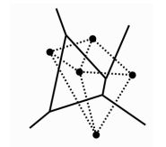
Example
Fig shows an interpretation of prototype vectors in two dimensions.
The dots at the centre of each cell are the prototype vectors, and any datapoint that lies within a cell is represented by the dot.
The name for each cell is the Voronoi set of a particular prototype. Together, they produce the Voronoi tesselation of the space.
If you connect together every pair of points that share an edge, as is shown by the dotted lines, then you get the Delaunay triangulation, which is the optimal way to organise the space to perform function approximation.

Slide 33
The question is how to choose the prototype vectors, and this is where competitive learning comes in.
We need to choose prototype vectors that are as close as possible to all of the possible inputs that we might see.
This application is called learning vector quantisation because we are learning an efficient vector quantisation.
The k-means algorithm can be used to solve the problem if we know how large we want our codebook to be.

Slide 34
THE SELF-ORGANISING FEATURE MAP
A self-organizing map (SOM) or self-organizing feature map (SOFM) is a type of artificial neural network (ANN) that is trained using unsupervised learning to produce a low-dimensional (typically two-dimensional), discretized representation of the input space of the training samples, called a map, and is therefore a method to do dimensionality reduction.
Self-organizing maps differ from other artificial neural networks as they apply competitive learning as opposed to error-correction learning (such as backpropagation with gradient descent), and in the sense that they use a neighborhood function to preserve the topological properties of the input space.

Slide 35
Maintains the topology of the dataset
Training occurs via competition between the neurons
Impossible to assign network nodes to specific input classes in advance
Can be used for detecting similarity and degrees of similarity
It is assumed that input pattern fall into sufficiently large distinct groupings
Random weight vector initialization

Slide 36

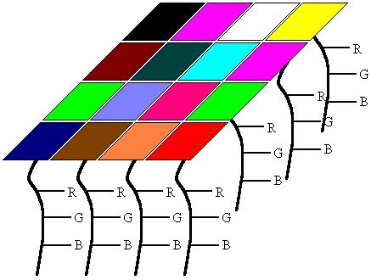
Components of SOM
Sample data
Weights
Output nodes

Slide 37
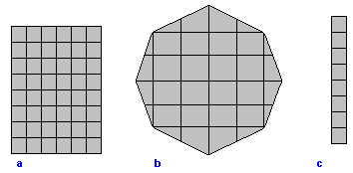
Structure of the map
2-dimensional or 1-dimensional grid
Each grid point represents a output node
The grid is initialized with random vectors

Slide 38
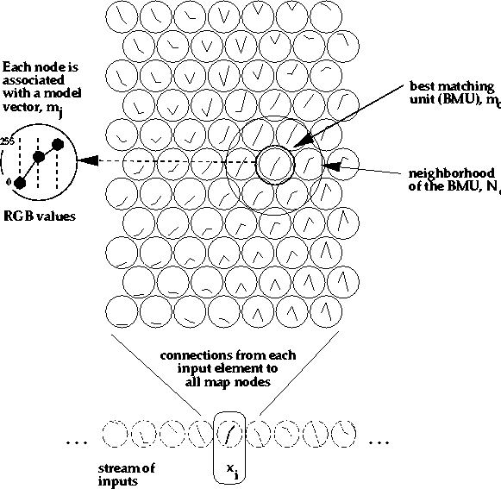
Training Algorithm
Initialize Map
For t from 0 to 1
Select a sample
Get best matching unit
Scale neighbors
Increase t a small amount
End for

Slide 39
Initializing the weights
SOMs are computationally very expensive.
Good Initialization
Less iterations
Quality of Map

Slide 40
Get Best Matching Unit
Any method for vector distance i. e.
Nearest neighbor
Farthest neighbor
Distance between means
Distance between medians
Most common method is Euclidean distance.
More than one contestant, choose randomly

Slide 41
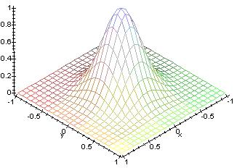
Scale Neighbors
Determining Neighbors
Neighborhood size
Decreases over time
Effect on neighbors
Learning

Slide 42
Necessary conditions
Amount of training data
Change of weights should be
In excited neighborhood
Proportional to activation received
Advantages
Very easy to understand
Works well
Disadvantages
computationally expensive
every SOM is different

Slide 43
SUPERVISED LEARNING VS UNSUPERVISED LEARNING
Factor | SUPERVISED LEARNING | UNSUPERVISED LEARNING
Input Data | Uses Known and Labeled Data as input | Uses Unknown Data as input
Computational Complexity | Very Complex | Less Computational Complexity
Real Time | Uses off-line analysis | Uses Real Time Analysis of Data
Number of Classes | Number of Classes are known | Number of Classes are not known
Accuracy of Results | Accurate and Reliable Results | Moderate Accurate and Reliable Results

