Slide 1
STT 465 Lecture 2: Belief, probability, independence, conditional independence, exchangeability (G. de los Campos)

Slide 2
Beliefs & Probability
Beliefs and probability (read the chapter in the book)
Review of probability
Events {A_{i}} & Sample space S={A₁,…}
Probability (map from events to numbers in the [0,1] interval that follows a few rules).
(3) P(A_{i})>0
(4) P(S)=1
(5) Probability of the union: P(A_{i}UA_{j})=P(A_{i})+P(A_{j})-P(A_{i}∩A_{j}) [U=OR, ∩=&]
Marginal, conditional and joint probabilities
(6) Marginal probability: P(A)
(7) Joint probability: P(A&B)=P(A,B) [we will commonly use ‘,’ for joint]
(8) Conditional probability: p(A|B)
(9) Factorization: P(A,B)=P(A) P(B|A)=P(B)P(A|B)
(10) Rule of marginal probability: P(A )=P(A|B) P(B) +P(A|Not B)P(Not B)
Bayes rule: p(A|B)=P(B|A)P(A)/P(B)

Slide 3
Examples
Review income/education example (p 16 )
Example: genetics of disease
Genotype Status
AA H
AB | BA H
BB D
p(A)=0.8
Determine
(1) The (marginal) probability of each genotype under random mating, p(G)
(2) The conditional probability of disease given genotypes, p(D|G)
(3) The probability of disease of a randomly sampled individual, P(D)
Hint: use the law of marginal probabilities.
(4) The joint probability of disease and genotypes, p(D,G). Hint: use p(A,B)=P(A|B)p(B)
(5) The conditional probability of genotype given disease, p(G|D). Hint: use Bayes rule.

Slide 4
Conditional Independence
X,Y are independent if p(X,Y)=p(X)p(Y)
X,Y are said conditionally independent if, given a third variable (Z), X and Y are independent, that is:
Conditional Independence: p(X,Y|Z)=P(X|Z)*P(Y|Z)
Let’s see an example

Slide 5
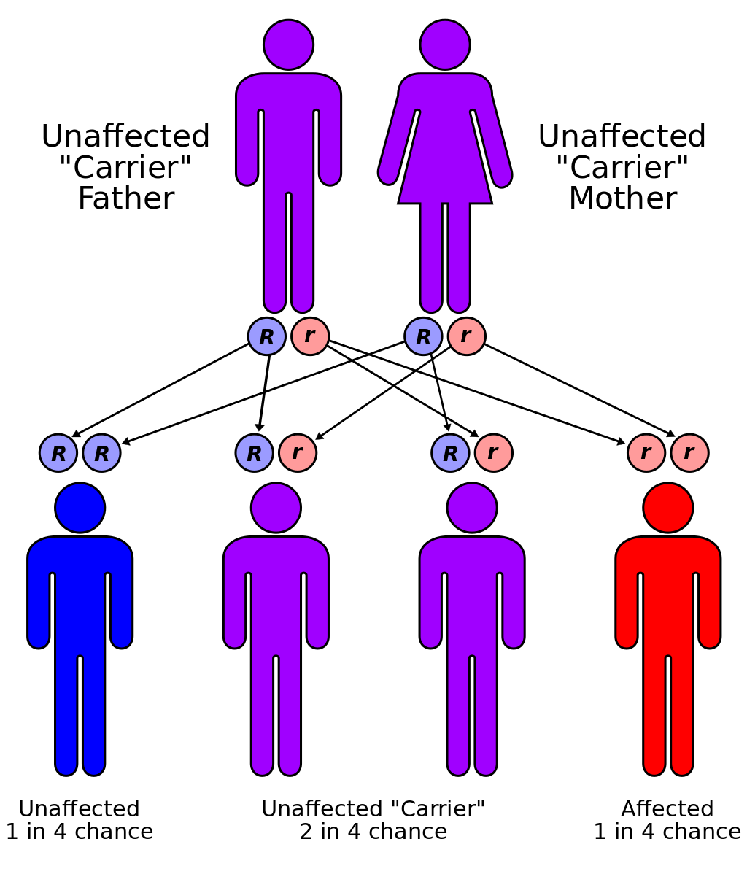
Bayesian Learning
Goal: to make statements about the genotype
of one of the parents given the phenotype
of one or more offspring.
Compute the probability that a parent is a carrier given that the first offspring is healthy p(G₀=AB|O₁=H)
Ho would that probability be updated if you know that the second offspring is also healthy? Hint: you can assume conditional independence; therefore,
Source: Wikipedia

Slide 6
REVIEW HW 1
Questions?

Slide 7
Remarks
The joint probability contains all the information needed to arrive at the marginal s and conditionals
We cannot arrive at the joint distribution from the marginal distributions
(under independence this is trivial, but in other cases we need to know the
conditional distributions and one of the marginal to get to the joint distribution).
Distinction between independence and conditional independence (see HW1)

Slide 8
Exchangeability
Define Exchangeable Sequence of Random Variables
- Sequence of Random Variables Y₁, Y₂,…. Y_{N}
- Permutation: π={π₁, π₂,…, , π_{N}}
A sequence of RV is said to be exchangeable if
p(Y_{π1}, Y_{π2} ,…., Y_{πN}) is the same for any permutation π
Note: sequence of IID RVs are exchangeable (discuss), but the converse is not TRUE
Importantly, independence is not required for exchangeability (discuss MVN case)

