Slide 1
STT 465 Belief, probability, independence, conditional independence, exchangeability

Slide 2
Beliefs & Probability
Beliefs and probability (read the chapter in the book)
Review of probability
Events {A_{i}} & Sample space S={A₁,…}
Probability (map from events to numbers in the [0,1] interval that follows a few rules).
(3) P(A_{i})>0
(4) P(S)=1
(5) Probability of the union: P(A_{i}UA_{j})=P(A_{i})+P(A_{j})-P(A_{i}∩A_{j}) [U=OR, ∩=&]
Marginal, conditional and joint probabilities
(6) Marginal probability: P(A)
(7) Joint probability: P(A&B)=P(A,B) [we will commonly use ‘,’ for joint]
(8) Conditional probability: p(A|B)
(9) Factorization: P(A,B)=P(A) P(B|A)=P(B)P(A|B)
(10) Rule of marginal probability: P(A )=P(A)P(A|B) + P(Not B)P(B|Not A)
Bayes rule: p(A|B)=P(B|A)P(A)/P(B)

Slide 3
Examples
Review income/education example (p 16 )
Example: recessive disease (e.g. sickle cell disease)
Genotype Status
----------------------------------
AA H
AB | BA H
BB D
----------------------------------
p(A)=0.8
Determine
(1) The (marginal) probability of each genotype under random mating, p(G_{i})
(2) The probability of disease of a randomly sampled individual P(D_{i})
(3) The conditional probability of disease given genotypes, p(D_{i}|G_{i})
(4) The joint probability of disease and genotypes, p(D_{i},G_{i})
(5) The conditional probability of genotype given disease p(G_{i}|D_{i})

Slide 4
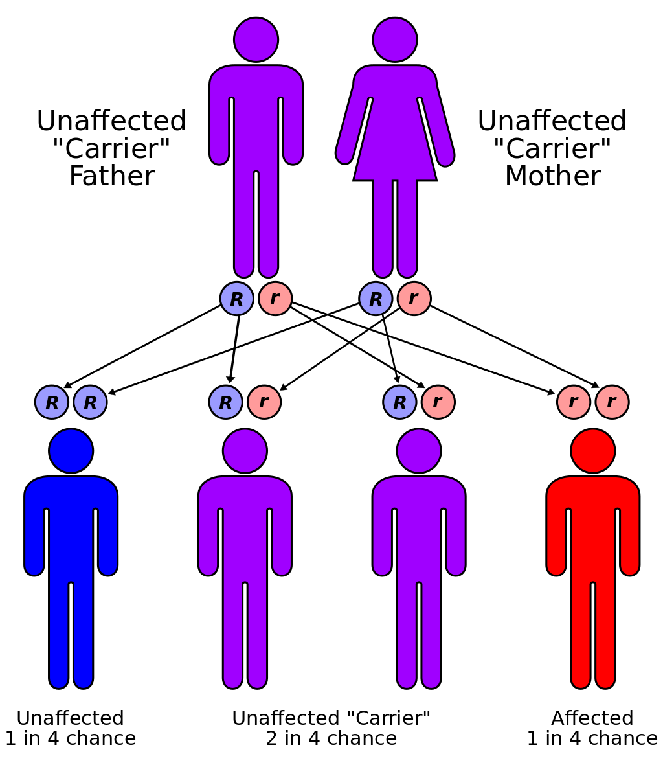
Bayesian Learning
Goal: to make statements about the genotype
of one of the parents given the phenotype
of one or more offspring.
Compute the probability that a parent is a carrier given that the first offspring is healthy p(G₀=AB|O₁=H)
Ho would that probability be updated if you know that the second offspring is also healthy?
What about if you know that the third offspring developed the disease?
Source: Wikipedia

Slide 5
Conditional Independence
X,Y are independent if p(X,Y)=p(X)p(Y)
X,Y are said conditionally independent if, given a third variable (Z), X and Y are independent, that is:
Conditional Independence: p(X,Y|Z)=P(X|Z)*P(Y|Z)
Review Q1 HW1

Slide 6
Remarks
The joint probability contains all the information needed to arrive at the marginal s and conditionals
We can arrive at the joint distribution from the marginal only with knowledge of the conditional distributions (under independence this is trivial).

Slide 7
Exchangeability
Due to the mathematician Bruno de Finetti (de Finetti’s theorem)
Define Exchangeable Sequence of Random Variables
- Sequence of Random Variables X₁, X₂ ,….
- Permutation: π={π₁, π₂,…}
A sequence of RV is said to be exchangeable if
p(X_{π1}, X_{π1} ,….) is the same for any permutation π
Note: sequence of IID RVs are exchangeable (discuss), but the converse is not TRUE
Importantly, independence is not required for exchangeability (discuss MVN case)
Implication: it provides a basis for formulating models based on conditionally independent distributions, we will use a lot in building Bayesian models.

Slide 8
Common Distributions of Discrete RV
Bernoulli: outcome of an experiment with two possible outcomes (0/1)

Slide 9
Common Distributions of Discrete RV
Binomial: X=# of successes in k Bernoulli trails.

Slide 10
Common Distributions of Discrete RV
Hypergeometric: X=# of successes in k draws without
replacement from a population of size N
that contains K successes.

Slide 11
Common Distributions of Discrete RV
Negative Binomial: X=# of successes (s) observed in Bernoulli trials
before f failures occur.

