Slide 1
Biostatistics 612 (Statistical Analysis II)
Outline
Types of Random Variables
Descriptive Statistics:
Univariate
Bivariate
Example in JMP.

Slide 2
Types of Random Variables
Data sets typically include different types of random variables (RVs).
The type of RV will determine what descriptive statistic/graph we use to describe it.

Slide 3
Types of Random Variables
Quantitative (usually continuous). Can take on an infinite number of values, and there is a notion of order and distance between values (e.g., height)
Categorical; take on a finite number of values (e.g., presence/absence of disease).
Categorical RVs can be divided into various subtypes.

Slide 4
Types of Categorical Random Variables
Binary (presence/absence)
Polychotomous/Multinomial (Green, Red, Blue...); there is no natural order between the levels.
Ordered Multinomial (e.g., small/medium/large); there is a natural order between the levels.

Slide 5
Example
CPS5 data set (Goldberger 1998, adapted from Berndt 1991)
http://www.hup.harvard.edu/features/golint/CPS5.txt.
This data comprise information from 528 people surveyed in 1985.
The variables included in the data set are:
- years of education (integer, but can be analyzed as continuous)
- years of experience in the labor market (integer, but can be analyzed as continuous)
- wage USD/hour (continuous)
- Sex (Male/Female, binary)
- Region (South/non-South, binary)
- Marital status (married/ not married)
We illustrate regression analysis to quantify effects of education on wages, after accounting for differences due to sex, and region.

Slide 6
The first rows of the CPS5 data set…
Quantitative
- Education
- Experience and
- Hourly-wage
Multinomial:
- Ethnicity
Binary:
- Region (south=1)
- Sex (female=1)
- Married (yes=1)
- Unionizes (yes=1)

Slide 7
Descriptive Analysis
The 1st step in any statistical analysis consist on performing descriptive statistics/graphs.
The objectives of such an analysis is to:
(a) detect potential problems (e.g., coding errors) and
(b) get insights into the associations between variables.
We will use:
- Statistics (functions of the data, e.g. minimum, maximum, mean..).
- Graphs.
There are two basic types of descriptive statistics
- Univariate; these are used to describe RVs, one at a time.
- Bivariate; thee are used to describe the association between two RVs.

Slide 8
Univariate Analysis for Discrete RVs
Commonly used statistic: frequency tables
Black Hispanic White
--------------------------------------
67 25 436
--------------------------------------
Black Hispanic White
--------------------------------------
12.7% 4.7% 82.6%
--------------------------------------
Commonly used graphs: bar and pie charts.

Slide 9
Univariate Analysis for Continuous RVs
Commonly used Statistics:
- Central measures (e.g., mean, median or other percentiles)
- Measures of dispersion (e.g., range, variance, standard deviation…)
Hourly Wage:
Min. 1st Qu. Median Mean 3rd Qu. Max.
-------------------------------------------------------------------
1.75 5.25 7.79 9.05 11.25 44.50
-------------------------------------------------------------------

Slide 10
Univariate Descriptive Statistics & Graphs:
Continuous RVs
Commonly used graph: Histogram
The variable on the x-axis is divided into bins of equal width.
Here, each bin has $2 increments.
The height of each bar reflects the number of subjects falling in each bin.
Here, 40 people make $12-14 USD/hr

Slide 11
Bivariate Descriptive Analysis
The objective is to describe patterns of associations between two RVs.
We will use both statistics (e.g., correlation) and graphs.
In univariate descriptive analysis the focus is on the marginal distribution of a RV.
In bivariate analysis we focus on the joint distribution of two RV, and on the conditional distribution of one RV given the other RV.
The type of statistic/graph we use depends on the type of RV.

Slide 12
Bivariate Descriptive Analysis By Type of RV
Discrete Continuous
Contingency Tables
Box-Plots;
Conditional Means
Discrete
Scatter-Plots
Co-variance & Correlation
Continuous

Slide 13
Contingency Tables
(Discrete By Discrete RV)

Slide 14
Contingency Tables
(Discrete By Discrete RV)
Counts
Black Hispanic White Total
South 27 11 116 154
Other 40 14 320 374
Total 67 25 336 528
Frequencies
Black Hispanic White Total
South 5.2% 2.1% 22.0% 29.2%
Other 7.6% 2.7% 60.6% 70.8%
Total 12.7 % 4.7% 82.6% 100.0%
Joint Distribution
Marginal Distributions

Slide 15
Conditional Distributions
Ethnic Group Given Region
Black Hispanic White Total
South 10.7% 3.7% 85.6% 100%
Other 17.5% 7.1% 75.3% 100%
Do these descriptive statistics show association between these two RVs?
Region Given Ethnic Group
South Other
Black 40.3% 59.7%
Hispanic 44.0% 56.0%
White 26.6% 73.4%

Slide 16
Conditional Distributions With Barplots

Slide 17
Continuous and Discrete

Slide 18
Conditional Statistics
Conditional Mean: the average value of one RV for a given value of the other RV.
The same idea can be applied to other statistics (min, max, sd)
Example: Conditional Min, Mean, Median, Max and SD of Hourly Wage Given Sex.
 | Min | Mean | Median | Max | SD
Male | 2.01 | 10.1 | 9 | 26.3 | 5.3
Female | 1.75 | 7.9 | 6.73 | 44.5 | 4.7

Slide 19
Boxplot
Displays the percentiles of the conditional distribution of a continuous RV by level of a discrete RV.

Slide 20
Two Continuous RVs

Slide 21
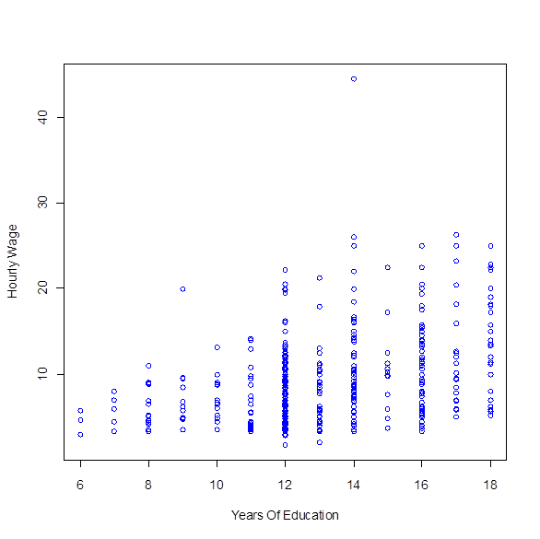
Scatter-plot
What do we see?
Variability of wages increases with years of education.
The average wage also seems to increase with years of education.
How do we quantify this association?
How do we estimate conditional means in this case?

Slide 22
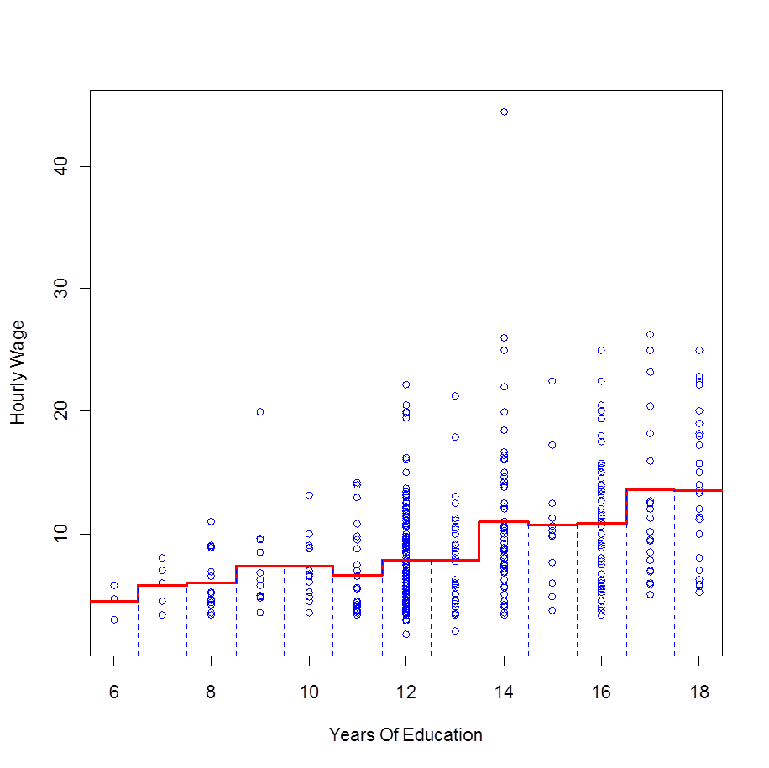
Conditional Mean
The estimated conditional mean suggest an increase in wage associated to increased years of education.
One of the central topics of this class will be how to approximate this conditional mean using linear methods (see next)

Slide 23
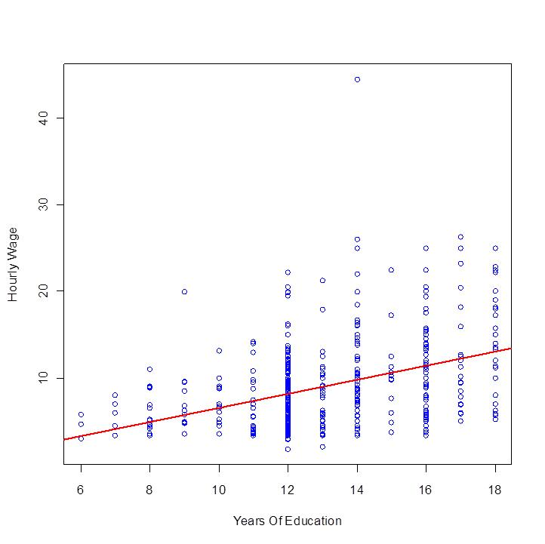
Linear Approximation to the conditional mean
Next class we will discuss how to quantify association between two quantitative variables using linear methods (co-variance, correlation, regression)

Slide 24
Summary
The 1st step of any statistical data analysis is to perform a descriptive statistics analysis.
To this end we use statistics (means, frequencies, etc.) and graphs.
The type of statistic/graph we use depends on the type of RV.
RVs can be classified in quantitative and discrete. Within discrete there are various subtypes.
We perform univariate and bivariate descriptive analysis.
There are also multivariate methods, but we will not use them much in this course.
Univariate descriptive analysis focuses on the marginal distribution of a RV and functions of it (e.g., mean, variance, frequencies, percentiles).
Bivariate analysis focuses on the association patterns between two RVs.
Here we focus on the joint, and mainly on the conditional distribution of Y given X.

