Slide 1
STT 465 (Fall, 2015): Bayesian Statistical Methods
Instructor: Gustavo de los Campos (Asoc. Prof., EPI-Biostat & Statistics)
Contact: gustavoc@msu.edu
Primary office: 909 Fee Rd. Room B637
Websites: http://quantgen.github.io
=> TA: Scott Manski (Email: manskisc@stt.msu.edu )
Office Hours: MW 9:00-10:00 AM (Wells, office TBA)
Course website: https://github.com/gdlc/stt465
Syllabus: see course website for info about the course, pre-requisites,
grading, etc.
Pre-requisites, rules, exams & grading policy (see syllabus)

Slide 2
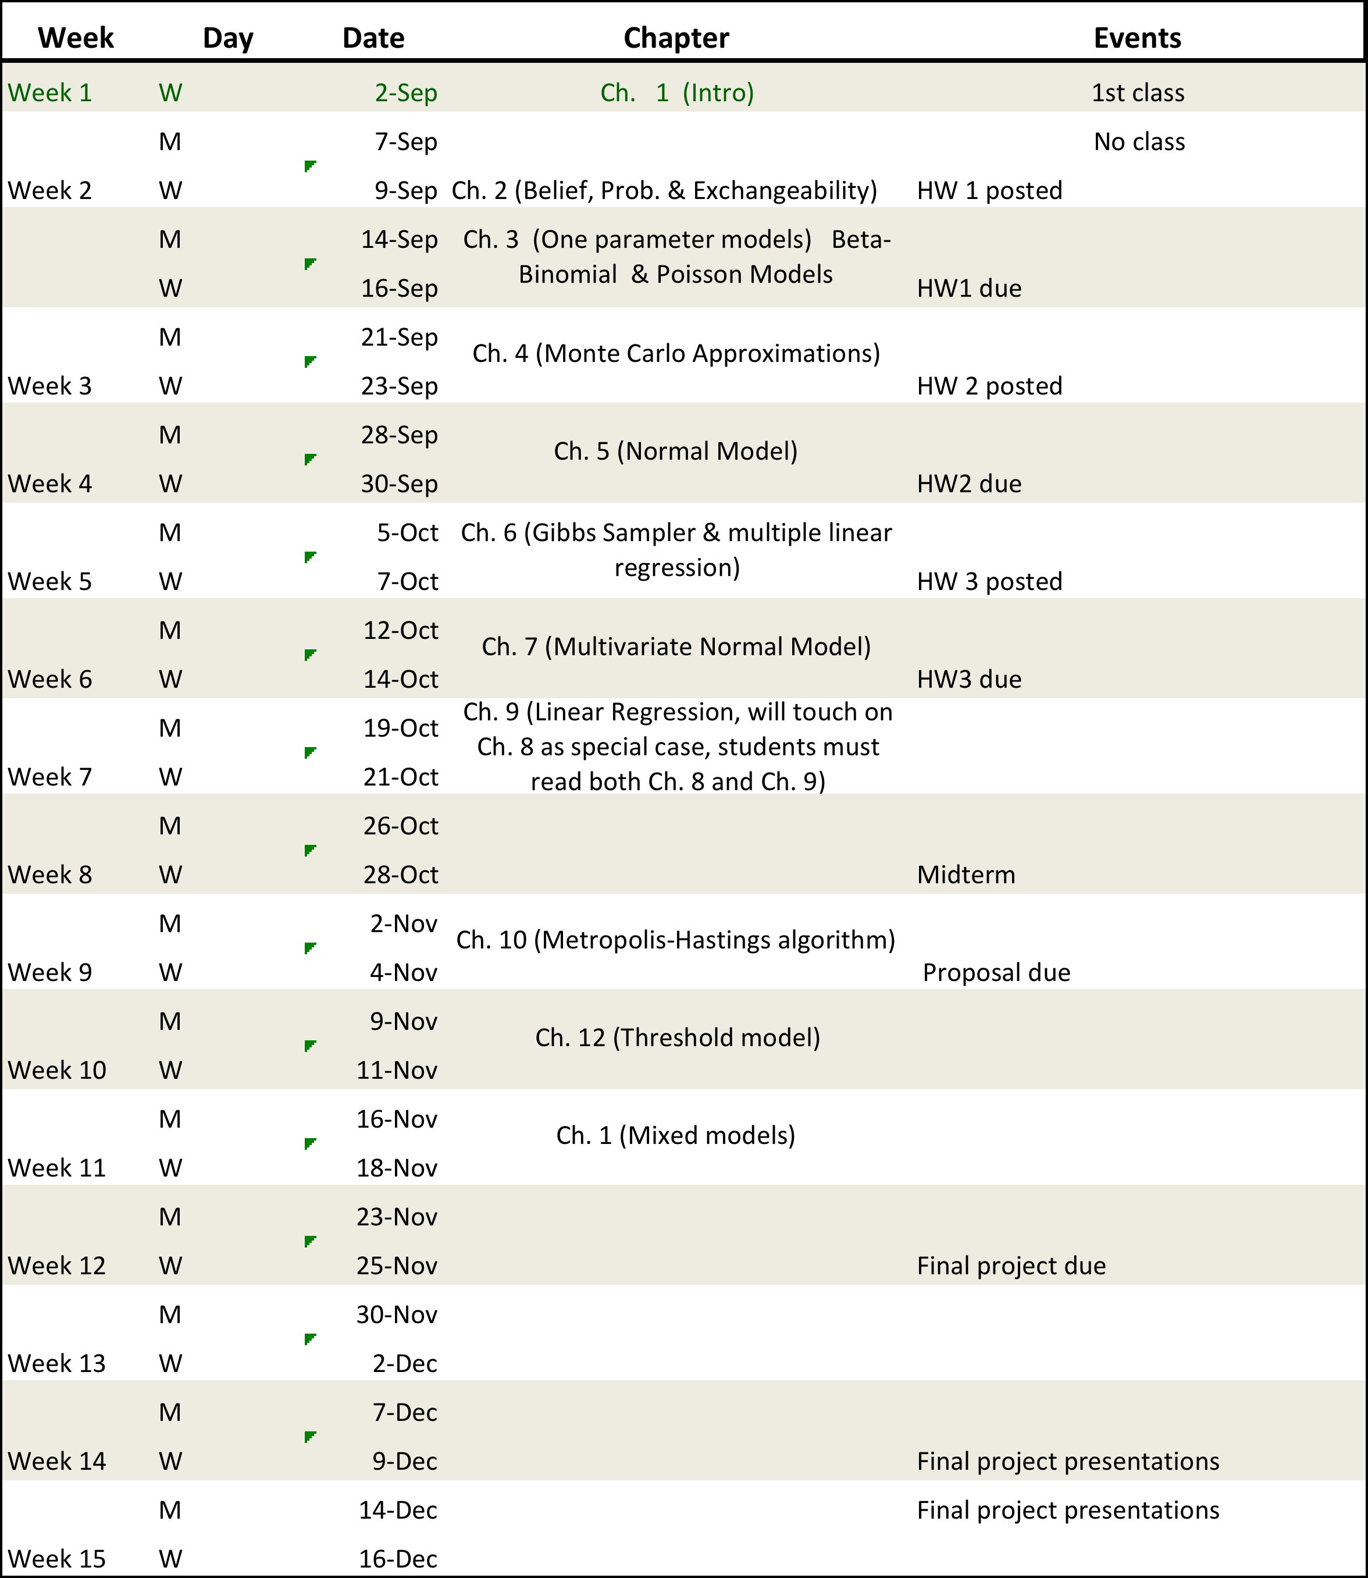
Tentative Schedule

Slide 3
Statistical Inference
Review of basic concepts:
- Population Y={y₁,…} (may be finite or infinitely large).
- Sample We collect a sample of size n from the population Y_{s}={y_{1,…,}y_{n})
- Estimator:
Inference: we make statements about population parameters based on the sampled data.
Two approaches:
- Classical (frequentist) inference: statements are based on the sampling distribution of the estimator over conceptual repeated sampling
- Bayesian: statements are conditional on the observed data (the only sample we have drawn from the population).

Slide 4
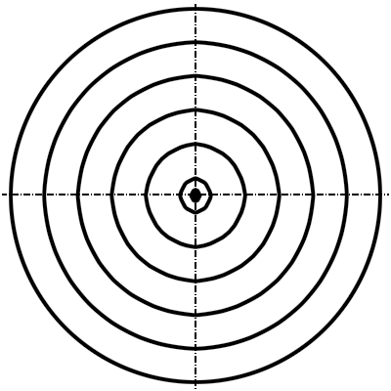
Frequentist approach
Sampling Distribution of Estimates
Let’s look at an example:
(Binomial Sampling)
Squared-Bias
Variance

Slide 5
Sampling from binomial
Code: example_1.md
Discuss:
- Binomial model
- Maximum Likelihood estimator.
- Expected value and variance of the estimator.
- Compare the bias and variance with Monte Carlo estimates of those quantities.

Slide 6
Bayesian approach
Elements of a Bayesian Model
(1) Sampling model:
- Describes the probability of the data
- Usually indexed by a set of parameters
(2) Prior distribution of unknowns (typically model parameters)
(3) Posterior distribution: the probability of the parameters given the sample.

Slide 7
Bayes Theorem
Preliminaries
- The joint distribution is the product of the marginal
times the conditional distribution
- Law of total probability
Bayes Theorem

Slide 8
Beta-Binomial Model
- Sampling model (iid Bernoulli)
- Prior (Beta)
Posterior Distribution (will discuss later on this result in detail)
Maximum a-posteriori

Slide 9
Beta-Binomial Model
- Prior Mean
- MLE
Posterior Mean
Bayesian estimates are ‘shrunken’ estimates. You can view them as MLE estimates shrunken towards the prior mode/mean. Shrinkage reduces the variance of the estimator, at the expense of potentially introducing more bias. The extent of shrinkage depends on how informative the prior is and how informative is the likelihood (sample size). If parameters are identified at the likelihood, as sample size increases Bayesian estimates converge to MLE.

