Slide 1
STT 465: Bayesian Statistical Methods
Introduction & Roadmap
Instructor: Gustavo de los Campos (gcampos@msu.edu)
Contact: gcampos@msu.edu (preferred)
Primary office: 909 Fee Road, Room B637
Office hours: mostly by appointment
Course website: https://github.com/gdlc/stt465
Syllabus (see website)
Pre-requisites, Rules & Grading (see website)

Slide 2
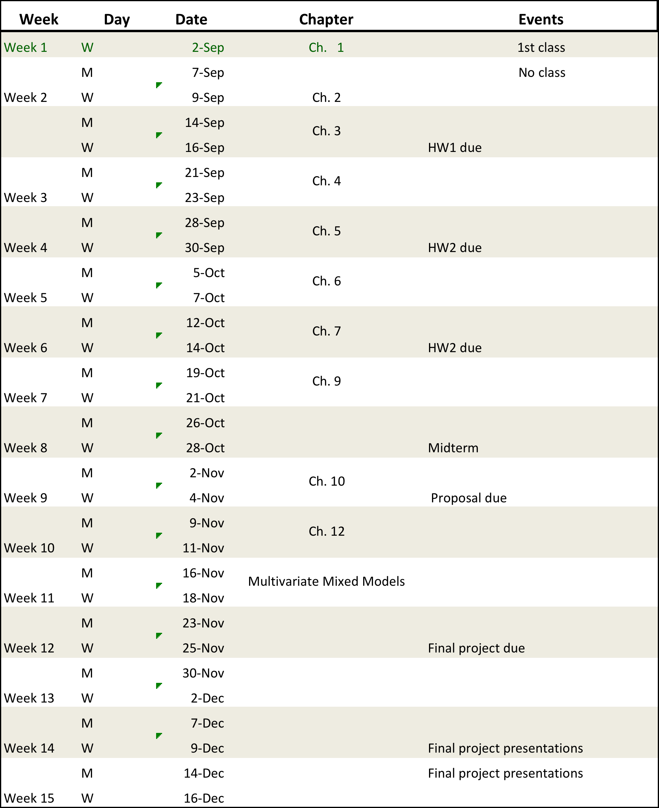
Tentative Schedule

