Slide 1
STT 465 (Fall, 2015): Bayesian Statistical Methods
Instructor: Gustavo de los Campos (Asoc. Prof., EPI-Biostat & Statistics)
Contact: gustavoc@msu.edu
Primary office: 909 Fee Rd. Room B637
Websites:
Office Hours: Mostly by appointment
Course website: https://github.com/gdlc/stt465
Syllabus: see course website for info about the course, pre-requisites,
grading, etc.
Pre-requisites, rules, exams & grading policy (see syllabus)

Slide 2
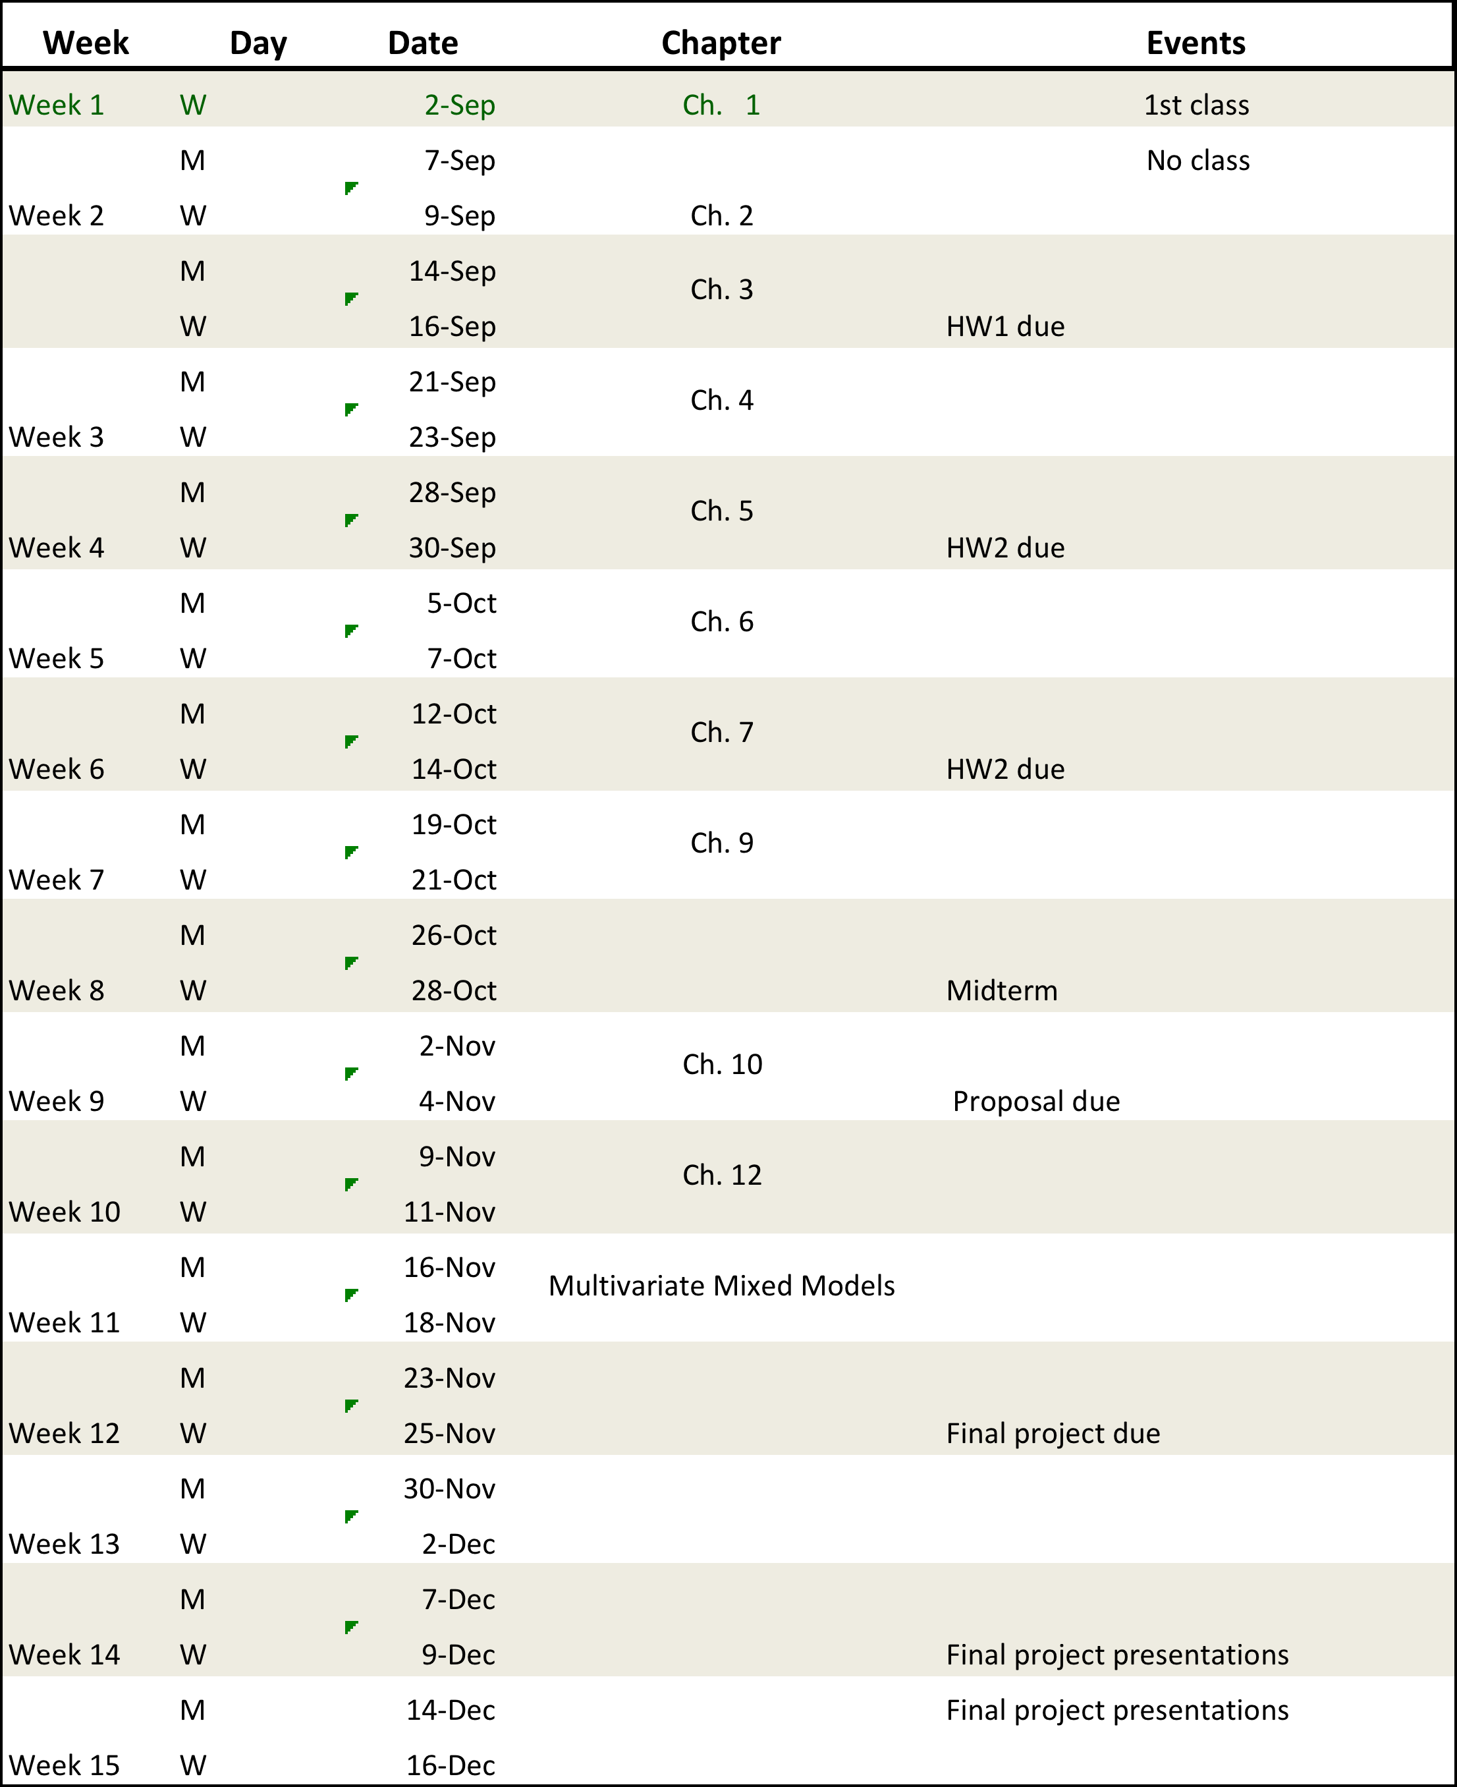
Tentative Schedule

Slide 3
Statistical Inference
Review of basic concepts:
- Population
- Sample
- Estimator
Inference: we make statements about population parameters based on data.
Two approaches:
- Classical (frequentist) inference: statements are based on the sampling distribution of the estimator over conceptual repeated sampling
- Bayesian: statements are conditional on the observed data (the only sample we have drawn from the population).
Discuss the problem of estimating the mean of Y in a population.

Slide 4
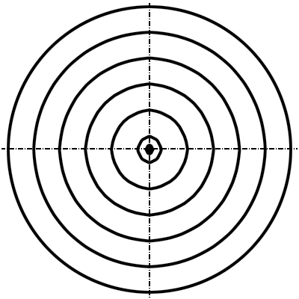
Frequentist approach
Sampling Distribution of Estimates
Bias-Variance
Tradeoffs
Squared-Bias
Variance

