Slide 1

RL for CAB Driver Revenue Optimization Team: Anirith Pampati Priyanka askani

Slide 2
Problem Statement
Operational Challenges for Cab Drivers: Cab drivers face the complex task of making real-time decisions regarding ride acceptance and routing, directly impacting their earnings and service efficiency.
Limitations of Existing Systems: Traditional ride-hailing platforms often employ static algorithms that may not effectively adapt to individual driver goals.
Unique Approach of Our Solution: We developed a reinforcement learning-based system that assists cab drivers in optimizing their revenue. By analyzing factors such as pickup and drop-off locations, time of day, and potential future ride opportunities, our model provides data-driven recommendations aimed at maximizing earnings. This approach enhances individual driver profitability and contributes to the efficiency of the broader ride-hailing ecosystem.

Slide 3
Explored Models
• Policy Gradient Architecture (PGA): Directly optimizes the policy by maximizing expected cumulative rewards.
• Deep Q-Network Architecture 1 (DQN1): Predicts Q-values for specific state-action pairs, requiring separate evaluations for each action.
• Deep Q-Network Architecture 2 (DQN2): Efficiently predicts Q-values for all possible actions simultaneously, enhancing computational efficiency.
• Highlight: Among these, DQN2 demonstrated superior performance in balancing efficiency and effectiveness in decision-making.
Notes:
The DQN2 architecture processes the current state of the environment and outputs Q-values for all possible actions in a single forward pass. This design improves computational efficiency and enables the model to evaluate multiple actions simultaneously. The state representation includes the driver's current location, time of day, and day of the week, while the action space consists of potential ride requests defined by pickup and drop-off locations.

Slide 4
Results
Performance Metrics:
Cumulative Rewards: DQN2 achieved higher cumulative rewards compared to PGA and DQN1.
Training Stability: DQN2 exhibited more stable convergence during training phases.
Computational Efficiency: DQN2 required fewer resources due to simultaneous action evaluations.
Conclusion: DQN2 effectively optimized cab drivers' decision-making processes, leading to increased profitability and operational efficiency.
Success rate of DQN2 after 10000 episodes: 90.38%
Architecture | 200 | 400 | 600 | 800 | 1000 | 1200 | 1400 | 1600 | 1800 | 2000 | 2500
Arch - 1 | 08.45 | 12.21 | 18.63 | 25.21 | 28.27 | 29.55 | 33.33 | 35.97 | 38.31 | 40.37 | 46.00
Arch - 2 | 20.39 | 25.68 | 34.44 | 42.69 | 48.85 | 54.45 | 58.52 | 63.14 | 66.66 | 69.61 | 62.49

Slide 5
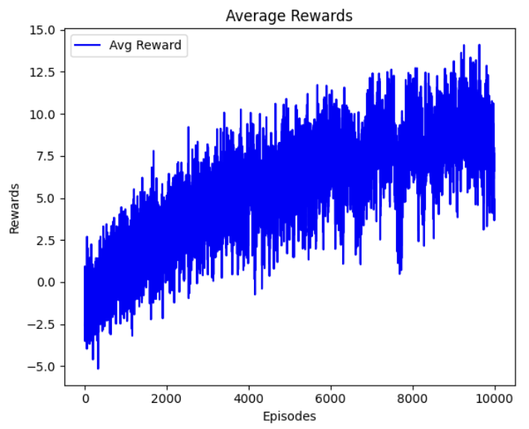
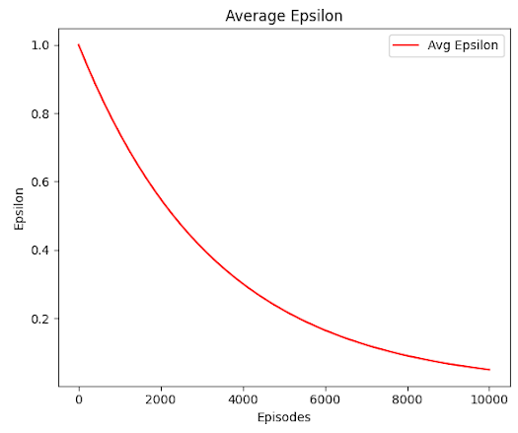

Slide 6
Future Scope
• Incorporating Real-Time Data: Integrate live traffic updates and demand forecasts to enhance decision accuracy.
1
• Scalability: Adapt the model for deployment across various cities with diverse traffic patterns and demand profiles.
2
• Driver Retention: Utilize insights from the model to develop strategies aimed at improving driver satisfaction and retention rates.
3
• Advanced RL Techniques: Explore the application of more sophisticated reinforcement learning algorithms to further refine decision-making capabilities.
4

Slide 7

Thank You!! ☺

