Slide 1
$
FinSight
FinSight
A Finance Analytics Dashboard, Built End-to-End in Power BI
Data Cleaning → Data Modeling → DAX Measures → Interactive Dashboards
Portfolio Project | Power BI · DAX · Power Query

Slide 2
Project Objective
Why this dashboard exists
Give a finance team real-time visibility into transaction health, customer behavior, and risk — in one place.
◷
Monitor transaction volume and value trends over time, by month and by year.
◎
Break down performance by customer segment, gender, state, and occupation.
⇄
Track transaction status (success / failed / pending) to spot operational risk.
≣
Compare fees, tax, and transaction counts across every transaction type.
2

Slide 3
Data Sources
Two tables loaded into Power BI, connected on Customer ID
Finance Transactions (Fact)
Customer (Dimension)
• Transaction ID
• Customer ID
• Transaction Date
• First Name
• Account ID
• Last Name
• Customer ID
• Gender
• Transaction Type
• Date of Birth
• Channel
• City
• Merchant Category
• State
• Amount
• Occupation
• Fee Amount
• Customer Segment
• Tax Amount
• Annual Income
• Currency (INR)
• Join Date
• Transaction Status
• Is Fraud
• Risk Score
Relationship: Customer ID → used to connect both tables in the data model
• Reference Number
3

Slide 4
Data Cleaning in Power Query
Reviewed via Column Distribution, Column Quality, and Column Profile before transforming
⧉
Duplicate keys
∅
Missing values
Transaction ID contained duplicates — identified and removed.
Fee Amount had NULLs — filled with the column average (₹14.52).
␣
Inconsistent text
±
Negative amounts
Channel had extra whitespace — fixed with Transform → Format → Trim.
Amount held negative values — corrected with Transform → Scientific → Absolute.
Aa
Casing
⊕
Merged fields
Currency values standardized with Transform → Format → UPPERCASE.
Customer First Name + Last Name merged into a single Full Name column.
4

Slide 5
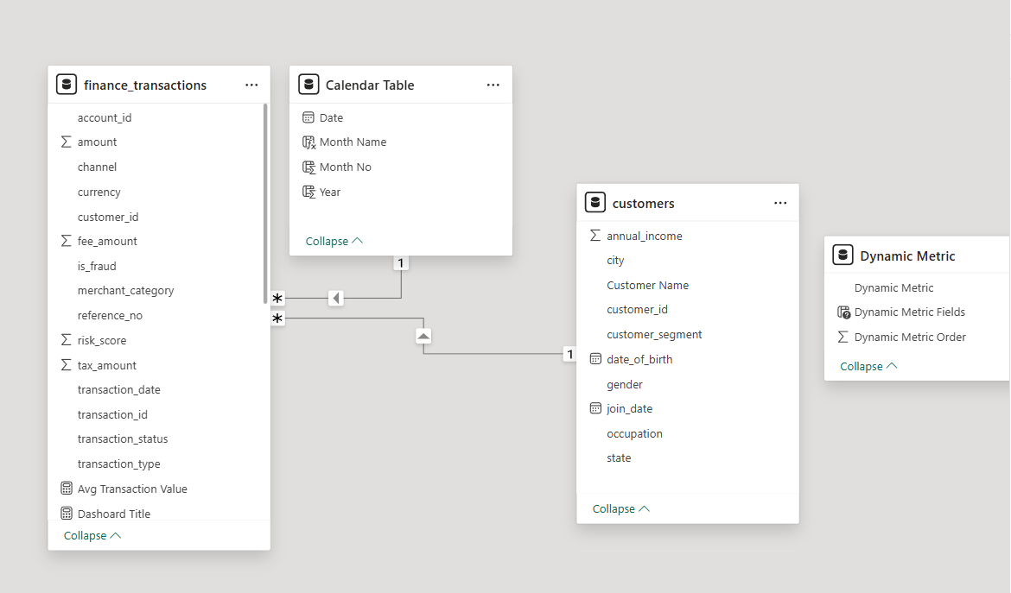
Data Modeling
A star-schema style model, joined on Customer ID, with a dedicated date table
Calendar Table
Finance Transactions
(Fact Table)
Customer Table
(Dimension)
Calendar Table = CALENDAR( MIN(Finance_Transactions[Transaction_Date]), MAX(Finance_Transactions[Transaction_Date]) )
5

Slide 6
DAX Measures — The 5 Core KPIs
Every KPI follows the same pattern: Current → Prior Year (SAMEPERIODLASTYEAR) → YoY → YoY %
Total Amount
Total Transactions
Avg Transaction Value
Total Fees
Total Tax
₹137.53M
14.94K
₹9.20K
₹216.94K
₹39.04K
SUM( Amount )
DISTINCTCOUNT( Transaction ID )
AVERAGE( Amount )
SUM( Fee Amount )
SUM( Tax Amount )
Year-over-Year pattern (applied to every KPI above)
PY Amount = CALCULATE( [Total Amount], SAMEPERIODLASTYEAR( Calendar[Date] ) )
YoY Amount = [Total Amount] − [PY Amount]
YoY % Amount = DIVIDE( [YoY Amount], [PY Amount] )
Plus a “Dynamic Measure” parameter — Total Amount / Total Transactions / Total Fees / Total Tax — driving every chart on the report from a single slicer.
6

Slide 7
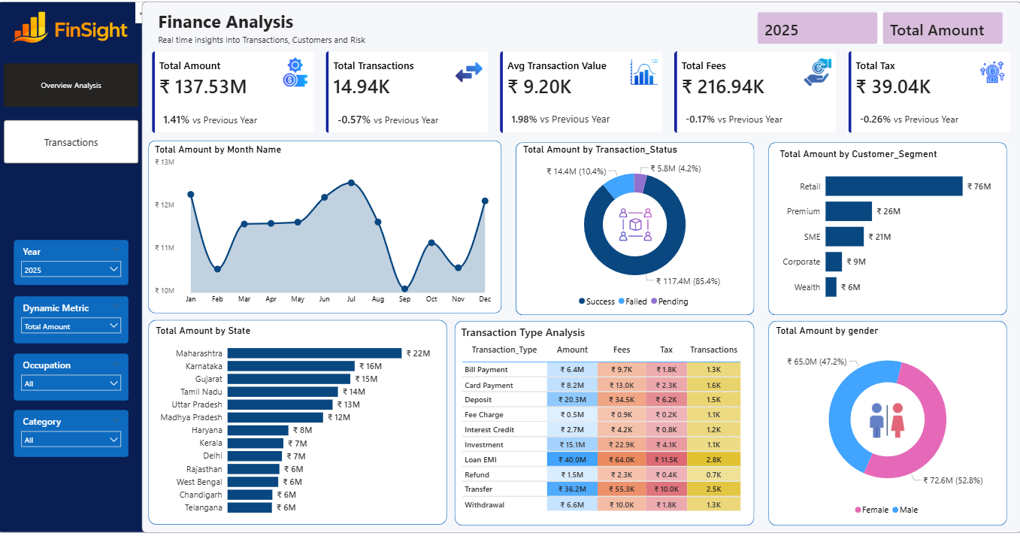
Dashboard 1 — Overview Analysis
5 KPIs with YoY · monthly trend · status, segment, state & gender breakdowns · transaction-type summary table
7

Slide 8
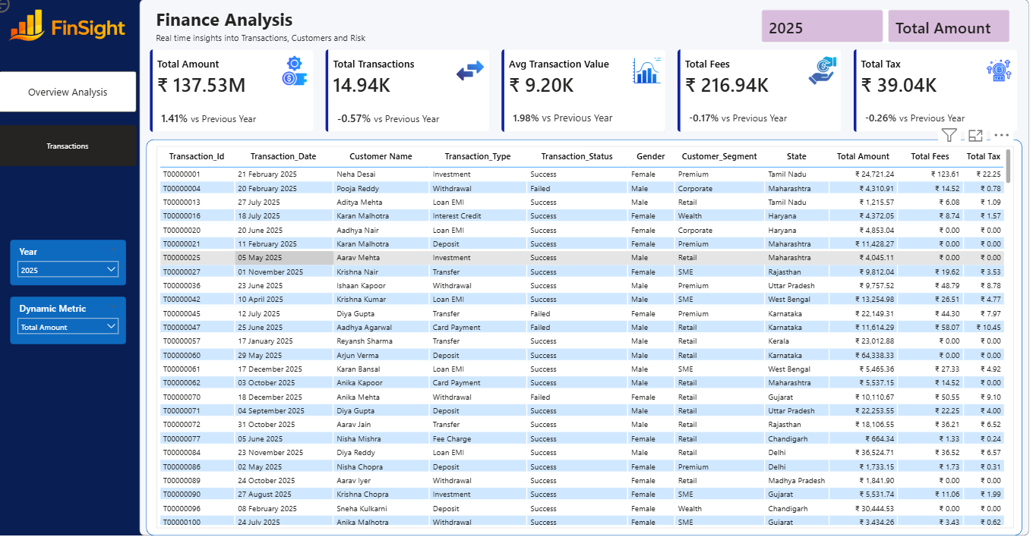
Dashboard 2 — Transactions
Row-level detail table — Transaction ID, date, customer, type, status, segment, state, amount, fees & tax
8

Slide 9
Skills Demonstrated
The full analytics workflow, in one project
⌁
⛓
ƒx
Power Query
Data Modeling
DAX
Data profiling, cleaning & transformation
Star-schema relationships & date tables
KPI, time-intelligence & YoY measures
☰
▤
◈
Parameters
Dashboard Design
Data Storytelling
Dynamic, user-driven measure switching
Layout, hierarchy & interactivity
Translating numbers into insight
9

Slide 10
$
Thanks for reading
FinSight — a finance analytics dashboard built end-to-end in Power BI, from raw data to real-time insight.
Full project files & PBIX walkthrough on GitHub · Let's connect on LinkedIn

