Slide 1
Strongly Connected Components
Project work by: Algorithm Team
Nurdaulet Daudov
Medet Kurganbayev
Ali Tulebergenov
Askarov Adlet
Zhomart Abdrakhman

Slide 2
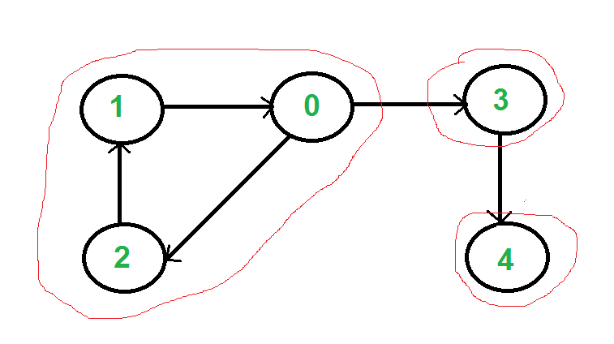
A directed graph is strongly connected if there is a path between all pairs of vertices. A strongly connected component (SCC) of a directed graph is a maximal strongly connected subgraph. For example, there are 3 SCCs in the following graph.

Slide 3
Kosaraju’s and Tarjan’s algorithm
We can find our SSC in 2 ways, using kosaraju’s or tarjan’s Kosaraju’s is based on DFS, it does DFS two times. The basic concept of this algorithm is that if we are able to arrive at vertex v initially starting from vertex u, then we should be able to arrive at vertex u starting from vertex v, and if this is the situation, we can say and conclude that vertices u and v are strongly connected, and they are in the strongly connected sub-graph.
Tarjan’s is based on DFS too, but It does only one DFS. Tarjan’s is based on following facts : 1. DFS search produces a DFS tree/forest 2. Strongly Connected Components form subtrees of the DFS tree. 3. If we can find the head of such subtrees, we can print/store all the nodes in that subtree (including head) and that will be one SCC. 4. There is no back edge from one SCC to another (There can be cross edges, but cross edges will not be used while processing the graph).
Both of them are in linear time complexity.

Slide 4
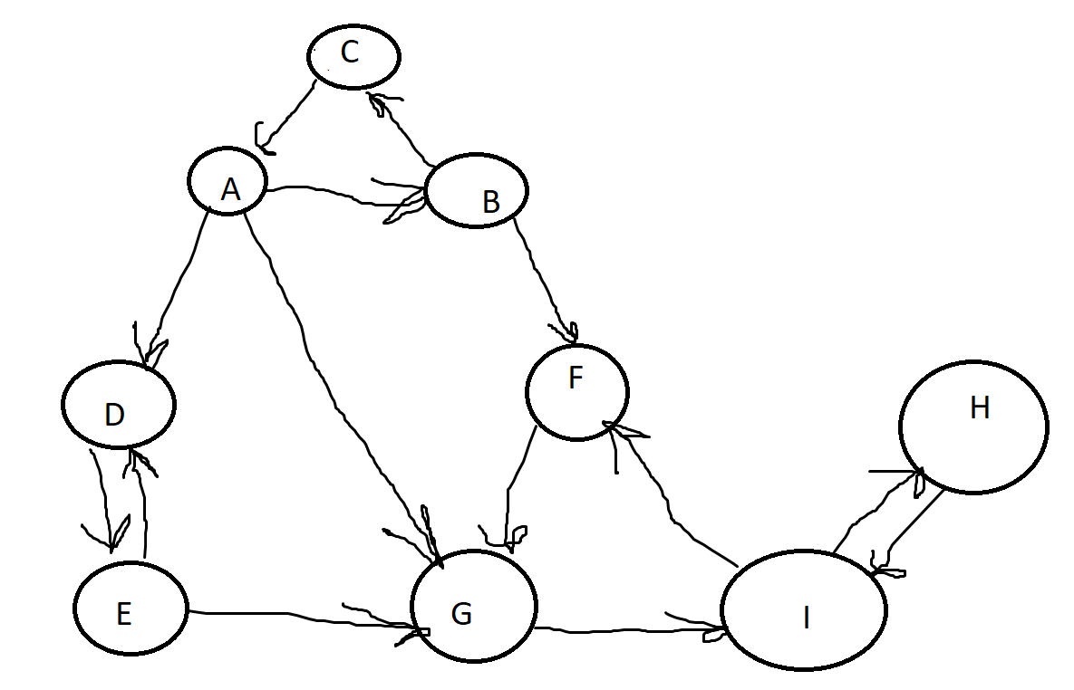
Here is graph, lets find strongly connected components

Slide 5
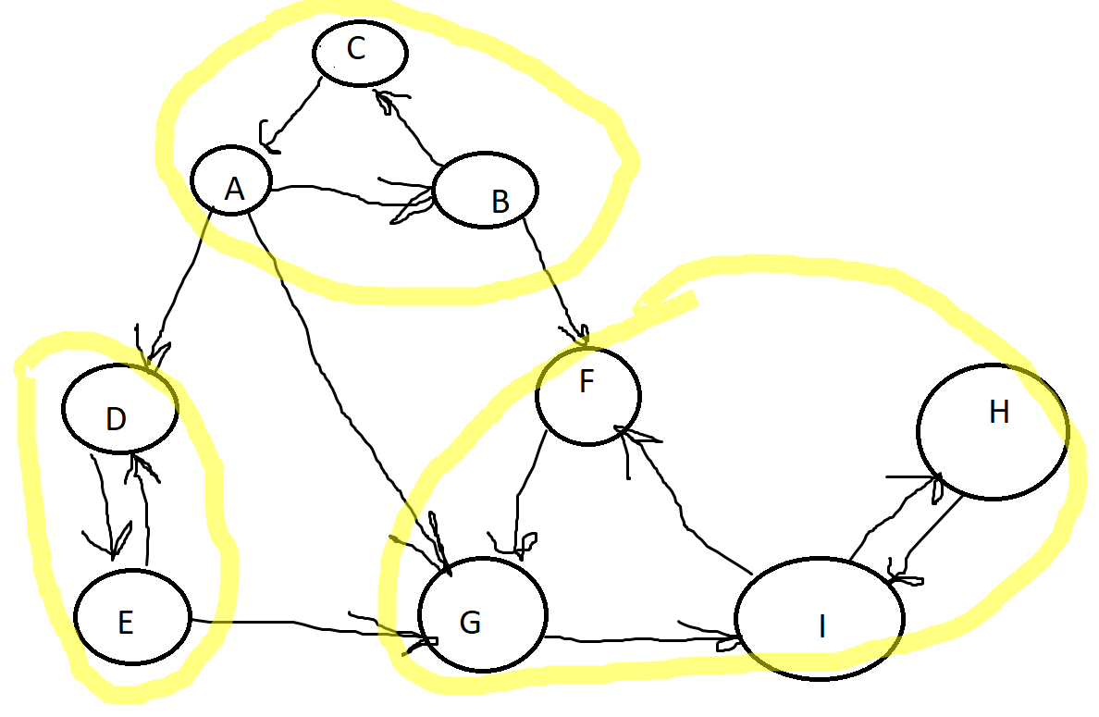
Solution

