Slide 1
Minimum Spanning Tree
Quantum Computing
Valerio Colombo, Valentina Deda, Tommaso Fontana
Software Enginering II – Research Project
2018/2019

Slide 2
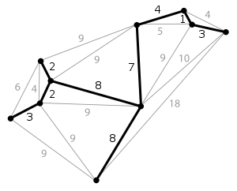
Minimum Spanning Tree
The problem: Minimum Spanning Tree
Given an undirected, weighted graph, the Minimum Spanning Tree (MST) is a subset of its edges that connects all the vertices, without any cycles and with the minimum total edge weight.

Slide 3
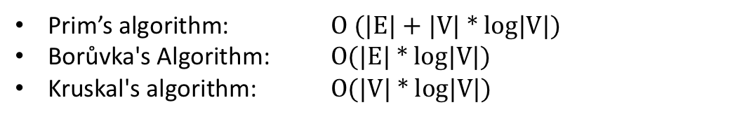
Minimum Spanning Tree
Solutions to the problem:
3 classical Algorithms
Prim’s algorithm: O (|E| + |V| * log|V|)
Borůvka's Algorithm: O(|E| * log|V|)
Kruskal's algorithm: O(|V| * log|V|)

Slide 4
Minimum Spanning Tree
Prim’s Algorithm

Slide 5
Minimum Spanning Tree
Borůvka's Algorithm

Slide 6
Minimum Spanning Tree
Kruskal’s Algorithm
Create a forest F (a set of trees), where each vertex in the graph is a separate tree;
Create a set S containing all the edges in the graph;
While S is nonempty and F is not yet spanning
Remove an edge with minimum weight from S;
If the removed edge connects two different trees then add it to the forest F, combining two trees into a single tree;
At the termination of the algorithm, the forest forms a minimum spanning forest of the graph. If the graph is connected, the forest has a single component and forms a minimum spanning tree

Slide 7
Minimum Spanning Tree
Kruskal’s Algorithm – Quantum version
Create two empty sets: a set of edges belonging to the MST and a set of visited nodes;
For |V| - 1 times
Select the minimum outgoing edge. An outgoing edge is an edge incident to a vertex which isn’t in the Visited Nodes Set;
Add the edge to MST Edge Set and the newly visited node to the Visited Nodes Set;

Slide 8
Minimum Spanning Tree
Kruskal’s Algorithm – Quantum version
Create two empty sets: a set of edges belonging to the MST and a set of visited nodes;
For |V| - 1 times
Select the minimum outgoing edge. An outgoing edge is an edge incident to a vertex which isn’t in the Visited Nodes Set;
Add the edge to MST Edge Set and the newly visited node to the Visited Nodes Set;
Selecting the minimum outgoing edge is a search problem → we can use Grover’s
Algorithm to speed up the computation

Slide 9
Minimum Spanning Tree
Grover’s Algorithm

Slide 10
Minimum Spanning Tree
Quantum computing in practice
What is a Qubit?
A classical bit can have values 0 or 1.
A Qubit (Quantum bit) has a certain probability to be 0 or 1. It collapses on either 0 or 1 only when measured.
n Qubits can be represented by a complex vector of length N = 2^{n}. This vector is called a Wave Function.

Slide 11
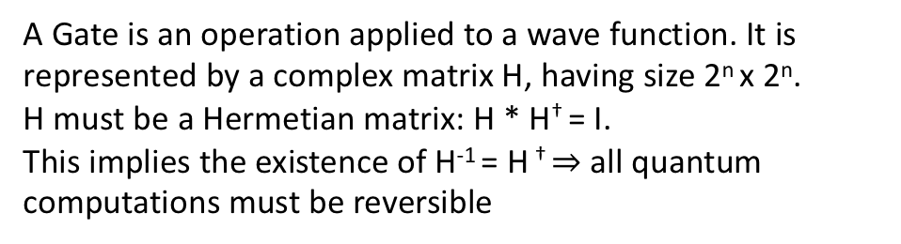
Minimum Spanning Tree
Quantum computing in practice
What is a Quantum Gate?
A Gate is an operation applied to a wave function. It is represented by a complex matrix H, having size 2^{n} x 2^{n}.
H must be a Hermetian matrix: H * H† = I.
This implies the existence of H⁻¹ = H † $⇒$ all quantum computations must be reversible

Slide 12
Minimum Spanning Tree

