Slide 1
Data Visualization of Apple Stock Price
Name: Avishek Khadka
Date: 12/02/2021

Slide 2
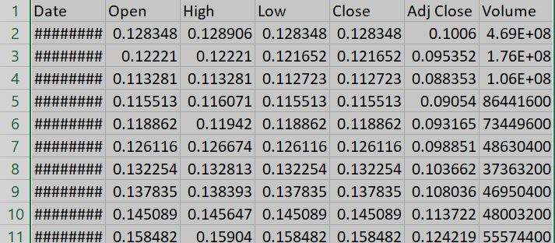
Data Set
The dataset contains price of Apple stock from its IPO to 2021
Source: Kaggle.com
Collected by Yahoo Finance
Attributes:
Date
Open
High
Low
Close
AdjClose
Volume

Slide 3

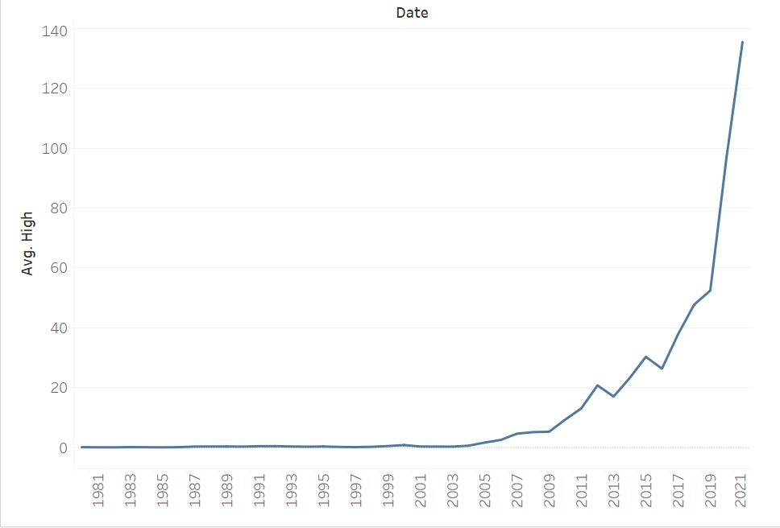

Display the price of Apple stock throughout from its IPO in 1981 to 2021.
Apple stock is a good stock with very good returns
Has been really bullish for the last 3 years
Has grown 4 times in the last 3 years
2021 is the year this stock has been at its all time high

Slide 4
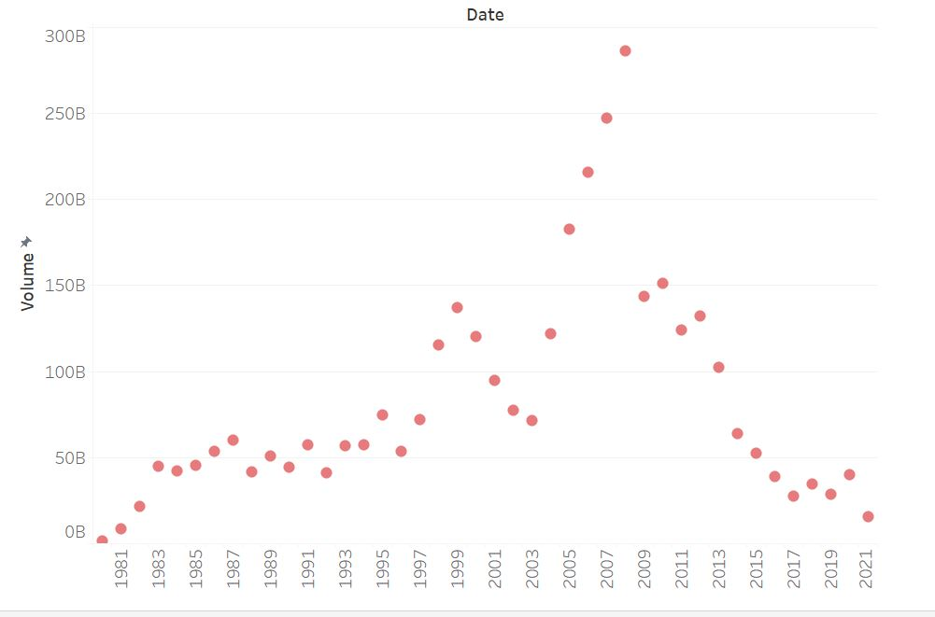
To determine which days the stock is traded the most and which days they are traded the least
Volume represents how much the stock has been traded
During the financial crisis of 2009 apple stock was traded the most.
The volume of Apple stock has been following a down trend
The average volume has been around 50billion

Slide 5
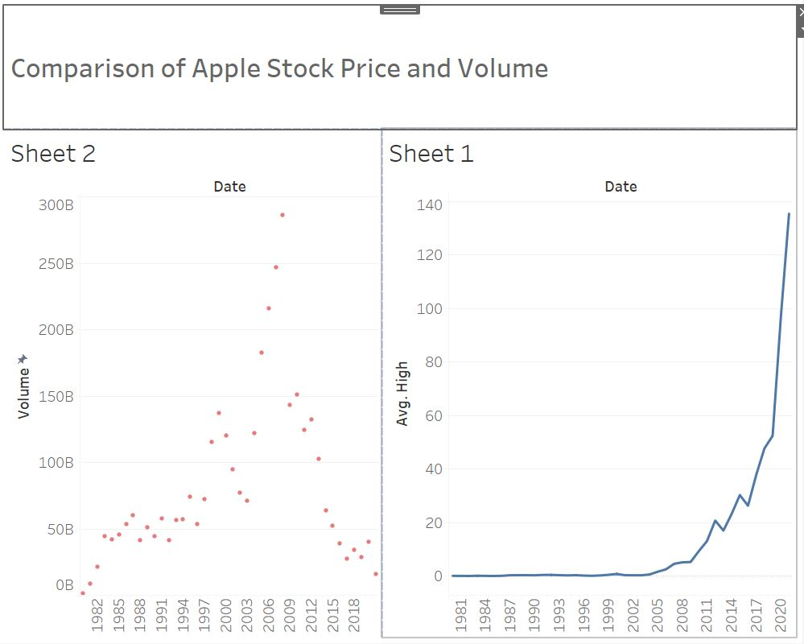
Summary
This is the dashboard with one side displaying the price of apple stock every year and the other chart showing volume of the stock every year.
We can see that there is no correlation in the charts between the volume and the price.

