Slide 1
Synaptic, the digital solution
Matej Mujezinović
Asim Veledarević
Mahmut Beširević

Slide 2
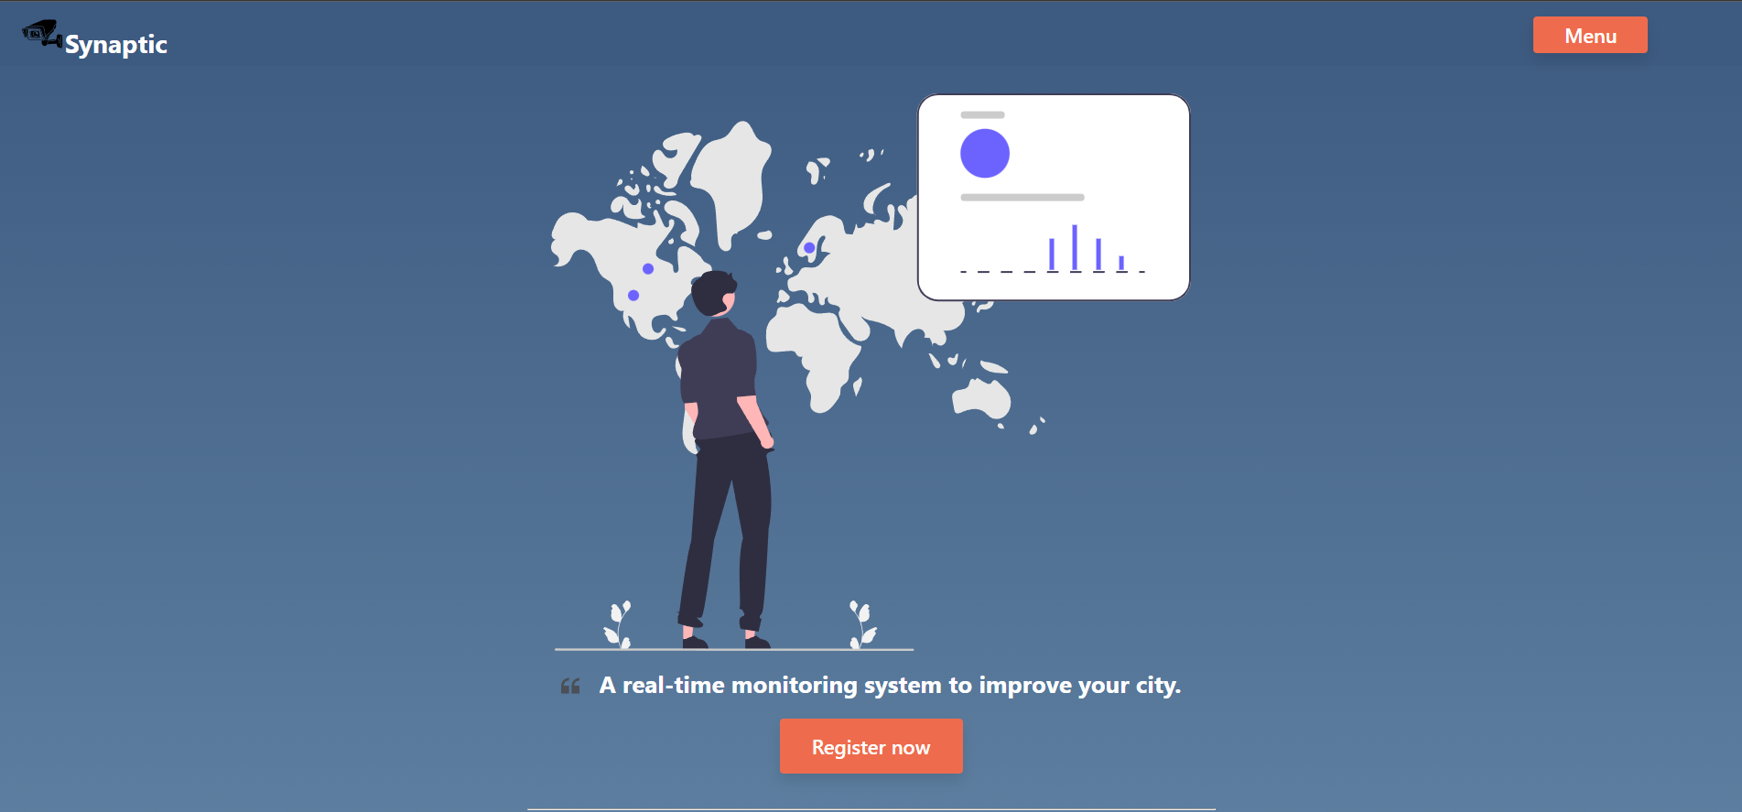
Features:
- Issue speeding tickets via notifications.
- Locate closest parking spot.
- Government and civizen accounts.
- Place markers at accident locaiton.
- Detect roadblocks

Slide 3
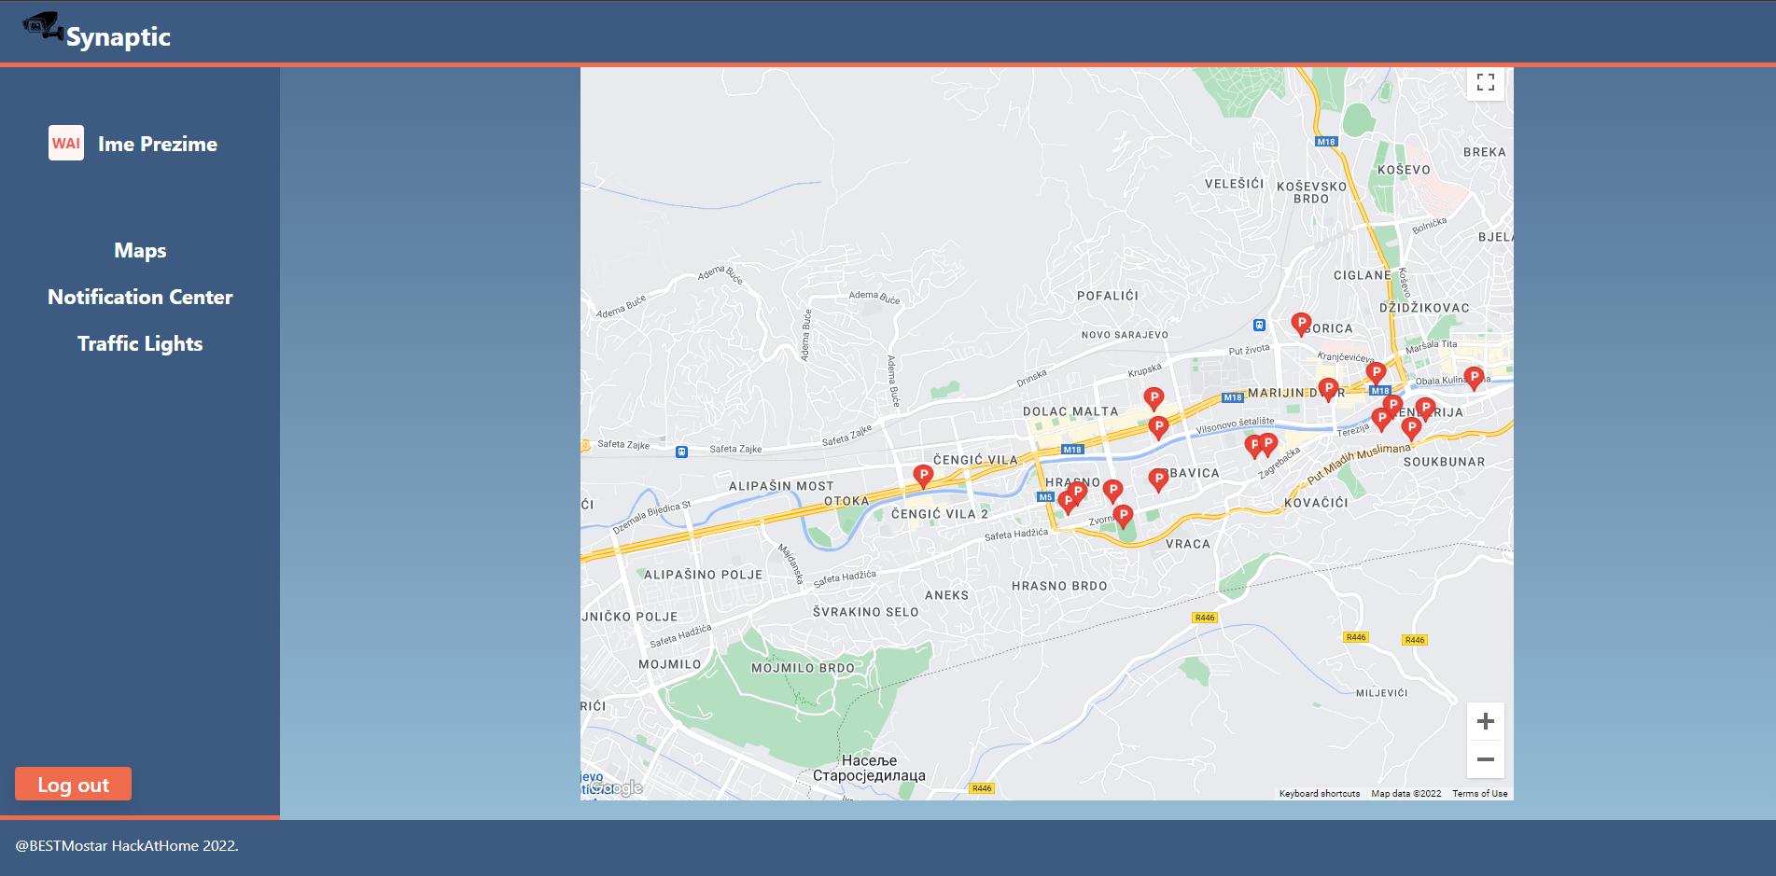
The Idea:
- Make Sarajevo more digitaly accessable
- Allow government to issue tickets via notifications
- Make parking easier.
- Reduce trafic congestion.

Slide 4
What problems it solves:
- Makes speeding tickets much easier to see and issue.
- Allows tourists and citizens to have more on-demand acces to important locations in the city.
- Solves trafic clogg by changing the time window of green light.

Slide 5
Thank you!

