Slide 1
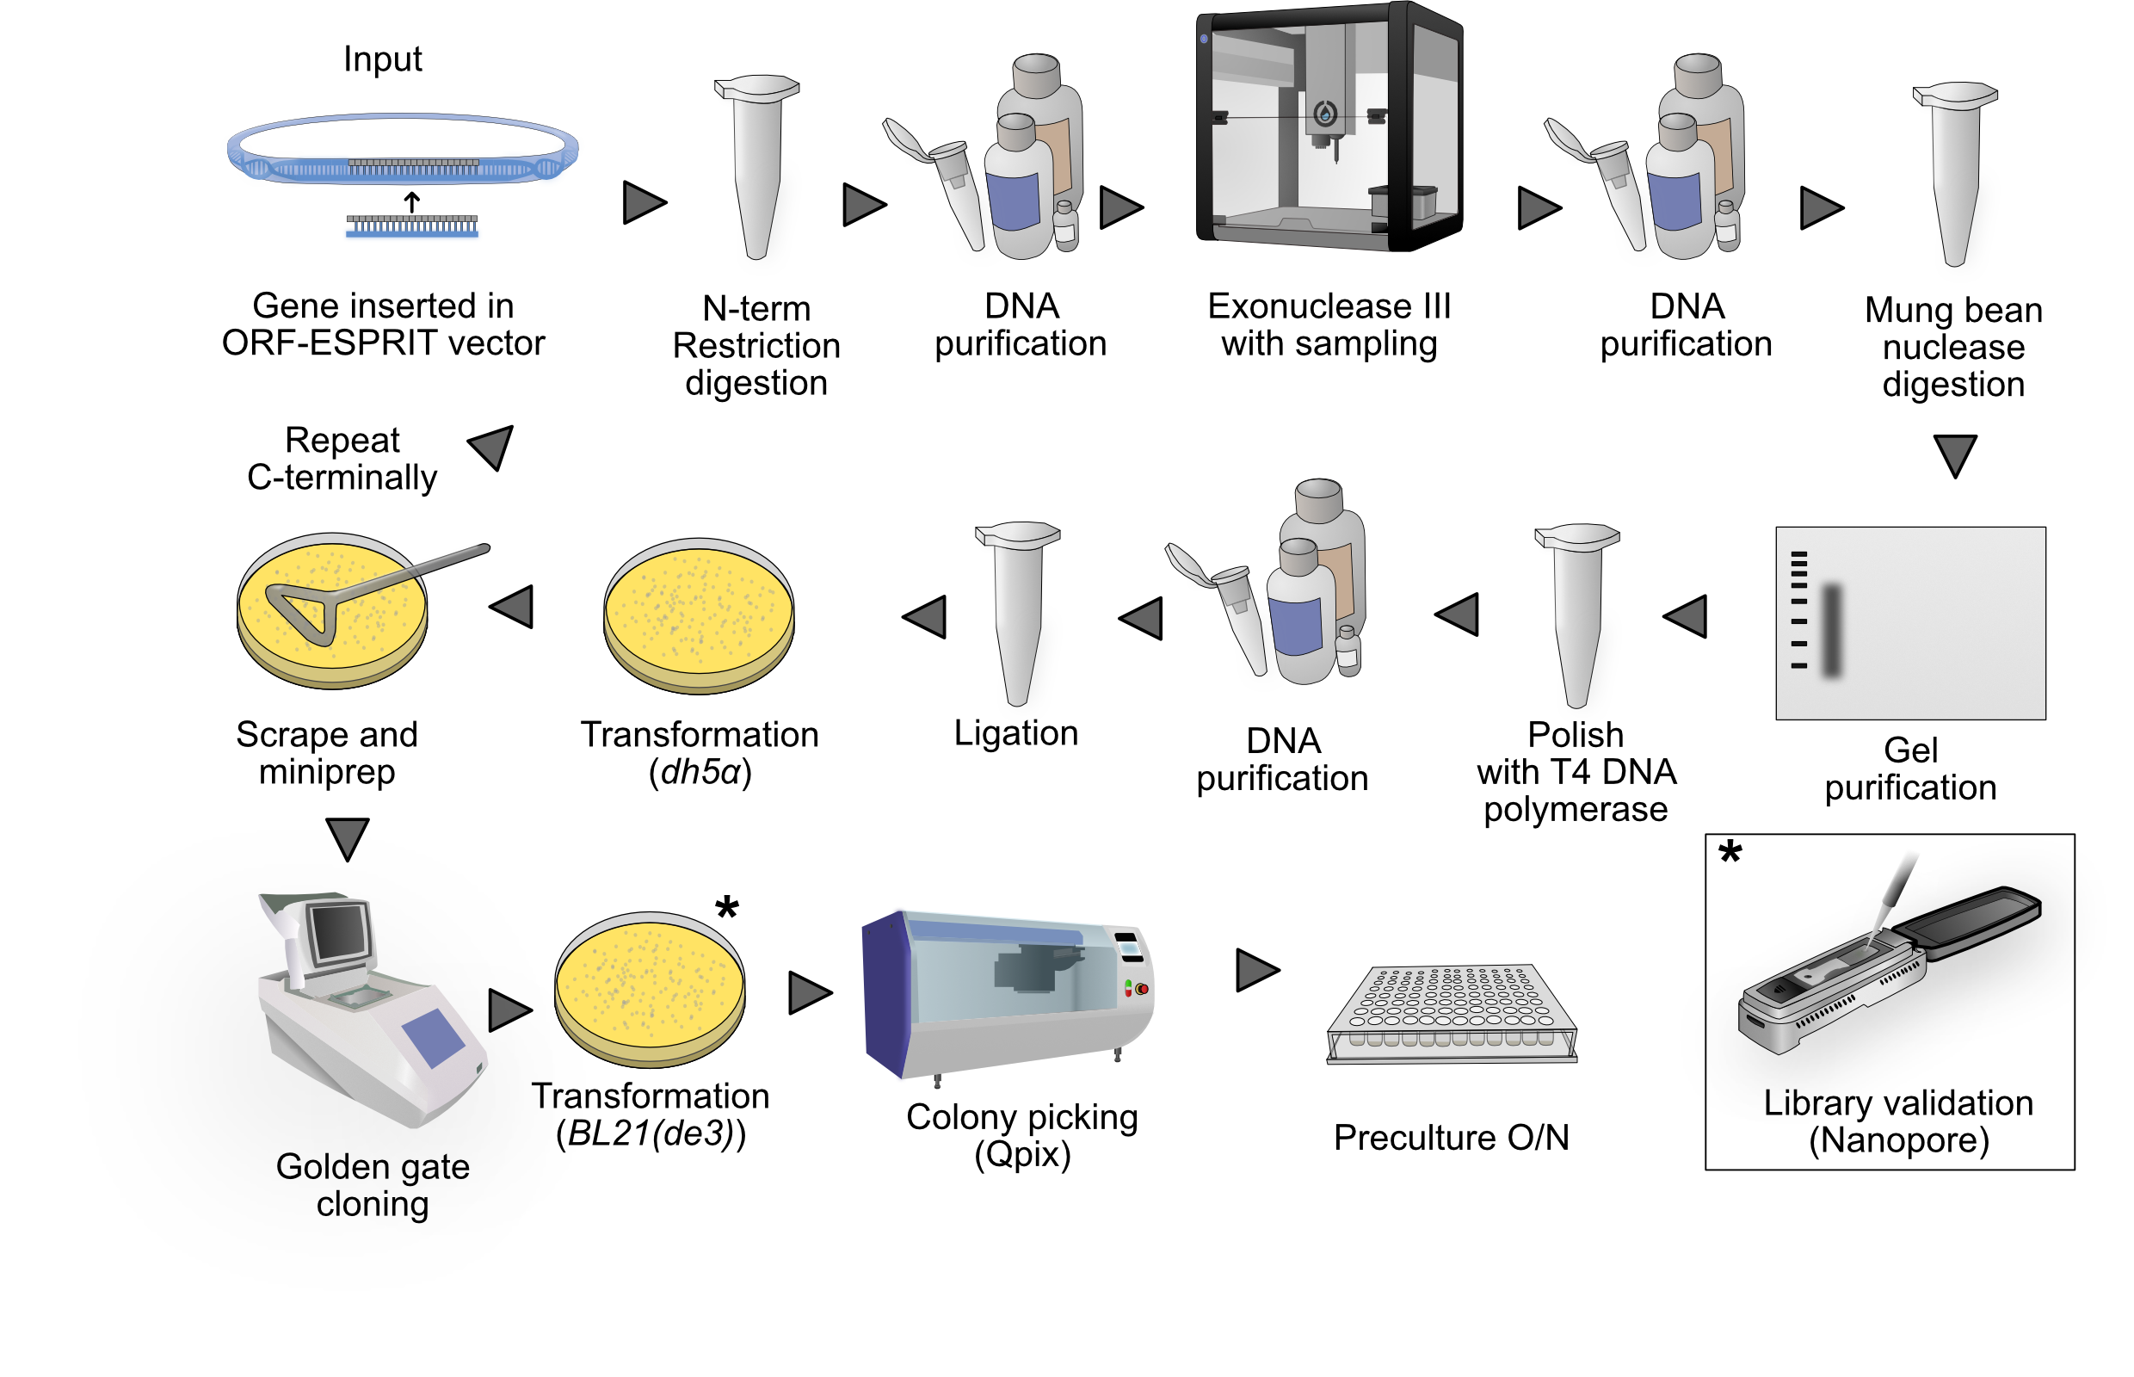
ORF-ESPRIT
1
Opentron scripts:
Exonuclease sampling:
2023_10_27_ESPRIT_1kb_4samples.py
Notes: Remember to set time (protocol.delay) based on DNA seq length
2. Plate filling
PlateFiller_Hamilton.py
Notes: Set Amount_of_liquid to 200 µL
2

Slide 2
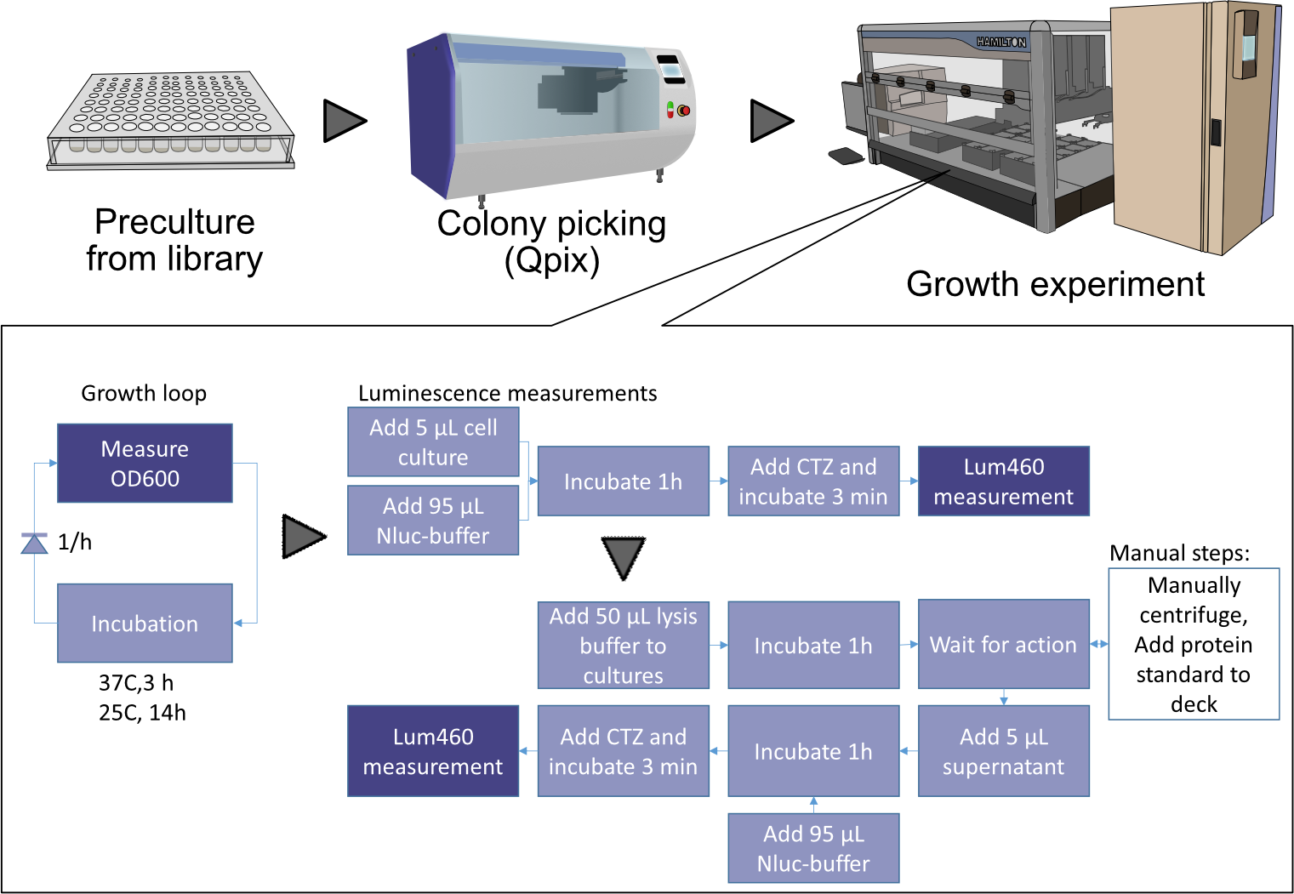
Growth and expression
3
Opentron scripts:
3. Plate filling (150)
PlateFiller_Hamilton.py
Notes: Set Amount_of_liquid to 150 µL

Slide 3
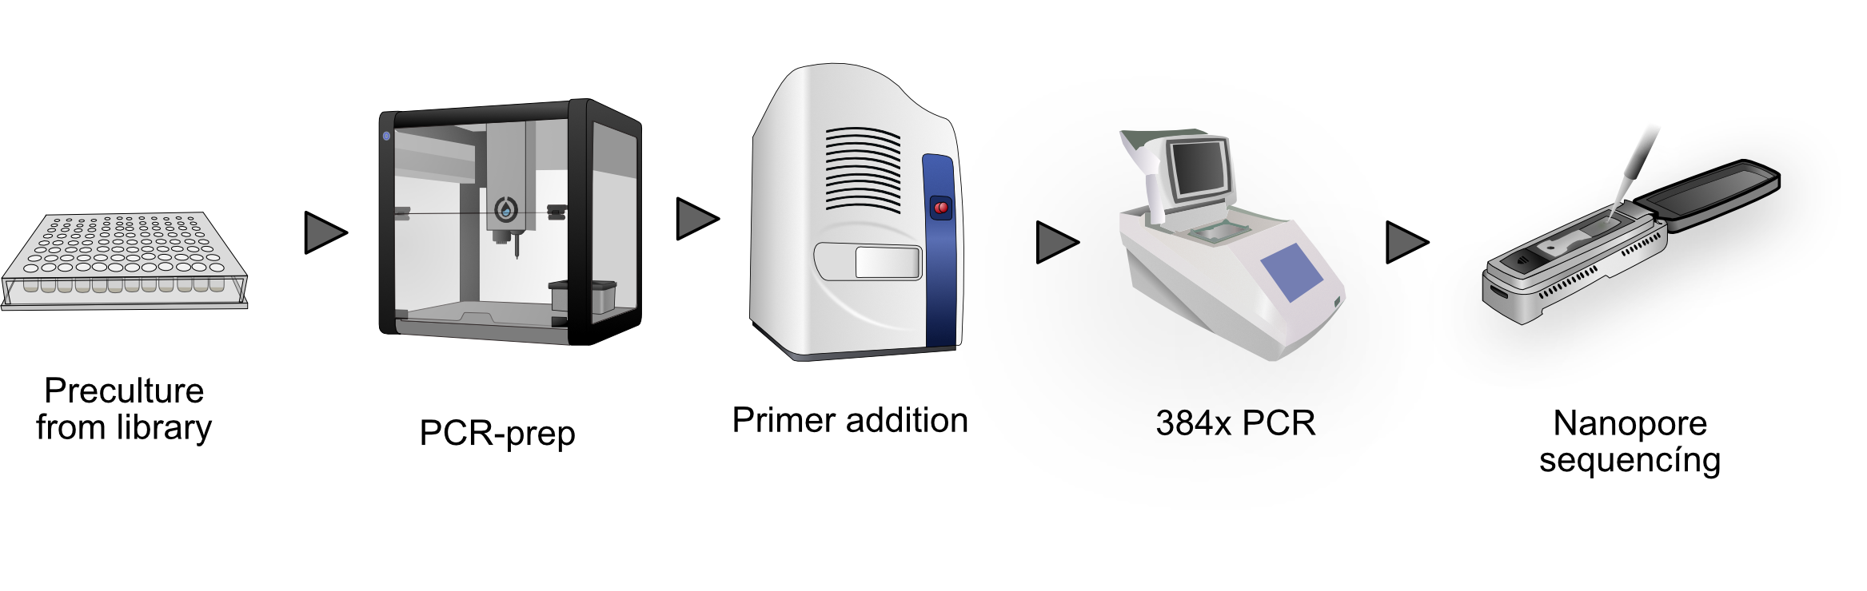
PCR and nanopore
Opentron scripts:
4. PCR prep
384_PCR_Filler.py
Notes: Preparing primers is done with 2023_06_12_Primer_Echo_prep.py into a 384 Echo source plate
2023_12_15_Primer_water_add.py can be used for adding water to primerplates
5. Glycerol addition (Stocks)
PlateFiller_Hamilton_Glycerol.py
6. PCR reaction extraction
2023_06_26_Echo_extractor.py
Notes: Pool and purify before Nanopore
5*
6*
4
7: Echo CSVs added as well

