Slide 1

PLANT DISEASE DETECTION AND
PREVENTION
By
Batch No: B14
S B Asqeem Nas | 19121A12A5
T Satyavathi | 19121A12C3
S Dharani | 19121A12B8
P Jyothirmai | 19121A1295
P Yashwanth | 20125A1209
S Sravani | 19121A12B1
Department of Information Technology
SREE VIDYANIKETHAN ENGINEERING COLLEGE
(AUTONOMOUS)
Supervisor . Head of the Dept.
Mr. G. M. Chanakya, M . Tech. . Dr. K. Ramani, M .Tech., Ph.D.
Assistant Professor. Professor and HOD

Slide 2
CONTENTS
ABSTRACT
INTRODUCTION
LITERATURE SURVEY AND LIMITATIONS
PROBLEM STATEMENT
OBJECTIVES
PROPOSED SYSTEM
SYSTEM REQUIREMENTS
SYSTEM DESIGN
WORKING PROCESS
TRAINING & TESTING
RESULTS
CONCLUSION
REFERENCES

Slide 3
ABSTRACT
Identification of the plant diseases is the key to preventing the losses in the yield and quantity of the agricultural product. The studies of the plant diseases mean the studies of visually observable patterns seen on the plant. Health monitoring and disease detection on plant is very critical for sustainable agriculture. It is very difficult to monitor the plant diseases manually. It requires tremendous amount of work, expertise in the plant diseases, and also require the excessive processing time. Hence, image processing is used for the detection of plant diseases. Disease detection involves the steps like image acquisition, image pre-processing, image segmentation, feature extraction and classification. Any technique or method to overcome this problem and getting a warning before the plants are infected would aid farmers to efficiently cultivate crops or plants, both qualitatively and quantitatively. Thus, disease detection in plants plays a very important role in agriculture
Keywords: Plant disease detection, image processing, image acquisition, segmentation, feature extraction, classification.

Slide 4
INTRODUCTION
Agriculture is an important source in the economic development of India. About 70% of Indian economy relies on agriculture. Hence, damage to the crops would lead to huge loss in productivity and would ultimately affect the economy.
Leaves being the most sensitive part of plants show disease symptoms at the earliest . The crops need to be monitored against diseases from the very first stage of their life-cycle to the time they are ready to be harvested. Initially, the method used to monitor the plants from diseases was the traditional naked eye observation that is a time-consuming technique which requires experts to manually monitor the crop fields .
In the recent years, a number of techniques have been applied to develop automatic and semi-automatic plant disease detection systems. These systems have so far resulted to be fast, inexpensive and more accurate than the traditional method of manual observation by farmers.
Thus, this invokes researchers to deploy more intelligent technological systems for plant disease detection which do not require human intervention.The objective of this project is to review various techniques of plant disease detection and discuss in terms of various parameters.

Slide 5
[1] D.A. Bashish, et.al (2010),“opted for k-means segmentation for partitioning the leaf image into four clusters using the squared Euclidean distances”
LITERATURE SURVEY
K-nearest neighbor classifier is used to calculate the minimum distance between the given point and other points to determine the given point belongs to which class. Goal is to computes the distance from the query sample to every training sample and selects the neighbor that is having minimum distance.
K-nearest neighbor classifier is simpler classifier as exclusion of any training process. Applicable in case of a small dataset which is not trained.
Limitations
Speed of computing distance increases according to numbers available in training samples.
Expensive testing of each instance and sensitive to irrelevant inputs.

Slide 6
[2] M.Bhange et.al (2015) ,”A web based tool has been developed to identify fruit diseases by uploading fruit image to the system”..
LITERATURE SURVEY (Contd..)
Features extraction has been done using parameters CCV (color coherence vector). SVM is used for classification as infected or non-infected. This work achieved an accuracy of 82% to identify pomegranate disease .
The color histogram of two images has been compared using sum of squared distances. Morphology is useful for boundary extraction or the shape vector. CCV is used for comparing images having spatial information.
Simple geometric interpretation and a sparse solution. Can be robust, even when training sample has some bias.
Limitations
Slow training. Difficult to understand structure of algorithm.
Large no. support vectors are needed from training set to perform classification task.

Slide 7
[3] V. Singh et.al (2016) has worked on “automating the detection and classification of plant diseases by implementing genetic algorithm” as the image segmentation technique.
LITERATURE SURVEY (Contd..)
A small number of images have been used for the training and test sets for four plants leaves namely, banana, beans, lemon and rose.
For performing clustering, the search capability of genetic algorithm has been used, to separate unlabeled points of N-dimension into K clusters.
The minimum distance criterion with k-mean clustering gave an accuracy of 86.54% and with SVM the accuracy was 95.71%. Using Genetic Algorithm along with the minimum distance criterion increased the accuracy to 93.63%.
Limitations
Speed of computing distance increases according to numbers available in training samples.
Expensive testing of each instance and sensitive to irrelevant inputs.

Slide 8
[4] G. Saradhambal, et.al (2018) proposed “an approach to produce a system for automatic plant disease detection”.
LITERATURE SURVEY (Contd..)
The shape oriented features that were extracted in this work included area, color axis length, eccentricity, solidity and perimeter, whereas the texture oriented features were contrast, correlation, energy, homogeneity and mean
Research was carried out to predict the infected area of the leaves by applying k-means clustering algorithm and the Otsu’s classifier.
The Otsu’s algorithm assumes image to contain two classes of pixels i.e. it forms bimodal histogram with the foreground and background pixels.
The shape oriented features used werearea, color axis length, eccentricity, solidity and perimeter whereas, contrast, correlation, energy, homogeneity and mean were the texture oriented features
Limitations
This model can’t handle noisy data input.

Slide 9
[5] Malvika Ranjan et al. in the paper ―Detection and Classification of leaf disease using “Artificial Neural Network” proposed an approach to detect diseases in plant utilizing the captured image of the diseased leaf.
LITERATURE SURVEY (Contd..)
Artificial Neural Network (ANN) is trained by properly choosing feature values to distinguish diseased plants and healthy samples. The ANN model achieves an accuracy of 80%.
The shape oriented features that were extracted in this work included area, color axis length, eccentricity, solidity and perimeter, whereas the texture oriented features were contrast, correlation, energy, homogeneity and mean.
Limitations
Speed of computing distance increases according to numbers available in training samples.

Slide 10
[6] Kulkarni et al. in the paper ― ”Applying image processing technique to detect plant diseases”.
LITERATURE SURVEY (Contd..)
Artificial Neural Network (ANN) is trained by properly choosing feature values to distinguish diseased plants and healthy samples. The ANN model achieves an accuracy of 80%.
Methodology for early and accurately plant diseases detection, using artificial neural network (ANN) and diverse image processing techniques. As the proposed approach is based on ANN classifier for classification and Gabor filter for feature extraction, it gives better results with a recognition rate of up to 91%.
Limitations
Speed of computing distance increases according to numbers available in training samples.
This model can’t handle noisy data input.

Slide 11
PROBLEM STATEMENT
Development of Plant Disease detection System that can detect a plant disease at very initial stage by using automatic disease detection technique.

Slide 12
OBJECTIVES
The objective is to develop a system that is capable to detect and identify the type of disease based on Blobs Detection and Statistical Analysis.
Increase accuracies using large dataset to train the algorithm and maximize epoch values.
Make use of existing deep learning modules for plant leaf disease detection and will check their performance on the basis of various evaluation.

Slide 13
PROPOSED SYSTEM
In the proposed system, we use the CNN algorithm to detect disease in plant leaves because with the help of CNN the maximum accuracy can be achieved if the data is good.
Firstly, the images of various leaves acquired using a digital camera with required resolution for better quality. The construction of an image database is clearly dependent on the application. The image database itself is responsible for the better efficiency of the classifier which decides the robustness of the algorithm.
Image pre-processing: In the second step, this image is pre-processed to improve the image data that suppress undesired distortions, enhances some image features important for further processing and analysis task. It includes color space conversion, image enhancement, and image segmentation.
Training the network: The deep convolutional model can be used to classify labels specific to the task at hand. It train a new layer which performs task of classifying the custom specified classes. The dataset contains labelled folders with images, the path to these folders is provided to the retrain script. A portion of these images is retained for testing.
Testing : The trained model is tested on a set of images. Random images are introduced to the network and output label is compared to the original known label of the image.

Slide 14
SYSTEM REQUIREMENTS
HARDWARE REQUIREMENTS | SOFTWARE REQUIREMENTS
System – I3 / Intel Processor | OS – Windows 10
RAM – 8GB(minimum) | Languages – Python
Hard Disk – 160GB | Editor – Anaconda

Slide 15
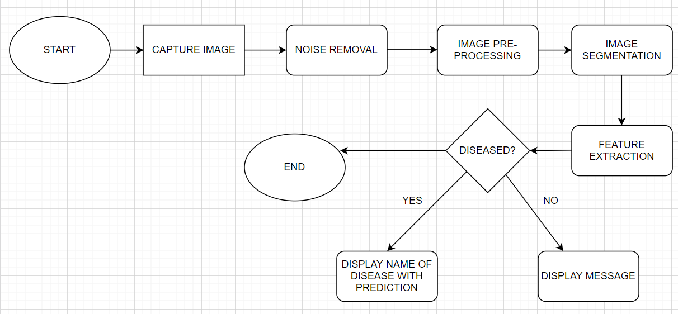
WORKING PROCESS

Slide 16
WORKING PROCESS
The whole process is divided into three stages:
Input images are first created by an Android device or uploaded to our web application by users.
Segmentation pre-processing includes the process of image segmentation, image enhancement and color space conversion. First, the digital image of the image is enhanced with a filter. Then convert each image into an array. Using the scientific name for Binarizes Diseases, each image name is converted to a binary field.
CNN classifiers are trained to identify diseases in each plant class. Level 2 results are used to call up a classifier, which is trained to classify various diseases in that plant. If not present, the leaves are classified as "healthy".
The trained model is tested on a set of images. Random images are introduced to the network and output label is compared to the original known label of the image.

Slide 17
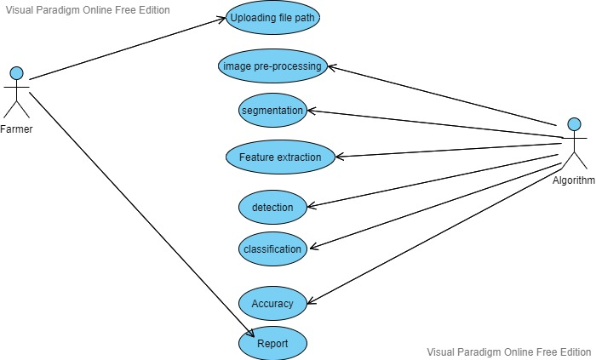
SYSTEM DESIGN
A use case diagram is a graphical depiction of a user's possible interactions with a system. A use case diagram shows various use cases and different types of users the system has and will often be accompanied by other types of diagrams as well. The use cases are represented by either circles or ellipses.
Figure use cases Diagram for classification and detection.

Slide 18
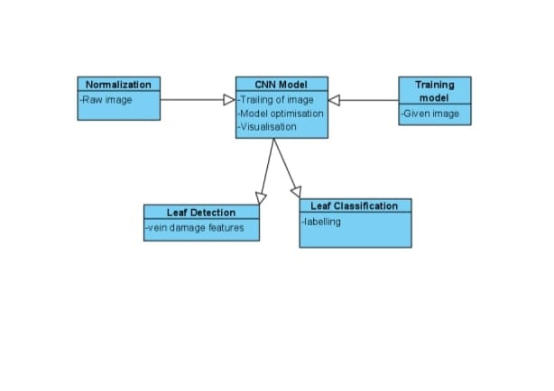
System Design(Contd..)
In software engineering, a class diagram in the Unified Modeling Language (UML) is a type of static structure diagram that describes the structure of a system by showing the system's classes, their attributes, operations (or methods), and the relationships among objects.
The class diagram is the main building block of object-oriented modeling. It is used for general conceptual modeling of the structure of the application, and for detailed modeling, translating the models into programming code. Class diagrams can also be used for data modeling.
Figure classDiagram for finding vacant area in parking lot

Slide 19
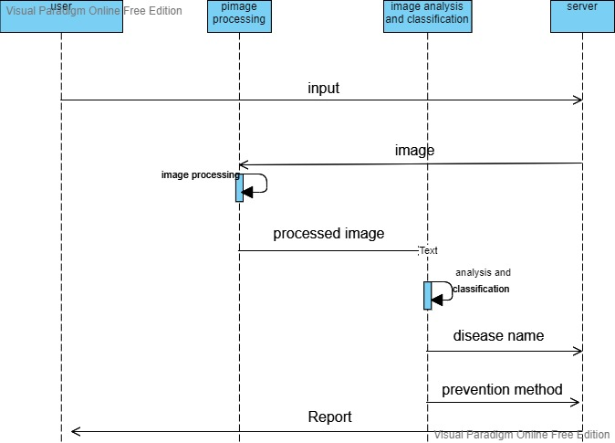
System Design(Contd..)
A sequence diagram or system sequence diagram (SSD) shows object interactions arranged in time sequence in the field of software engineering. It depicts the objects involved in the scenario and the sequence of messages exchanged between the objects needed to carry out the functionality of scenario.
Sequence diagrams are typically associated with use case realizations in the logic view of the system under development. Sequence diagrams are sometimes called event diagrams or event scenarios.
Figure Sequence Diagram

Slide 20
DATASET CLASSIFICATION:
Dataset Classification Selection of proper set of images for training of model is a significant task. Centroid of each image is calculated to retrieve select images. Centroid can be calculated by use of contours. Contour is a curve that joins all the points along the periphery of a shape. Contours can much be detected much precisely on binary images. Hence, every image has to be converted to grayscale with a threshold applied on it. ‗find Contours‘ function can be use for this purpose. Three arguments provided to this function are Source image, contour retrieval mode and contour approximation method. Output of the function contains the images, contours and hierarchy. Output contains all contours in the image. Every contour is array of (x,y) coordinates of boundary points. Moments return a dictionary of all moment values. From this moments one can extract data such as centroid, area, etc. As we only need centroid of the image, it is given by the relations,
Cx = (M[―m10‖]/M[―m00‖])
Cy = (M["m01"] / M["m00"])
here, M is the dictionary of moments.
After calculating the centroid of each image using the above method, we set a definite range for (x, y) coordinates after overlooking all the centroids. The images falling between the range are selected for further processing.

Slide 21
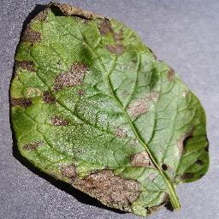
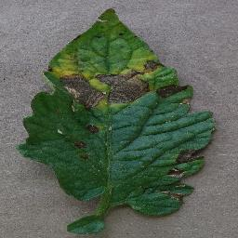
Figure : Potato Early Blight Figure: Pepper Bacterial spot
Data Analysis The dataset that is used in this proposed system project is the Plant Village dataset and it was downloaded from the Kaggle website; the dataset consisted of images of diseased and healthy plant leaf images.

Slide 22
TRAINING & TESTING
Training of CNN was performed using a Python library called Keras with Tensorflow backend , which is a deep learning framework. After a successful training of the CNN, the feature extraction layers (from Conv1 to global-average-pooling layer, Figure were optimized to capture specific features from the image for the diagnosis of the plant disease.
The trained model is tested on a set of images. Random images are introduced to the network and output label is compared to the original known label of the image. Parameters used for evaluation are F1 score, precision and recall. Precision is the proportion of predicted positives that are truly positives. Recall gives the proportion of actual positives correctively classified. F1 score helps in maintaining a balance between precision and recall. Evidences for needs of such innovations are event from GBD surveys. A number of studies on related aspects have been reported by different authors.

Slide 23
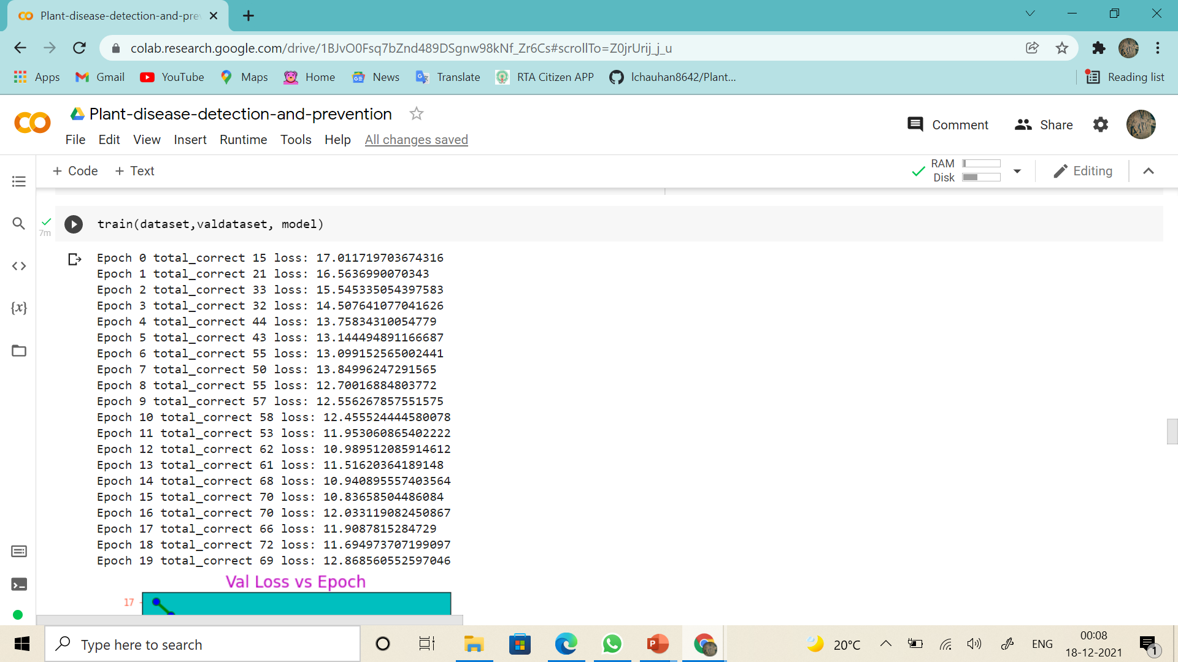
TRAINING:

Slide 24
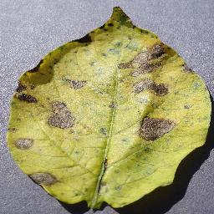
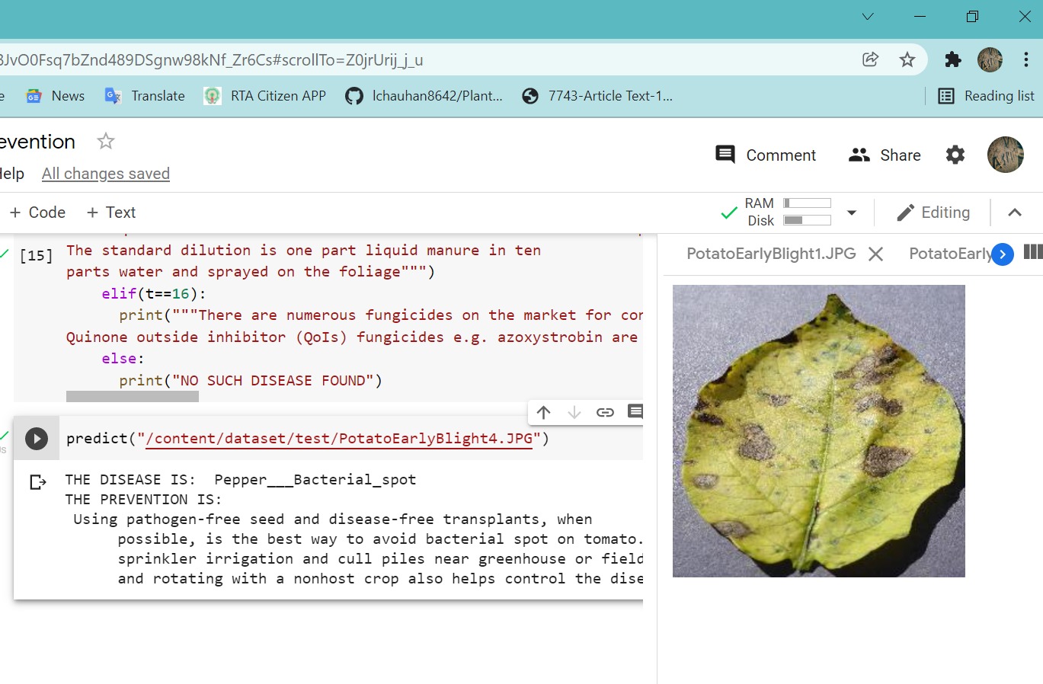
TESTING :
Input :
Output:
Figure 11: Input 1

Slide 25
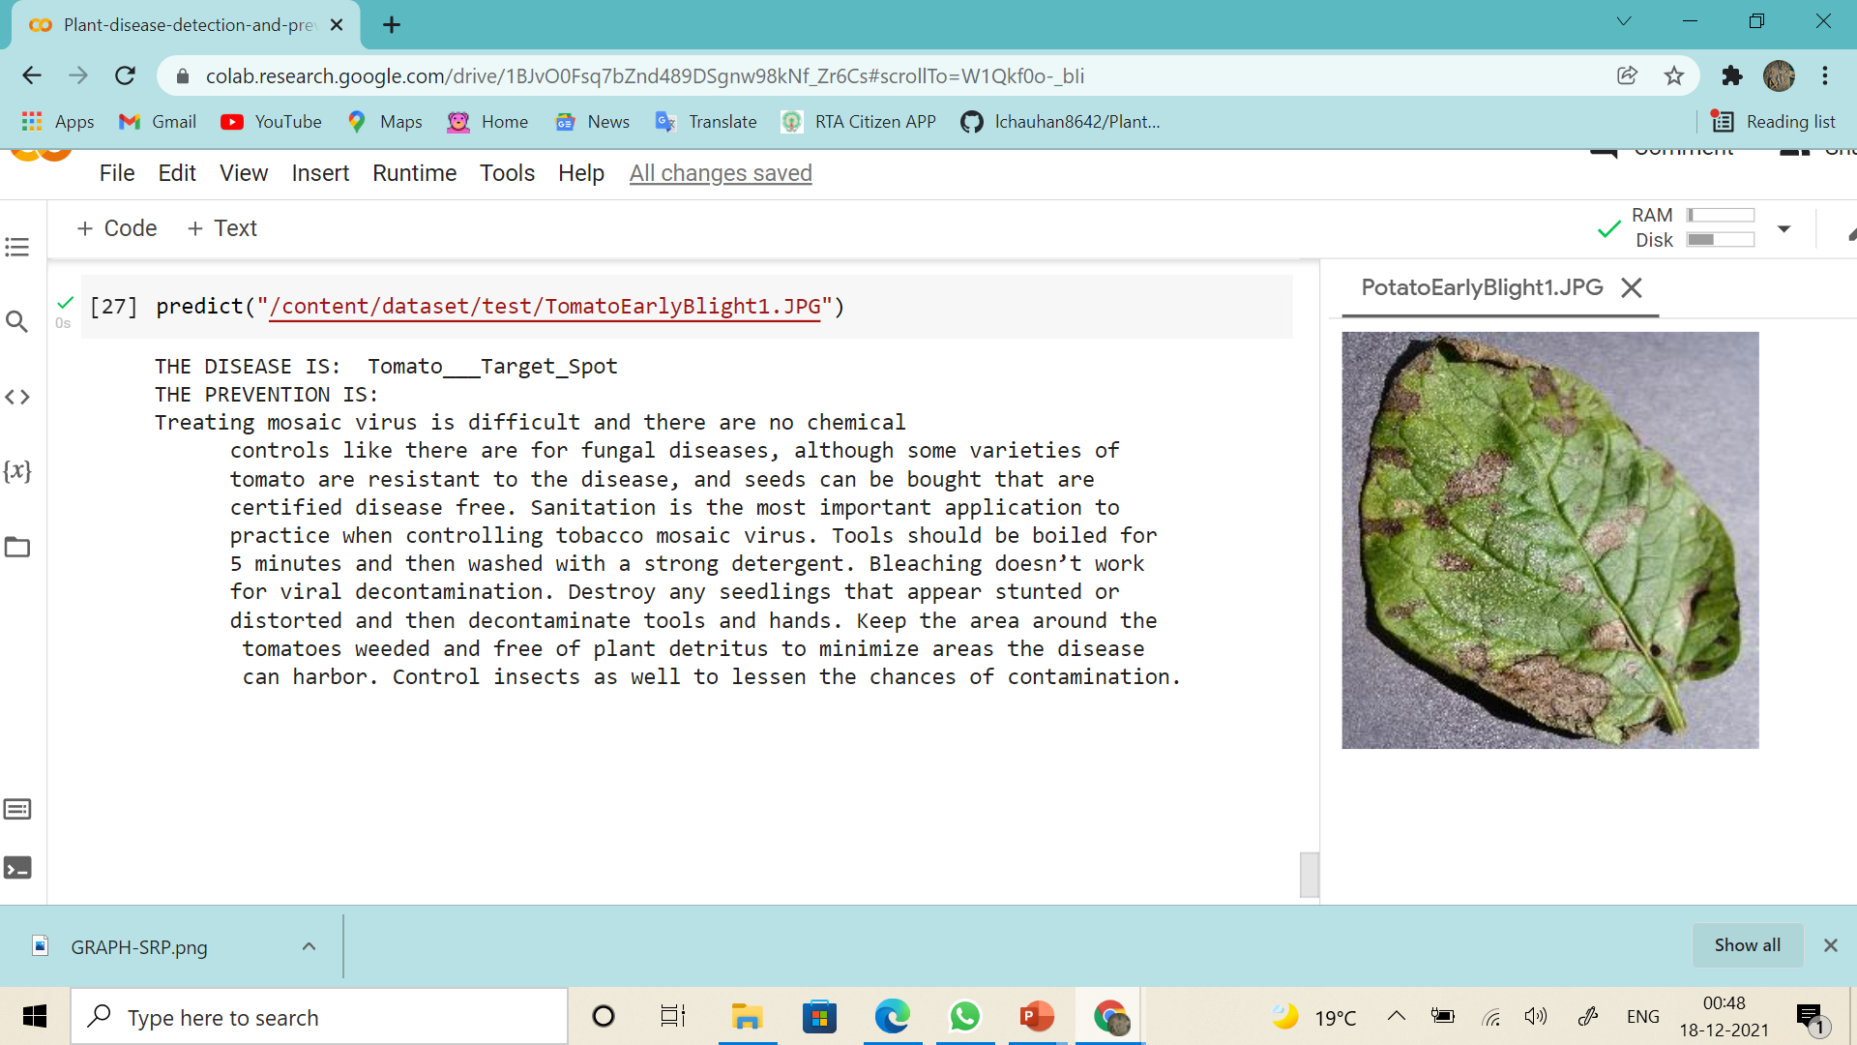
RESULT:
This system classifies and trains the dataset and thus will predict the disease of the plant with the given leaf picture as input.
This will also suggest methods for reducing the disease in early stage.

Slide 26
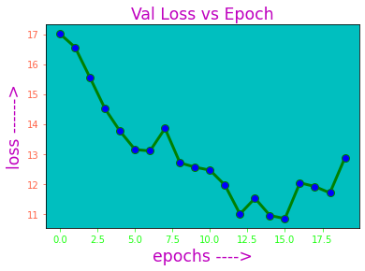
RESULT:
The graph shown here depicts showing training accuracy vs testing accuracy. The accuracy achieved is around 94.8%.

Slide 27
CONCLUSION:
A large part of the Indian population relies on agriculture, hence it becomes very essential to detect and recognize the leaf diseases that results in losses, since agriculture is critical to the growth of the economy. This project based on deep learning approach called CNN is utilized to build 13 different plant leaf disease identification, detection and recognition system. This approach utilized a minimum set of layers to identify the diseases of seven classes. The neural network is trained with Plant Village dataset. A Graphical User Interface is designed for this system. This GUI permits the user to choose the images from the dataset. User can select any image from the dataset and the image gets loaded, following which the prediction of the disease will be shown on the User Interface. Convolutional neural network, trained for identifying and recognizing the plant leaf disease, could classify and predict the diseases correctly for almost all the images with few anomalies thus and obtained 94.8% accuracy.

Slide 28
REFERENCES:
Sammy V. Militante, Bobby D. Gerardo, Nanette V. Dionisio, “Plant Leaf Detection and Disease Recognition using Deep Learning” Proceeding of the IEEE Eurasia Conference on IOT, Communication and Engineering (ECICE), Yunlin, Taiwan, 2019, pp 579-582
Ch. Usha Kumari, S. Jeevan Prasad, G. Mounika, “Leaf Disease Detection: Feature Extraction with K-means clustering and Classification with ANN “Proceedings of the 3rd International Conference on Computing Methodologies and Communication (ICCMC)”, Erode, India, 2019, pp 1095-1098
Mercelin Francis, C. Deisy, “Disease Detection and Classification in Agricultural Plants Using Convolutional Neural Networks — A Visual Understanding”, Proceeding of the 6 th International Conference on Signal processing and Integrated network, Noida, India, 2019, pp 1063-1068.
Jiayue Zhao, Jianhua Qu, “A Detection Method for Tomato Fruit Common Physiological Diseases Based on YOLOv2 “Proceeding of the 10th International Conference on Information Technology in Medicine and Education”, Qingdao, China, China, 2019

Slide 29
REFERENCES:
Halil Durmus, Ece Olcay Gunes, “Disease detection on the leaves of the tomatoplants by using deep learning” Proceeding of the 6 th International Conference oftheAgro-Geoinformatics, 2016, Fairfax, VA, USA
H. Sabrol , K. Satish, “Tomato plant disease classification in digital images using classification tree” Proceeding of the International conference on communication and signal processing, Melmaruvathur, India, 2016 pp 1242-1246
Usama Mokhtar, Mona A.S. Ali, Hesham Henfy, “Tomato leaves diseases detection approach based on support vector machines” Proceeding of the 11th International Computer Engineering Conference, Cairo, Egypt, 2015 pp 246-250
Suma V.R Amog Shetty, Rishab F Tated, Sunku Rohan, Triveni S Pujar, “CNNbased Leaf Disease Identification and Remedy Recommendation System “, Proceedings of the Third International Conference on Electronics Communication and Aerospace Technology, Coimbatore, India, 2019 pp 395-399

Slide 30


