Slide 1
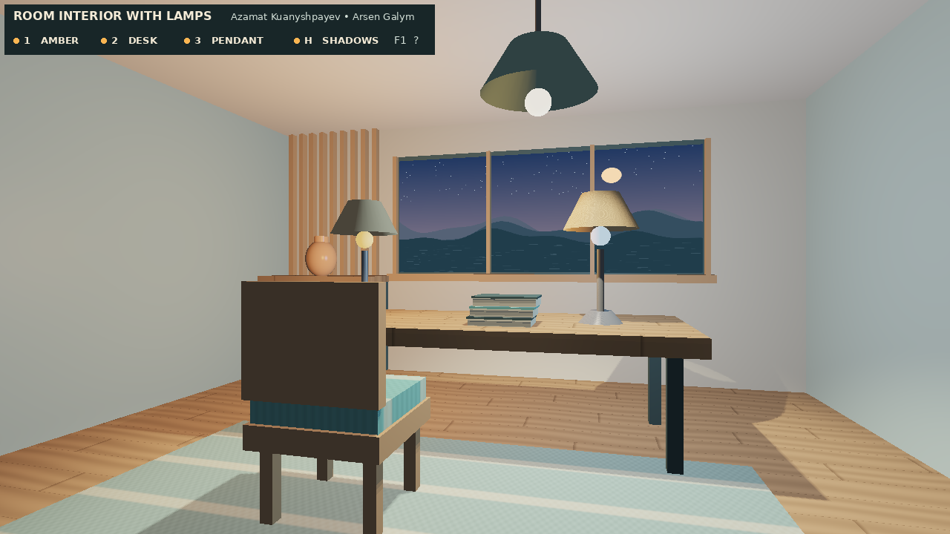
Topic 16 / Computer Graphics Fundamentals
Room interior with lamps
Azamat Kuanyshpayev · IT-2514
Arsen Galym · IT-2510
Notes:
Azamat • 45 seconds. Open the final executable on the reset view. Identify the two desk fixtures and overhead pendant on screen. Point out that the window stays visible when the lamps go dark. Our question is how to tell which source lights which surface. Hand off the walkthrough to Arsen.

Slide 2
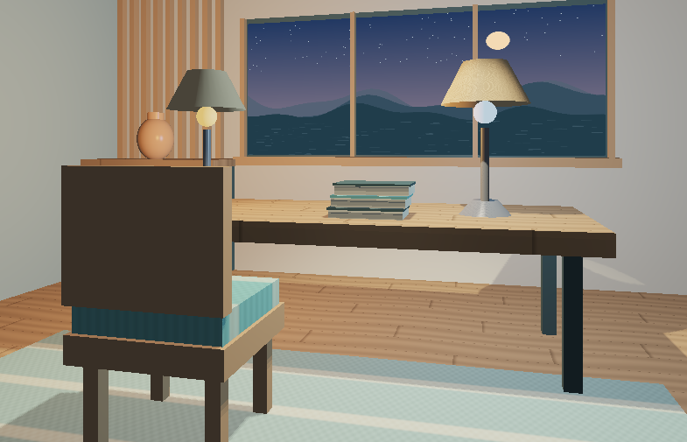
Arsen / Scene and interaction
From two lamps to a furnished study
Indexed primitives form the desk, reading chair, books and cabinet.
Wood grain and woven bands use world coordinates. The window samples a project-authored dusk image.
Notes:
Arsen • 60 seconds. Name one reused midterm feature: the procedural cube or camera class. Explain how a desk leg uses a scaled cube, and why its normal must be transformed correctly. Walk sideways around the chair, then show that the desk blocks forward travel. Scroll once to zoom. R resets the view.

Slide 3
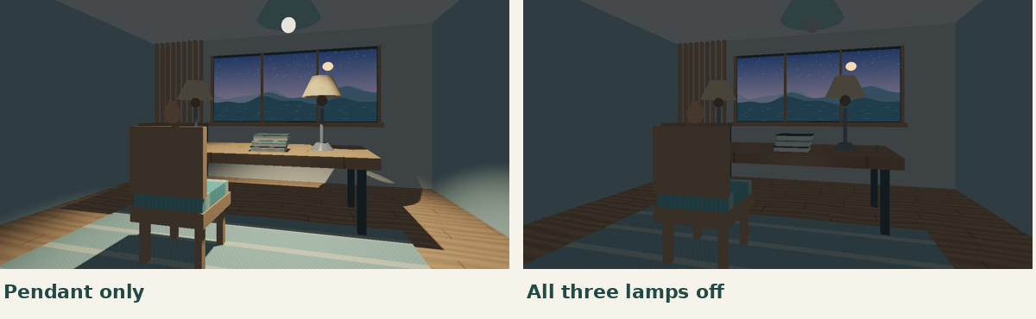
Azamat / Lighting
Three fixtures, three distinct effects
1 Amber desk light 2 Cool desk light 3 Shadow-casting pendant Switching each fixture changes both its bulb and its light contribution.
Notes:
Azamat • 60 seconds. Demonstrate 1, 2 and 3 separately. Describe diffuse response as the normal-light dot product and the Phong highlight as a power of the reflected light vector dotted with the eye vector. Use the ceramic vase as an example of a narrow highlight. The darker capture retains ambient light and a visible dusk window.

Slide 4
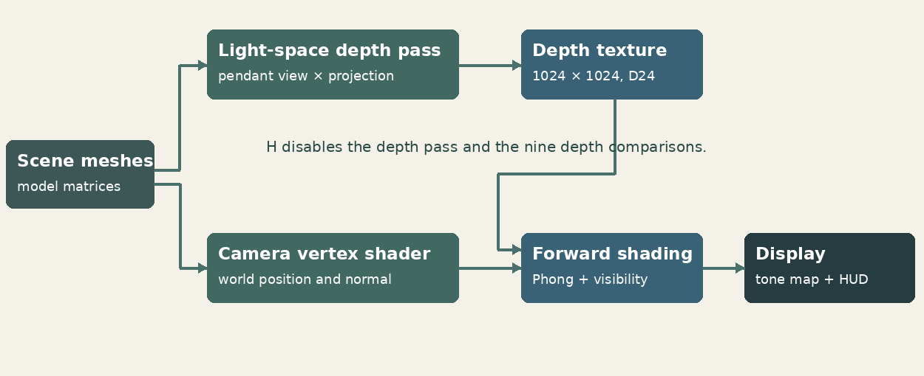
Azamat / Renderer
How the pendant casts a shadow
The first pass stores the nearest depth from the pendant. The second compares each visible surface with nine nearby samples.
Notes:
Azamat • 75 seconds. Follow both paths in the diagram. The same mesh transform must be used for the depth pass and camera pass. Describe projection into the map, division by w and conversion into texture coordinates. A depth comparison answers whether a surface is behind a blocker. Nine tap results are averaged. The bias prevents a surface from shadowing itself. Move the pendant live with J or L.

Slide 5
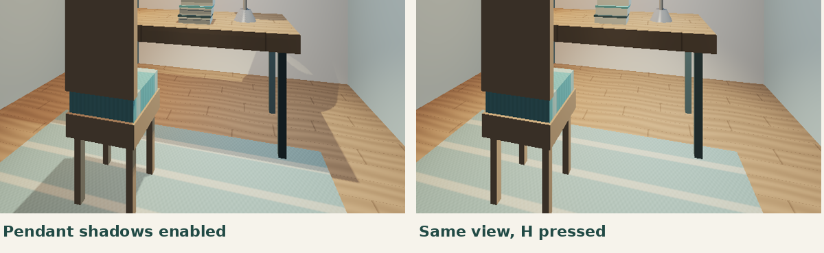
Arsen / Controlled comparison
What changes when H is pressed?
Watch the floor beneath the desk. H removes only pendant visibility. The lamp, camera and exposure stay fixed.
Notes:
Arsen • 55 seconds. Press R, then switch off the two desk lamps. Point to the table occlusion on the rug. Press H twice. The pendant still lights the floor, but when the map is bypassed the furniture stops blocking that contribution. Explain why the two side lamps can fill a pendant shadow even with shadow mapping enabled.

Slide 6
Both / Evaluation
The cost of the shadow map
80.3 FPS shadows on
101.9 FPS shadows off
The depth pass and filtering added 2.64 ms per frame in these runs.
1280 × 720
Mesa llvmpipe
80 timed frames per mode
15 warm-up frames
Notes:
Arsen • 50 seconds. Describe the test conditions: Mesa llvmpipe software OpenGL, 1280 × 720, 15 warm-up frames, then 80 timed with completion synchronization. Results include the scene, depth test, and status overlay. No video capture during benchmark. These numbers characterize the test environment; repeat on the lab GPU.

Slide 7
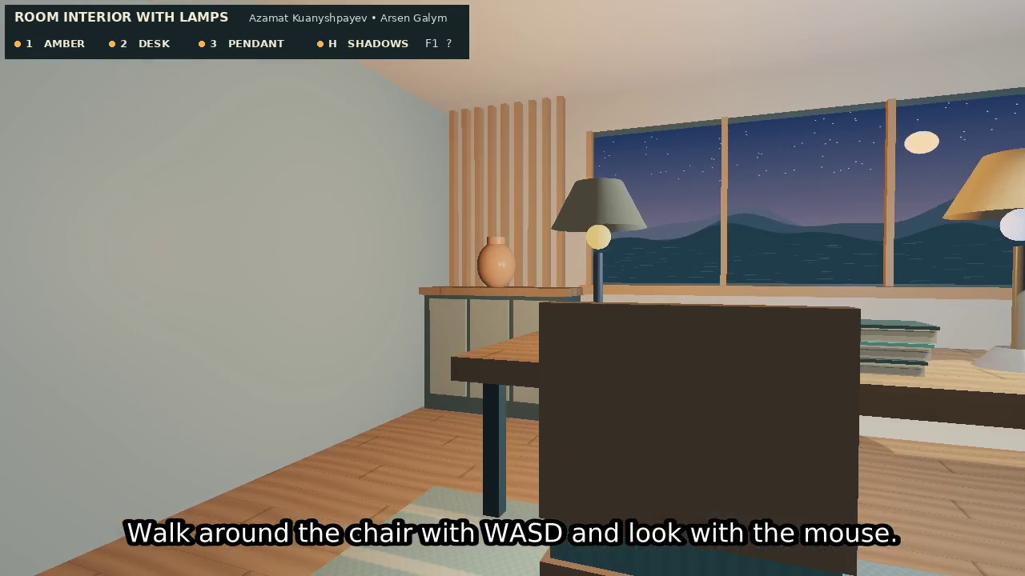
Both / Defence
Live walkthrough
R restore the scene
1, 2 isolate the pendant
H compare shadows
J / L move the pendant
Space start or pause its sweep
− / = adjust exposure
Notes:
Both • 60–75 seconds. Arsen navigates, Azamat explains visibility. Finish by returning to the initial state. Questions to prepare: Why skip the emitter in its own map? What does a larger bias do? Why do the desk lamps still illuminate the shadow? What changes if map resolution doubles? Each teammate should be ready to change one shader constant and explain the result.

