Slide 1

Endangered Species
Presentation subtitle

Slide 2
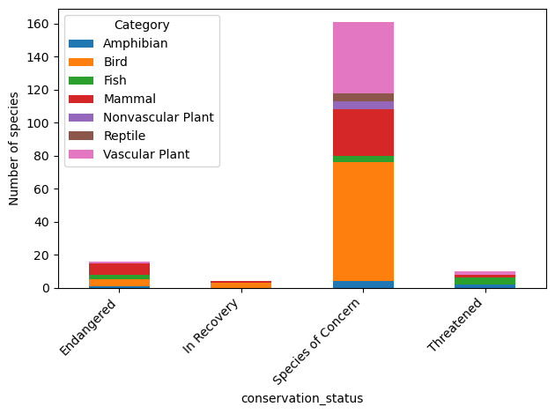
Conservation Status of Species by Type of Animal

Slide 3
Recommendations: Species of concern
Many species of concern
Prevent from becoming endangered

Slide 4
Recommendations: Endangered
Keep in safeplaces
Help to Breed

