Slide 1


SecureECU TEE
Hardware-Isolated Forensic Logging
for Automotive ECUs
A zero-BOM-cost Trusted Execution Environment for tamper-evident
cybersecurity event recording on ARM Cortex-M33 TrustZone
Presented to
TATA MOTORS LIMITED
Surajprakash Narwariya
Indian Institute of Technology Delhi

Slide 2
THE PROBLEM
The Problem: Scale, Mandates & Liability
The Threat Landscape
Business and Liability Risk
The Critical Gap
• Hyper-Connected ECUs:
70–150 ECUs and 100K+ lines of code
create an impossibly large attack
surface.
• "Assume Breach" Reality:
Hackers routinely gain root access via
infotainment or cellular exploits.
• Warranty & Odometer Fraud:
Erasing DTCs and rolling back
odometers costs OEMs millions
annually.
• Accident Forensics:
Without immutable logs, OEMs
cannot prove software innocence in a
crash.
• Traditional Logs are Useless:
When ECUs use software-based
logging running on the main operating
system.
• The Fatal Flaw:
If an attacker compromises the OS,
they immediately delete or alter the
logs.
The gap: If an attacker compromises the ECU's firmware, they control the logger. Current ECUs have no hardware-isolated tamper-proof logging.
TML SecureECU TEE | Indian Institute of Technology Delhi
2

Slide 3

EXISTING APPROACHES
Traditional approaches for automotive logging
Approach
Mechanism
Fatal weakness
Verdict
Software-only logger
Log file on same OS
Same privilege level
Attacker with root access deletes,
modifies, or forges all log entries
ZERO TAMPER
RESISTANCE
External HSM /
Separate logger ECU
Dedicated security chip
or second microcontroller
Added BOM cost ($5–15/unit),
extra wiring, latency, limited flexibility
$5–15 ADDED
BOM COST
Centralized Security Gateway
A gateway only monitors network traffic (CAN/Ethernet)
Blind to Application-Layer attacks,It cannot see the internal state
FAILS APPLICATION ATTACKS
Root cause: The logger operates at the same privilege level as the attacker. Any software compromise gives full control over the logging mechanism.
Our approach: Hardware-level isolation using the CPU's built-in TrustZone — zero BOM cost, survives full OS compromise, works offline, real-time.
TML SecureECU TEE | Indian Institute of Technology Delhi
3

Slide 4
CONCEPTUAL FOUNDATION
What is a Trusted Execution Environment (TEE)?
A TEE is a protected area inside the main processor that guarantees three properties — even if the main OS is fully compromised.
Confidentiality
Integrity
Attestation
Secure code and data are
hidden from the Normal World.
NS cannot read Secure memory.
NS cannot modify Secure
memory or registers.
Any attempt → hardware fault.
Secure World can prove its
identity via cryptographic
signatures (keyed HMAC).
Software isolation vs. hardware isolation:
SOFTWARE ISOLATION (e.g., OS process)
HARDWARE ISOLATION (TrustZone TEE)
The OS enforces boundaries.
If the OS is compromised, ALL boundaries collapse.
The attacker IS the referee.
The silicon enforces boundaries.
Compromising the OS gives ZERO access to Secure World.
The referee is built into the transistors.
TML SecureECU TEE | Indian Institute of Technology Delhi
4

Slide 5

THE SOLUTION
Hardware-isolated logging on a single chip
ARM Cortex-M33 TrustZone splits one CPU into two hardware-isolated worlds. The Secure World acts as a tamper-evident flight recorder that the Normal World cannot read, modify, or disable.
SECURE WORLD
NON-SECURE WORLD
Forensic ring buffer (Secure SRAM)
ECU application logic
Blockchain hash chain + HMAC signatures
NSC
Gateway
Sensor data processing
5-stage NSC validation pipeline
Actuator / motor control
SG instruction
CMSE validated
6 entry points
CAN bus security gatekeeper
CAN TX requests (via gateway only)
NS liveness watchdog (heartbeat)
Diagnostic service handlers (UDS)
HW SHA-256 accelerator
User interface / LED indicators
BOM cost
$0
Uses existing CPU silicon
Log entry cost
4 µs
Per secure event
TZ switch
19 cycles
76 ns @ 250 MHz
Memory
8 KB
Total Secure SRAM
TML SecureECU TEE | Indian Institute of Technology Delhi
5

Slide 6
ARCHITECTURE RATIONALE
Why ARM Cortex-M33 — not Cortex-A — for ECU security
Cortex-A (phones, servers)
Cortex-M33 (automotive ECU)
Target use
Application processing
Real-time embedded control
Clock speed
1–3 GHz
Up to 250 MHz
Memory model
MMU + virtual memory
MPU — flat physical memory
OS requirement
Linux / Android / RTOS
Bare-metal or lightweight RTOS
SMC → EL3 monitor (~1200 cycles)
SG instruction → branch (~19 cyc)
TrustZone switch
SG instruction → branch (~19 cycles)
TEE software
OP-TEE: 256 KB – 4 MB
None required (8 KB total)
Power
Watts
Milliwatts
BOM for security
Separate secure module
Built into existing CPU ($0)
Determinism
Non-deterministic (OS jitter)
Deterministic (real-time safe)
63× faster TZ switching • 30–500× smaller memory footprint • Zero BOM cost • Real-time deterministic
Sources: ARM Cortex-M33 TRM (DDI0553B), ARM Cortex-A53 TRM (DDI0500J), OP-TEE documentation
TML SecureECU TEE | Indian Institute of Technology Delhi
6

Slide 7
PROCESSOR ARCHITECTURE
ARM Cortex-M33 — security-relevant block diagram
ARM Cortex-M33 Core (ARMv8-M Mainline) @ 250 MHz
3-stage pipeline
Fetch → Decode → Execute
1.5 DMIPS/MHz
FPU (SP)
+ DSP
MAC instructions
DWT
Cycle counter
8 watchpoints
Debug
SWD/JTAG
8 breakpoints
I-Cache
16 KB
1-way
SECURE STATE
NON-SECURE STATE
SAU (8 regions)
Security Attribution
MPU_S (8 regions)
Secure Memory Protection
IDAU (fixed by ST)
Chip-level attribution
MPU_NS (8 regions)
NS Memory Protection
SysTick_S
Secure timer (banked)
NVIC_S
Secure interrupts (banked)
TZ
boundary
SysTick_NS
NS timer (banked)
NVIC_NS
NS interrupts (banked)
MSP_S / PSP_S
Secure stacks
CONTROL_S / PRIMASK_S
Secure control regs
MSP_NS / PSP_NS
NS stacks
CONTROL_NS / PRIMASK_NS
NS control regs
TML SecureECU TEE | Indian Institute of Technology Delhi
7

Slide 8
CONCEPTUAL FOUNDATION
How TrustZone-M enforces hardware isolation
Every memory address has a security attribute checked on every access — enforced by silicon, not software.
SAU
Security Attribution Unit
IDAU
Implementation Defined
Attribution Unit
GTZC
Global TrustZone Controller
8 programmable regions. We define which memory is Secure, Non-Secure, or Non-Secure Callable. Unconfigured addresses default to Secure.
Fixed by ST at chip fabrication. Defines the base memory map — Bank 1 (0x08000000) is Secure flash, Bank 2 (0x08100000) is NS flash.
TZSC: assigns each peripheral as S or NS. Memory Protection Control Block Based: per-256-byte SRAM block security attribution.
Configured at boot by Secure firmware
Cannot be changed by any software
ST-specific, extends ARM TrustZone
NS code reads Secure memory → SecureFault (hardware trap) | NS code accesses Secure peripheral → Bus fault (GTZC)
TML SecureECU TEE | Indian Institute of Technology Delhi
8

Slide 9
CONCEPTUAL FOUNDATION
TrustZone state transitions: SG instruction & register scrub
NS Code
NSC Region
Secure Function
BXNS Return
Calls function
from veneer library
SG instruction
executes (1 cycle)
Validation + logging
(full Secure access)
Registers scrubbed
LR = FNC_RETURN
What the hardware guarantees at each transition:
NS → S (entry)
~6 cycles
SG validates NSC region • Branch to Secure code • Stack pointer banks to MSP_S
S → NS (return)
~13 cycles
All S registers cleared (prevent leakage) • LR set to FNC_RETURN (hide S addresses) • SP banks to MSP_NS
Round-trip total
~19 cycles = 76 ns
63× faster than Cortex-A SMC monitor call (1,200 cycles) • No software monitor required
Source: ARM Cortex-M33 TRM (DDI0553B) §11.3 — Security state transitions
TML SecureECU TEE | Indian Institute of Technology Delhi
9

Slide 10
CONCEPTUAL FOUNDATION
Banked registers — two truly independent worlds
ARM Cortex-M33 duplicates critical system registers. Each world has its own hardware instance — not shared, not permission-gated, physically separate.
Register
Secure instance
NS instance
Why this matters
MSP (Main Stack Pointer)
MSP_S
MSP_NS
NS stack overflow cannot corrupt Secure stack
PSP (Process Stack Pointer)
PSP_S
PSP_NS
Independent thread-mode stacks
SysTick timer
SysTick_S
SysTick_NS
Secure heartbeat check runs even if NS crashes
NVIC (Interrupt controller)
NVIC_S
NVIC_NS
NS cannot mask or reprioritize Secure interrupts
MPU (Memory protection)
MPU_S
MPU_NS
Independent memory region configuration
CONTROL register
CONTROL_S
CONTROL_NS
Independent privilege level per world
FAULTMASK / PRIMASK
PRIMASK_S
PRIMASK_NS
NS cannot disable Secure fault handlers
Key insight: When NS crashes, Secure SysTick keeps ticking, Secure NVIC keeps prioritizing, Secure MSP keeps its stack intact. The Secure World is operationally independent — not just permission-separated.
TML SecureECU TEE | Indian Institute of Technology Delhi
10

Slide 11
MEMORY ARCHITECTURE
STM32H573 TrustZone memory map
FLASH (2 MB)
SRAM (640 KB)
PERIPHERALS
0x08000000
0x30000000
USART1
Secure + Priv
SRAM1 (256 KB)
Secure
Ring buffer
Block history
Metrics
Secure Flash
(Bank 1 — 1 MB)
Secure firmware
+ NSC veneers
HASH
Secure + NPriv
FDCAN1
Secure + Priv
0x30040000
SRAM2 (64 KB)
Secure
Secure stack
0x0FFF8000
NSC Region
(veneer table)
SysTick_S
Secure (banked)
SG entry points
0x30050000
GPIO I (LEDs)
Non-Secure
0x08100000
SRAM3 (320 KB)
Non-Secure
NS application
data + stack
GPIO C (button)
Non-Secure
Non-Secure Flash
(Bank 2 — 1 MB)
NS application
(hashed at boot)
SysTick_NS
Non-Secure (banked)
Secure
Non-Secure
Non-Secure Callable
Enforced by: SAU (8 regions) + IDAU (fixed by ST) + GTZC TZSC (peripherals) + MPCBB (SRAM 256B blocks)
TML SecureECU TEE | Indian Institute of Technology Delhi
11

Slide 12
SYSTEM ARCHITECTURE
End-to-end data flow — sensor to forensic log
SECURE WORLD
NON-SECURE WORLD
UART RX ISR
(sensor input)
SPI6_IRQ
notify NS
UART TX output
(forensic stream)
SPI6 IRQ Handler
read sensor value
Ground truth
log + timestamp
Ring buffer
push (32 bytes)
SHA-256 hash chain
+ block signature
Actuator logic
(duty cycle calc)
NSC Gateway
(5-stage validation)
CommitActuation()
via NSC gateway
NSC call
SysTick watchdog
(500ms check)
Heartbeat()
NSC call
per NSC gateway call
TML SecureECU TEE | Indian Institute of Technology Delhi
12

Slide 13
TRUST ARCHITECTURE
Three-tier trust model: every log entry is attributed
A forensic analyst can reconstruct what the hardware actually observed vs. what the software claimed.
GROUND_TRUTH
Hardware-originated events
49% of events in test run (51 of 105)
Generated by Secure World ISRs or hardware peripherals. Cannot be faked by NS. Always accepted — never dropped even under buffer pressure.
Sensor capture, CAN RX, fault handlers, boot events, heartbeat failure, anomaly detection
CLAIM
NS-originated events (unverified assertions)
35% of events
(37 of 105)
Submitted by Normal World via NSC gateway. Passes 5-stage validation but content is a claim, not ground truth. May be summarized under buffer pressure.
Actuator commands, CAN TX requests, odometer reports, DTC set/clear, UDS diagnostic requests
META
Security alerts (Secure World detection)
16% of events
(17 of 105)
Generated when the validation pipeline detects suspicious activity. Every rejected or blocked action creates a META event — the attack itself becomes evidence.
Rate limit hit, pointer forgery, CAN injection blocked, odometer rollback, DTC suspicious clear
Every event is stamped with: sequence number (monotonic) + Secure timestamp + source ID + trust level
TML SecureECU TEE | Indian Institute of Technology Delhi
13

Slide 14
DATA STRUCTURE
LogEntry_Internal_t — 32-byte packed struct
Every log entry is exactly 32 bytes — one cache line. Packed with __attribute__((packed)) for zero padding waste.
source
reserved
0
1
2
3
4
5
6
7
8
9
10
11
12
13
14
15
16
17
18
19
20
21
22
23
24
25
26
27
28
29
30
31
sequence_number
secure_timestamp
payload
4B
4B
1B
1B
1B
1B
20B
event_type
trust_level
Field details:
Field
Type
Bytes
Offset
Description
sequence_number
uint32_t
4
0
Monotonic counter, Secure-set. Gaps = evidence.
secure_timestamp
uint32_t
4
4
HAL_GetTick() at entry creation. Secure SysTick.
event_type
uint8_t
1
8
0x01–0x0F = Cat-A (GT), 0x10–0x1F = Cat-B (CL), 0xF0+ = META
source
uint8_t
1
9
SRC_HARDWARE_ISR / SRC_NS_GATEWAY / SRC_SECURE_INTERNAL / SRC_CAN
trust_level
uint8_t
1
10
TRUST_GROUND_TRUTH (0x01) / TRUST_CLAIM (0x02) / TRUST_META (0x03)
reserved
uint8_t
1
11
Alignment padding (always 0x00)
payload
uint8_t[20]
20
12
Event-specific data: "THR=45%", "ID=400 D=32", "PC=08001234", etc.
TOTAL
32 bytes — exactly one cache line. 128 entries × 32B = 4,096 bytes ring buffer.
TML SecureECU TEE | Indian Institute of Technology Delhi
14

Slide 15
DATA STRUCTURE
Circular ring buffer — 128 entries in Secure SRAM
Logical view (linear representation of circular buffer):
0
64
96
127
TAIL
(read)
HEAD
(write)
Normal zone (0–95)
All event types accepted.
GROUND_TRUTH, CLAIM, and META events are pushed normally. Rate limiter prevents NS flooding.
Degraded zone (96–127)
CLAIM and META events are summarized into a single META_SUMMARY entry.
GROUND_TRUTH events ALWAYS accepted — bypass degradation.
Full (128/128) — GT override
If a GT event arrives and buffer is full, the oldest entry is force-evicted.
GT loss probability = 0%. Architecturally impossible.
Recovery: when buffer drops below 50% (64 entries), full logging resumes automatically + BUFFER_RECOVERED event logged.
TML SecureECU TEE | Indian Institute of Technology Delhi
15

Slide 16
SECURITY ARCHITECTURE
NSC gateway: 5-stage validation pipeline
Every NS event passes through 5 hardware + software checks before entering the Secure log. Total cost: 885 cycles (3.54 µs).
1
CMSE pointer check
129
cmse_check_address_range() — verifies NS pointer is actually in NS memory
Pointer forgery
2
Rate limiter
82
Token bucket: max 25 events/sec from NS (5 tokens, 200ms refill)
Flood / DoS
3
Event type whitelist
43
NS can only submit types 0x10–0x50 (Category B). Cannot claim to be hardware.
Category-A spoofing
4
Secure timestamp
~30
Secure SysTick overrides any NS-provided timestamp. Banked — NS cannot touch.
Time manipulation
5
Source tagging
631
Every entry stamped: SRC_NS_GATEWAY + TRUST_CLAIM. Includes ring buffer push.
Trust escalation
Total: 885 cycles = 3.54 µs | 5 attack classes blocked | Cost per attack class: ~177 cycles (0.7 µs)
TML SecureECU TEE | Indian Institute of Technology Delhi
16

Slide 17
SECURITY FLOWCHART
NSC validation pipeline — decision flow
NS calls
SecureLog_SubmitEvent()
1. CMSE
pointer check
OK
2. Rate
limiter
OK
3. Event
whitelist
OK
4+5. Timestamp +
source tag + push
META_FORGERY
reject (-1)
META_RATE
reject (-2)
META_INVALID
reject (-3)
Ring buffer
(Secure SRAM)
Measured cycle costs per stage:
CMSE check
129 cycles
14.6%
TryFlush()
hash + sign + output
Rate limiter
82 cycles
9.3%
Whitelist check
43 cycles
4.9%
Timestamp + tag + push
631 cycles
71.3%
TOTAL
885 cycles
100% = 3.54 µs
Every rejected event creates a META log entry — the attack itself becomes forensic evidence. Attackers cannot probe silently.
TML SecureECU TEE | Indian Institute of Technology Delhi
17

Slide 18
INTEGRITY MECHANISM
Blockchain-style hash chain with keyed signatures
Each flush cycle seals a block. Tampering with any block breaks all subsequent hashes — detectable in O(n).
Block #1
seq 1–4
Block #2
seq 5–8
Block #3
seq 9–12
prev_hash
0000000000...
prev_hash
7B8AE116...
prev_hash
C754AA3E...
block_hash
7B8AE116...
prev_hash
= hash
block_hash
C754AA3E...
prev_hash
= hash
block_hash
DE99DF14...
signature
HMAC(hash||key)
signature
HMAC(hash||key)
signature
HMAC(hash||key)
Forensic properties:
Integrity
SHA-256(prev_hash || entry) — any modification breaks the chain
Collision resistance: 2^128
Authenticity
Signature = SHA-256(hash || secret_key) — only Secure World knows the key
Production: HUK-derived via SAES
Ordering
Monotonic block counter — never resets, even across CLEAR commands
Gaps = evidence of session clear
TML SecureECU TEE | Indian Institute of Technology Delhi
18

Slide 19
INTEGRITY MECHANISM
Block sealing process — inside the hash chain engine
Step 1: Assemble input
prev_hash
(32 bytes)
from last block
||
entry_bytes
(32 bytes)
from ring buffer
= 64 bytes = 1 SHA-256 block (512 bits)
Step 2: Hardware SHA-256
STM32H573 HASH peripheral → SHA-256(prev_hash || entry) → block_hash (32 bytes)
1,902 cycles = 7.6 µs
Step 3: Keyed signature
Step 4: Seal block
block_hash
(32 bytes)
||
secret_key
(32 bytes)
SHA-256 →
signature (32B)
BlockHeader stored:
block_hash + signature + prev_hash + metadata
1,151 cycles = 4.6 µs
Secret key: Prototype = hardcoded 32B. Production = derived from STM32H573 Hardware Unique Key (HUK) via SAES. Unique per physical chip.
TML SecureECU TEE | Indian Institute of Technology Delhi
19

Slide 20
FORENSIC PRINCIPLE
The monotonic property — counters that never go backward
Three independent monotonic counters ensure forensic completeness. Each one proves a different property.
Sequence number
Proves:
Secure World
Completeness — gaps in sequence = evidence of data loss or tampering.
[0001] → [0002] → [0003] → [0105]
Increments on every log entry.
Never resets. NS cannot influence.
Missing 4–104? Chain was cleared — but block counter proves it.
Block counter
Proves:
Secure World
Session tracking — gaps in block numbers = evidence that a session was cleared.
Block #1 → #2 → ... → #26 → CLEAR → #27
Increments on every sealed block.
Survives CLEAR command. Never resets.
Investigator sees #27 follows #26 but seq restarted — clear event detected.
Odometer counter
Proves:
Secure World
Tamper detection — rollback attempts are cryptographically logged.
15000 km → 15500 km → 12000 km (!)
Monotonically increases. Any
new < stored = META_ODO_TAMPER.
Third entry triggers TAMPER alert logged as GROUND_TRUTH.
All three counters are controlled exclusively by Secure World. NS has zero ability to read, set, reset, or influence any of them.
TML SecureECU TEE | Indian Institute of Technology Delhi
20

Slide 21
CAN SECURITY
CAN bus gatekeeper: 4-layer validation in Secure World
FDCAN1 is assigned Secure+Privileged via GTZC. NS cannot directly access the CAN peripheral — every frame goes through Secure World validation.
ID whitelist
13 authorized CAN IDs (UDS, powertrain, chassis, body). Unknown IDs rejected and logged as META_CAN_INJECT_BLOCK.
1
O(n) linear search, n=16 max
Blocks CAN injection
DoS detection
Frame rate counter per 1-second window. Exceeding 100 frames/sec triggers META_CAN_DOS_DETECT alert.
2
Threshold: 100 frames/sec
Blocks bus flooding
Replay detection
Same CAN ID + same data within 50ms window = duplicate. Logged as META_CAN_REPLAY_BLOCK.
3
Blocks replay attacks
memcmp, 50ms window
Plausibility check
Payload range validation — e.g., throttle (ID 0x400) must be 0–100%. Out-of-range values flagged.
4
Blocks invalid data
Per-ID range tables
TML SecureECU TEE | Indian Institute of Technology Delhi
11

Slide 22
CAN SECURITY FLOW
CAN frame validation — 4-stage decision flowchart
CAN frame arrives
(FDCAN1 RX)
Why each check matters
ID whitelist
CAN has no authentication. Any node can send any ID. The whitelist prevents unknown ECUs from injecting frames. 13 IDs authorized (UDS, powertrain, chassis, body).
1. ID Whitelist
13 authorized IDs
BLOCKED
META_CAN_INJECT
DoS detection
pass
An attacker can flood the bus to create denial of service. We count frames per second and alert above 100/s. The alert is logged as GT — cannot be suppressed.
2. DoS check
>100 frames/sec?
BLOCKED
META_CAN_DOS
Replay detection
pass
An attacker records a valid frame and replays it. We compare: same ID + same data within 50ms = duplicate. Temporal detection catches exact replays.
3. Replay check
same data <50ms?
BLOCKED
META_CAN_REPLAY
Plausibility
pass
Even with valid ID and non-duplicate, the data might be impossible. Throttle (ID 0x400) > 100% is physically implausible — flagged but not blocked (may be valid in edge cases).
FLAGGED
META_CAN_PLAUS
4. Plausibility
range check
ACCEPTED → log
as GROUND_TRUTH
pass
TML SecureECU TEE | Indian Institute of Technology Delhi
22

Slide 23


LIVENESS & RECOVERY
Silence attack detection & NS World recovery
Heartbeat liveness detection
NS World forced reset
NS calls SecureLog_Heartbeat() every loop iteration
Secure World can force-restart NS application
Secure SysTick checks flag every 500 ms
Triggered by: RESET_NS UART command
3 consecutive misses = NS_HEARTBEAT_FAIL (GT)
Or programmatically on critical anomaly
Detection time: 3 × 500 ms = 1.5 seconds
NS gets clean restart from 0x08100000
Secure SysTick is banked — NS cannot disable it
Secure World continues running uninterrupted
Verified: [0105] GT !NS_DEAD! NS_SILENT ts=89500
All forensic state survives: ring buffer,
blockchain, statistics, block counter
The NS World can crash, be compromised, or go silent — the Secure World keeps watching and logging.
TML SecureECU TEE | Indian Institute of Technology Delhi
23

Slide 24
AUTOMOTIVE FRAUD DETECTION
Diagnostic, odometer, and warranty fraud detection
UDS diagnostic state machine
Odometer rollback detection
DTC warranty fraud detection
Secure World tracks session state:
Monotonic counter in Secure World
DTC lifecycle tracking with timestamps
DEFAULT → EXTENDED → SEC_REQ → UNLOCKED
New reading < stored value = TAMPER
Set → Clear within 60 seconds =
WriteDataByIdentifier (0x2E) without prior SecurityAccess (0x27) = blocked
Logged as META_ODO_TAMPER (GT)
META_DTC_SUSPICIOUS (GT)
NS cannot reset the counter
No physical repair in <60s is possible
Logged as META_UDS_UNAUTHORIZED
Example: WAS=15000 NOW=12000
Detects warranty claim manipulation
Every session transition = GROUND_TRUTH
Used car market fraud prevention
Example: P0301 SET then CLR in 2s
All three attack types are real-world fraud vectors in the Indian and global used-vehicle market
TML SecureECU TEE | Indian Institute of Technology Delhi
24

Slide 25
EVENT LIFECYCLE
Complete journey of one event — with timing
NS calls
SubmitEvent()
SG + bank
switch
CMSE
ptr check
Rate
limiter
Whitelist
check
Tag +
push
BXNS
return
~6 cyc
24 ns
129 cyc
0.5 µs
82 cyc
0.3 µs
43 cyc
0.2 µs
631 cyc
2.5 µs
~13 cyc
52 ns
Asynchronous flush (triggered after push):
Ring buffer
entry (32B)
Build hash
input (64B)
HW SHA-256
hash
HW SHA-256
signature
Store block
header
UART TX
output
Update
chain head
In SRAM
memcpy
1,902 cyc
7.6 µs
1,151 cyc
4.6 µs
112 bytes
~7.9 ms
(debug only)
32 bytes
End-to-end timing budget:
NSC gateway (NS→S + validation + S→NS)
~1,097 cycles
4.4 µs
Flush: hash + sign
3,053 cycles
12.2 µs
0.05% of flush
Flush: UART output (debug)
~1.97M cycles
7.9 ms
30% — REMOVED in production
Flush: snprintf formatting (debug)
~4.5M cycles
18 ms
69% — REMOVED in production
Production total (no debug)
~4,150 cycles
~16.6 µs
Gateway + hash + sign
TML SecureECU TEE | Indian Institute of Technology Delhi
25

Slide 26
LIVE DEMONSTRATION
10 attack scenarios — each detected, logged, attributed
Each B2 button press triggers the next scenario. Every attack is stopped by a specific security mechanism.
#
Scenario
What happens
Category
1
Normal operation
Baseline — sensor → actuator loop, CAN, odometer
BASELINE
2
Throttle override
Sensor says 10%, NS commands 99% → anomaly detection
ANOMALY
3
Silence attack
NS stops heartbeat → detected in 1.5s by Secure SysTick
LIVENESS
4
Flood attack
Rapid event submission → token bucket rate limiter blocks
RATE LIMIT
5
Forgery attack
NS passes Secure pointer → CMSE check rejects
POINTER
6
CAN injection
Unauthorized CAN ID → whitelist blocks and logs
CAN
7
CAN replay
Duplicate frame within 50 ms → temporal detection
CAN
8
UDS exploit
Write without SecurityAccess → unauthorized, logged
DIAGNOSTIC
9
Odometer fraud
Rollback attempt → monotonic counter catches it
TAMPER
10
DTC manipulation
Clear DTC <60s after set → suspicious pattern flagged
WARRANTY
11
Forensic DUMP
Complete timeline extraction with blockchain chain verification
FORENSIC
26
TML SecureECU TEE | Indian Institute of Technology Delhi

Slide 27
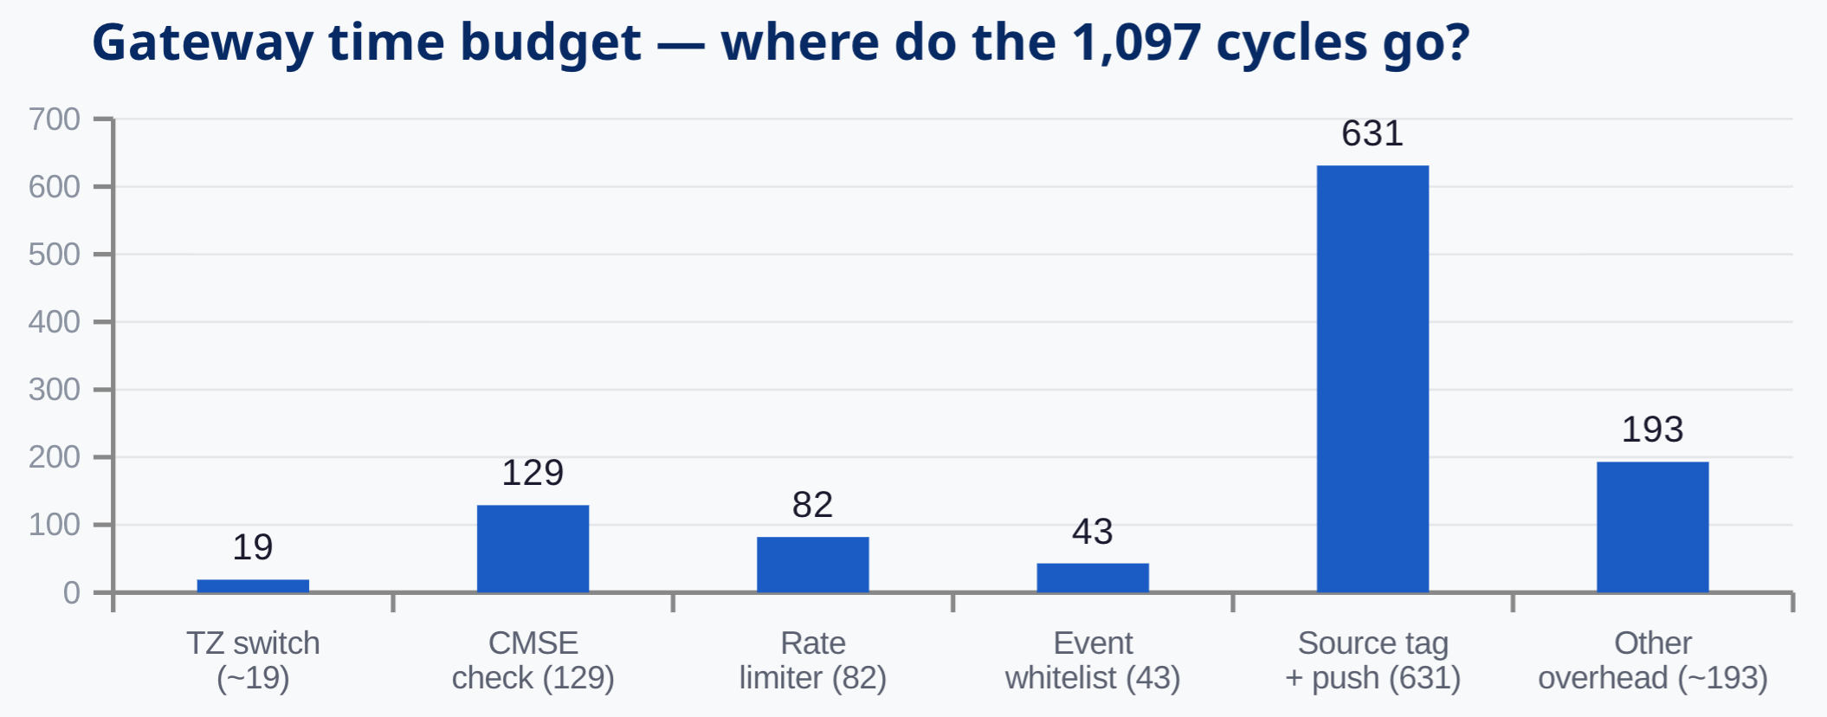
MEASURED PERFORMANCE
NSC gateway latency — measured on hardware
DWT cycle counter @ 250 MHz. Every number below is from a real run on the STM32H573I-DK board.
Typical latency
Best case
TZ switch share
Useful work
1,097
924
1.9%
98.1%
cycles (4.4 µs)
cycles (3.7 µs)
of gateway time
validation + logging
Gateway time budget — where do the 1,097 cycles go?
Context
ECU control loop: 1–10 ms
Our overhead: 4.4 µs = 0.44%
TZ switch: 19 of 1,097 cycles
= Hardware isolation is nearly free
The cost is the security work —
which is exactly where you want cycles spent.
TML SecureECU TEE | Indian Institute of Technology Delhi
27

Slide 28
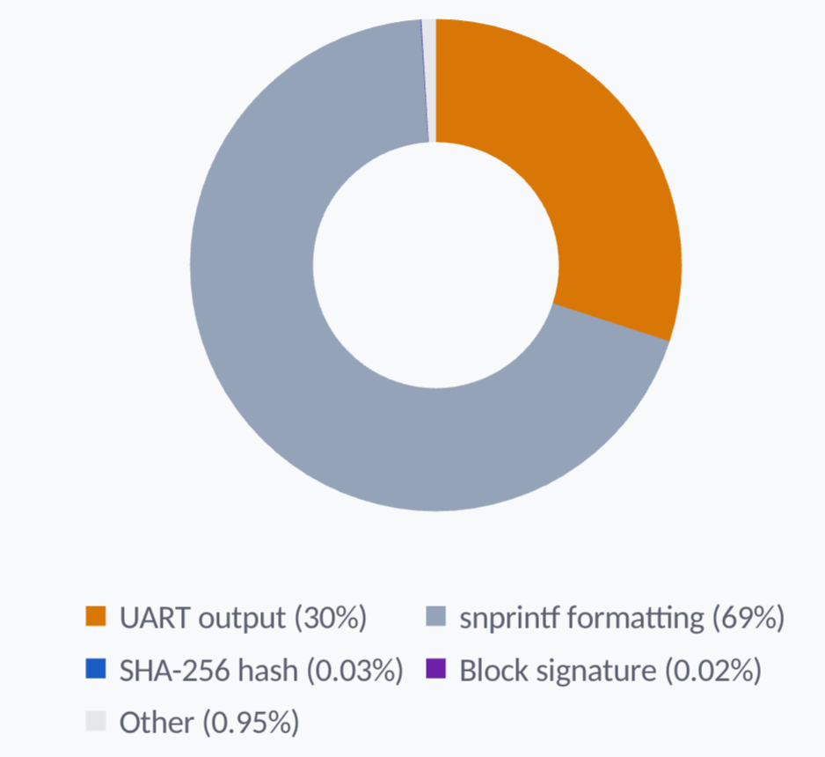
MEASURED PERFORMANCE
Flush cycle breakdown — cryptographic integrity is free
Total flush
SHA-256 hash
6,512,947 cycles
1,902 cyc
0.03%
26 ms (with debug UART)
7.6 µs
Block signature
1,151 cyc
0.02%
4.6 µs
Combined crypto
3,053 cyc
0.05%
12.2 µs total
Production projection (without debug UART):
Remove UART + snprintf = remove 99% of flush time. Production flush: ~3,100 cycles = 12.4 µs per sealed block.
This means full blockchain integrity (hash + sign + chain update) at 80,000+ events/second.
TML SecureECU TEE | Indian Institute of Technology Delhi
28

Slide 29
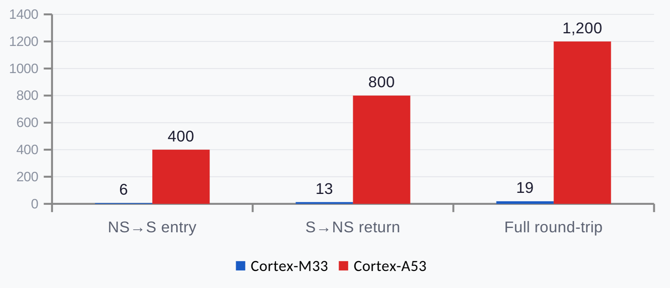
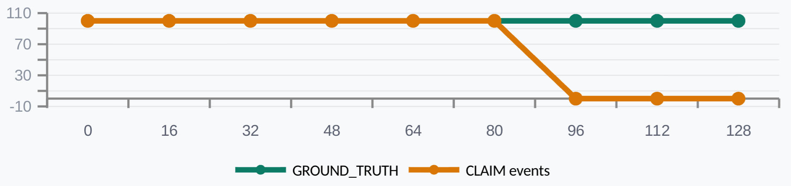
DERIVED ANALYSIS
Mathematically derived metrics — architecture proof points
TrustZone round-trip: Cortex-M33 vs Cortex-A53
Derived from runtime + documentation
TZ speedup
63× faster than Cortex-A
Max throughput
~250K events/sec (gateway)
Sustained throughput
80K+ events/sec (production)
Buffer flood time
0.77 ms (no rate limit)
Buffer flood (limited)
5.12 sec (with rate limit)
Chain verify cost
~0.4 ms per 1000 blocks
Collision resistance
2^128
Buffer occupancy vs. event acceptance rate
Key architectural guarantee
GROUND_TRUTH events have 0% loss probability at any buffer level.
CLAIM events are gracefully summarized above 75% — never silently dropped. The degradation itself is logged.
TML SecureECU TEE | Indian Institute of Technology Delhi
29

Slide 30
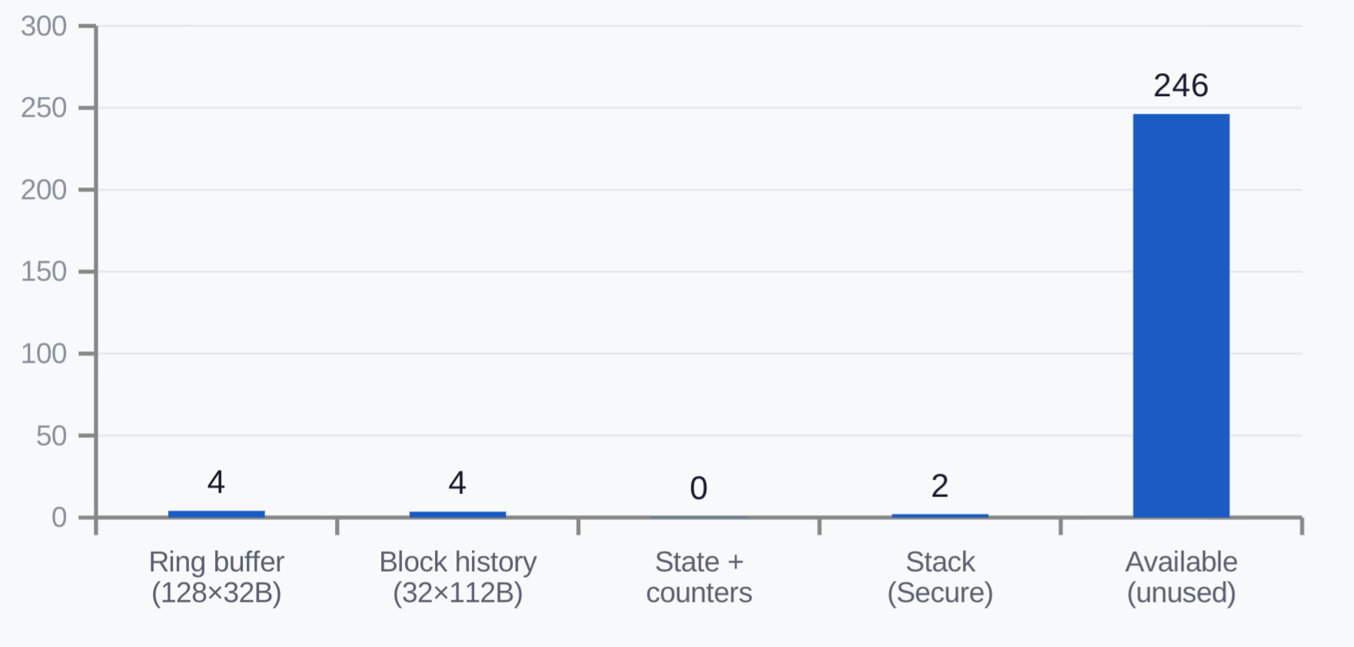
RESOURCE USAGE
Ultra-lightweight TEE — 3% of available resources
Secure SRAM allocation
Secure SRAM used
~8 KB
of 256 KB (3.1%)
Secure Flash used
~20 KB
of 1,024 KB (2.0%)
Log entry size
32 bytes
packed, cache-aligned
Block header
112 bytes
hash + sig + metadata
Comparison: TEE memory footprint
Our TrustZone TEE
8 KB SRAM + 20 KB Flash
28 KB total
OP-TEE on Cortex-A
256 KB – 4 MB
1,000–140,000 KB
Advantage
30–500× smaller
TML SecureECU TEE | Indian Institute of Technology Delhi
30

Slide 31
LIVE PROOF
26 blocks sealed — every chain link verified VALID
Actual output from the STM32H573I-DK board after running all 11 demo scenarios:
Block #1
ts=14267 | seq 1–4
Block #2
ts=15896 | seq 5–8
prev:
00000000...00000000
prev:
7B8AE116...9194CB54
hash:
7B8AE116...9194CB54
hash:
C754AA3E...DA4A9DEB
sig:
2051D4AA...9A680025
sig:
99403483...C0768BAF
GENESIS
VALID → #1
Block #13
ts=36201 | seq 49–52
Block #26
ts=88000 | seq 101–104
prev:
F2D9FF37...A1AA1680
prev:
C01885E9...5DB8D4BE
hash:
72A952D5...02B6D018
hash:
1C48BCC1...4FB6B380
sig:
E21E599B...819F0718
sig:
0DE17358...D0991F71
VALID → #12
VALID → #25
26 blocks • 105 events • All chain links VALID • Monotonic block counter: never resets, even across CLEAR
TML SecureECU TEE | Indian Institute of Technology Delhi
31

Slide 32
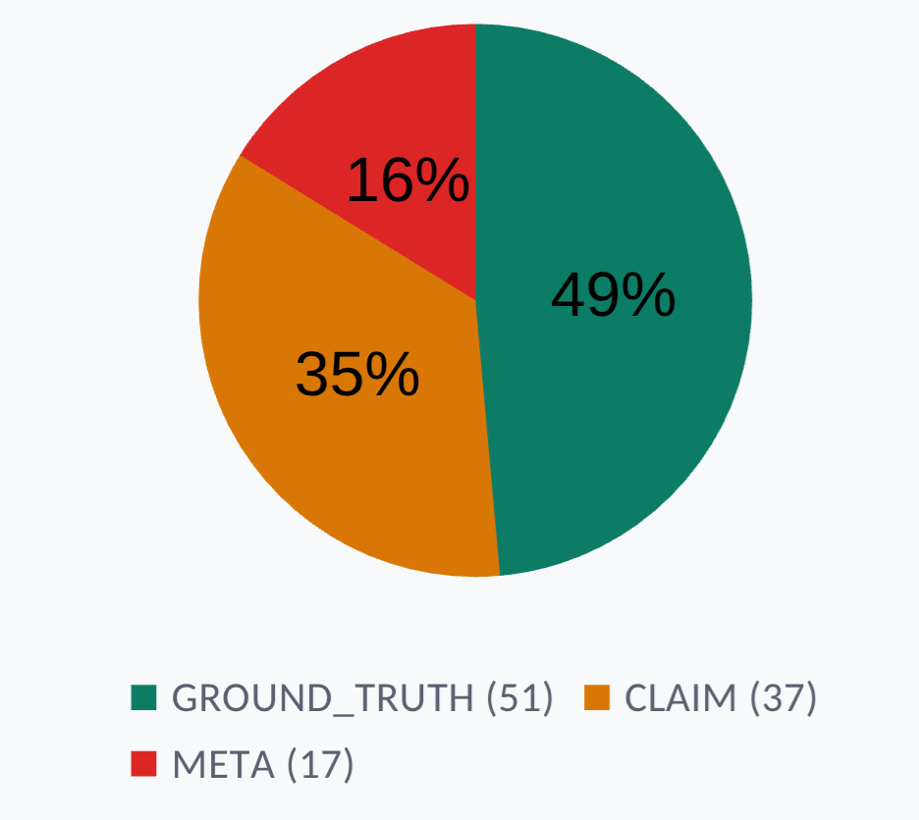
FORENSIC VALUE
What a forensic investigator sees from one test run
Test run statistics (from DUMP output)
Total events logged
105
Complete timeline reconstruction
GROUND_TRUTH events
51 (49%)
Hardware-observed, unforgeable
CLAIM events
37 (35%)
NS-originated, validated but unverified
META security alerts
17 (16%)
Attacks detected + logged as evidence
Anomalies detected
10
Throttle override, odometer rollback, etc.
Events rejected
17
Forgery, flooding, invalid type attempts
CAN frames blocked
2
Unauthorized CAN IDs rejected
Sealed blockchain blocks
26
All chain links verified VALID
What an investigator can determine from this data:
Exact sequence and timing of every hardware event and software action
Which events came from hardware (GT) vs. which were software claims (CL)
Every attack attempt — even failed ones — preserved as META evidence
Cryptographic proof that no log entries were added, removed, or reordered post-hoc
Whether the ECU was reset, and if so, why (reset cause logged at boot)
TML SecureECU TEE | Indian Institute of Technology Delhi
32

Slide 33

SECURITY ANALYSIS
Six attacks, six hardware barriers — defense in depth
Every attack vector is stopped by a different hardware mechanism. No single point of failure.
Attack vector
HW barrier
How it's stopped
Hardware unit
NS reads log buffer
SAU
Memory access → security attribute check → SecureFault exception
ARM CPU core
NS writes fake log entries
NSC Gateway
Must pass 5-stage validation: CMSE + rate + whitelist + timestamp + tag
CMSE intrinsics
NS accesses HASH peripheral
GTZC TZSC
Peripheral marked Secure+Privileged → bus fault on NS access
ST GTZC
NS disables Secure SysTick
Banked registers
NS SysTick and S SysTick are separate hardware instances
ARM banked regs
NS overwrites Secure flash
SECWM + option bytes
Secure watermark region protected by OTP option bytes
Flash controller
NS crashes or goes silent
Independent S world
Secure World keeps running, detects silence, can restart NS
TrustZone isolation
All barriers are enforced in silicon — no software patch can bypass them. Attacker must defeat all 6 simultaneously.
TML SecureECU TEE | Indian Institute of Technology Delhi
33

Slide 34
BUFFER MANAGEMENT
Graceful degradation — GT events never lost
Under sustained attack, the buffer fills. Our priority system ensures hardware evidence is always preserved.
NORMAL ZONE
0 – 95 entries
0% – 74%
Design properties
All event types accepted:
GROUND_TRUTH + CLAIM + META
GT loss probability
0%
Architecturally impossible
Buffer size
4,096 bytes total
128 entries
DEGRADED ZONE
96 – 127 entries
75% – 99%
Degrade threshold
Configurable
75% (96)
CLAIM/META summarized into single META_SUMMARY.
GROUND_TRUTH always accepted.
Recovery trigger
50% (64)
Auto-resumes full logging
Summary event
Counts summarized events
FULL (GT OVERRIDE)
128 / 128
100%
META_SUMMARY
Rate limiter
Prevents reaching degradation
GT events force-evict oldest entry.
CLAIM/META rejected. No GT loss — ever.
25 evt/sec
TML SecureECU TEE | Indian Institute of Technology Delhi
34

Slide 35
LIVE DEMONSTRATION
Demo guide — 3 minutes, 11 scenarios
1
Connect STM32H573I-DK via USB
Open terminal: 115200 baud, 8N1. Type CLEAR to reset.
2
Press B2 button — Scene 1: Normal
Sensor → actuator loop. Green entries = GROUND_TRUTH.
3
B2 × 2–5: Attack scenarios
Throttle override → silence → flood → forgery. Watch RED META alerts.
4
B2 × 6–7: CAN attacks
CAN injection (ID blocked) → CAN replay (temporal detection).
5
B2 × 8–10: Fraud scenarios
UDS exploit → odometer rollback → DTC manipulation.
6
Type DUMP in terminal
Complete forensic extraction: all events + blockchain chain + metrics.
7
Verify blockchain chain
Every block shows VALID. prev_hash links verified. Monotonic counter.
UART commands: THROTTLE:XX | DUMP | CLEAR | RESET_NS | CAN:ID:DATA | UDS:XXYYZZ | ODO:KM | DTC:SET:PXXXX | DTC:CLR:PXXXX
TML SecureECU TEE | Indian Institute of Technology Delhi
35

Slide 36
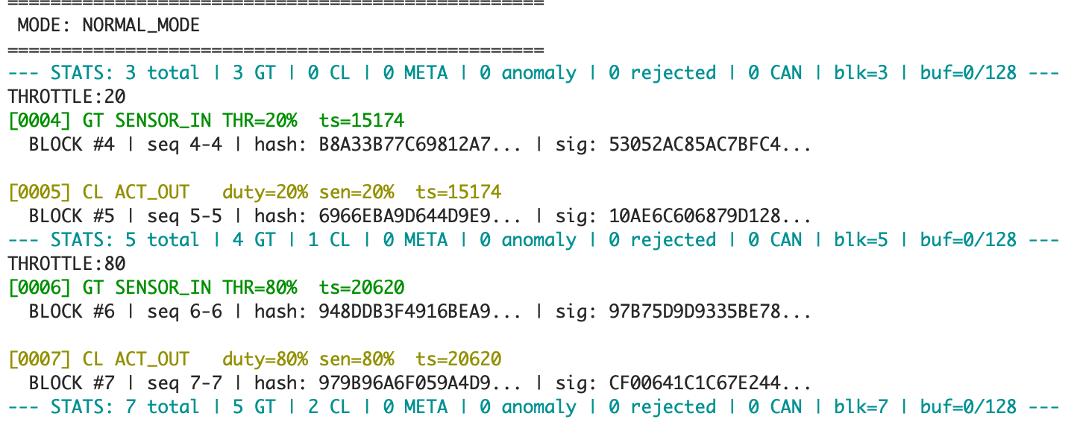
SCENE 1
INPUT-DEPENDENT
Normal operation — honest sensor-to-actuator loop
What happens:
THROTTLE:20 and THROTTLE:80. The Secure World captures the real sensor value as GROUND_TRUTH. NS receives it via SPI6 notification, computes duty = sensor (honest), and calls CommitActuation(). The output matches the input — no anomaly.
How it's configured:
SPI6 handler checks g_current_scene == SCENE_NORMAL and sets duty = (uint32_t)sensor. No override. This establishes the baseline so the audience can see input = output before the attack.
INPUT:
THROTTLE:20 THROTTLE:80
Log keywords:
GT
SENSOR_IN
Hardware-captured sensor value
CL
ACT_OUT
NS actuator command (claim)
GT
duty=X% sen=X%
Duty matches sensor = honest
TML SecureECU TEE | Indian Institute of Technology Delhi
36

Slide 37
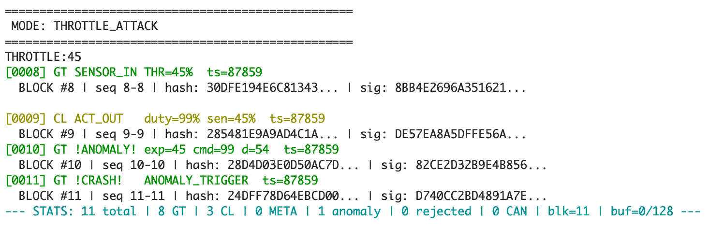
SCENE 2
INPUT-DEPENDENT
Throttle override attack — anomaly detection
What happens:
THROTTLE:45. Secure World logs real sensor = 45% as GT. But NS (in attack mode) overrides duty to 99% regardless. Secure World sees duty=99% vs sensor=45%, deviation=54 > threshold(20) → ANOMALY detected + accident snapshot triggered.
How it's configured:
SPI6 handler checks g_current_scene == SCENE_THROTTLE_ATTACK and forces duty = 99. The deviation is computed inside SecureLog_CommitActuation() in Secure World: abs(duty - sensor) > ANOMALY_THRESHOLD(20).
Log keywords:
GT
SENSOR_IN
Real sensor value (45%)
CL
ACT_OUT
NS claims duty=99% (override)
GT
!ANOMALY!
Deviation detected by Secure World
GT
!CRASH!
Accident snapshot marker
GT
exp=45 cmd=99
Expected vs commanded values
TML SecureECU TEE | Indian Institute of Technology Delhi
37

Slide 38
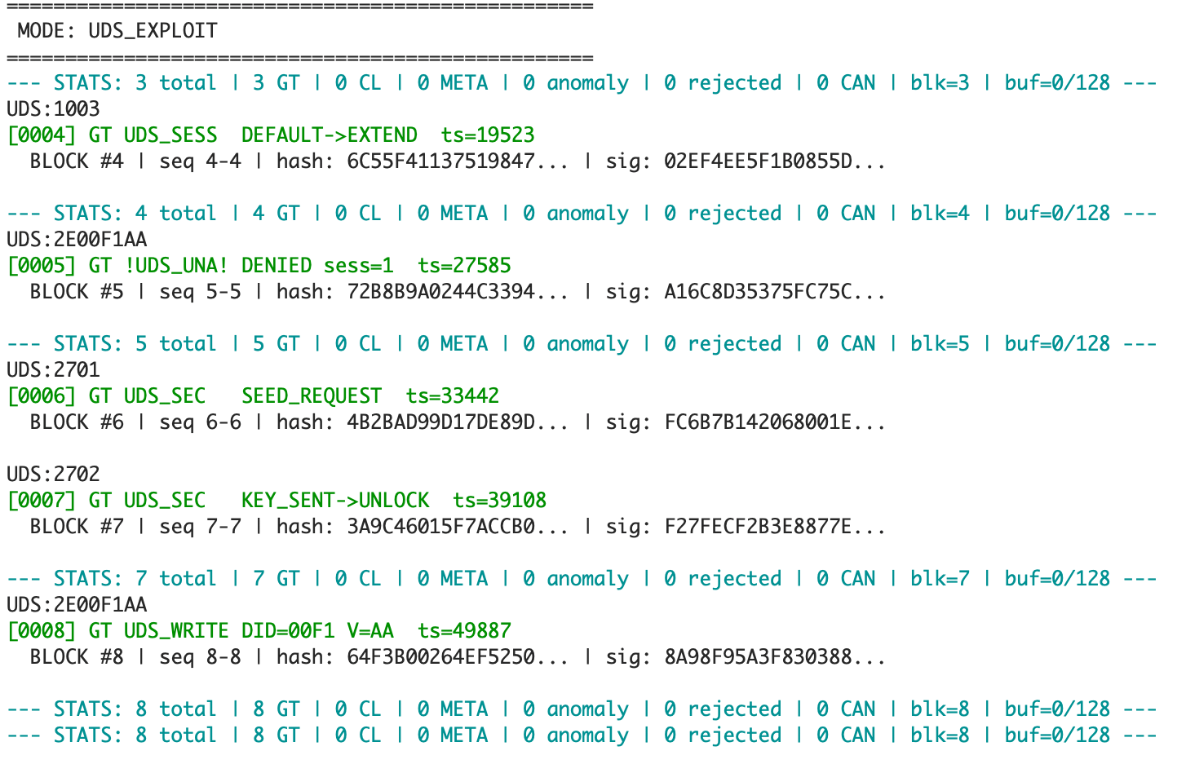
SCENE 3
INPUT-DEPENDENT
UDS diagnostic exploit — unauthorized write detection
What happens:
First enters extended session (0x1003), then attempts write (0x2E) without security unlock → DENIED. Then requests seed (0x2701), sends key (0x2702) → UNLOCKED. Now same write succeeds. Complete audit trail as GROUND_TRUTH.
How it's configured:
Secure World UART ISR parses UDS:XXYYZZ commands and calls SecureLog_ProcessUDS(). State machine tracks: DEFAULT → EXTENDED → SEC_REQ → UNLOCKED. Write without unlock triggers META_UDS_UNAUTHORIZED.
Log keywords:
GT
UDS_SESS
Session state transition logged
GT
!UDS_UNA!
Unauthorized write attempt
GT
UDS_SEC
Security access event
GT
UDS_WRITE
Authorized write completed
GT
DENIED sess=1
Write rejected — not unlocked
TML SecureECU TEE | Indian Institute of Technology Delhi
38

Slide 39
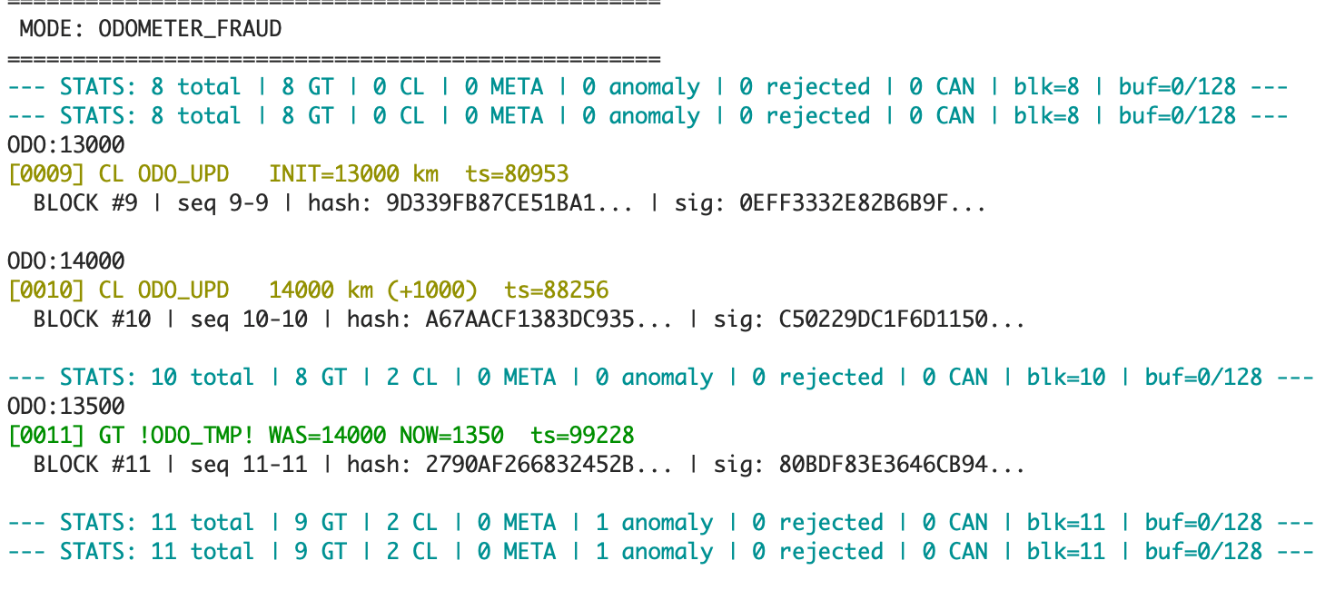
SCENE 4
INPUT-DEPENDENT
Odometer fraud — monotonic rollback detection
What happens:
Initializes odometer at 13000 km, increments to 14000 km (accepted). Then types 13500 km — a rollback attempt. Secure World's monotonic counter catches it: 13500 < 14000 = TAMPER. Logged as GROUND_TRUTH. The rollback value is rejected; counter stays at 14000.
How it's configured:
SecureLog_ReportOdometer() NSC gateway maintains g_odometer_km in Secure SRAM. Any new < stored value triggers META_ODO_TAMPER with both values recorded. NS cannot read or reset the counter.
Log keywords:
CL
ODO_UPD
Odometer reading reported by NS
CL
INIT=13000 km
First reading initializes counter
CL
+1000
Valid increment accepted
GT
!ODO_TMP!
Rollback tamper detected
GT
WAS=14000 NOW=1350
Previous vs attempted value
TML SecureECU TEE | Indian Institute of Technology Delhi
39

Slide 40
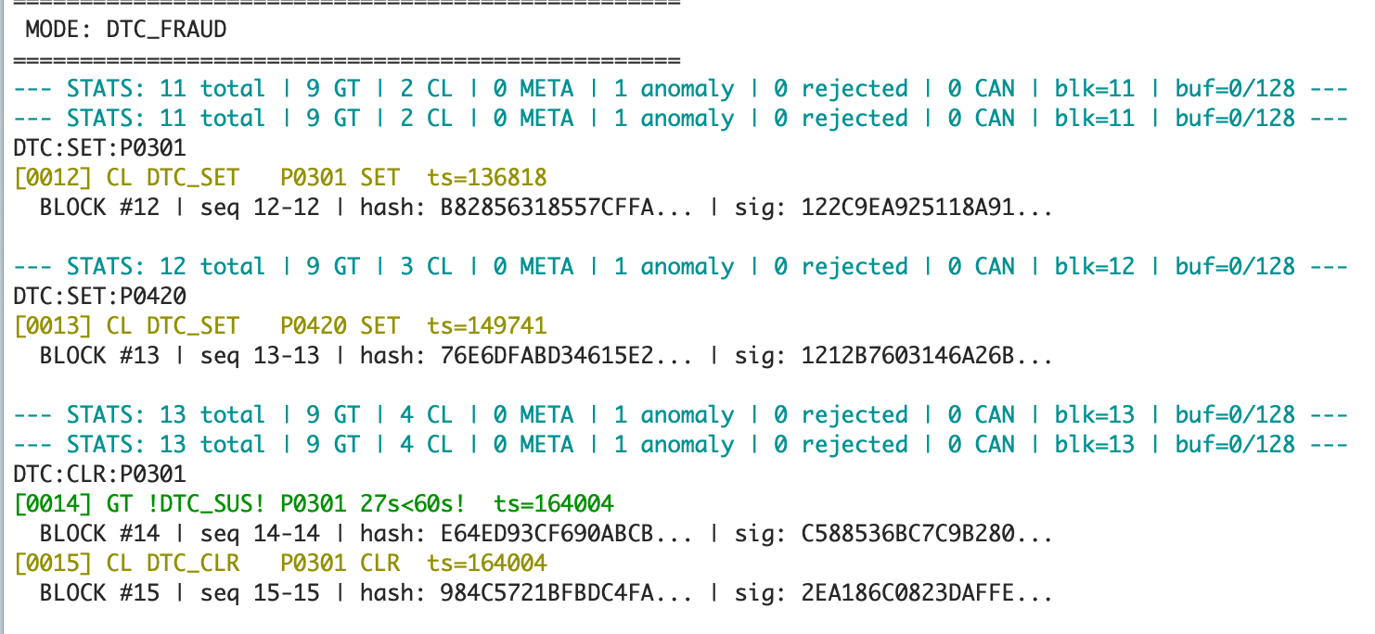
SCENE 5
INPUT-DEPENDENT
DTC manipulation — warranty fraud detection
What happens:
Sets DTC P0301 (cylinder misfire), then clears it 27 seconds later. The 60-second minimum repair time check fires: no physical repair is possible in 27 seconds → META_DTC_SUSPICIOUS logged as GROUND_TRUTH. The clear itself is logged as CLAIM.
How it's configured:
SecureLog_ReportDTC() stores DTC with timestamp in g_dtc_table[]. On CLEAR, elapsed time is checked against DTC_MIN_REPAIR_TIME_S (60). If elapsed < 60s, META_DTC_SUSPICIOUS is generated. Timestamp is Secure SysTick — NS cannot manipulate.
Log keywords:
CL
DTC_SET
Fault code set by NS application
CL
DTC_CLR
Fault code cleared by NS
GT
!DTC_SUS!
Suspicious clear detected
GT
27s<60s!
Elapsed time < minimum repair time
TML SecureECU TEE | Indian Institute of Technology Delhi
40

Slide 41
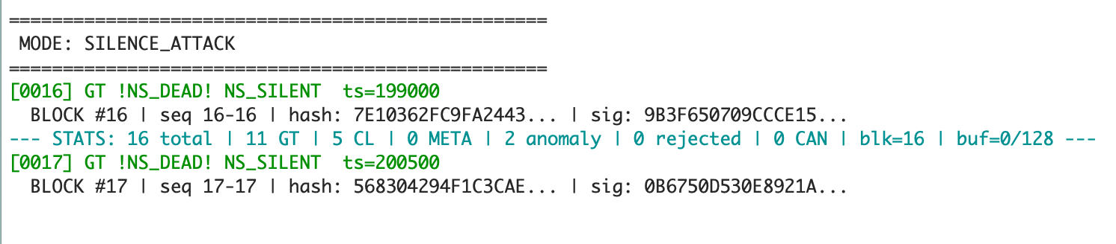
SCENE 6
AUTOMATED
Silence attack — liveness detection
What happens:
NS stops calling SecureLog_Heartbeat() for 4 seconds by setting g_silence_active = 1. Secure SysTick (banked, independent hardware) checks the flag every 500ms. After 3 consecutive misses (1.5s), logs NS_HEARTBEAT_FAIL as GROUND_TRUTH. NS cannot prevent detection.
How it's configured:
RunScene_Silence() sets g_silence_active = 1. Main loop skips Heartbeat() call. SecureLog_WatchdogCheck() in Secure SysTick ISR increments g_heartbeat_miss_count. At miss count ≥ 3, event is logged. Banked SysTick_S runs independently from NS.
Log keywords:
GT
!NS_DEAD!
NS World heartbeat failure
GT
NS_SILENT
NS stopped communicating
TML SecureECU TEE | Indian Institute of Technology Delhi
41

Slide 42
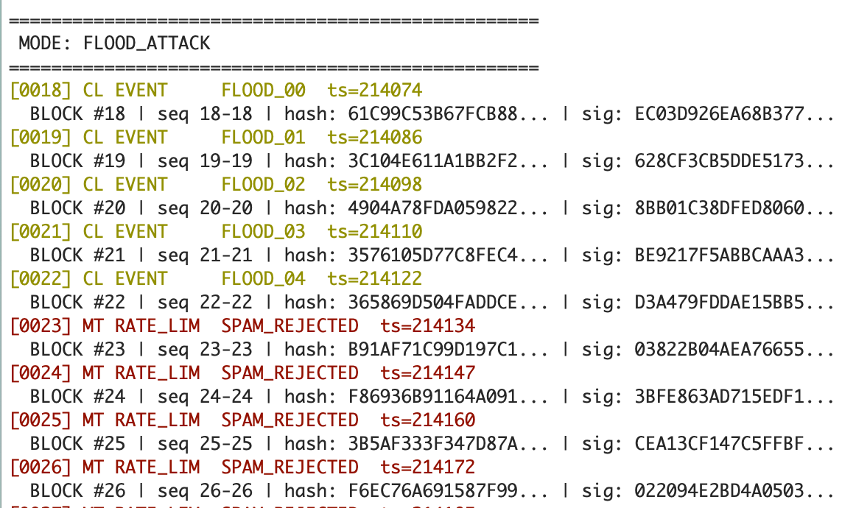
SCENE 7
AUTOMATED
Flood attack — token bucket rate limiter
What happens:
NS submits 20 rapid SubmitEvent() calls in a tight loop. Token bucket has 5 tokens, refills at 1 token per 200ms. First 5 events (FLOOD_00 to FLOOD_04) are accepted as CLAIM. Remaining 15 are rejected — each rejection logged as META RATE_LIM SPAM_REJECTED.
How it's configured:
RunScene_Flood() calls SecureLog_SubmitEvent() 20 times with EVT_GENERIC. Inside the NSC gateway, token bucket checks: if tokens == 0, push META_RATE_LIMIT and return -2. Tokens refill at REFILL_RATE_MS (200ms). MAX_TOKENS = 5.
Log keywords:
CL
EVENT
Generic NS-submitted event
CL
FLOOD_XX
Flood event payload (sequence)
MT
RATE_LIM
Rate limiter triggered
MT
SPAM_REJECTED
Event rejected — no tokens
TML SecureECU TEE | Indian Institute of Technology Delhi
42

Slide 43
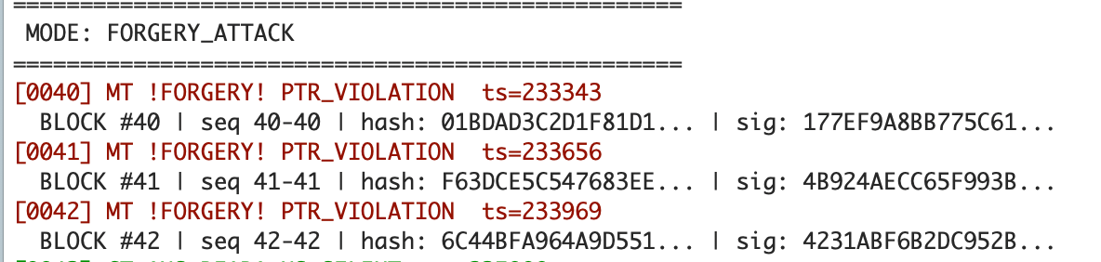
SCENE 8
AUTOMATED
Forgery attack — CMSE pointer validation
What happens:
NS passes three malicious pointers to SubmitEvent(): 0x30000000 (Secure SRAM), 0x08000000 (Secure Flash), and NULL. cmse_check_address_range() verifies each pointer is in NS memory. All three fail → META_FORGERY_ATTEMPT PTR_VIOLATION logged for each.
How it's configured:
RunScene_Forgery() creates LogEntry_NS_t* pointing to Secure addresses. Inside SubmitEvent(), cmse_check_address_range(ptr, size, CMSE_NONSECURE | CMSE_MPU_READ) returns NULL for Secure addresses. This is an ARM CMSE compiler intrinsic — hardware-enforced.
Log keywords:
MT
!FORGERY!
Pointer validation failure
MT
PTR_VIOLATION
Address is not in NS memory
TML SecureECU TEE | Indian Institute of Technology Delhi
43

Slide 44
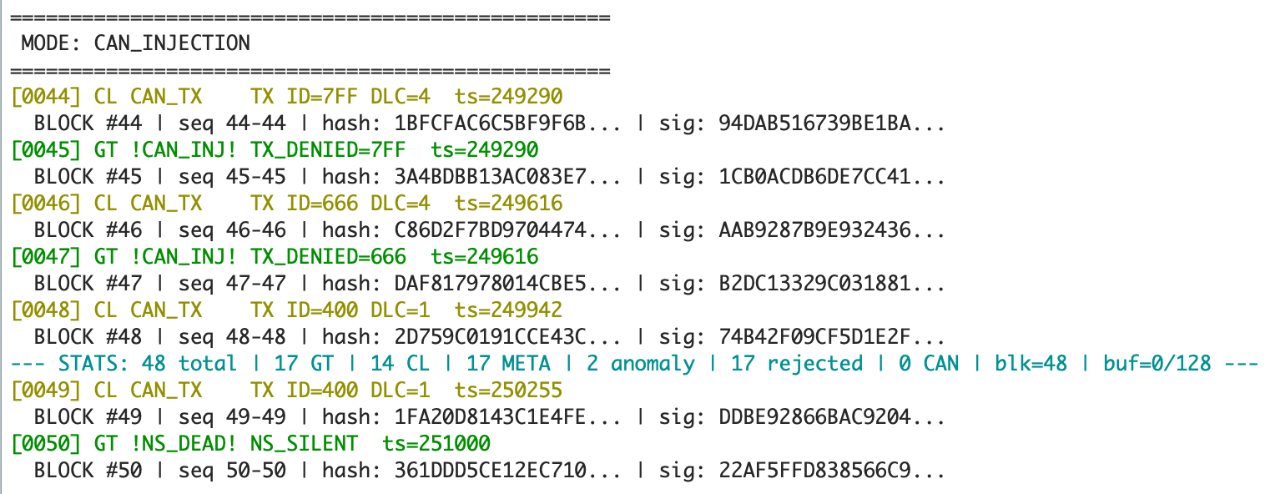
SCENE 9
AUTOMATED
CAN injection — ID whitelist enforcement
What happens:
NS sends 4 CAN frames via SecureLog_SendCANFrame(): ID 0x7FF (not in whitelist → BLOCKED), ID 0x666 (not in whitelist → BLOCKED), ID 0x400 with value 0xFF (valid ID)
How it's configured:
SecureLog_SendCANFrame() NSC gateway first validates the pointer (CMSE), then calls CAN_FindWhitelistIndex(). 13 authorized IDs in can_whitelist[]. Rejection logs META_CAN_INJECT_BLOCK as GROUND_TRUTH.
Log keywords:
CL
CAN_TX
NS requested CAN transmission
GT
!CAN_INJ!
Unauthorized CAN ID blocked
GT
TX_DENIED=7FF
ID 0x7FF not in whitelist
GT
CAN_RX
Frame accepted after all checks
TML SecureECU TEE | Indian Institute of Technology Delhi
44

Slide 45
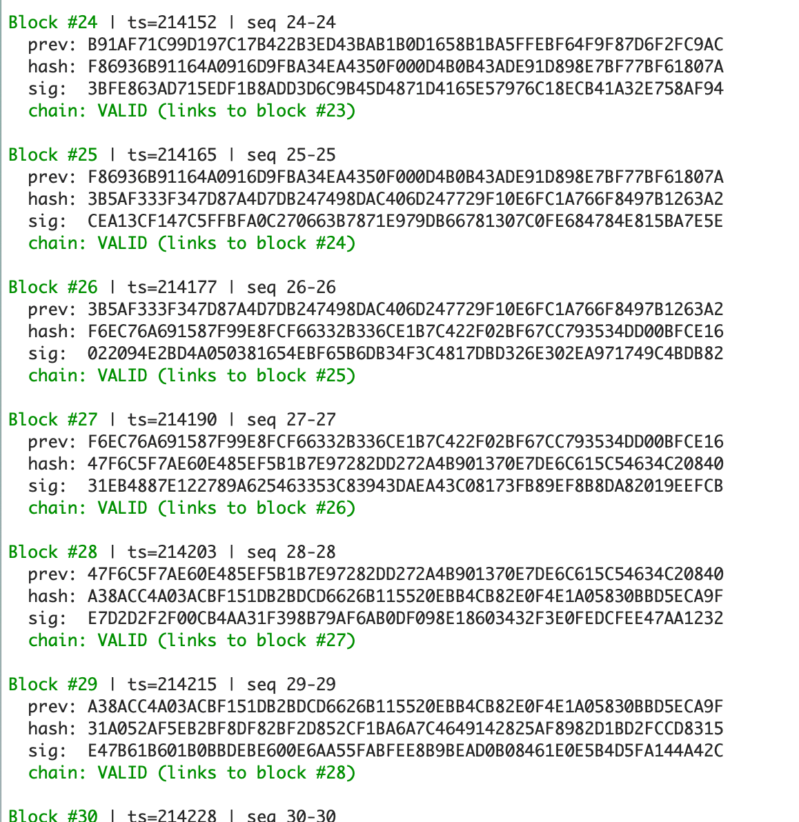
FORENSIC PROOF
Blockchain chain — every block verified VALID
What you're seeing:
The DUMP command extracts the complete blockchain from Secure SRAM. Each block contains: block number (monotonic), timestamp, sequence range, previous block's hash (chain link), current block's SHA-256 hash, and the HMAC signature proving Secure World origin.
Chain verification:
Each block's prev: field must exactly match the previous block's hash: field. "chain: VALID (links to block #N)" confirms this match. Any modification to any block breaks all subsequent hashes — tamper-evident by design.
Block fields:
Block #N
Monotonic block number (never resets)
ts=XXXXX
Secure SysTick timestamp at seal time
seq N-N
Entry sequence range in this block
prev:
SHA-256 hash of previous block (chain link)
hash:
SHA-256(prev_hash || entry_bytes)
sig:
SHA-256(block_hash || secret_key) — HMAC
chain: VALID
prev matches previous block's hash
chain: GENESIS
First block (prev = all zeros)
TML SecureECU TEE | Indian Institute of Technology Delhi
46

Slide 46
REFERENCES
Document references and standards
#
Document
ID
Sections used
[1]
ARM Cortex-M33 Technical Reference Manual
DDI0553B
TZ transitions §11.3, IRQ latency §11.6.3, SG instruction §3.3.1
[2]
ARM Cortex-A53 Technical Reference Manual
DDI0500J
SMC instruction timing §4.3.29 — Cortex-A comparison baseline
[3]
STM32H573 Datasheet
DS14258
Flash characteristics T31, HASH performance T66, clock specs §5.3.2
[4]
STM32H573 Reference Manual
RM0481
HASH §35, SRAM §7, GTZC/MPCBB §12, FDCAN §48
[5]
STM32 Cortex-M33 Programming Manual
PM0264
NVIC, MPU, core register descriptions, DWT configuration
[6]
ST TrustZone Training (STM32L5)
STM32L5_Security_TRZ
M-profile vs A-profile TZ mechanism comparison (slide 3)
TML SecureECU TEE | Indian Institute of Technology Delhi
47

Slide 47
SecureECU TEE
Thank you
Hardware-isolated forensic logging for automotive ECUs
4 µs
63×
0.05%
8 KB
$0
per secure event
faster than Cortex-A
crypto overhead
total Secure SRAM
additional BOM
Questions & Discussion
TML SecureECU TEE | Indian Institute of Technology Delhi

