Slide 1

MINOR PROJECT | MIDTERM PRESENTATION
Secure CAN Gateway using ARM TrustZone and OP-TEE
Secure CAN Ownership, Validation and Event Logging on Raspberry Pi 3
Aslam
Supervisor: Prof. Kolin Paul | Indian Institute of Technology Delhi
Secure CAN Event Processing and Logging
1 / 9

Slide 2
MOTIVATION
Can We Trust the CAN Event Throughout Its Lifecycle?
From receiving a CAN packet to making a security decision and storing the resulting event, each stage introduces a trust concern.
01
CAN MESSAGE TRUST
02
CAN PROCESSING TRUST
03
LOG INTEGRITY
Can We Trust the CAN Message?
Can We Trust the Validation Decision?
Can We Trust the Record Later?
ECU A ↔ CAN ↔ ECU B
↓
ID | Counter | Data
CAN PACKET
↓
ID | Counter | Data
↓
Linux / Normal World
(Process + Validate)
↓
ACCEPT / DROP
VALIDATED EVENT
↓
ID | Counter | Time | Result
↓
Store in Memory
(Security Log)
↓
Later / Analysis
• Communication: CAN enables ECUs to exchange control and monitoring messages.
• Security concern: The CAN frame itself does not provide cryptographic origin authentication.
• Processing: The received CAN packet is handled and validated by Linux / Normal World software.
• Trust concern: If the processing environment is compromised, can we trust the validation result?
• Storage: After validation, the CAN event is stored as a security record.
• Integrity concern: If the storage environment is compromised, can the recorded event be modified or erased?
TRUST ?
Can we trust the security decision?
Can we trust this record later?
THE RESEARCH GAP: Security-critical CAN events need trustworthy processing and trustworthy records, even when the Normal World may be compromised.
Secure CAN Event Processing and Logging
2 / 9

Slide 3
STATE OF THE ART
How Is Trustworthy CAN Handling Done Today?
Different approaches protect different parts of the system, but real trade-offs remain.
01
Software-Only Logging
02
External HSM / Logger
03
TrustZone + OP-TEE (Ours)
Validation and logging in the same OS
Security moved to separate hardware
Secure-World-owned validation on-chip
CAN Packet
↓
Validate + Log
(Linux)
↓
Log File
CAN Packet
↓
External HSM / ECU
↓
Log
CAN Packet
↓
Secure World
(Core1)
↓
Accept / Drop
• Simple, no extra hardware
• Vulnerable if OS is compromised
• No hardware isolation
• Isolates security from main ECU
• Extra hardware, wiring and cost
• Added system complexity
• No extra silicon - uses on-chip TrustZone
• ID / replay / timestamp checks hardware-proven
• HMAC authentication currently blocked
• Tamper-evident logging not yet implemented
Protects: None (software-dependent)
Protects: Security record (extra hardware)
Protects: Validation decision (logging planned, not built)
RESEARCH GAP: Can a single dedicated core running inside TrustZone deliver trusted, scalable CAN validation and tamper-evident logging, without dedicated security hardware, even when the Normal World is compromised?
Secure CAN Event Processing and Logging
3 / 9

Slide 4
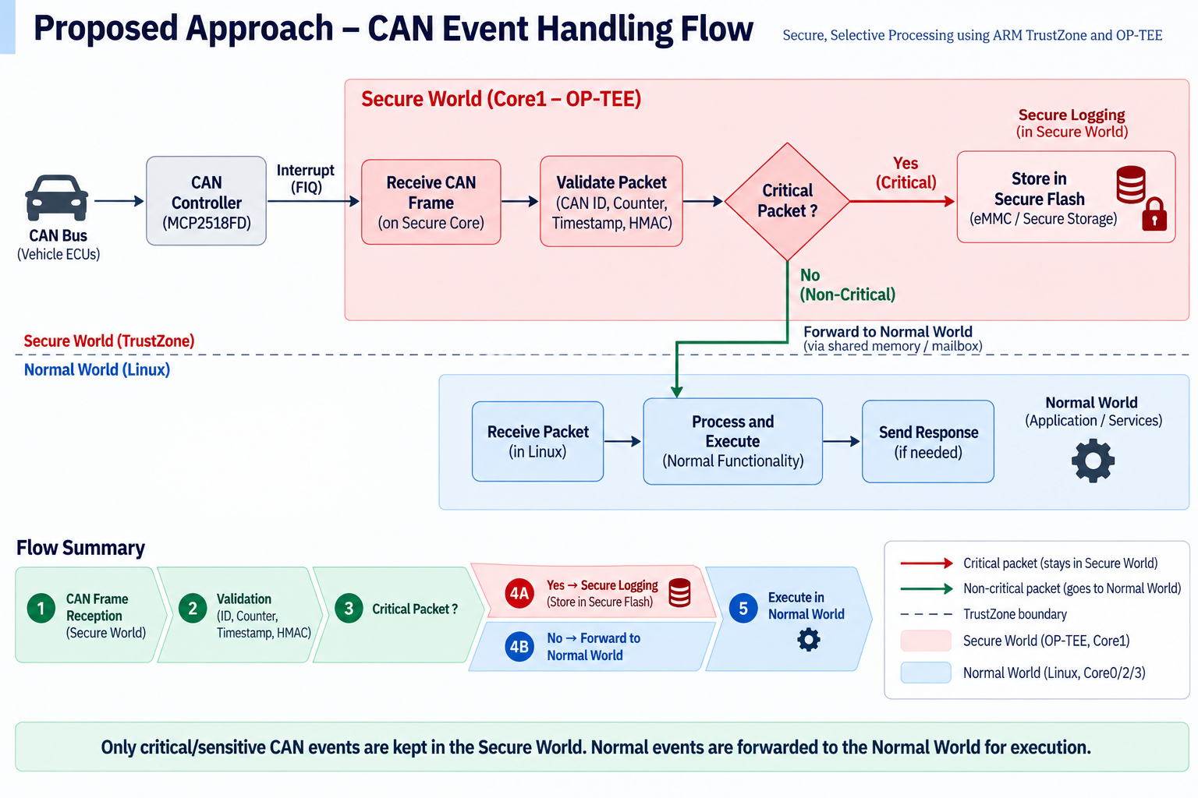

Slide 5
BOOT PROCESS FLOW
Raspberry Pi 3 + ARM TrustZone + OP-TEE — Core1 Secure World
POWER ON
→
GPU BOOT
→
ARMSTUB + FIP
→
TRUSTED FIRMWARE-A
→
U-BOOT
Raspberry Pi 3 SoC
bootcode.bin
armstub8.bin
@ 0x00000000
BL1
bootcmd
↓
↓
↓
↓
BL2
Load DTB +
kernel8.img
Boot ROM
start.elf + fixup*.dat
↓
↓
Padded TF-A BL1
+
fip.bin
BL31
↓
↓
EL3 Secure Monitor
↓
VideoCore
config.txt
↓
↓
Set bootargs → booti
Reads first FAT32 boot partition
Loads boot files from SD card
ARM stub contains BL1 + FIP
BL32
OP-TEE OS
Secure World
BL33
U-Boot
Non-Secure
Non-Secure / Normal World
LINUX KERNEL BOOT
LINUX SMP BRING-UP
CPU0
Linux
CPU1
Secure World
CPU2
Linux
CPU3
Linux
CPU1 online request
CPU1
PERMANENTLY RESERVED
FOR SECURE WORLD
↓
Intercepted in EL3
↓
opteed_enter_secure_server_if_core1()
↓
CPU1 → Secure World
↓
rpi3_can_server_loop()
Linux continues with CPU0, CPU2 and CPU3. Linux reports CPU1 offline.
NORMAL WORLD — LINUX
SECURE WORLD — OP-TEE
CPU0, CPU2, CPU3 — Linux Kernel + Userspace
CPU1 — rpi3_can_server_loop()
Applications: spi_poc_test · secure_can_demo · tee-supplicant
SECURE CAN PROCESSING
• CAN interrupt handling • SPI0 CAN access • Secure validation
CAN INTERRUPT PATH
MCP2518FD
CAN Controller (SPI0)
→
GPIO25 / INT
→
BCM2837
Interrupt Routing
→
Secure FIQ
→
CPU1 / OP-TEE
FINAL RUNTIME STATE: CPU0 + CPU2 + CPU3 → Linux / Normal World. CPU1 → OP-TEE / Secure World → Secure CAN Processing.

Slide 6
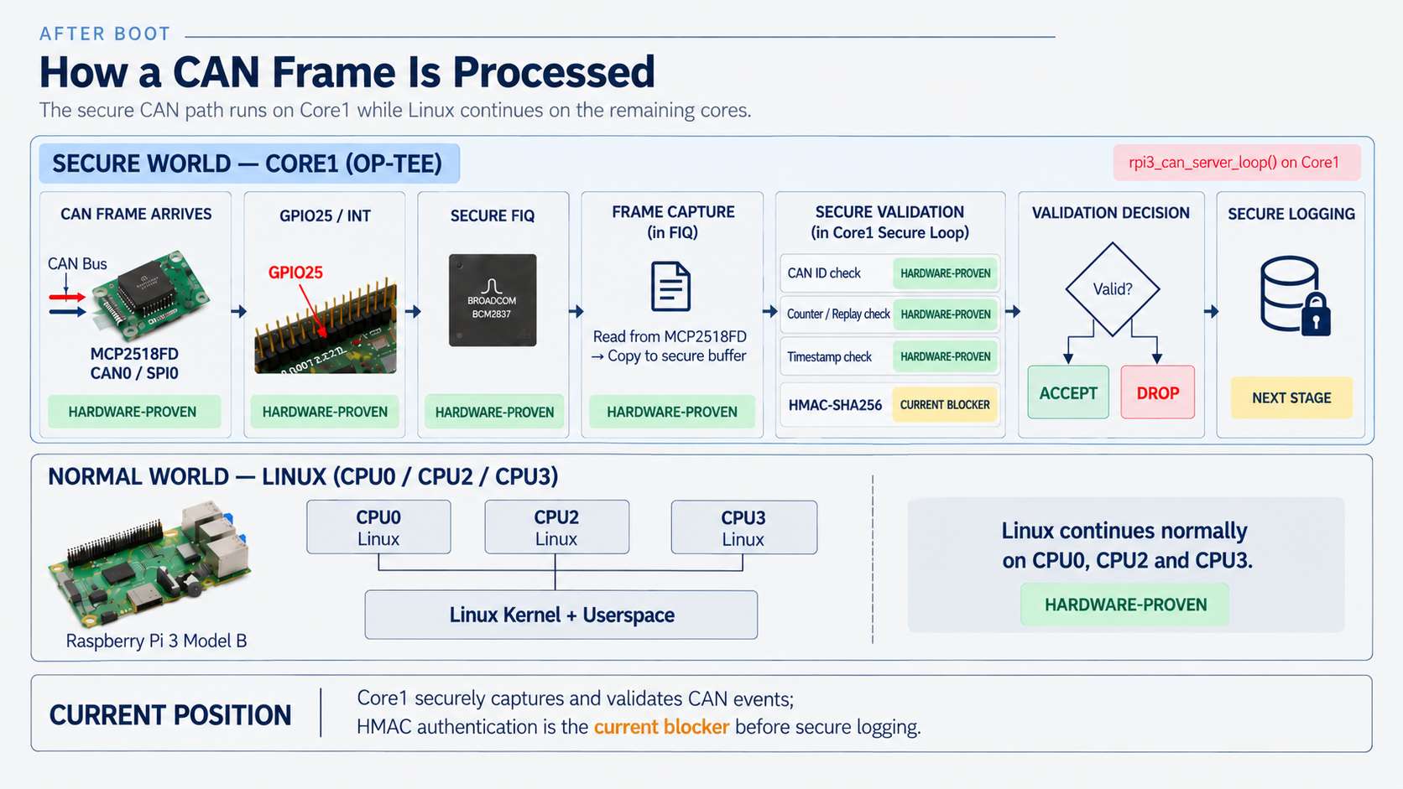

Slide 7
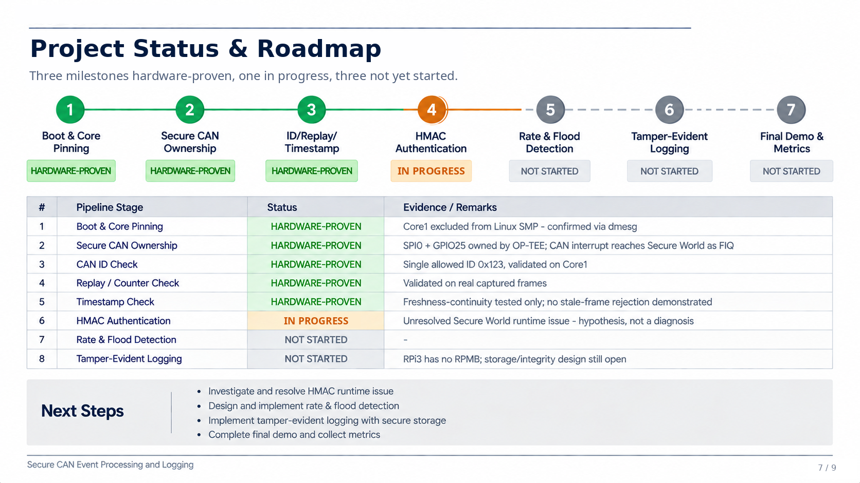

Slide 8
SUMMARY
What I'll Deliver Next
The concrete work planned between now and the final presentation.
HMAC authentication
Unresolved Secure World runtime issue - resolve or clearly document the root cause
Reduce validation latency
Measure and optimize latency / throughput / CPU-overhead of the validation pipeline
Store validated packets in flash memory
Tamper-evident logging design; RPi3 has no RPMB, storage boundary still to be designed
Rate & flood detection
Defend against a CAN-bus flood / denial-of-service
End-to-end demo with real measurements
Full hardware demonstration with real captured data, not placeholder values
By the final presentation: these five items resolved, implemented, or clearly documented - nothing promised beyond this list.
Secure CAN Event Processing and Logging
8 / 9

Slide 9
Thank You

