Slide 1
ML Presentation on Model building
Presentation BY – Team 5
Aslam Pasha S
Nanda Kishore MVS
Puneeth Harlapur
Raghuvara Bhat
Tauqeer Ulla Khan

Slide 2
Table of Content
Objective
Information on Dataset
Exploratory Data analysis
Model building exercise
Conclusion

Slide 3
Objective
To address the business problem statement of, predicting the number of bicycles needed at given point of time so that, the rental company to meet the demand effectively by providing the constant supply.
To analyze the given data set based on available numerical and categorical features understand the impact of independent variables on target variable by performing EDA
To build below models based on chosen variables and compare these models for accuracy of the prediction and to identify the model that would best resolve our primary objective.
OLS
Gradient Descent
Ridge and Random Forest Regression
Lasso

Slide 4
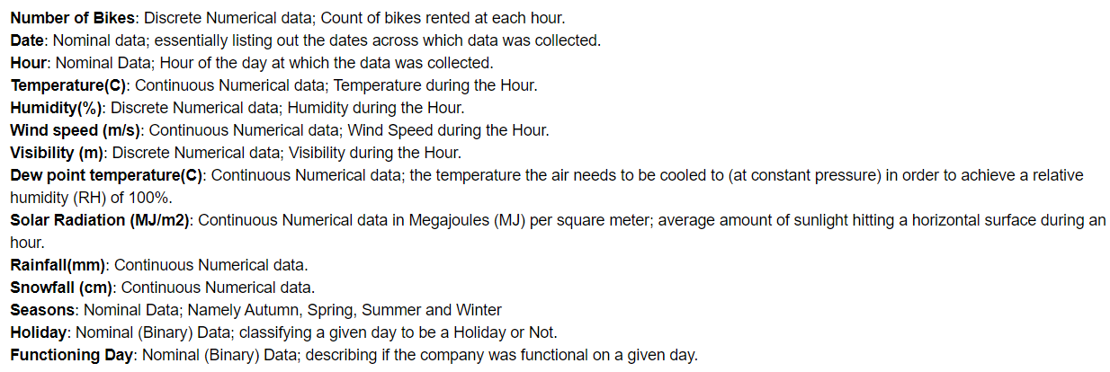
Information on Dataset
The dataset contains information about the number of bicycles rented every hour starting from 1st of Dec, 2017 to 30th of Nov, 2018
The data contains 8760 rows / observations of “Number of Bikes” rented and of various features (13) that could have affected the numbers.
Source: https://archive.ics.uci.edu/ml/datasets/Seoul+Bike+Sharing+Demand

Slide 5
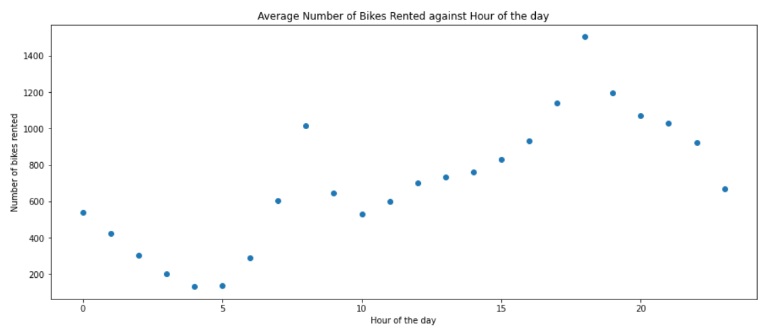
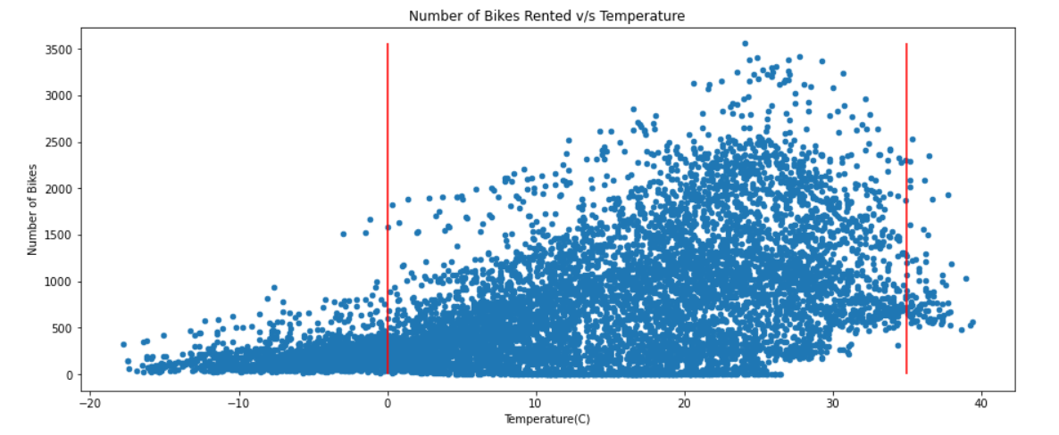
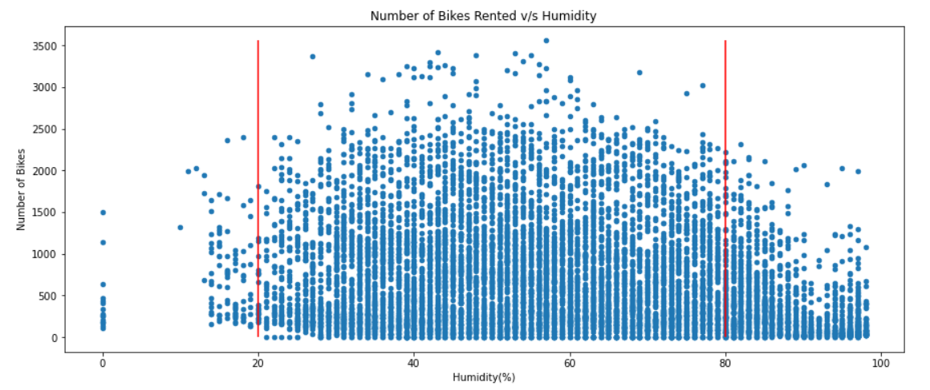
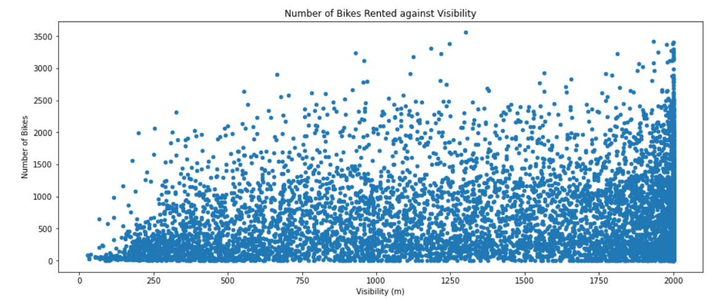
Exploratory Data analysis

Slide 6
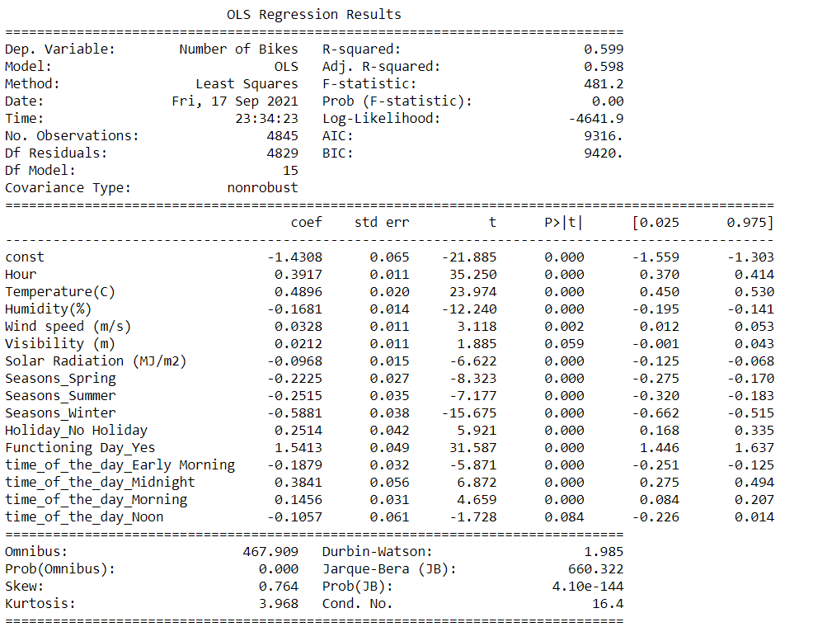
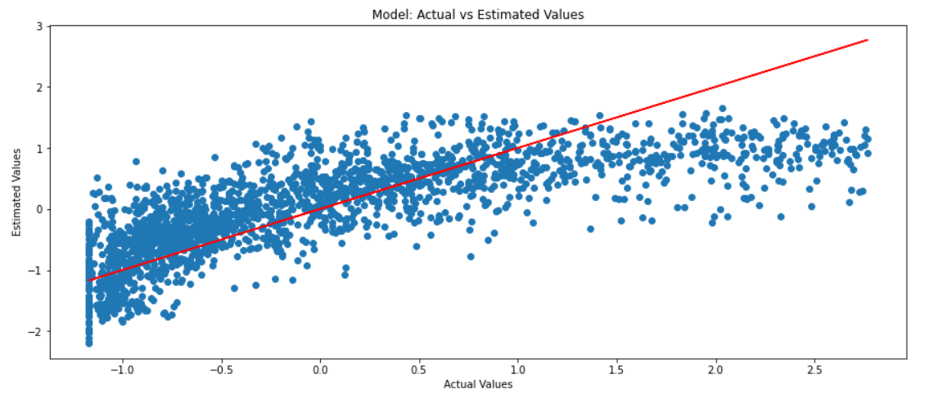
Model building exercise
Ordinary least squares (OLS)

Slide 7
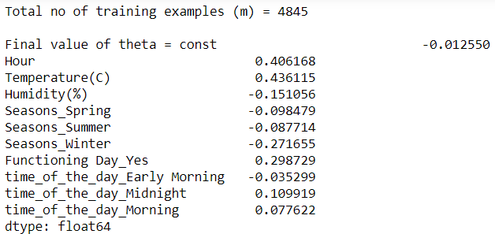
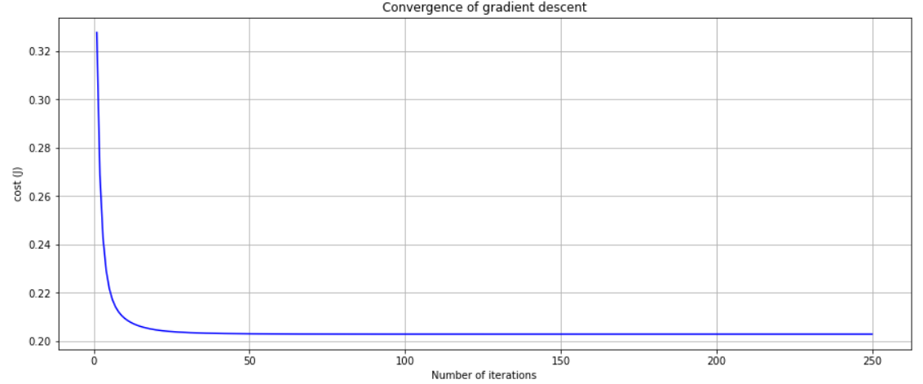
Model building exercise
Gradient Descent

Slide 8
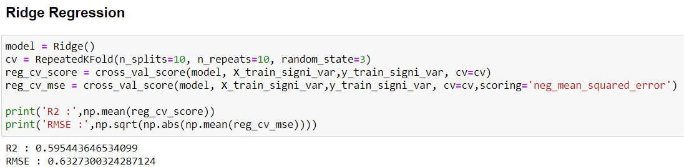
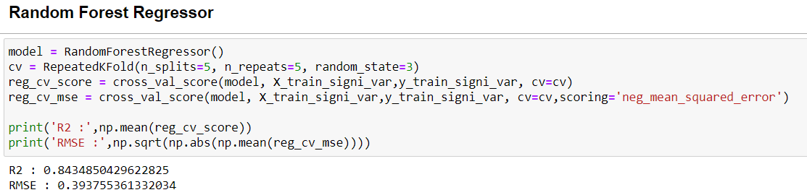
Model building exercise
Ridge and Random Forest Regression

Slide 9
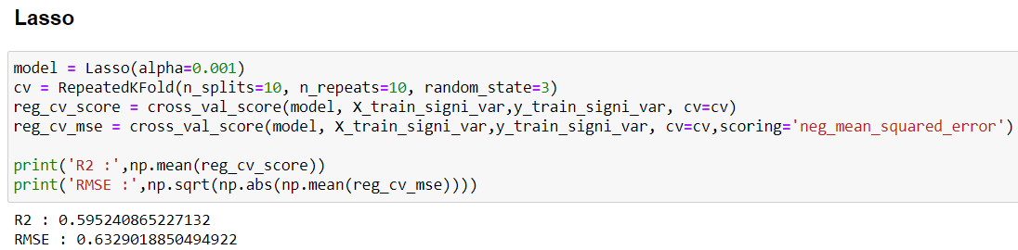
Model building exercise
Lasso Regression

Slide 10
Conclusion & Future Improvements
Based on the features that we selected from the dataset, we could come up with a model that would help us predict the number of bikes required.
OLS, Ridge and Lasso models perform identically with R2 of ~60% and similar RMSE values; however, Random Forest Regressor stands out with ~84% of R2 and 0.39 of RMSE.
The application of similar performing models on real data and performance of the same is yet to be seen.
Addition of any new features into the model as external parameter or using existing features might improve overall model performance; however, this can be a point of future improvement.
Model deployment and supporting data transformations.

Slide 11
Thank You!

