Slide 1

NLP model for Sarcasm Detection

Slide 2
Problem Statement
Develop an NLP classification model for sarcasm detection using the features provided in the dataset. During the course, explore NLP concepts and models. Further, evaluate and finalize the best modeling approach for the given dataset.
Problem Overview
Sarcasm is the caustic use of words, often in a humorous way, to mock someone or something. Sarcasm is a nice trait to have. However, there is a thin line between sarcasm and foul language. You have to define that thin line by building a classic NLP classification model using the provided dataset.
Metrics
Evaluate your models on F1_score: which combines the precision and recall of a classifier into a single metric by taking their harmonic mean.

Slide 3
Dataset Details
A university has chat groups on different topic. Students & their parents both have access to these chat groups. The dataset contains chat extract from the chat groups along with topic name and few other parameters, out of which three parameters description are classified (not disclosed).
This dataset contains following independent features.
1. ID: id of student
2. comment: Student sarcastic comment
3. date: Date on which comment was recorded
4. down: Undisclosed parameter
5. parent comment: Parent comment on the same topic
6. score: Undisclosed/classified parameter
7. top: Undisclosed/classified parameter
8. topic: Topic of the discussion
9. user: Chat login name of the student
10. label: Sarcasm level (0 -not a sarcasm , 1 -is sarcasm)

Slide 4
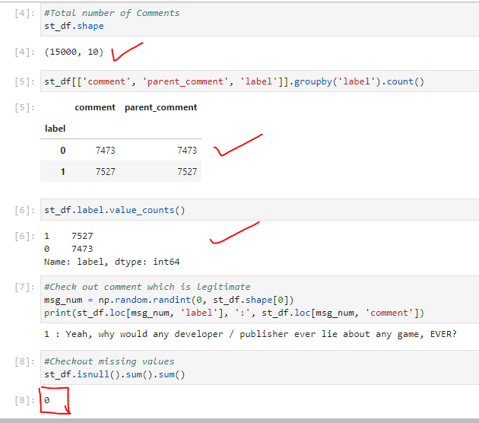
Dataset Cleaning
Dataset Details:
15000 Rows and 10 columns
Classification details and value counts
1). Students 0: 7473, 1: 7527
2). Parents 0: 7473, 1: 7527
There are no null values, so no need to take care of imputing the null values.
Split the data set 70:30
Train 70%
Test 30%

Slide 5
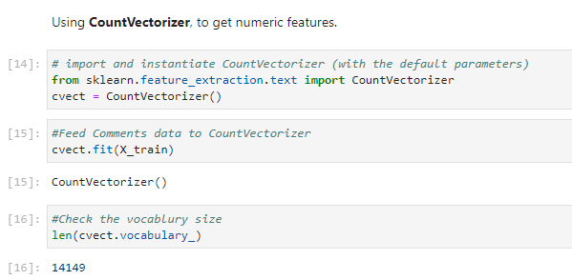
Tokenization & Vectorization

Slide 6
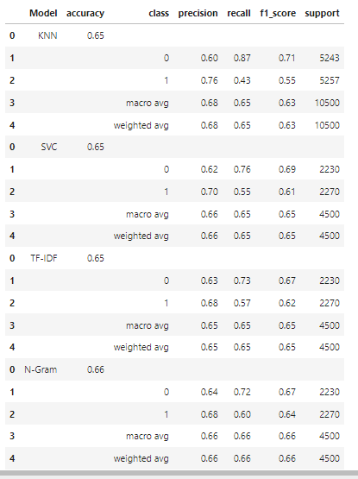
Explore Classics ML models
Classics ML models of NLP
KNN: Accuracy of the model is 65%
SVM : Accuracy of the model is 65%
TF-IDF: Accuracy of the model is 65%
N-Gram: Accuracy of the model is 66%

Slide 7
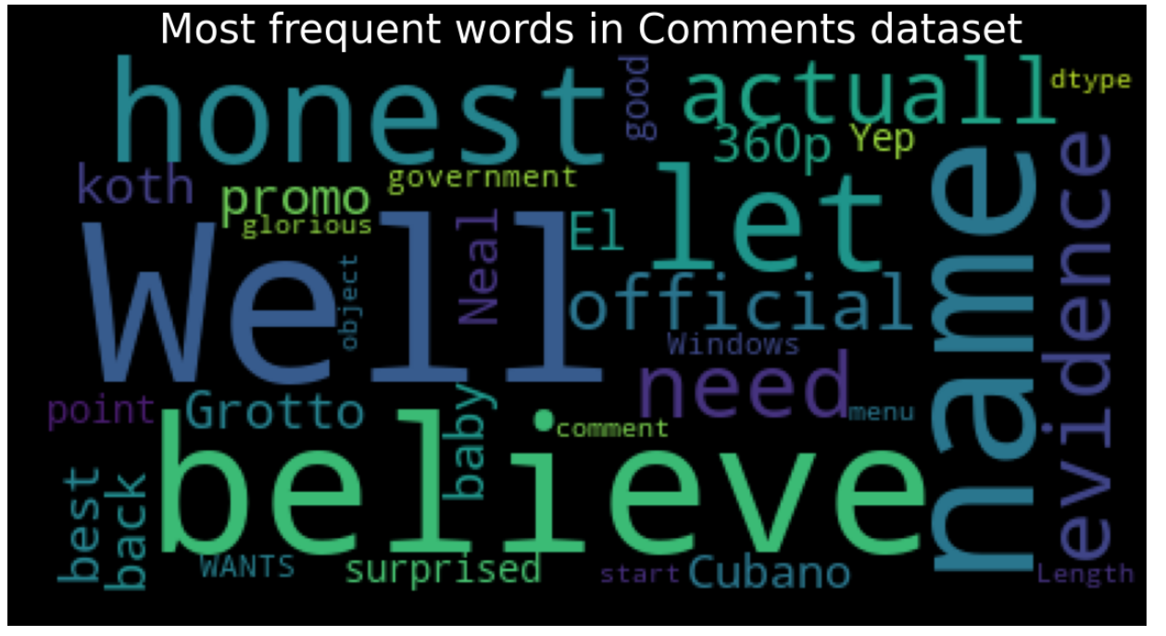
Word Cloud of NLP Data set

