Slide 1
PDS Project – Ecommerce Purchase Dashboard
Team Members –
Tauqeer ulla khan
Aslam pasha
Nandakishore MVS
Raghuvara Bhat

Slide 2
Description of Data
Ecommerce purchase data based users from the USA.
Assumption - the data is for a given day
The data file consists of below columns –
Address Lot AM or PM Browser Info Company Credit Card CC Exp Date | CC Security Code CC Provider Email Job IP Address Language Purchase Price

Slide 3
Data Exploration and Cleansing
Remove duplicates.
Enhance the data by adding LANG description for each LANG code using html.
Extract the Area Codes from data column – ‘Address’.
Add the Area description per each Area code using html
Enhance the Credit Card Provider details
Drop the unused data columns –
Credit Card, IP Address, CC Security Code, CC Exp Date
Add the Currency code as ‘$’

Slide 4
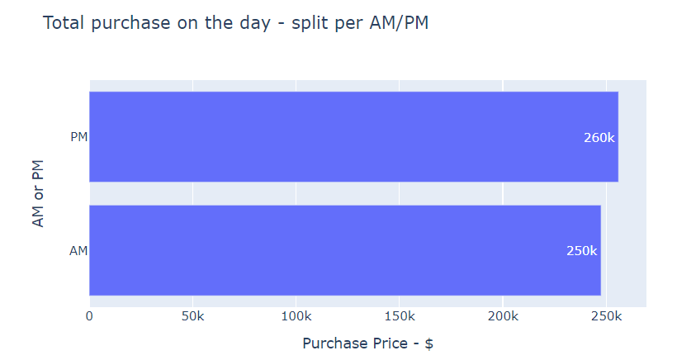
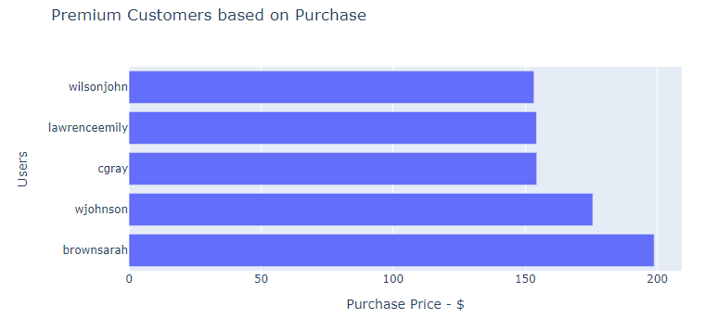
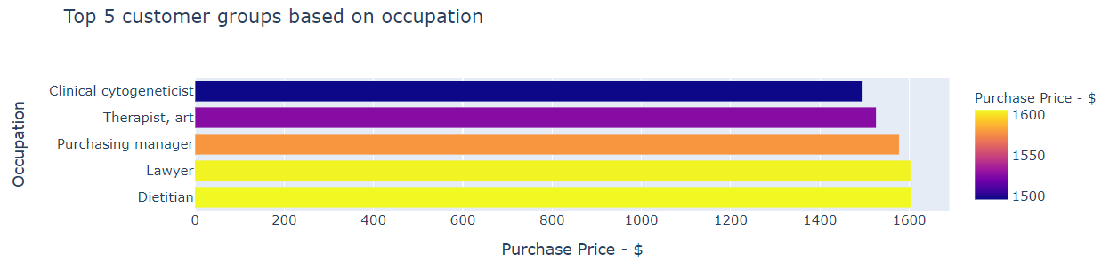

Slide 5
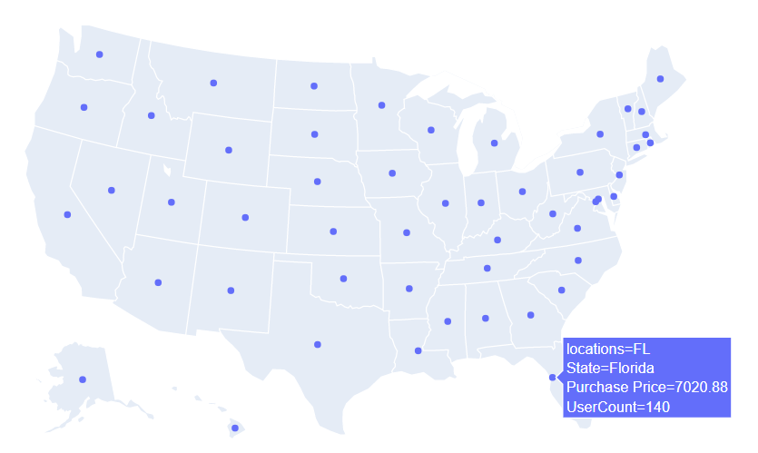

Slide 6
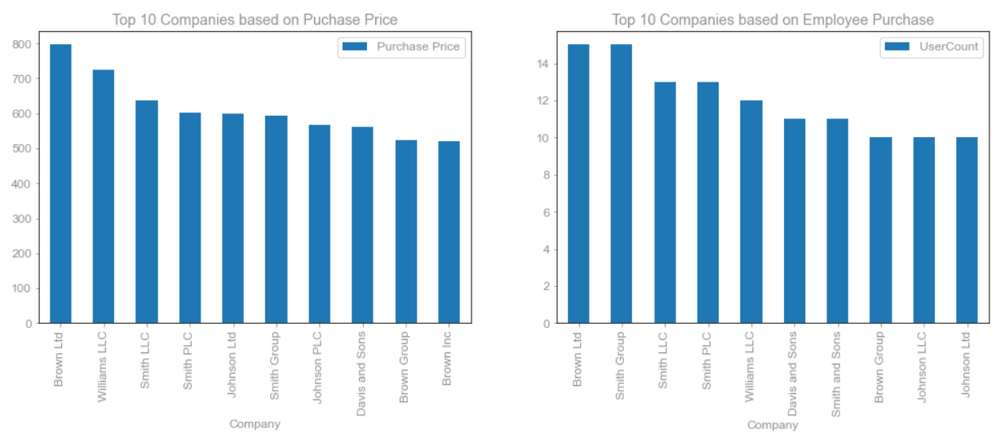
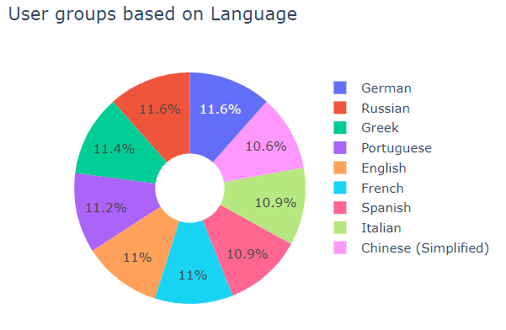
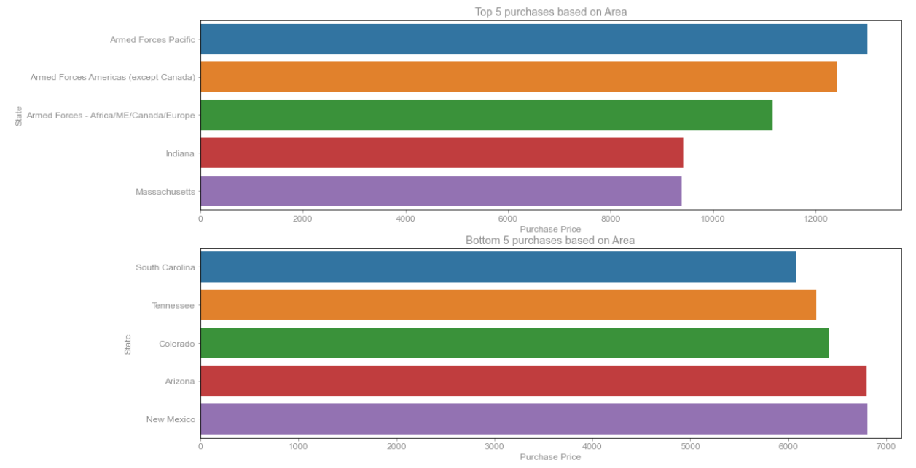
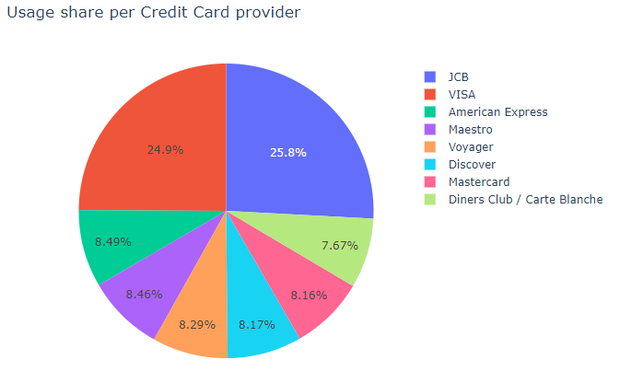

Slide 7

Thank You

