Slide 1
The Big Oscar night. Who Wins?
SMDM Presentation –
Aslam
Nanda
Raghu
Tauqeer

Slide 2
Contents
Data Collection & Descriptive Statistics
Types of Data
Exploratory Analysis
The Hypotheses
Conclusions

Slide 3
The DataSet
Curated data about Oscar award winners
~ 1670 movie personalities and their Oscar wins between 1928 and 2000
http://www.stat.ucla.edu/~vlew/datasets/OscarData.xls
Cleaned up and augmented using public domain data
Several core attributes along with number of awards won
Question:
What attributes in a movie personality are more likely to take home an Oscar?

Slide 4
The Data set
Number of persons - 1670
Number of attributes – 15
Categorical
6
Interval
5
Numerical
4

Slide 5
Types of Data
Categorical Data
Gender – Male or Female
Nationality – USA or Foreign
Ethnicity
Name Change – Original or screen name
Genre – Drama or Other
Alive – Yes or No
Interval Data
Birth Year
First Film Year
Last Film Year
First Nomination Year
First Win Year
Numerical Data
Number of Films
Number of Four-Star Films
Number of Nominations
Number of Wins

Slide 6
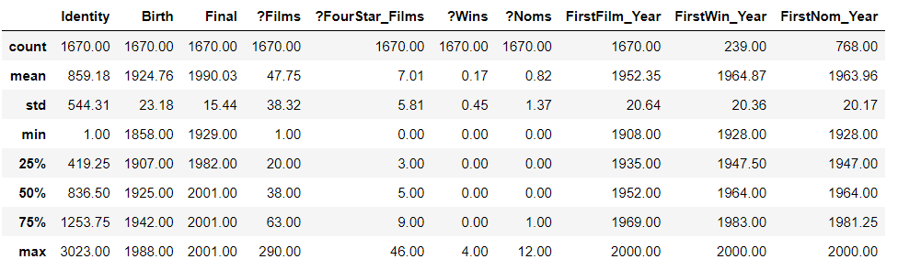
Exploratory Analysis - Describe
1670 persons in total
768 nominated at least once
239 won at least one award
290 – max films! really?
12 – max nominations
4 – max number of awards

Slide 7
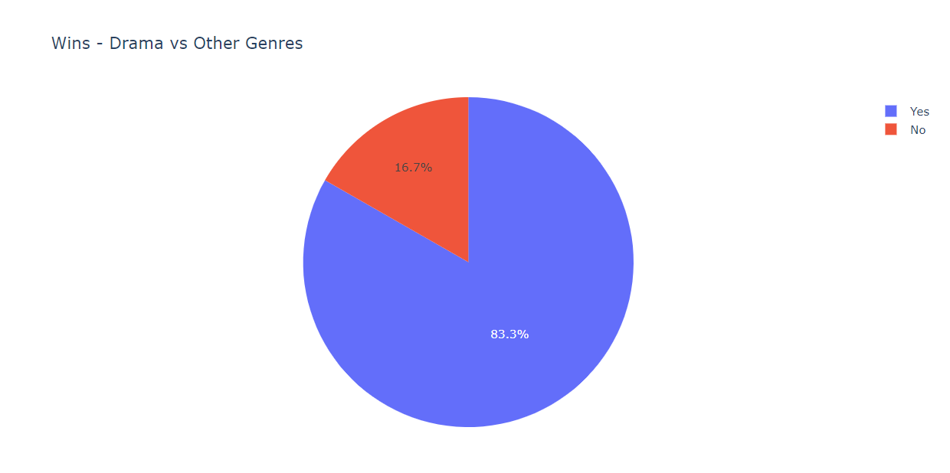
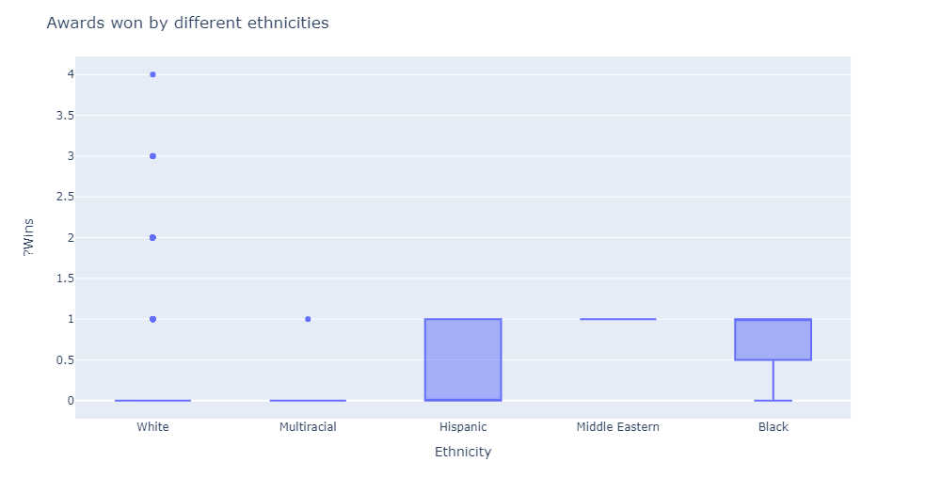
Exploratory Analysis - Visualize
Caucasians all the way! 1 at most for non-whites
Drama trumps all other genres with >80% awards pocketed

Slide 8
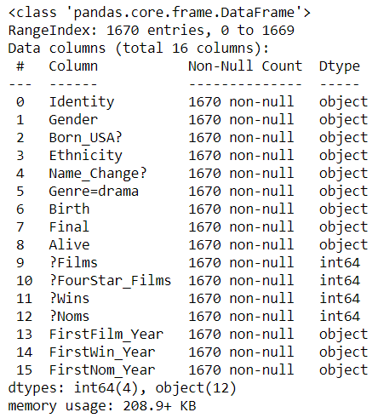
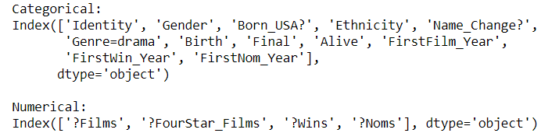
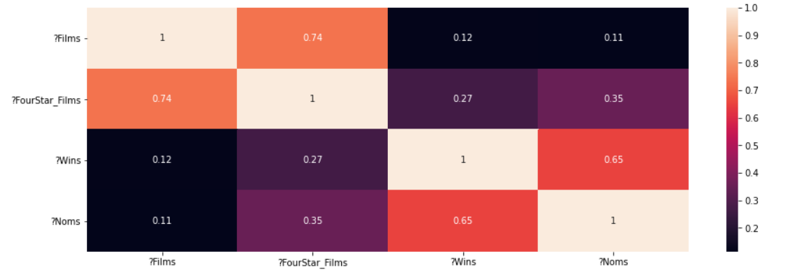
Descriptive Statistics

Slide 9
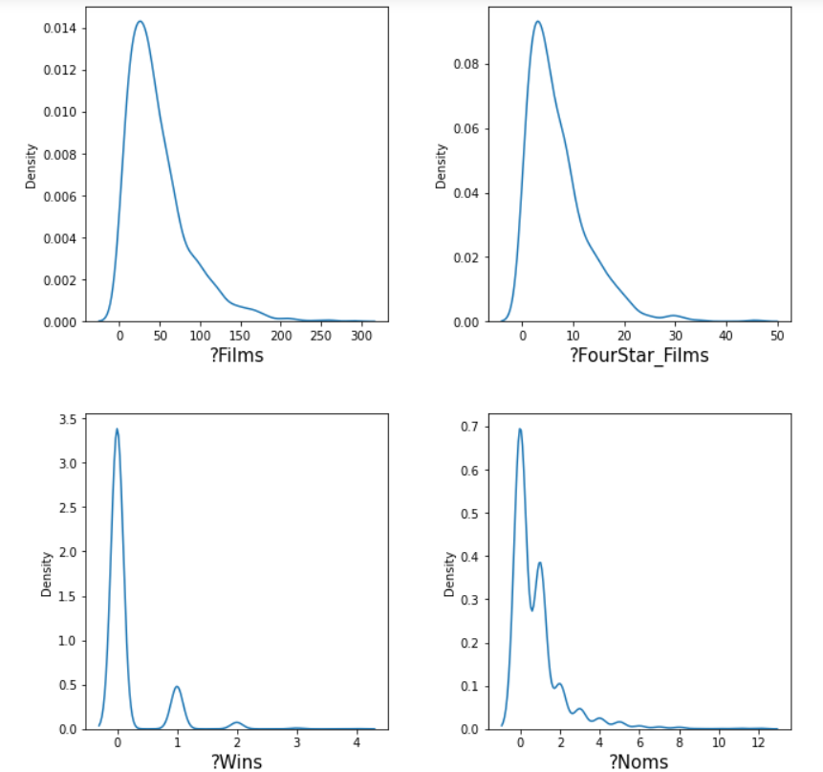
Data Display

Slide 10
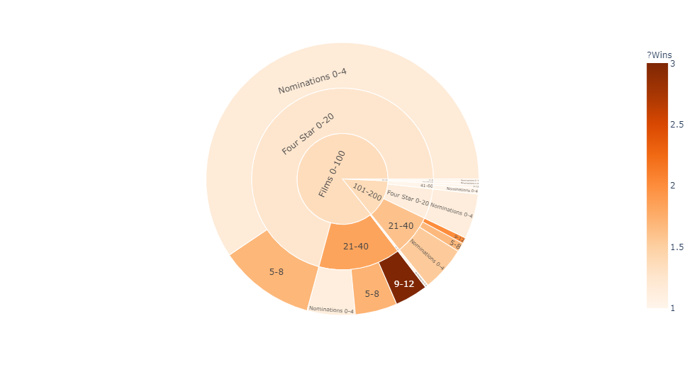
Films -> Four Star Films -> Nominations -> Wins
Max wins occurred in 9-12 nomination range, 21-40 four star films range
Number of four star films turns out to be better indicator of wins than films or nominations

Slide 11
Hypothesis testing and conclusion
Average Oscar wins per 100 movies is same for those with 100, 200 or 300 total movies.
Test Used: Kruskal Wallis H
Inference: P value is greater than alpha, thus we cannot reject null hypothesis. More movies made does NOT translate to higher average chance of winning an Oscar.
Average Oscar wins per 100 “four star” rated movies is same for those with 20 or 40 four star movies.
Test Used: Kruskal Wallis H
Test Result: p-value=0.0002, alpha=0.05
Inference: P value is lesser than alpha, thus we reject null hypothesis. More movies achieving “four star” rating DOES translate to higher average chance of winning an Oscar.
Test result: p-value=0.52, alpha=0.05

Slide 12
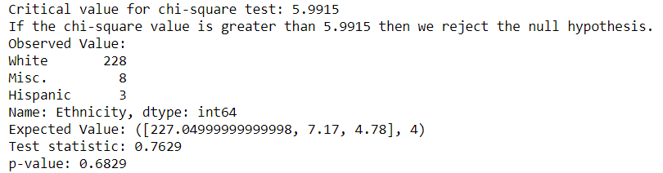


Hypothesis testing and conclusion
More than half of the people who have stage name, are actresses from White ethnicity.
Test Performed - Z Proportion Test - One Sample at 95% CI
Out of all Oscar winners, 95% are White, 2% Hispanic and rest belong to other ethnicity.
Test Performed - Chi-Square Test using 95% CI
H0: P <= 0.5; H1: P > 0.5
The Test Statistic is less than Critical Value; hence, we fail to reject the Null Hypothesis. This indicates, the claim "More than half of the people who have stage name, are actresses from White ethnicity" doesn't hold true.
H0: Claim is correct; H1: Claim is incorrect
The p-value is greater than 'alpha' and chi-square value is less than 'Critical value'; hence, we fail to reject Null Hypothesis. This strongly suggests that the claim could be correct.

Slide 13
Hypothesis testing and conclusion
Percentage of actors to win the Oscar once is 12%, twice is 2%, thrice is 1% and more than that is 0.5%.
Test Used: Chi-Sqare Test
Test result: p-value = 0.002399592320188581, alpha=0.05
Inference: The above output shows that the p-value is less than 0.05. Thus, we reject the null hypothesis and conclude that the claim is not correct.

Slide 14
Hypothesis testing and conclusion
Not more than 20% of nominated actors win Oscar.
Test Used: Critical value & Confidence Interval Measurement
Test result:
Inference: Here the z-score is greater than 1.64, the p-value is less than 0.05, also the confidence interval does not contain the value in the null hypothesis (i.e. 0.2). Thus, we reject the null hypothesis and we have enough evidence to conclude that more than 20% of nominated actors win Oscar
z-score = 7.704017654499069
95% confidence interval = (0.27845381745860226, 0.3439420158747311)
Z-critical = 1.64

Slide 15
Thank you

