Slide 1
Structuring & Visualizing Analytics Problems (SVAP)
Presentation BY –
Nanda Kishore MVS
Raghuvara Bhat
Aslam Pasha S
Tauqeer Ulla Khan

Slide 2
Table of Content
Company Information
Markets
Subsidiaries and Product portfolio
Stock Trend based on given dataset
Use of frameworks to build BCG, Ansoff Matrix and SWOT Analysis to bring
Business model
Cause- effect model

Slide 3
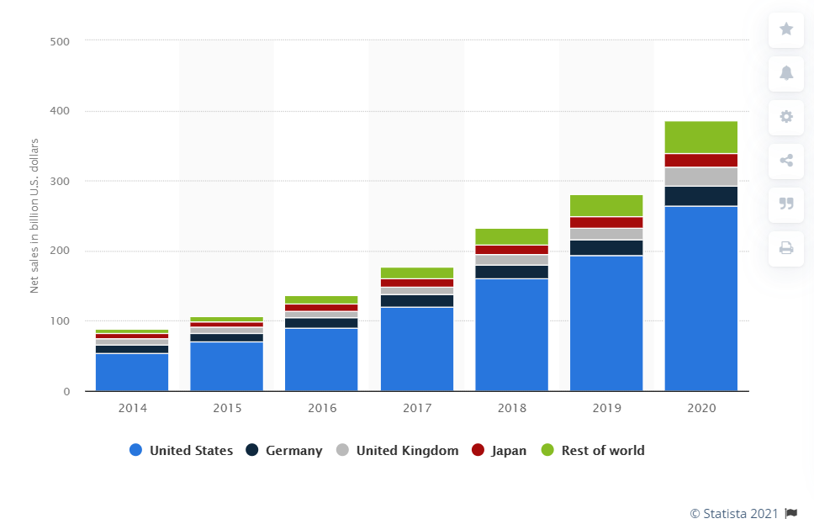
Markets
Annual net sales of Amazon in selected leading markets from 2014 to 2020(in billion U.S. dollars)
Source: • Amazon top markets net sales 2020 | Statista

Slide 4
Subsidiaries and Product portfolio
Focus areas include e-commerce, cloud computing, digital streaming, and artificial intelligence.
It is one of the Big Five companies in the U.S. information technology industry.
Domain Group | Subsidiary | Year of acquisition
Autonomous vehicle | Zoox | 2020
Book, Audiobook | Amazon Books | 2015
 | Amazon Publishing | 2009
 | Audible | 2008
 | Book Depository | 2011
 | ComiXology | 2014
 | Goodreads | 2013
Cargo Airline, Logistics | Amazon Air | 2015
 | Amazon Logistics
Digital Camera Review | Digital Photography Review | 2007
e-commerce | AbeBooks | 2008
 | Amazon.com Services
 | Souq.com | 2017
Film Production, Streaming & Video services, Video Games | Amazon Games | 2012
 | Amazon Studios | 2010
 | IMDb | 1998
 | Twitch Interactive | 2014
Domain Group | Subsidiary | Year of acquisition
Food and Apparel retail, Internet Retailer | Amazon Fresh | 2017
 | Whole Foods Market | 2017
 | Woot | 2010
 | Zappos | 2009
Home Security | Ring | 2018
Pharmacy | Amazon Pharmacy | 2020
 | PillPack | 2018
RnD & Computer Hardware | Amazon Lab126 | 2004
Robotic | Amazon Robotics | 2012
Software & Cloud | AWS | 2000
 | Body Labs | 2017
 | Graphiq | 2017
Web | Alexa Internet | 1999

Slide 5





BCG Matrix
The segment of video on demand had some issues such as poor connectivity which has limited the growth of this segment, making it a question mark The business unit of Zappos has faced issues of low growth and return on investment after Amazon’s acquisition of Zappos | The electronic items being sold at Amazon are in demand, making this business unit a rising star for the company as the market share in this domain is also increasing with time.
Rate of Market Growth
For Amazon mp3 has not been able to provide the company with any solid financial gains, therefore it can be placed into the category of dogs. | Amazon has generated a great deal of cash through the sale of its e-books, making them a cash cow for the company
Relative Market Share

Slide 6




Ansoff Growth Matrix
Present
Product
New
Continuous marketing of its products with the intention of penetrating deeper into its existing markets Introduced Amazon Prime for its premium customers to further benefit from their loyalty. Acquisition of various smaller brands in different markets. | The company started with a single product i.e. books and continued to expand its product portfolio over the years. The company also allows third-party sellers to utilize its platform to sell their products.
Present
Market
The company continues to expand into new geographical areas. Introducing the website in the regional market language it plans on entering. Listing various local products that are specific to the new market. | Acquisition of various new businesses already operating in new marketing such as the acquisition of Whole Foods. Launching cloud services for its clients to enter the software industry. Amazon Go
New

Slide 7
SWOT Analysis
Customer oriented
Differentiation and Innovation
Largest Merchandise Selection
Market Leader
Superior logistics and distribution systems
Minimum pay raise to $15 per hour
Easily imitable business model
Losing Margins in Few Areas
Tax Avoidance Controversy
Unfair use of third party data
Employees Strike
Product Flops and Failures
Strengths
Weakness
Opportunities
Threats
Expanding physical stores
Improve technological measures and organizational policies
Backward Integration
More acquisitions
Self Driving Technology
Launch of electric rickshaws in India
Few controversies
Government regulations
Links to exploitative labor
Aggressive competition (Walmart and ebay)
Imitation
Fake Products
Economic Recession
Fake reviews

Slide 8
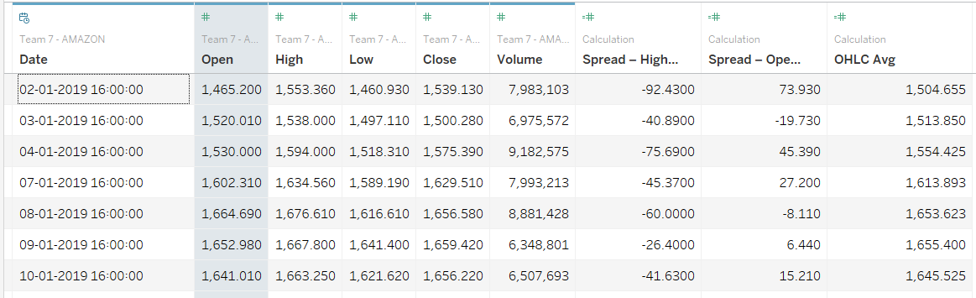
Data Set

Slide 9
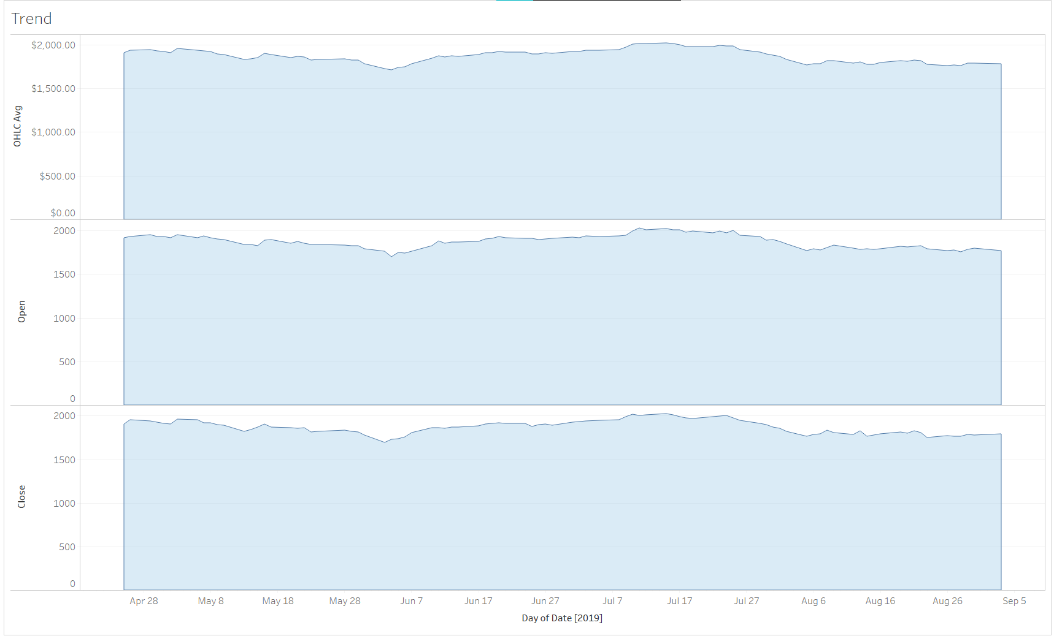
Stock Trend in 2019
Amazon reported strong earnings
Drop in share price due to correction of 14.8%
Highest intra-day value of $2025.6

Slide 10
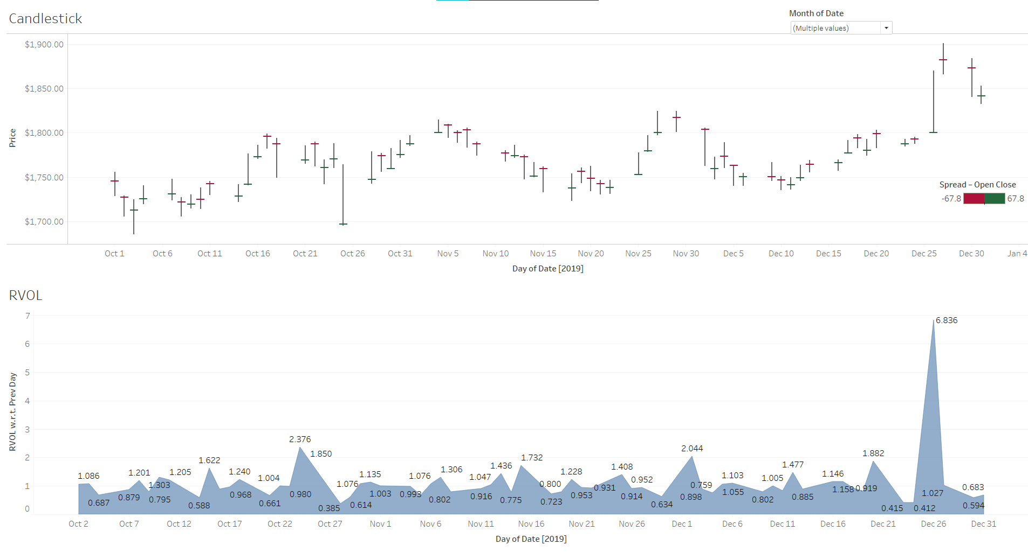
Stock Trend in 2019 (contd.)

Slide 11
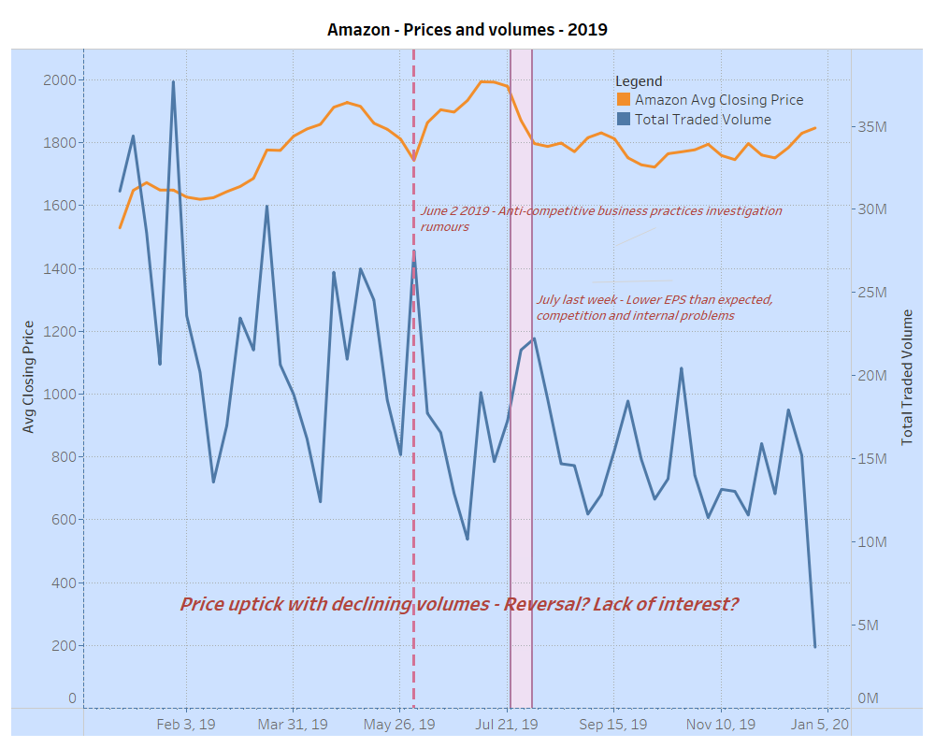
Stock Trend in 2019 (contd.)
Healthy overall increase in stock price despite localized negative impacts
Call to action
shore up falling trade volumes.
Innovative offerings and customer base expansion
Notes:
Sources:
https://www.fool.com/investing/2019/06/03/why-amazoncom-stock-dropped-6-on-monday.aspx
https://www.marketwatch.com/story/amazons-run-of-record-earnings-comes-to-an-end-and-the-stock-is-falling-2019-07-25
https://finance.yahoo.com/news/3-reasons-amazon-stock-down-145844754.html

Slide 12
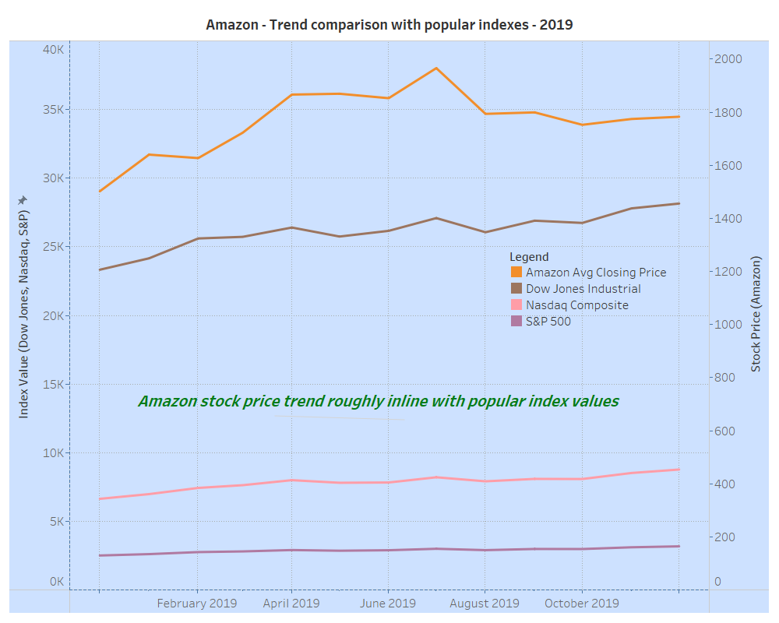
Overall Performance
All major indexes show healthy increase
Amazon stock price in line with market trend
Call to action
Maintain EPS, Returns..
Expect competition, protect market share
Notes:
Sources:
1. Index and stock values from yahoo finance python libraries (Jupyter notebook attached with presentation)

Slide 13
Thank You!

