Slide 1
CI/CD with AWS
Yuliya Yemelyanovich
Senior Systems Engineer
EPAM, February 2022

Slide 2
Continuous integration
Continuous integration is a DevOps software development practice where developers regularly merge their code changes into a central repository, after which automated builds and tests are run. Continuous integration most often refers to the build or integration stage of the software release process and entails both an automation component (e.g. a CI or build service) and a cultural component (e.g. learning to integrate frequently).

Slide 3
Continuous delivery and deployment
Continuous delivery is a software development practice where code changes are automatically prepared for a release to production.
With continuous delivery, every code change is built, tested, and then pushed to a non-production testing or staging environment. There can be multiple, parallel test stages before a production deployment. The difference between continuous delivery and continuous deployment is the presence of a manual approval to update to production. With continuous deployment, production happens automatically without explicit approval.

Slide 4
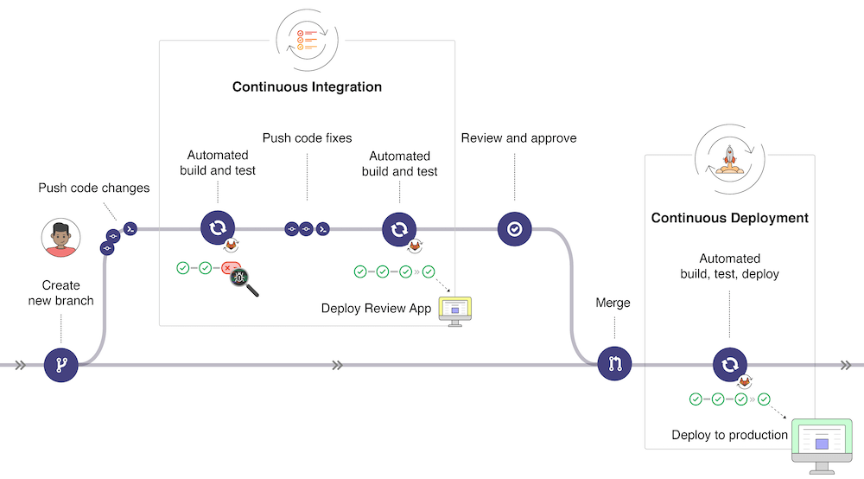
CI/CD concepts, GitLab

Slide 5
Why do it
Check code for issues
Automation saves time
Detect issues early
The faster and more reliable CI/CD is, the more often you can do releases, the shorter is time to market.

Slide 6
CI/CD concepts, GitLab

Slide 7
Popular tools
G2 Grid Continuous Integration
G2 Grid Continuous Delivery

Slide 8
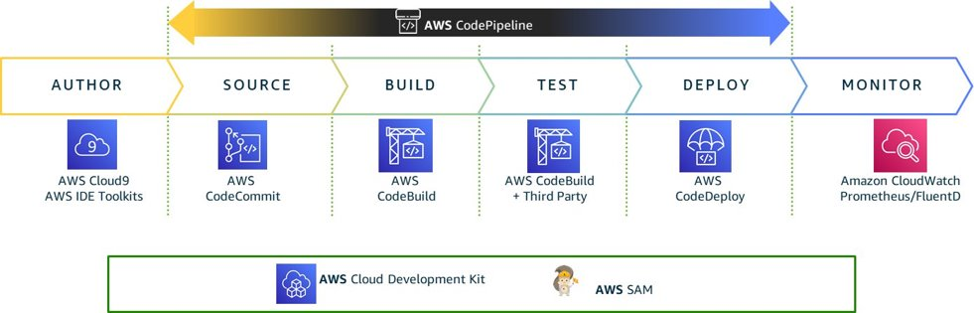
AWS and CI/CD

Slide 9
AWS and CI/CD

Slide 10
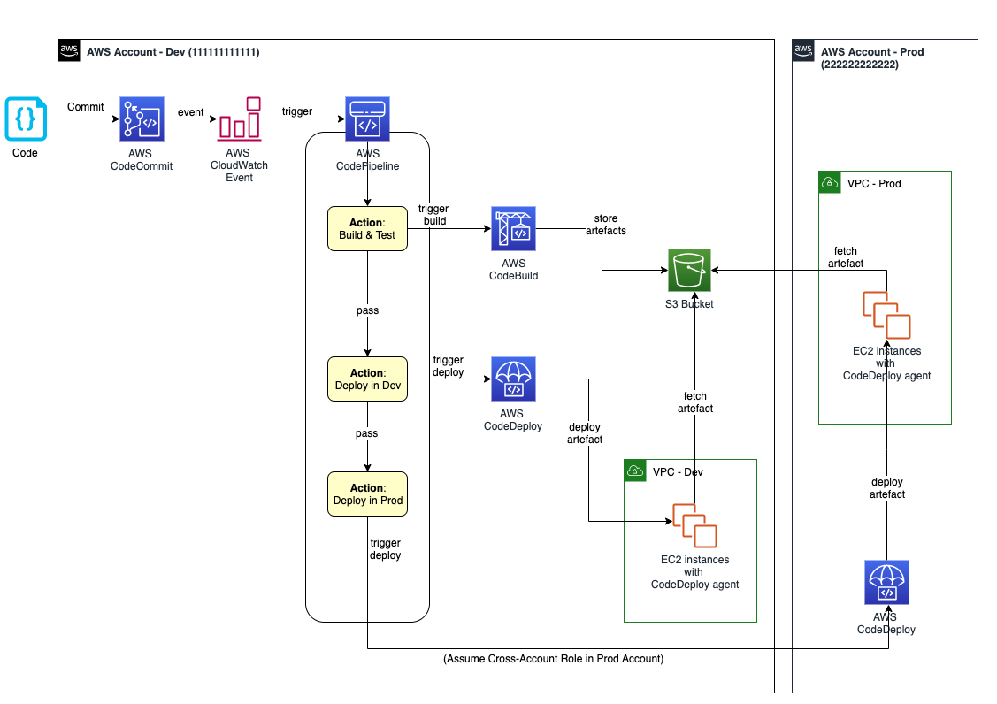
AWS DevOps Blog

Slide 11
AWS CodeCommit
CodeCommit is a secure, highly scalable, managed source control service that hosts private Git repositories.
Integration with other AWS services
Pull requests and approval templates
Access control

Slide 12
AWS CodeBuild
CodeBuild is a fully managed build service in the cloud.
Fully managed – CodeBuild eliminates the need to set up, patch, update, and manage your own build servers.
On demand – CodeBuild scales on demand to meet your build needs. You pay only for the number of build minutes you consume.
Out of the box – CodeBuild provides preconfigured build environments for the most popular programming languages. All you need to do is point to your build script to start your first build.

Slide 13
version: 0.2
phases:
install:
runtime-versions:
java: openjdk8
pre_build:
commands:
- echo Nothing to do in the pre_build phase...moving on...
build:
commands:
- echo Build started on `date`
- mvn test
- echo Test completed on `date`
post_build:
commands:
- mvn clean package
- echo Build completed on `date`
artifacts:
discard-paths: yes
files:
- target/*.jar
- scripts/*
- appspec.yml
Buildspec reference

Slide 14
AWS CodeDeploy
CodeDeploy is a deployment service that automates application deployments to Amazon EC2 instances, on-premises instances, serverless Lambda functions, or Amazon ECS services. You can deploy:
Code
Serverless AWS Lambda functions
Web and configuration files
Executables
Packages
Scripts
Multimedia files

Slide 15
Benefits of AWS CodeDeploy
Server, serverless, and container applications. CodeDeploy lets you deploy both traditional applications on servers and applications that deploy a serverless AWS Lambda function version or an Amazon ECS application.
Automated deployments. CodeDeploy fully automates your application deployments across your development, test, and production environments. CodeDeploy scales with your infrastructure so that you can deploy to one instance or thousands.
Minimize downtime. If your application uses the EC2/On-Premises compute platform, CodeDeploy helps maximize your application availability. During an in-place deployment, CodeDeploy performs a rolling update across Amazon EC2 instances. You can specify the number of instances to be taken offline at a time for updates. During a blue/green deployment, the latest application revision is installed on replacement instances. Traffic is rerouted to these instances when you choose, either immediately or as soon as you are done testing the new environment. For both deployment types, CodeDeploy tracks application health according to rules you configure.
Stop and roll back. You can automatically or manually stop and roll back deployments if there are errors.
Centralized control. You can launch and track the status of your deployments through the CodeDeploy console or the AWS CLI. You receive a report that lists when each application revision was deployed and to which Amazon EC2 instances.
Easy to adopt. CodeDeploy is platform-agnostic and works with any application. You can easily reuse your setup code. CodeDeploy can also integrate with your software release process or continuous delivery toolchain.
Concurrent deployments. If you have more than one application that uses the EC2/On-Premises compute platform, CodeDeploy can deploy them concurrently to the same set of instances.

Slide 16
Deployment types
In-place deployment: The application on each instance in the deployment group is stopped, the latest application revision is installed, and the new version of the application is started and validated. You can use a load balancer so that each instance is deregistered during its deployment and then restored to service after the deployment is complete. Only deployments that use the EC2/On-Premises compute platform can use in-place deployments.
Blue/green on an EC2/On-Premises compute platform: The instances in a deployment group (the original environment) are replaced by a different set of instances (the replacement environment) using these steps:
Instances are provisioned for the replacement environment.
The latest application revision is installed on the replacement instances.
An optional wait time occurs for activities such as application testing and system verification.
Instances in the replacement environment are registered with an Elastic Load Balancing load balancer, causing traffic to be rerouted to them. Instances in the original environment are deregistered and can be terminated or kept running for other uses.

Slide 17
Deployment types
Blue/green on an AWS Lambda or Amazon ECS compute platform: Traffic is shifted in increments accorinding to a canary, linear, or all-at-once deployment configuration.
Canary: Traffic is shifted in two increments. You can choose from predefined canary options that specify the percentage of traffic shifted to your updated Lambda function or ECS task set in the first increment and the interval, in minutes, before the remaining traffic is shifted in the second increment.
Linear: Traffic is shifted in equal increments with an equal number of minutes between each increment. You can choose from predefined linear options that specify the percentage of traffic shifted in each increment and the number of minutes between each increment.
All-at-once: All traffic is shifted from the original Lambda function or ECS task set to the updated function or task set all at once.

Slide 18
version: 0.0
os: linux
files:
- source: /
destination: /home/ec2-user/server2
permissions:
- object: /
pattern: "**"
owner: ec2-user
group: ec2-user
hooks:
BeforeInstall:
- location: install_dependencies.sh
timeout: 300
runas: ec2-user
ApplicationStop:
- location: stop.sh
timeout: 20
runas: ec2-user
ApplicationStart:
- location: start.sh
timeout: 20
runas: ec2-user
ValidateService:
- location: validate.sh
timeout: 20
runas: ec2-user
Appspec reference

Slide 19
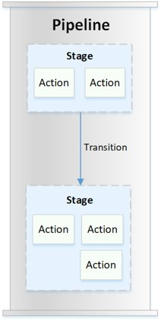
AWS CodePipeline
CodePipeline is a continuous delivery service you can use to model, visualize, and automate the steps required to release your software.

Slide 20
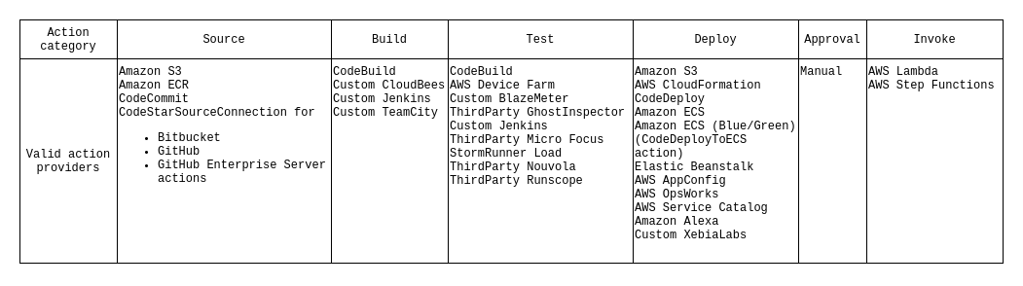
CodePipeline actions
Pipeline structure reference

Slide 21
AWS DevOps Blog

Slide 22
Demo
Simple deployment to ECS

Slide 23
Resources
Required for the quiz:
Best practices for CI/CD from AWS
AWS CodeCommit UserGuide
AWS CodeBuild UserGuide
AWS CodeDeploy UserGuide
Optional:
Practicing Continuous Integration and Continuous Delivery on AWS
Overview of Deployment Options on AWS
Serverless CI/CD for the Enterprise on the AWS Cloud
DevOps Minsk Meetup: Современный CI для автопилота: как ускорить Time2Market в 5 раз (и что такое KPI)

