Slide 1


U
U
U
U
P
U
P
U
P
P
U
P
P
U
P
P
P
P
P
U
U
U
P
P
P
P
P
P
P
P
P
U
P
U
P
C
C
C

Slide 3

Reduction in Complexity |  |  |  | Final Architecture
 | acc1 | acc2
VOC
Flowers
SVHN
# of global
blocks
FLOPs
Total # of
params

Slide 4
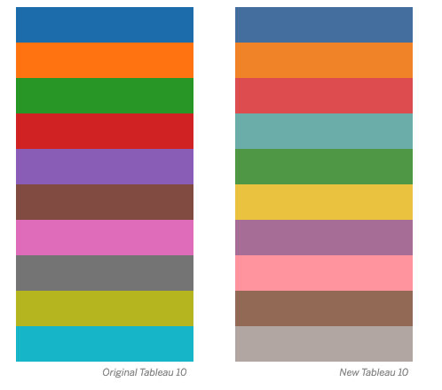
ResNet 18
ResNet 34
ResNet 50
ResNet 101
Model size

Slide 5
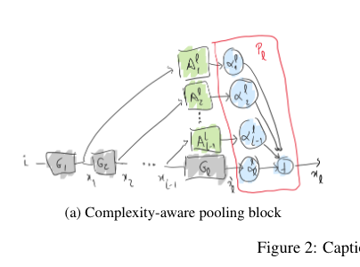

















Figure 2
…
$$A_{1}^{l}$$
$$∗$$
$$BN$$
$$α_{1}^{l}$$
$$A_{2}^{l}$$
$$∗$$
$$BN$$
$$α_{2}^{l}$$
A should be closer to the box but top right of the greenbox
All use same black arrow
…
$$A_{l−1}^{l}$$
$$∗$$
$$α_{l−1}^{l}$$
$$BN$$
$$i$$
$$G_{1}$$
$$G_{2}$$
…
$$G_{l}$$
$$α_{l}^{l}$$
+
$$x_{1}$$
$$x_{2}$$
$$x_{l−1}$$
$$x_{l}$$

Slide 6
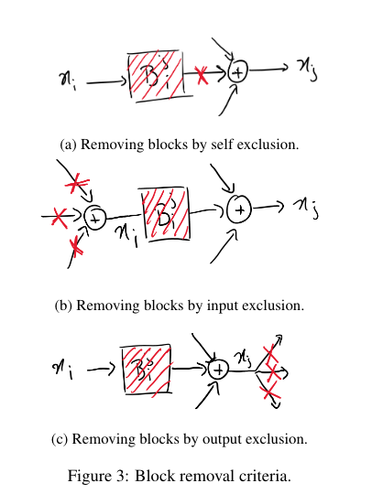




Figure 3
+
$$B_{i}^{j}$$
+
$$x_{i}$$
$$x_{j}$$
+
$$B_{i}^{j}$$
+
$$x_{i}$$
$$x_{j}$$
+
$$B_{i}^{j}$$
+
$$x_{i}$$
$$x_{j}$$

