Slide 1


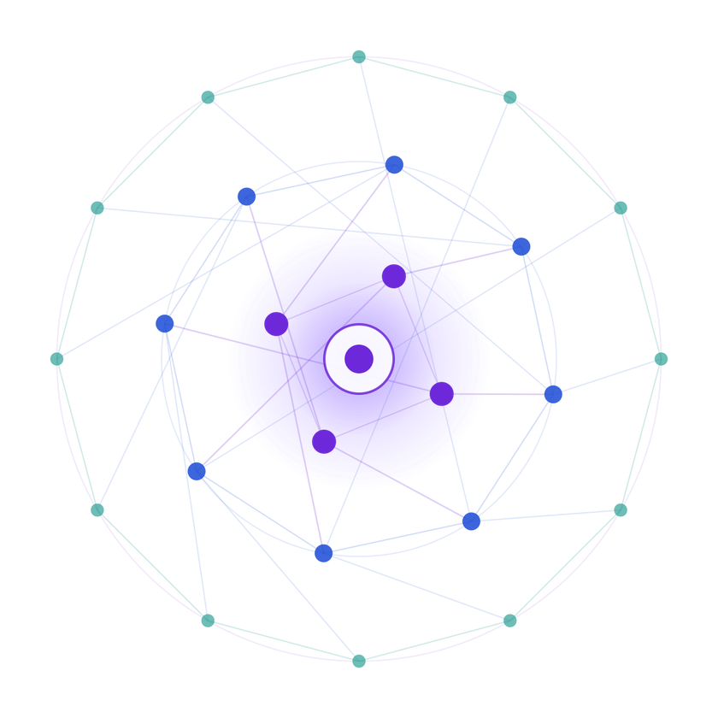
SAMSUNG PRISM
Generative AI
Hackathon
3rdEdition 2026-27
Theme ID - Theme 2 (SmartGuided TroubleshootingEngine) Team Name - Code & Chill_SRM
College Name - SRM UNIVERSITY OF SCIENCE AND TECHNOLOGY
Team Lead Name & Email 1 - Asleshita Tuduku (asleshita.t@gmail.com)
Member Name & Email 2 - Dhruthi (dhruti.p.2007@gmail.com)
Member Name & Email 3 - Bhavya Sri (bsri110725@gmail.com)
Submission Github link - https://github.com/Asleshita/prism-troubleshoot

Slide 2

Theme
Theme 2 - Smart Guided Troubleshooting Engine
Problem: Samsung support agents manually translate raw internal knowledge-store (SIIS) articles into step-by-step guidance for customers - slow and inconsistent.
Goal: build POST /v1/troubleshoot - an API that takes a user's query plus a raw SIIS article and returns a structured, deeplink-enriched troubleshooting guide (Goals -> Actions -> StepGroups), automatically.

Slide 3

Existing Solutions & Gaps
Existing Samsung support flow:customerdescribesissue-> agent manually
reads SIIS article -> agent manually decides which Settings screens to point to -> inconsistent phrasing and missed deeplinks.
Gap 1: No automatic structuring - raw SIIS text is unstructured prose, not actionable steps.
Gap 2: No deeplink discovery - agents don't reliably know which of the 578 Settings deeplinks applies to a given step.
Gap 3: No caching - the same or rephrased question is answered from scratch every time.
Gap 4: No safety net - a flaky LLM call means no answer at all for the customer.

Slide 4

Our Solutions & Architecture Diagram
Oursolution:apipelinethat turns (query,SIISarticle)intoavalidated
ContextDeeplinkResponse in one API call. Architecture:
query + siis_response -> cache check (by article content hash)
cache miss -> Gemini drafts goal / title / steps / description / category from the SIIS text only
Gemini failure or timeout -> automatic rule-based fallback derives steps directly from the SIIS text, so the API never errors or returns empty deeplink matcher attaches real Settings deeplinks by matching each step's own wording against the 578-entry catalog - never invents a URI
format repair + validation layer enforces the goal regex, 2-3 word title, "It will" + 5-7 word description, score range, and strips any URL before returning

Slide 5

Demo & Product Walkthrough
Live demo: GET /health returns {"status": "ok"} - confirms the API is up.
POST /v1/troubleshoot with a real query (e.g. "My Galaxy S22 screen is completely black and won't turn on") and its SIIS article returns a full ContextDeeplinkResponse with Goals, Actions, StepGroups and real deeplinks.
Demo video: https://drive.google.com/file/d/1cGXe4VlctF_X9bVcCWu7Apl_5MvlQKf9/view?usp=drivesdk

Slide 6

Tools and tech stack used
Python 3.11,FastAPI,Pydanticv2(schemavalidationagainst the
official schema.py)
Google Gemini (gemini-3.1-flash-lite) for query understanding and step drafting
In-memory cache keyed on SIIS article content hash, for sub-300ms repeat/paraphrase responses
Rule-based fallback generator (no external dependency) as a reliability safety net
Docker for reproducible deployment

Slide 7

Impact & Use case
Turns every rawSamsung support articleinto a ready-to-use,
structured troubleshooting flow - no manual agent authoring needed.
Customers get consistent, jargon-free steps with one-tap Settings deeplinks instead of generic text instructions.
Cuts response time for common issues (blank screen, touch problems, screen mirroring, etc.) from manual lookup to a sub- second cached API call.
Scales directly to any new SIIS article without retraining or rewriting rules, since steps are always derived live from the source text.

Slide 8

Innovation highlights, results and limitations
Innovation: deeplinks are matched by meaning (validation key / description), never invented - the LLM never writes a deeplink URI itself. Innovation: automatic fallback generator guarantees a valid, non-empty response even if the LLM is down, slow, or rate-limited.
Results: 20/20 kit scenarios pass every format rule (goal regex, title length, description rule, score range, auto-actions-have-deeplinks).
Results: zero URL leaks across all responses; cold-start latency under the 8- second limit.
Limitation: deeplink matching favors precision over recall - it may correctly leave a step as "manual" rather than risk attaching a wrong deeplink. Limitation: fallback phrasing is plainer than the LLM path, since it exists purely as a safety net.

Slide 9

What’s next
Move deeplink matching from keyword/label matching to embedding-based semantic matching for higher recall.
Add a persistent cache (Redis) so warm results survive a server restart.
Expand generalization testing against a wider set of unseen SIIS articles and query phrasings.
Add automated regression tests that run scripts/selfcheck.py on every commit.

Slide 10

Brownie points slide( differentiation)
Fullsafety net: every response is guaranteed schema-valideven
under LLM failure, thanks to the rule-based fallback.
Zero-URL-leak enforcement is applied as a final regex sweep over the entire JSON output, not just individual fields.
results.jsonl includes 8-10 genuinely diverse query_variations per query (synonym swaps, register changes, reordering, question framing) - not near-duplicates.
Self-check script (scripts/selfcheck.py) reproduces the judges' own checks locally, including cold/warm latency per query.

Slide 11

Checklist- Updated on Public GitHub
Working prototype code - public GitHub repo: Y (https://github.com/Asleshita/prism-troubleshoot) README with reproducible setup instructions: Y Demo video, max 5 minutes: [YOUR VIDEO LINK HERE] Presentation file (PPT or PDF): Y

Slide 12

Thank you
Organised by the Language AI Team and the PRISM Team, Samsung R&D Institute India

