Slide 1
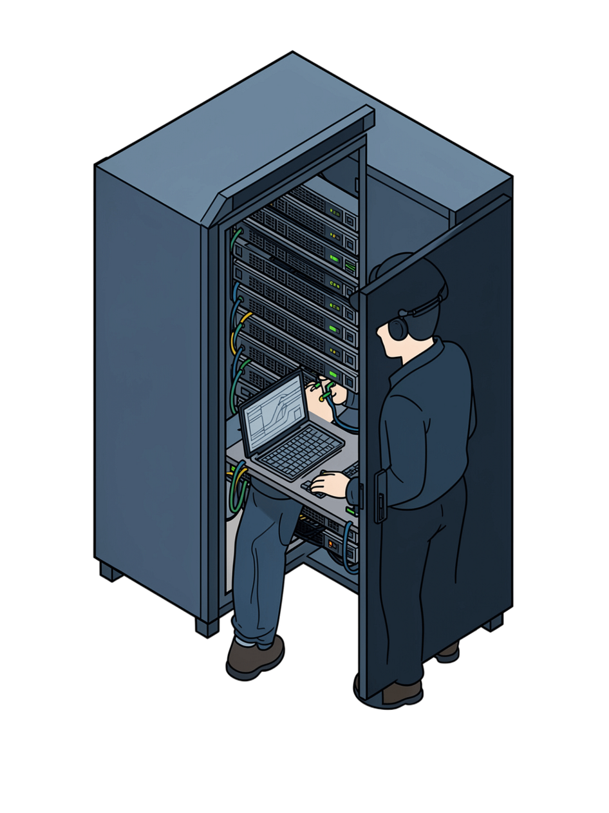

Aslin Dhurai — DevOps Engineer
Infrastructure · CI/CD · Automation · Reliability
Notes:
1

Slide 2
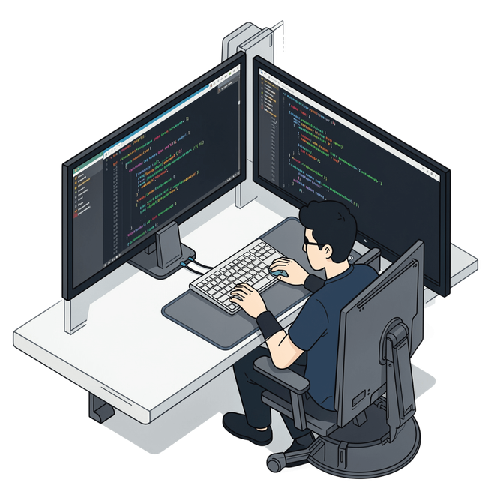
ABOUT ME
Who I Am
  DevOps engineer focused on cloud infrastructure, CI/CD, automation, and monitoring
  Passionate about making application delivery reliable and repeatable
  I enjoy the intersection of development, infrastructure, and reliability
Notes:
2

Slide 3




What DevOps Means to Me
Not just tools — a reliable process bridging development and operations.
Automation
CI/CD
Replace repetitive manual work
Consistent build, test, and deploy
Infra as Code
Monitoring
Version-controlled infrastructure
Know if the system behaves as expected
Notes:
3

Slide 4
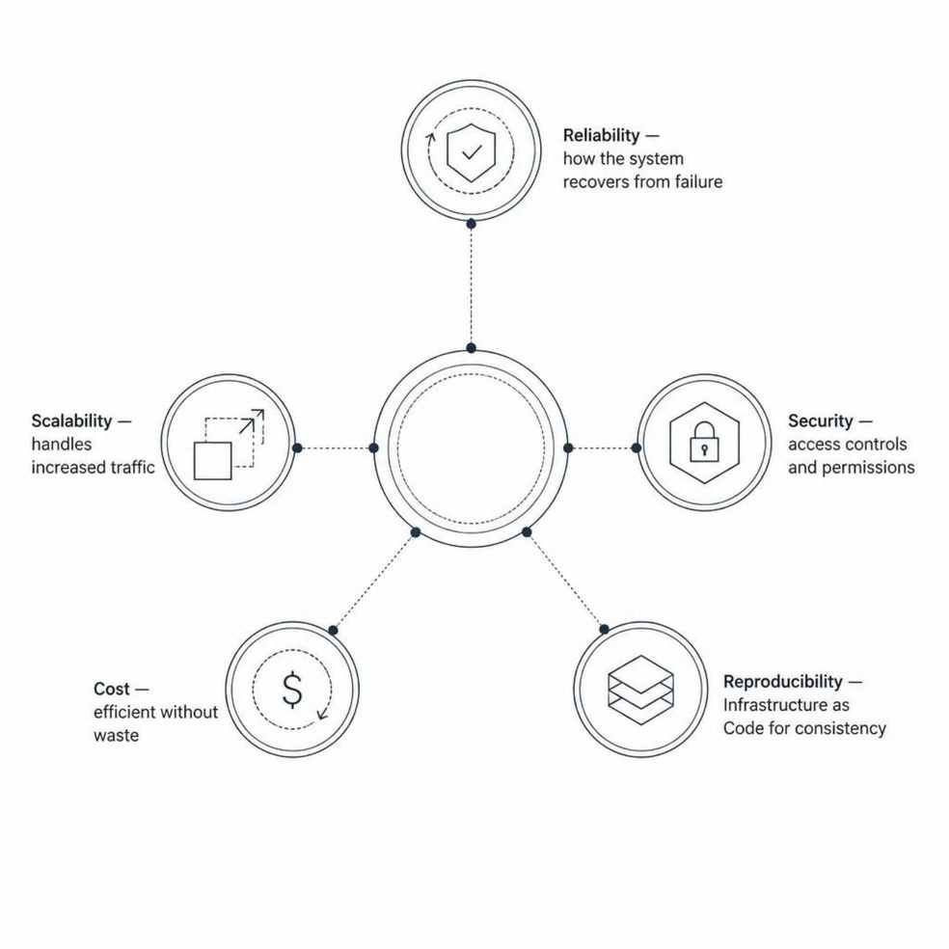

INFRASTRUCTURE
How I Approach Infrastructure
  Reliability: How does the system recover from failure?
  Scalability: Can it handle increased traffic?
  Security: Access controls, secrets, permissions
  Cost: Efficient without unnecessary expense
  Reproducibility: Infrastructure as Code for consistency
Notes:
4

Slide 5
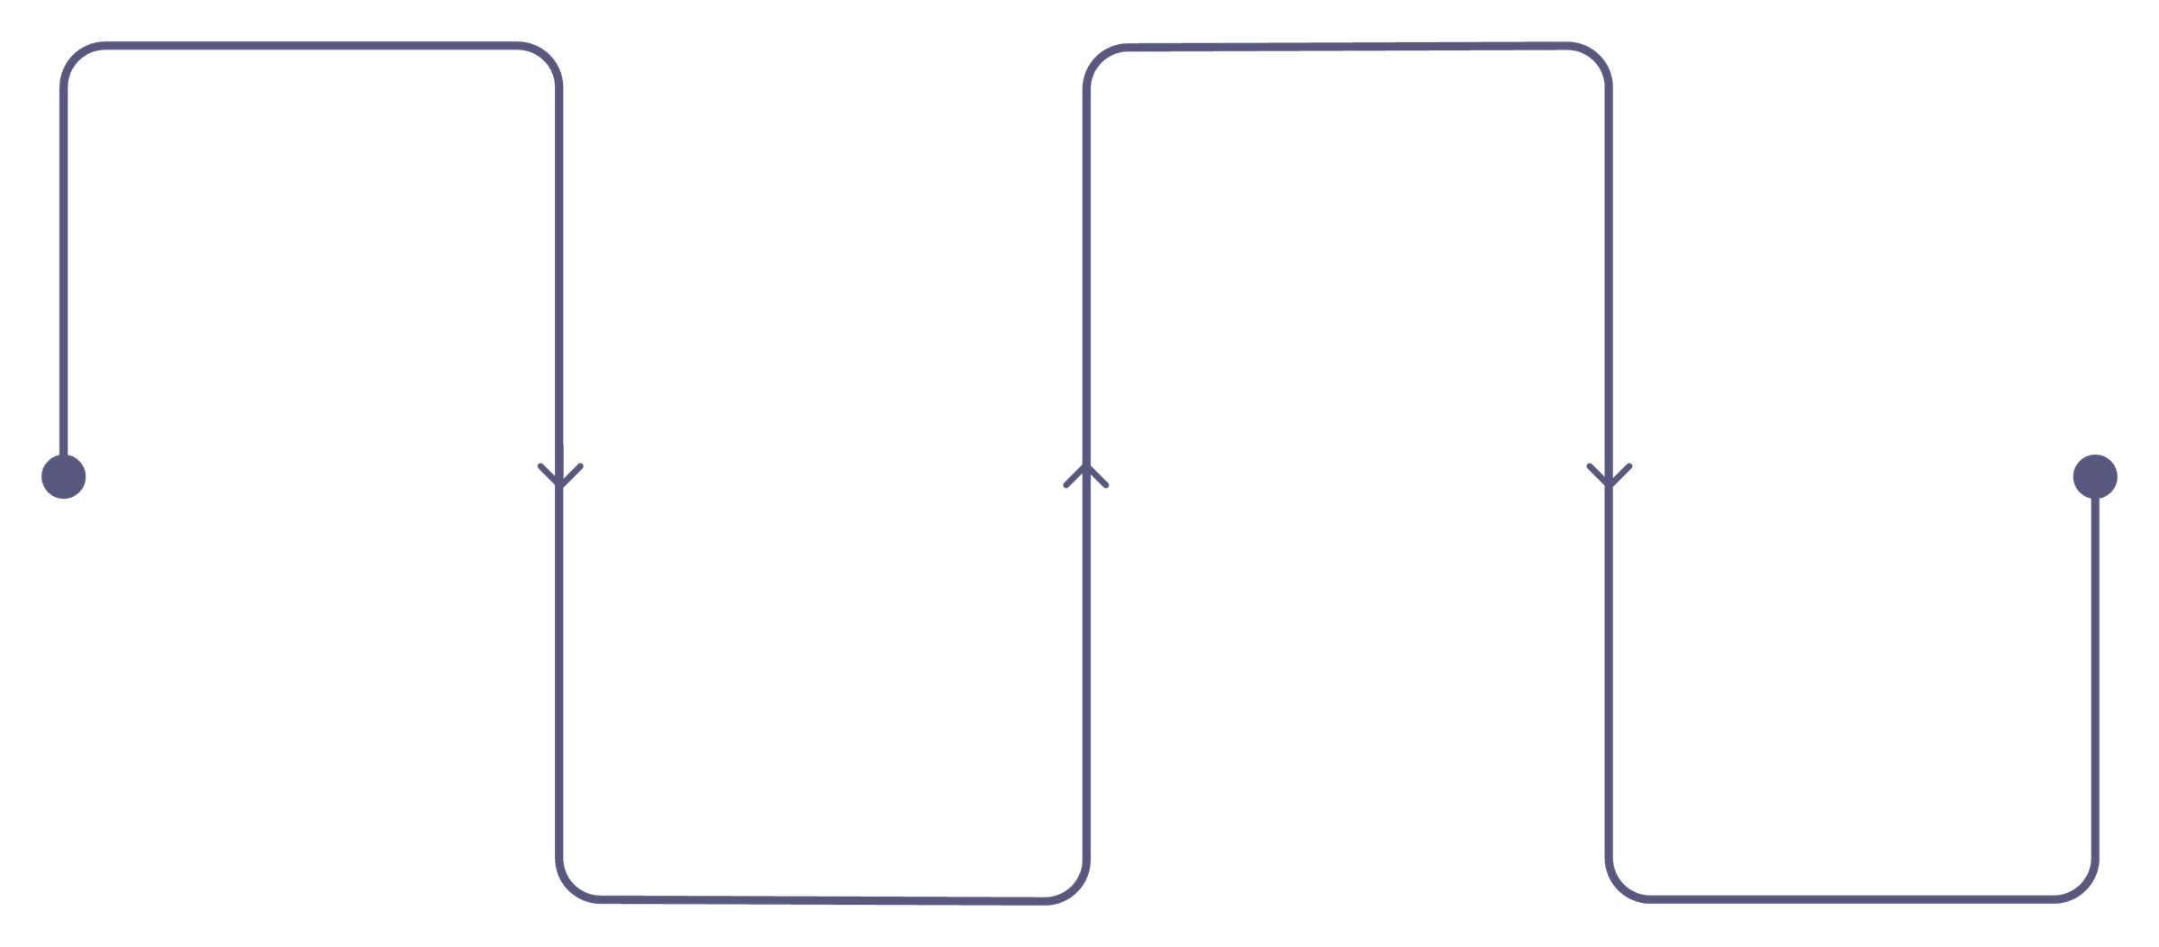
Project Intro: API Health Monitoring System
A cloud-native solution designed for proactive API health management and reliable issue detection.
Register API
Detect Changes
Add endpoints and targets
Identify state transitions
Periodic Checks
Generate Alerts
Scheduled health probes run
Emit notifications and events
This system leverages a decoupled, event-driven architecture to efficiently monitor user-defined APIs, evaluate health with configurable rules, and scale for numerous endpoints.
Notes:
5

Slide 6
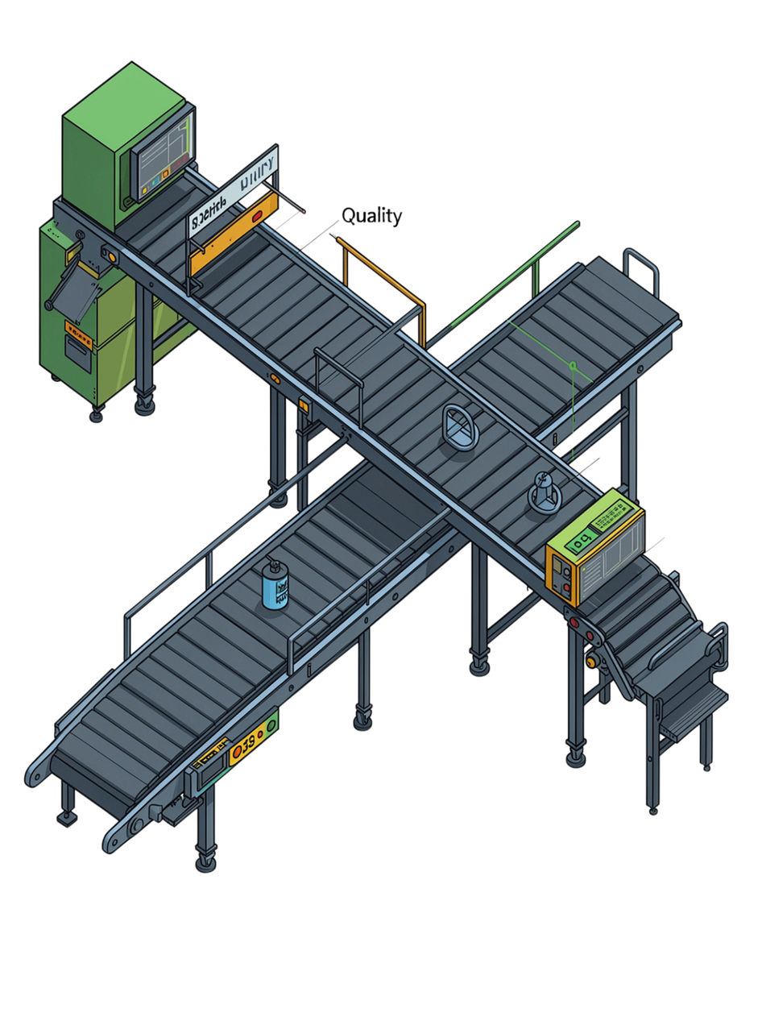




CI/CD: Safe & Predictable
Validate
Every code push triggers automated checks
Build & Test
Consistent, repeatable pipeline
Deploy
Rollback strategy, approval gates, secret management
Verify
Less manual effort, fewer human errors
Notes:
6

Slide 7
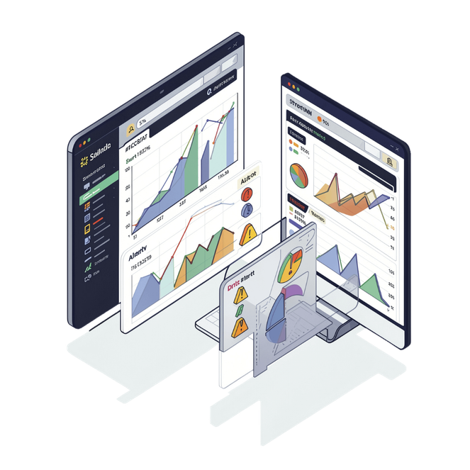

Monitoring & Observability
Give engineers the information they need to troubleshoot quickly.
Metrics
Logs
Alerts
CPU, memory, latency, request rates, error rates
Understand what happened when issues occur
Meaningful signals that require action — not noise
Notes:
7

Slide 8
Security Throughout DevOps
Built In, Not Bolted On
Least Privilege
Shift Left
Security is part of the design — not an afterthought
Only the permissions actually needed, nothing more
Identify vulnerabilities in applications and containers early
Notes:
8

Slide 9
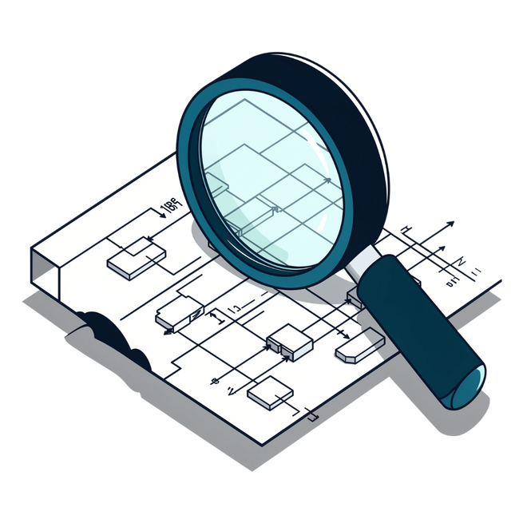
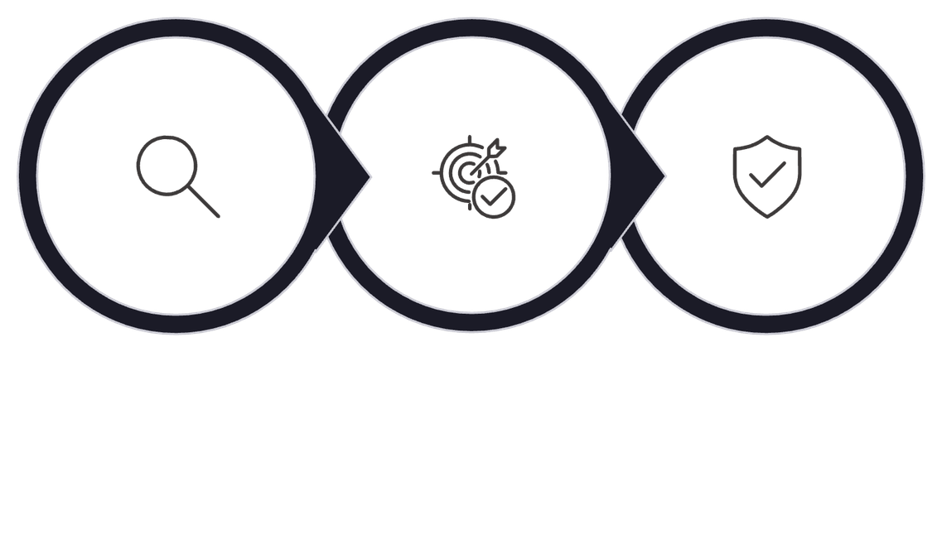

PROBLEM SOLVING
Troubleshooting Approach
Identify
Narrow
Resolve
Key insight: Solving the immediate problem is good. Preventing it from happening again is better.
Notes:
9

Slide 10



What I Bring
Technical Depth
Automation Mindset
Infrastructure, deployment, and operations
Always looking for ways to improve
Systems Thinking
Continuous Learner
Understanding how all pieces fit together
Adapting to new technologies and challenges
Notes:
10

Slide 11




Why Marloa?
AI Voice Workflows for Customer Automation
Build on a mission that puts voice automation at the center of the product
AI Systems That Handle Real Business Work
Work at the intersection of bookings, qualification, follow-up, and escalation
Infrastructure for 24/7 Reliability
Help build DevOps and reliability for always-on managed AI voice systems people can trust
Shape a New Product Category Early
Influence the infrastructure and reliability foundation for a new AI voice automation platform
Notes:
11

Slide 12


Thank You!
DevOps is about more than just tools – it's a culture of innovation for efficient and reliable software delivery.
Automation
Reliability
Streamline repetitive tasks and workflows for speed and consistency.
Build resilient, observable systems that recover quickly from failure.
Collaboration
Improvement
Foster a shared ownership mindset between development and operations teams.
Continuously learn, iterate, and adapt to evolving challenges and technologies.
I'm ready to dive into any technical area in more detail.
Questions?
Notes:
12

