Slide 1


SAP Fiori
Prepared By : Aaliya Banu Z

Slide 2
SAP Fiori Overview :
SAP Fiori gets its name from the Italian word for flower.
SAP Fiori is the user interface/ user experience application launched by SAP.
It was launched to offer a consistent user experience for all.
SAP Fiori has been adopted by companies to replace the traditional SAP GUI.
It can be used by various devices.
Fiori apps can be extended if required.

Slide 3
Fiori Design Principles :
Role Based
Responsive
Simple
Seamless Experience
Delightful
Displays relevant data to the user
Runs on multiple devices
Focused on important things
Same look and feel in all devices
Easy to use and User friendly

Slide 4
Types of Fiori Apps :
1) Transactional Apps : These applications let you perform SAP transactions on desktops and mobile devices. These apps are designed for interacting with business objects. These include sales orders, managing business lists, and processing financial documents.
2) Fact Sheets :
These apps display contextual information and key facts about central objects used in your business operations.From a fact sheet area (tile), you can drill down into its details. You can navigate from one fact sheet to its related fact sheets. For example, you can navigate from a document to the related business partner or to the master data.
3) Analytical Apps :
These applications are used to analyze business processes and key performance indicators.

Slide 5
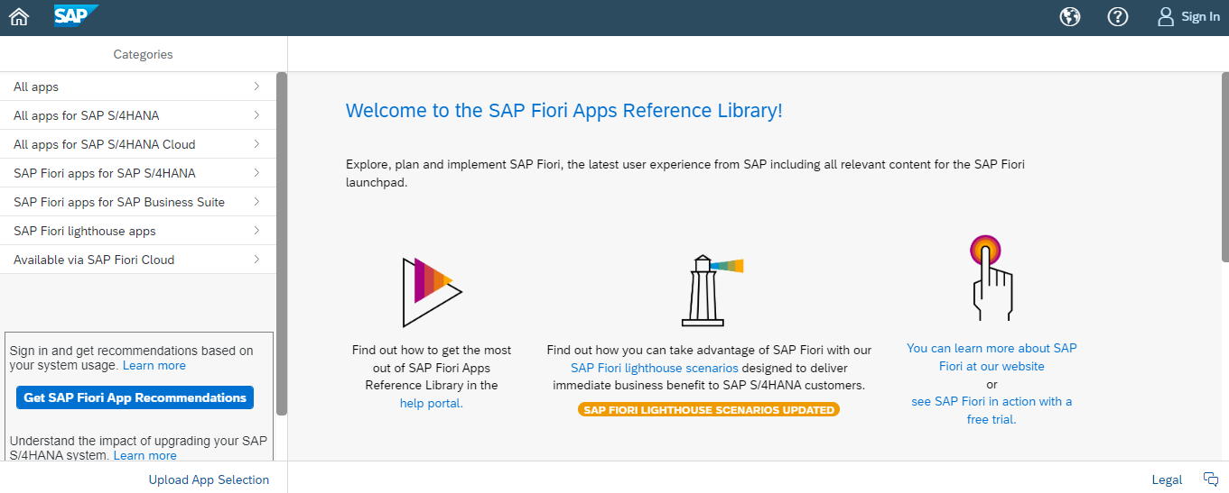
Fiori Apps Library:
https://fioriappslibrary.hana.ondemand.com/sap/fix/externalViewer/

Slide 6
Transport Request :
TR is a kind of ‘Container / Collection’ of changes that are made in the development system. It also records the information regarding the type of change, the purpose of transport, request category and the target system.
Tcode : SE09
TR Types
Workbench
Customized
Client Independent
Client Dependent

Slide 7
Tcodes used in Fiori
/ui2/flp
/ui2/flpd_cust
/ui2/flpcm_cust
sicf
/iwfnd/maint_services
/iwfnd/error_log
pfcg
SCC1

Slide 8
Fiori Links :
FLPD_CUST Link
FLP 110

Slide 9
Activating Standard Fiori Application
Set your TR in Fiori
Create your custom Catalog and Custom Group
Open your app in Fiori Apps Library
Find the Standard Catalog
Take reference of the Tile from your Standard Catalog to Custom Catalog
Take reference of the Target Mappings from your Standard Catalog to Custom Catalog
Move the Tile from the Catalog to Group

Slide 10
Odata Service Activation :
Go to the Tcode : /iwfnd/maint_services
Check the external service is available or not
If not, Click “Add Service”
Give your system alias and external service name
Select your service and click “Add Selected Service”
Remove System alias
Add it again to Capture it in Custom TR

Slide 11
Tcode as Tile Apps :
Go to your Custom Catalog
Click on “Create Target mapping”
Semantic object : Tcode
Action : Display
Application type : Transaction
Transaction : Tcode
Click on “+” in Tiles
App launcher - Static
Title : Tile Name
Subtitle : Tcode
Semantic Object : Tcode
Action : Display
Add this tile to your custom group

Slide 12

Thank you
Kaar Technologies
Level 8, Shyamala Towers,No 136,
Arcot Road, Chennai- 600 093 Tel: +91 (44) 4065 1500, Fax: +91 (44) 4065 1512
kaartech
@kaartech
in
Kaar Technologies
G+
Kaar Tech

