Slide 1
Breast Cancer Wisconsin (Diagnostic) Data Set
Asma Abdolijomoor
20241212

Slide 2
Dataset Overview
The “Breast Cancer Wisconsin (Diagnostic) Data Set” contains features that describe characteristics of cell nuclei present in breast cancer biopsies.
These features are extracted from digitized images of fine needle aspirate (FNA) samples from breast cancer patients.
The dataset is used for distinguishing between malignant and benign tumors.
The features are primarily derived from measurements taken from a breast mass image, and they provide insights into the shape, texture, and structure of the tumor cells.

Slide 3
Goal
The objective of building this application is to develop a predictive model that classifies cancer using the four most significant features identified through feature importance analysis.
This is the path to my ShinyApp
https://github.com/AsmaAbdolijomoor/ShinyApp

Slide 4
Source of Data
This dataset was originally collected by Dr. William H. Wolberg at the University of Wisconsin Hospitals, Madison.
The dataset is available on Keggle for machine learning classification tasks.

Slide 5
Columns (Features) of the Dataset
The dataset consists 569 rows (samples) and 32 columns (features), including 1 target variable (diagnosis) and 30 numerical feature columns. The following are the key columns:
1. id: A unique identifier for each tumor sample.
2. diagnosis: The diagnosis of the tumor (Malignant or Benign.
3. radius_mean: The mean of distances from the center to the perimeter of the tumor.
4. texture_mean: The mean of the standard deviation of gray-scale values.
5. perimeter_mean: The mean of the perimeter of the tumor.

Slide 6
Columns (Features) of the Dataset
6. area_mean: The mean of the tumor area.
7. smoothness_mean: The mean of local variation in radius lengths.
8. compactness_mean: The mean of the perimeter^2 / area - 1.
9. concavity_mean: The mean of the severity of concave portions of the tumor's boundary.
10. concave points_mean: The mean of the number of concave points on the tumor's boundary.
11. symmetry_mean: The mean of the symmetry of the tumor.
12. fractal_dimension_mean: The mean of the fractal dimension of the tumor, which measures the complexity of the tumor's boundary.

Slide 7
Dataset Structure
The dataset can be organized into the following categories:
1. Basic Shape and Size Features (Mean, SE, Worst):
radius, perimeter, area, compactness, concavity, concave points, symmetry, fractal dimension.
2. Texture Features:
texture_mean, texture_se, texture_worst.
3. Statistical Properties:The dataset also contains several statistical properties (mean, standard error, and worst) for each feature.

Slide 8
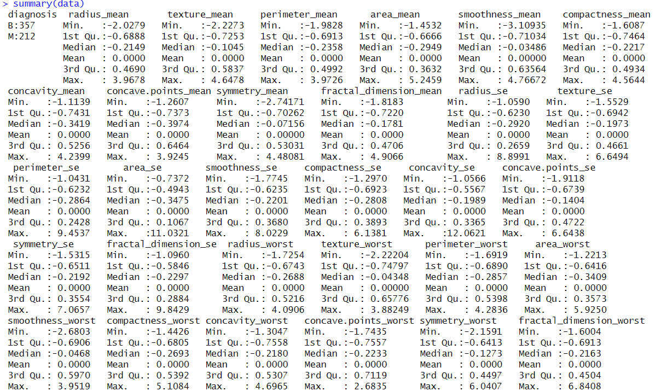
Summary for all the variables in the data set:

Slide 9
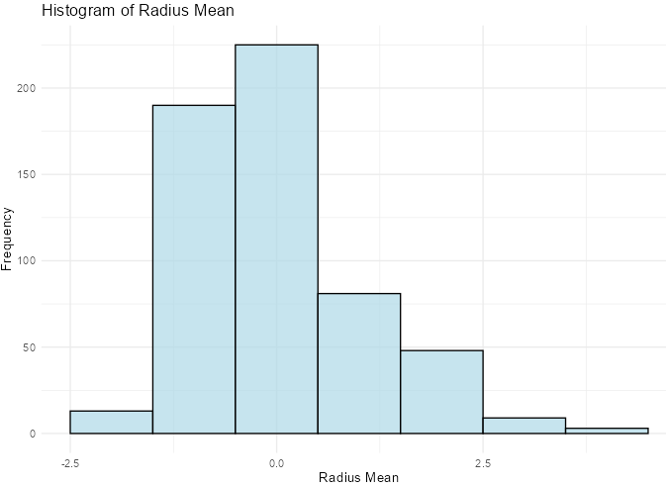
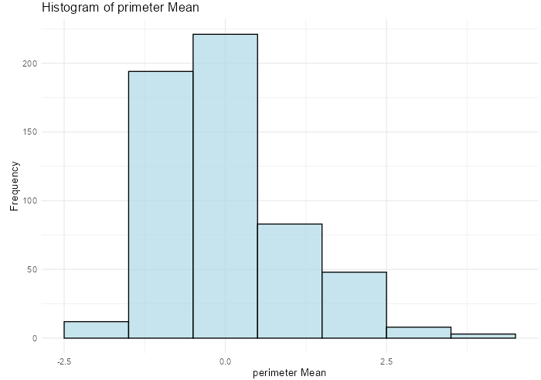
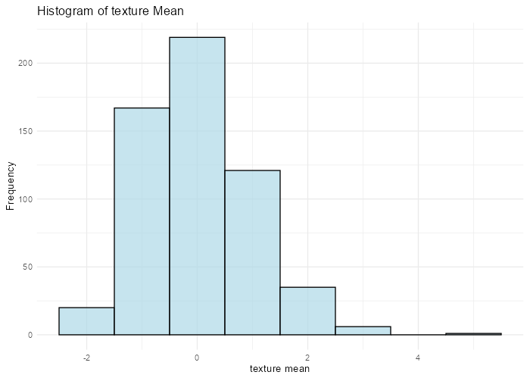
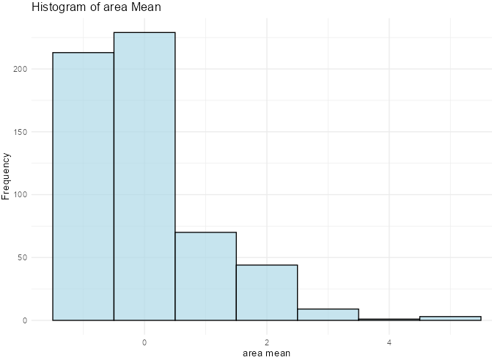
Histogram of some of the variables:

Slide 10
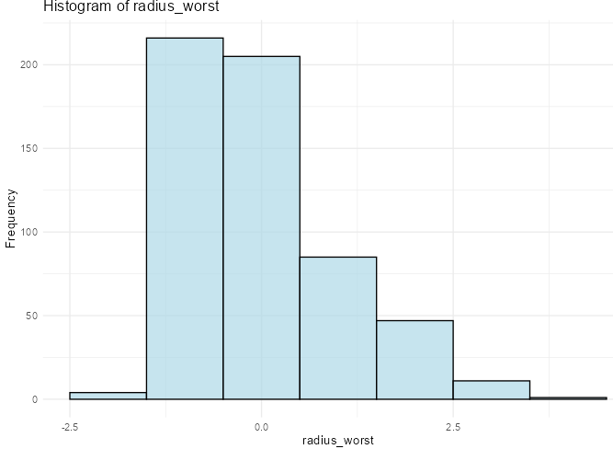
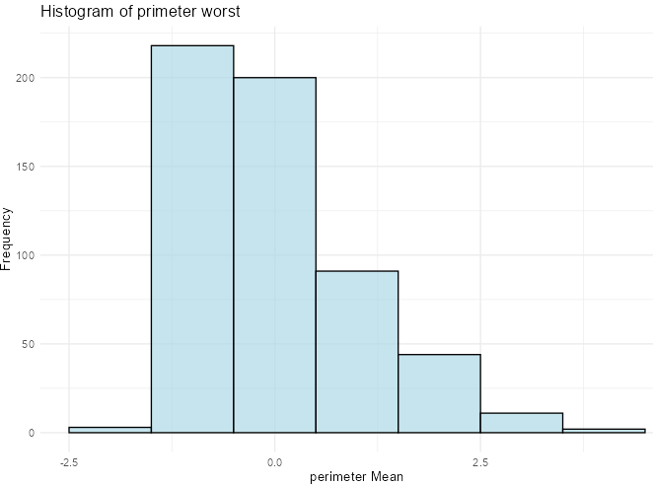
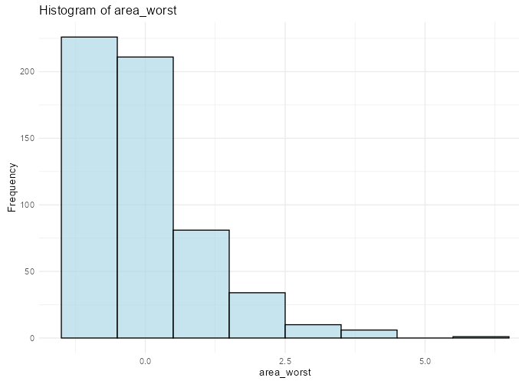
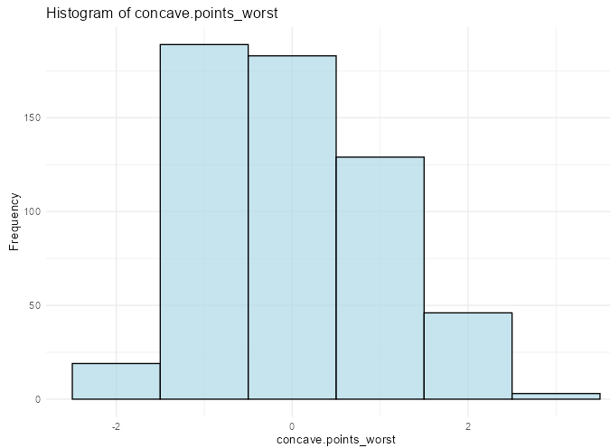

Slide 11
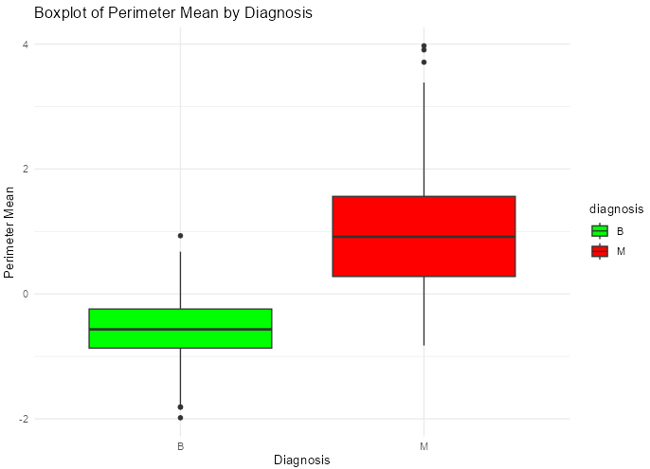

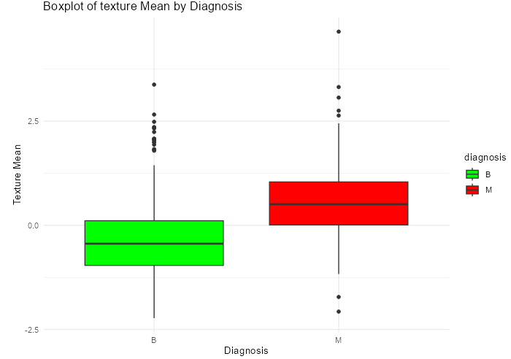
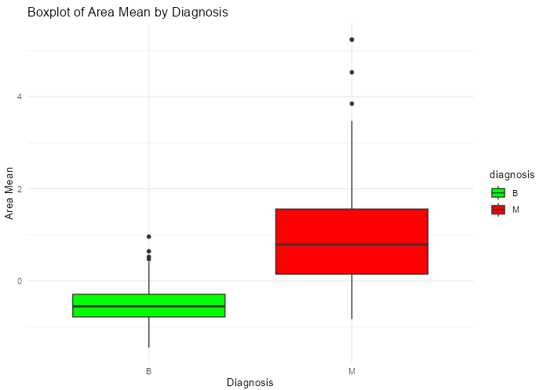
Boxplot for some of the variables:
To compare the distribution of these features between malignant and benign cases.

Slide 12
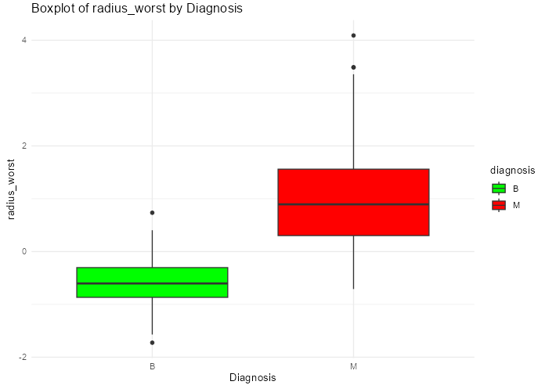
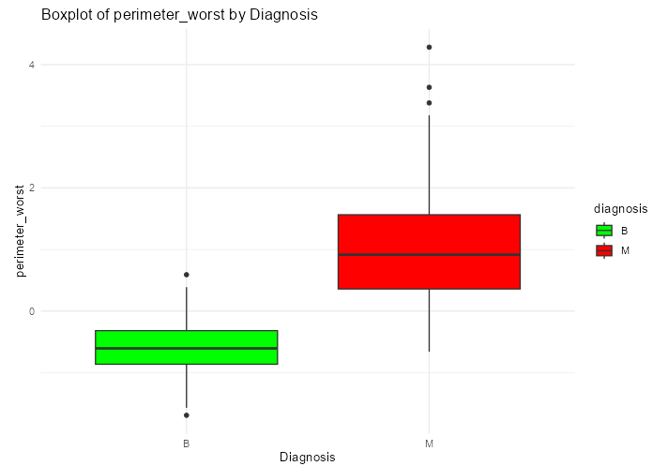
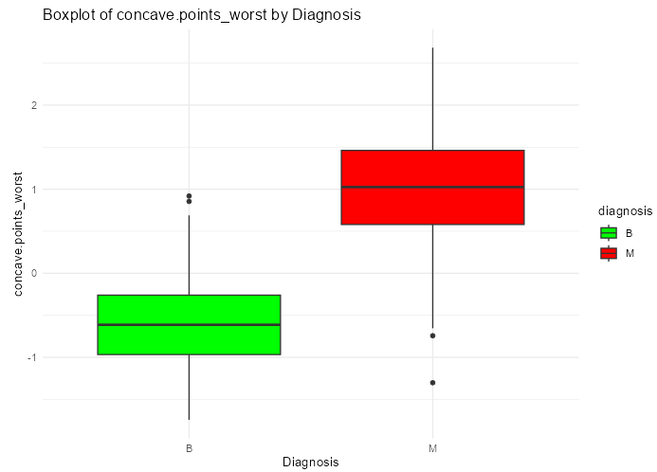
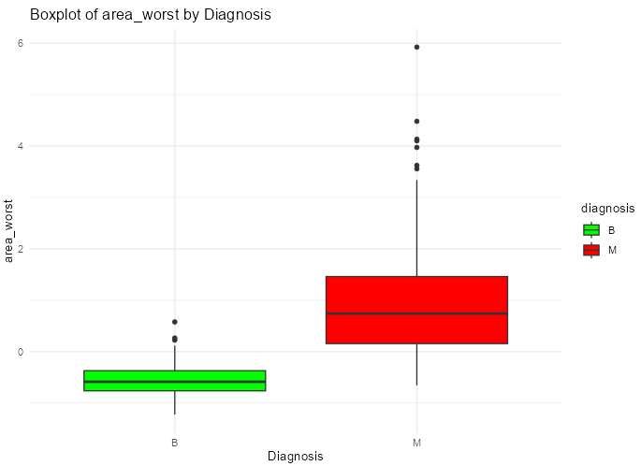

Slide 13
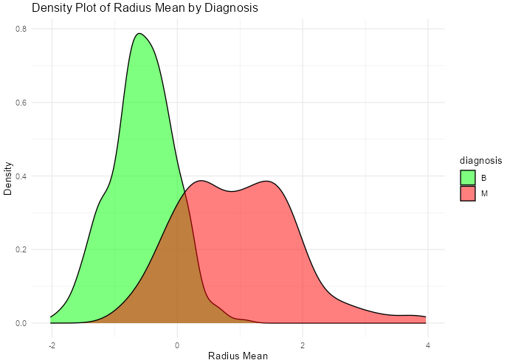
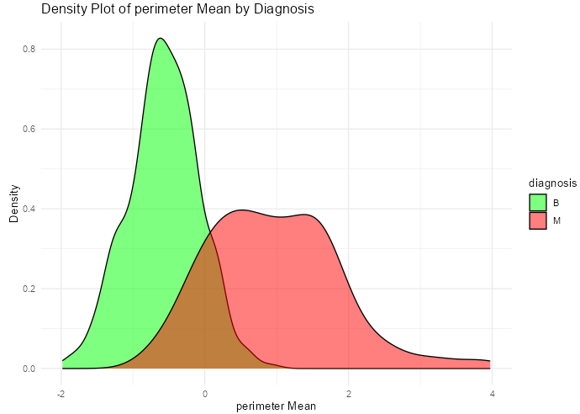
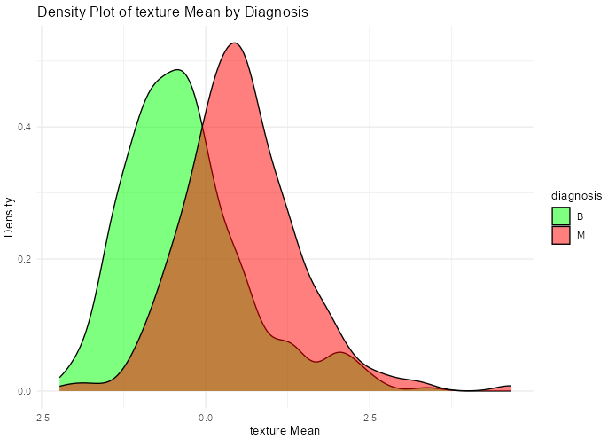
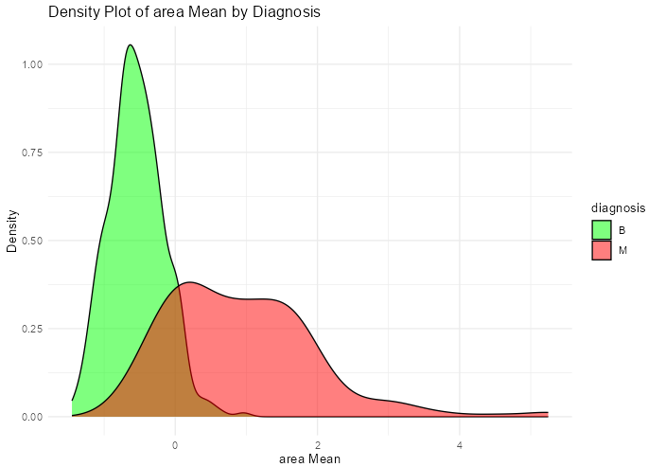
Density Plot for some of the variables:

Slide 14
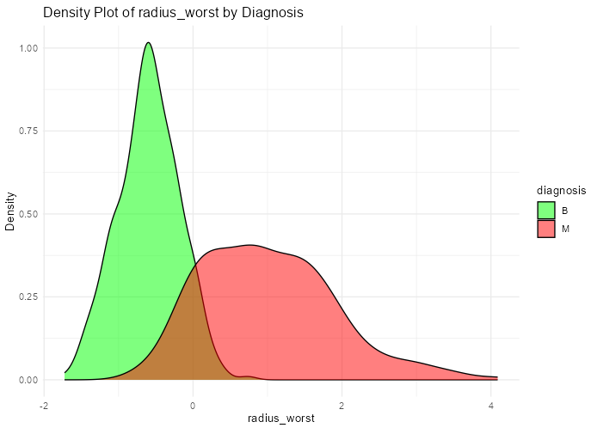
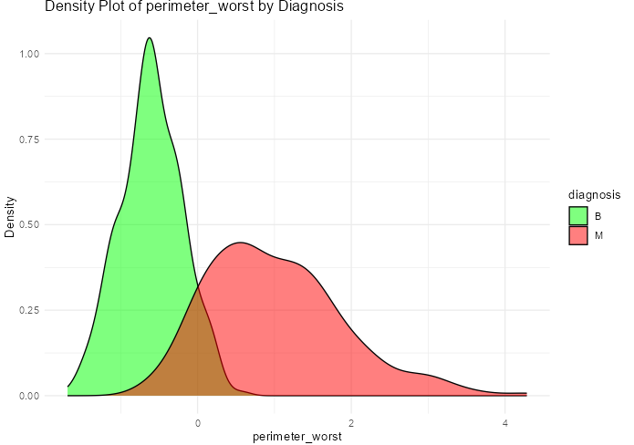
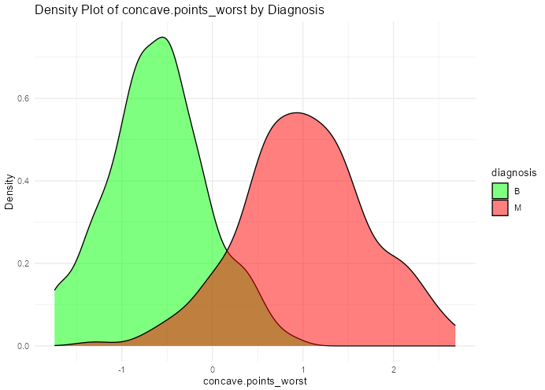
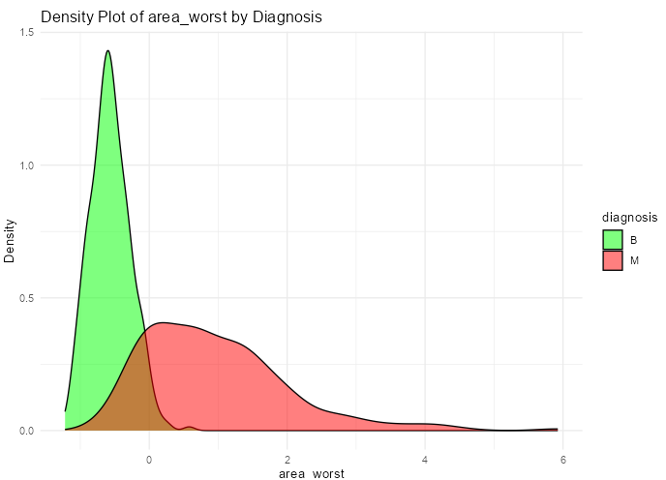

Slide 15
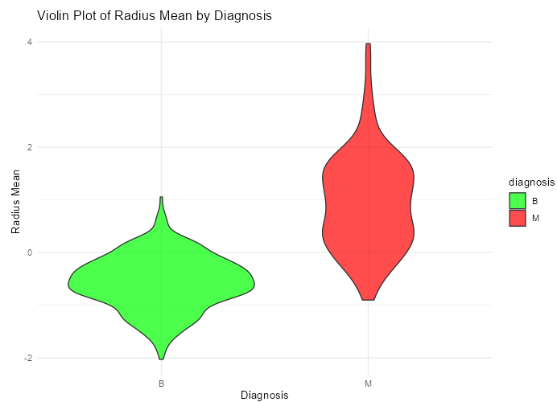
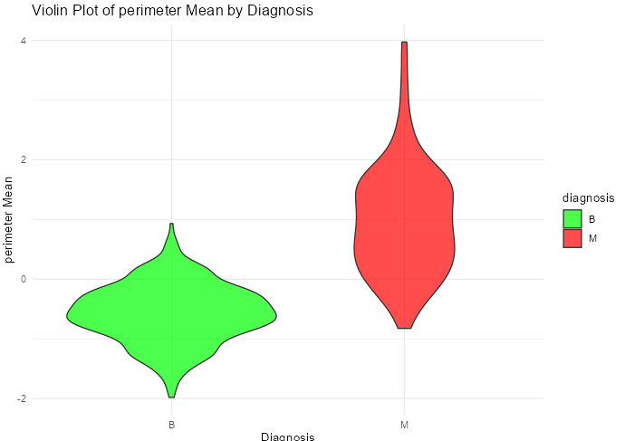
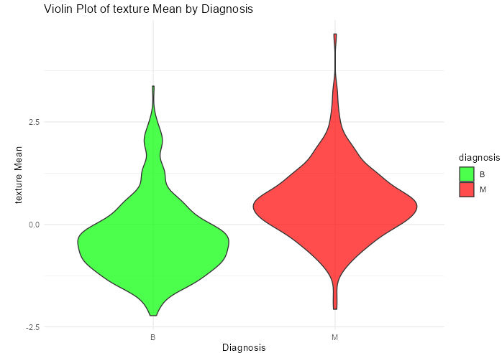
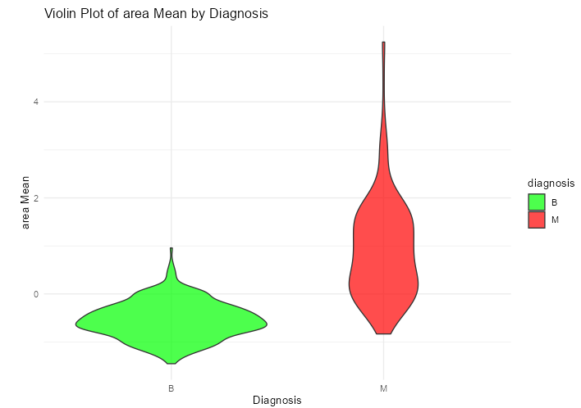
Violin plot for some of the variables:

Slide 16
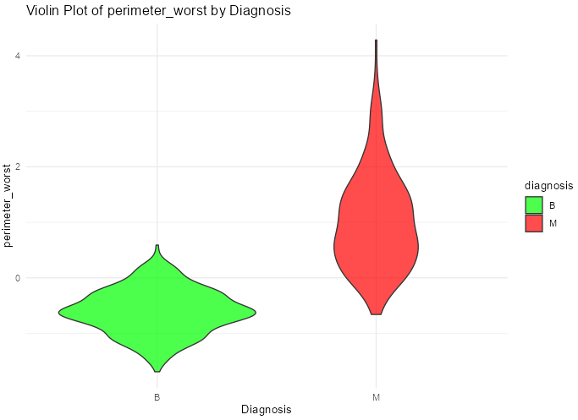
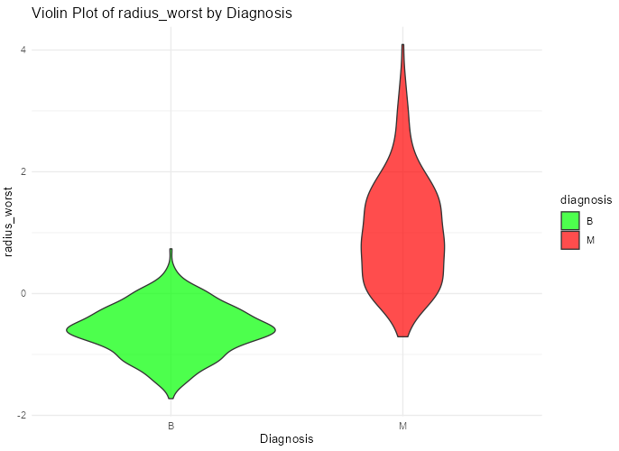
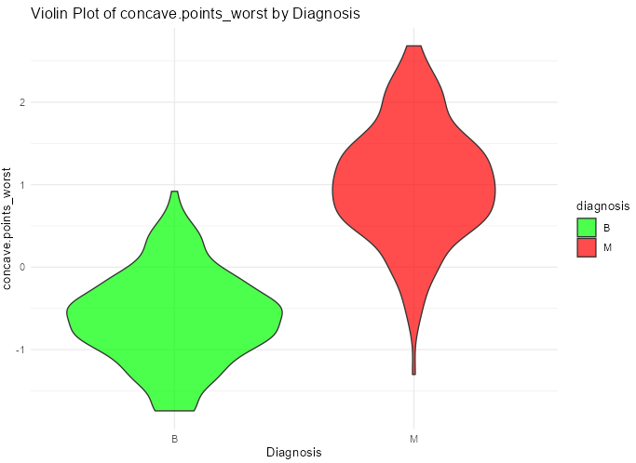
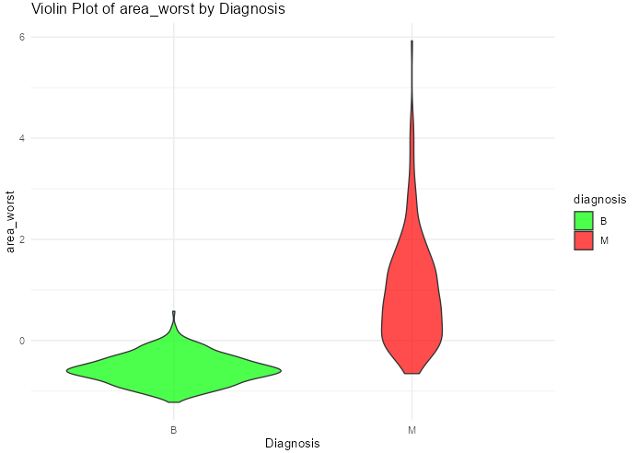

Slide 17
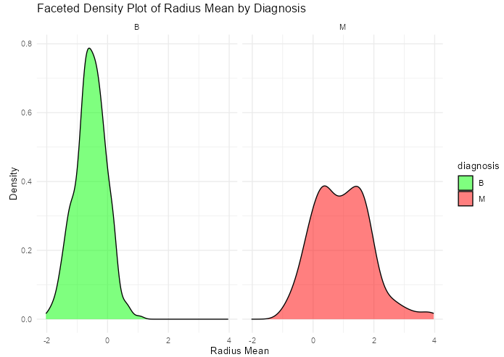

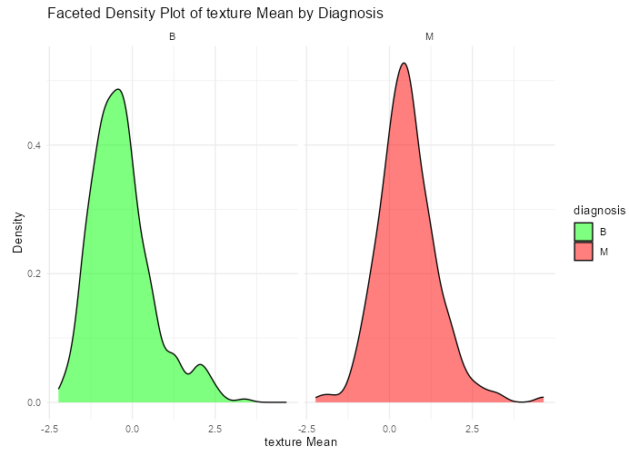
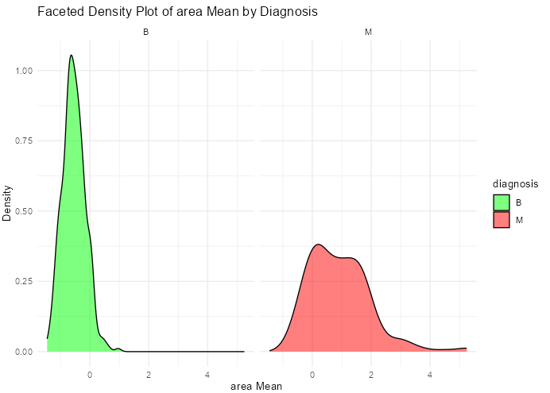
Facet Density plot of some of the variables:

Slide 18
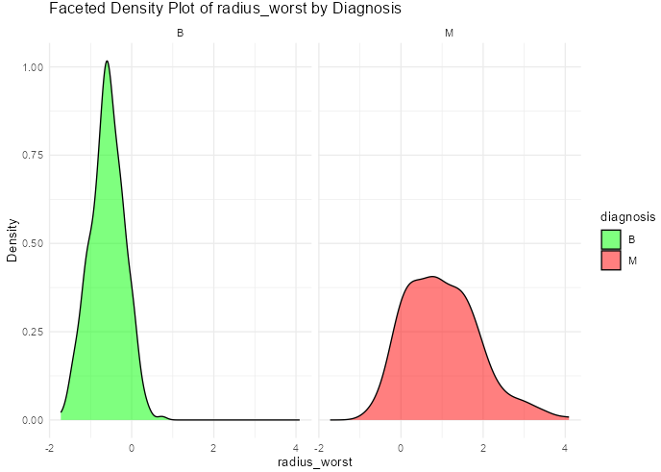
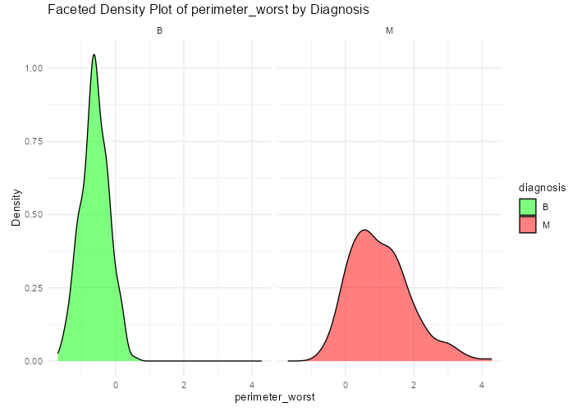
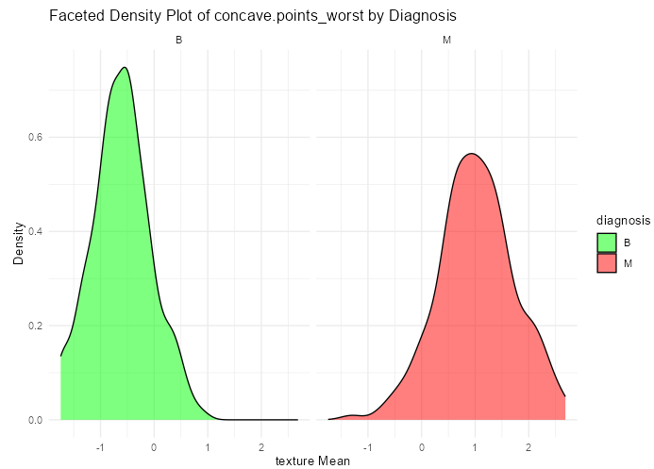
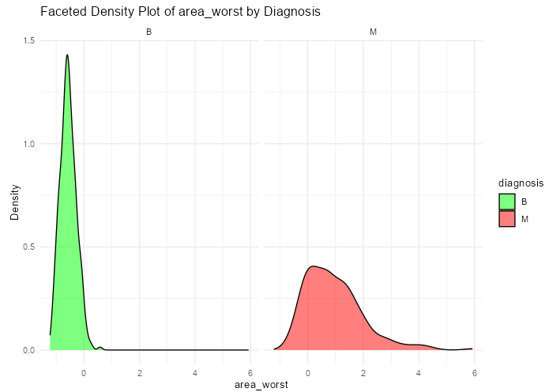

Slide 19
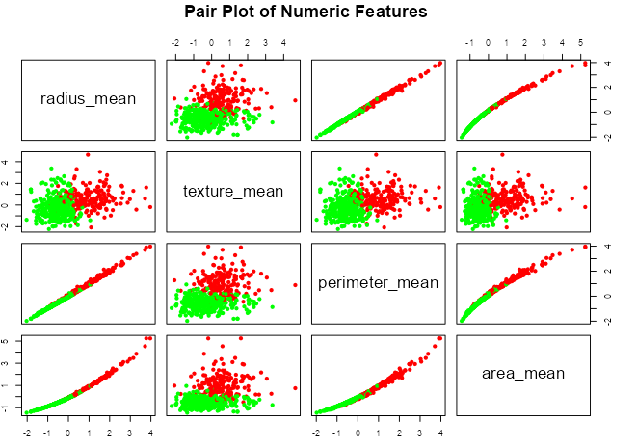
Pair pot of some of the variables:

Slide 20
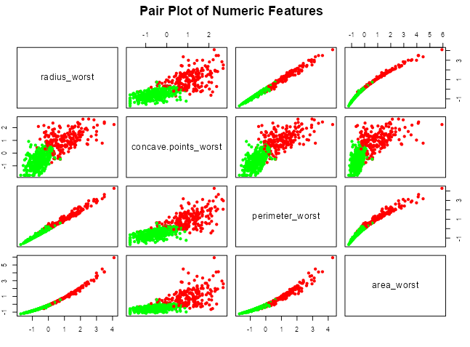

Slide 21
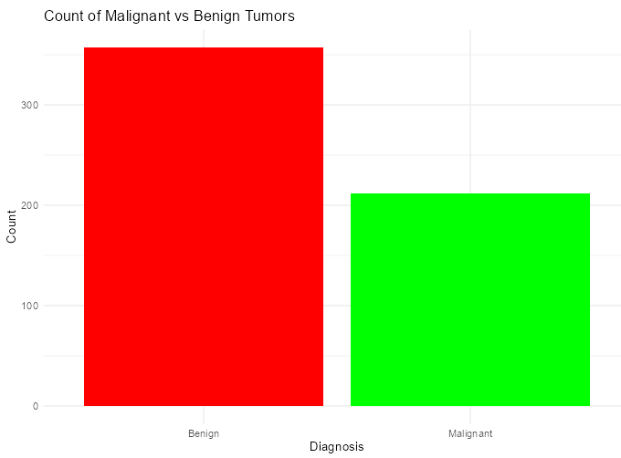
Count of Malignant vs Benign Tumors:

Slide 22
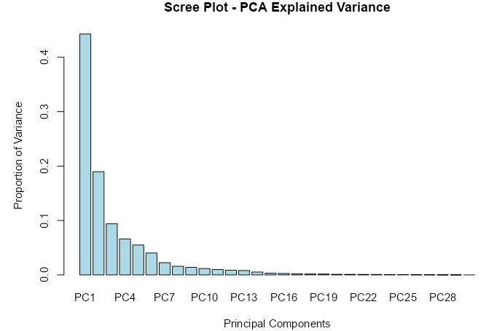
Scree plot:

Slide 23
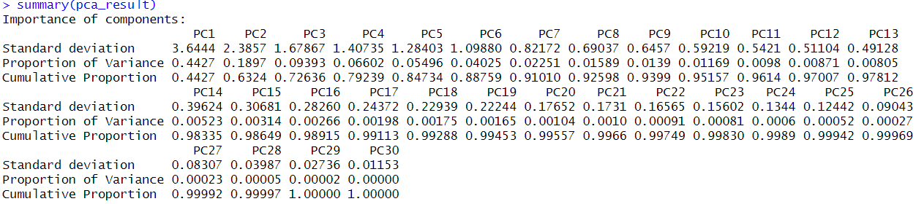
PCA results:

Slide 24
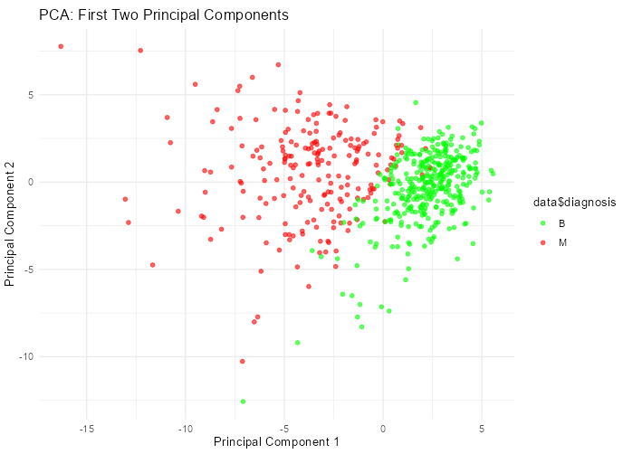
First two Principal Component

Slide 25
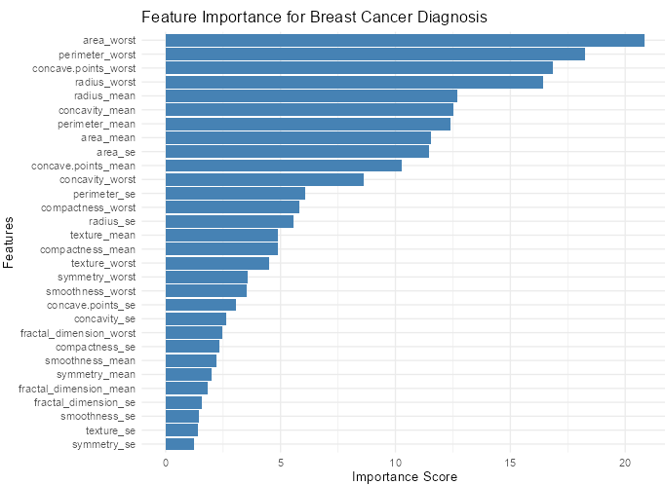
Feature Importance analysis:

Slide 26
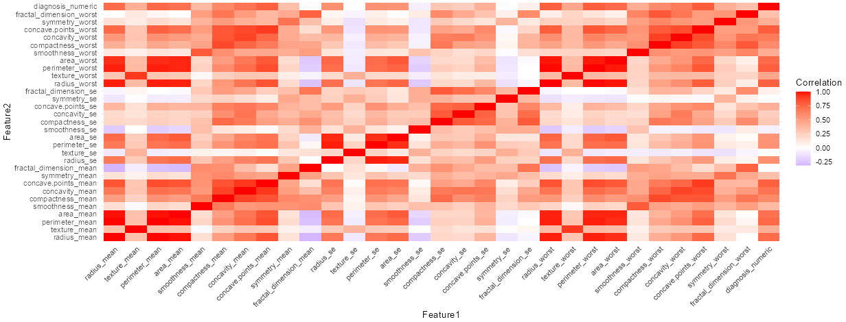
Feature correlation heatmap:

Slide 27
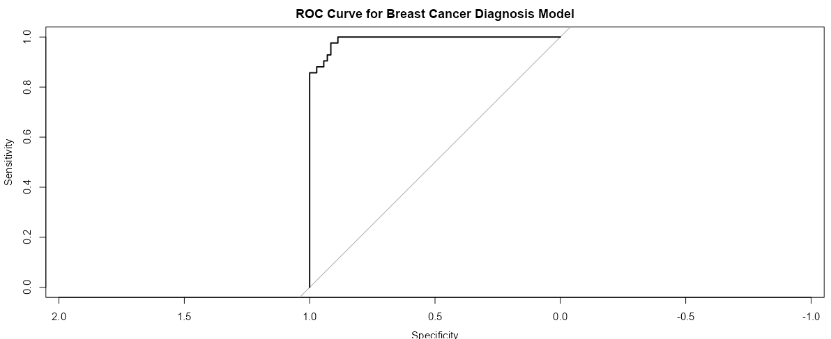
ROC curve for Breast Cancer Diagnosis Model:

Slide 28
What does our app do?
We developed a prediction model utilizing the top four features identified during the feature importance analysis. The model demonstrated robust performance in distinguishing between malignant and benign cases. These insights powered our Shiny App, designed to classify new cases with high accuracy. Capabilities of the Shiny App: Users can input new case data using the top four features, and the app predicts whether the tumor is malignant or benign. Interactive visualizations (e.g., feature distributions, heatmaps, PCA scatterplots) allow users to explore the dataset and understand how predictions are made.

