Slide 1
Q2 (csv to json using postgres, jupyter notebook and mongo db)
Work flow
By Asma Al-Fakhore

Slide 2
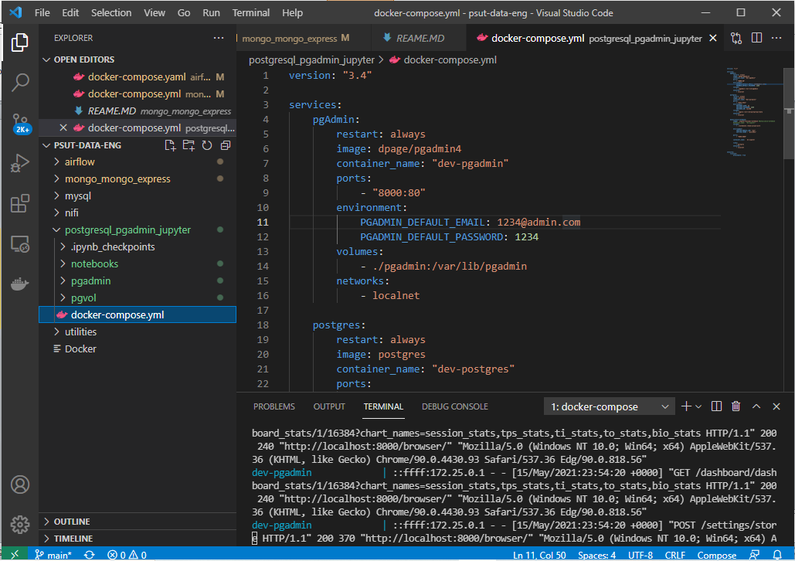
Run the compose file in VSC

Slide 3
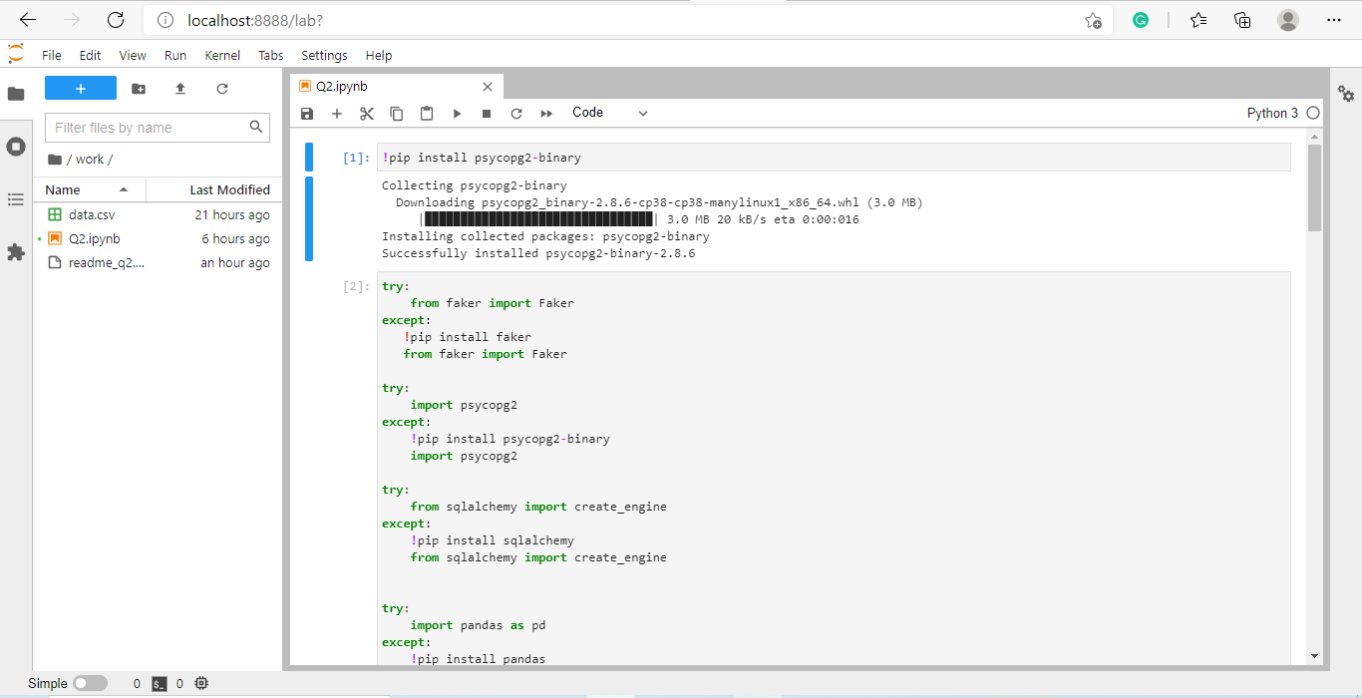
Open the Jupyter notebook (port8888)

Slide 4
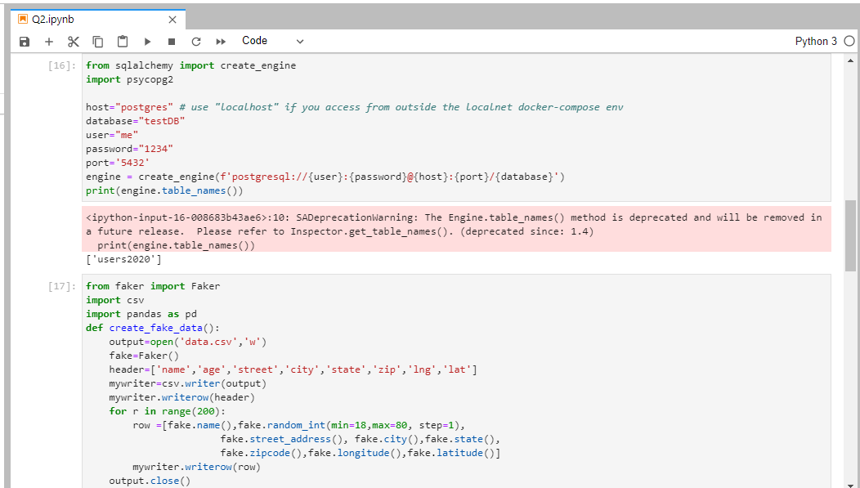
Create the engine to connect with PgAdmin (then creat fake data to see it in pgadmin)

Slide 5
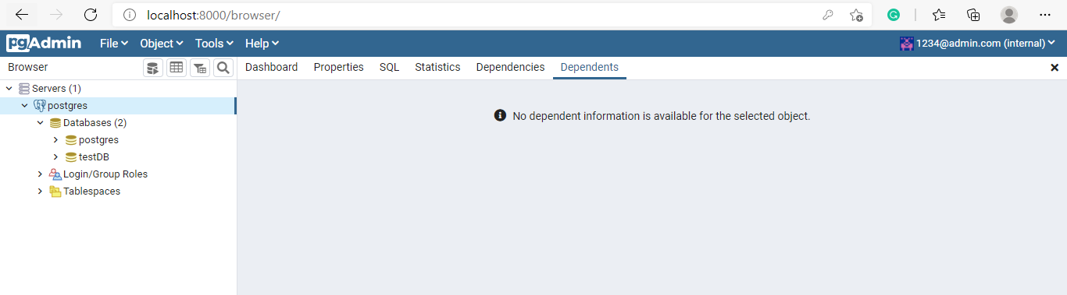
Open PgAdmin and create a server (port 8000)

Slide 6
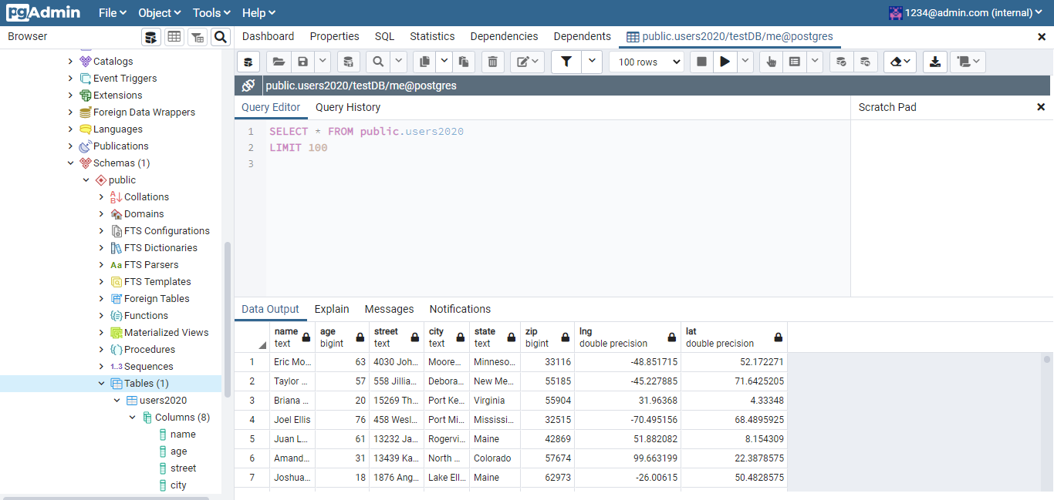
See the table in PgAdmin

Slide 7
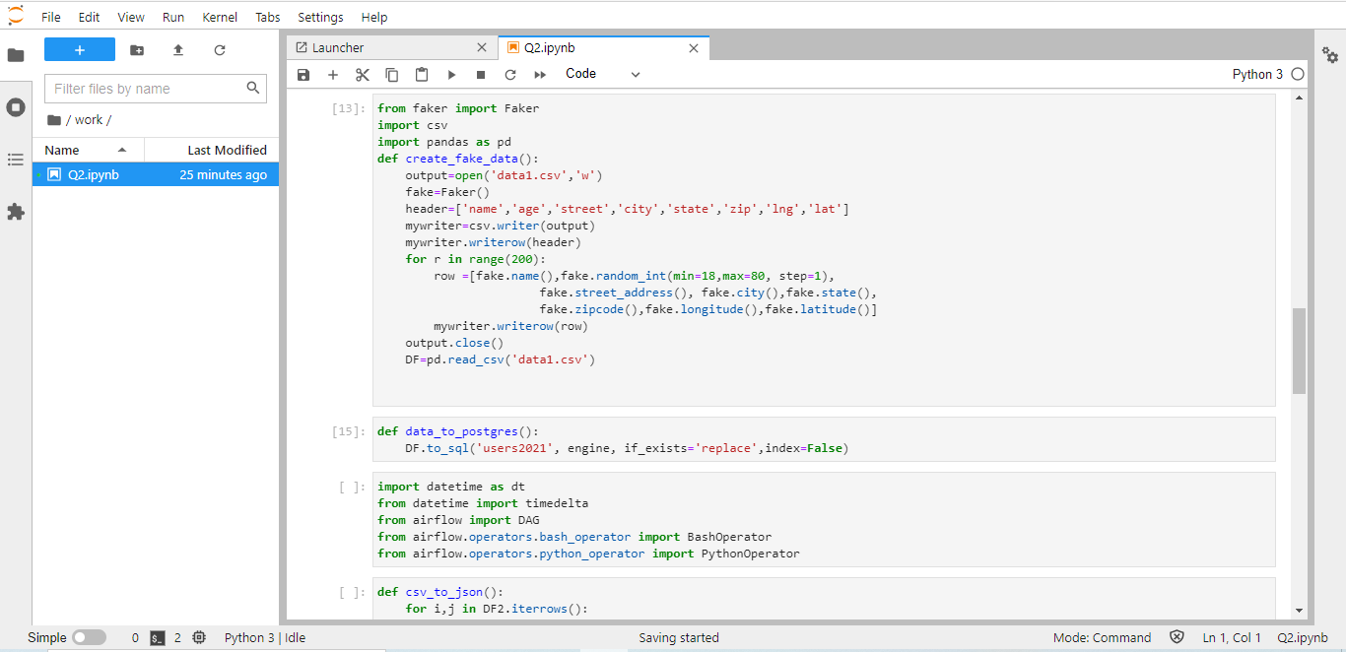
Complete the code to covert the csv file to json

Slide 8
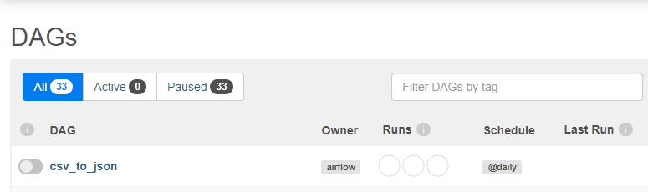
The Dag that we push it in the airflow

Slide 9
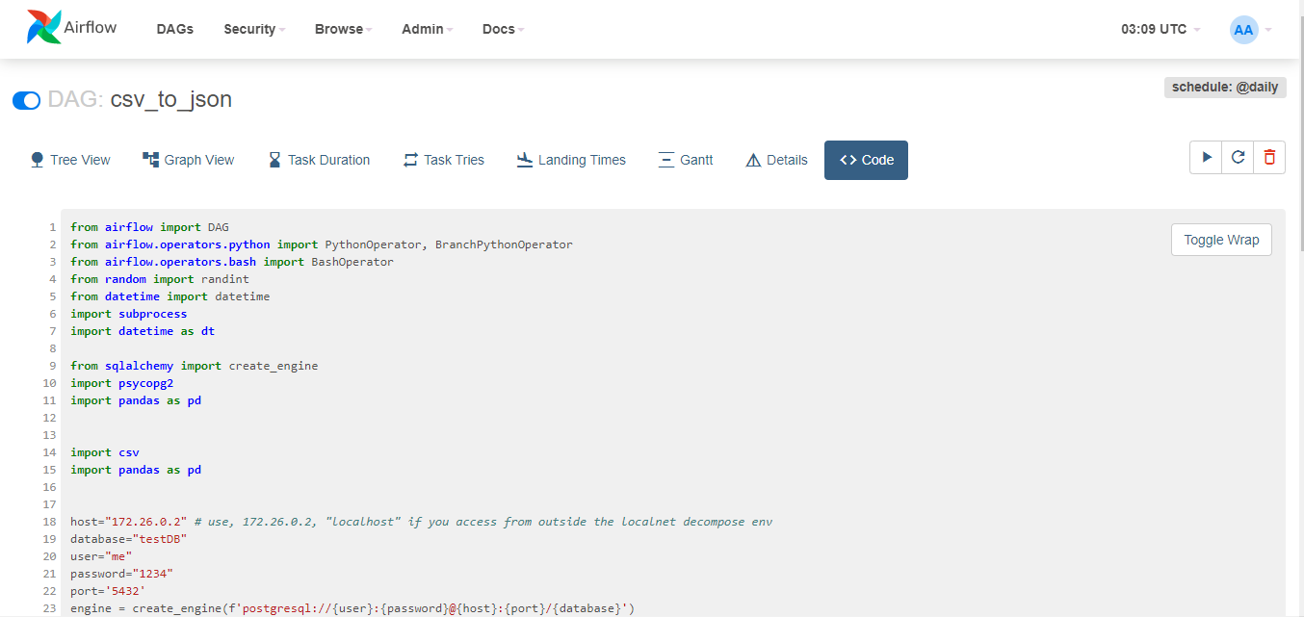
The code tab show the dag in details

Slide 10
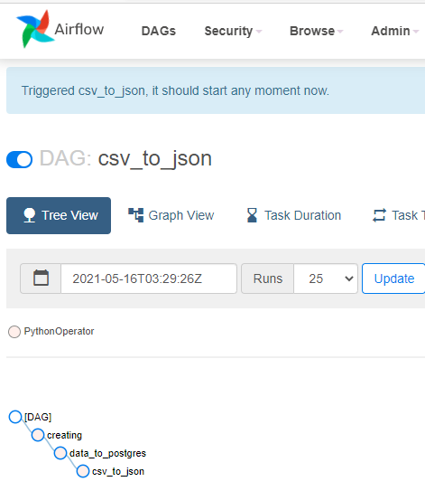
Tree View tab

Slide 11
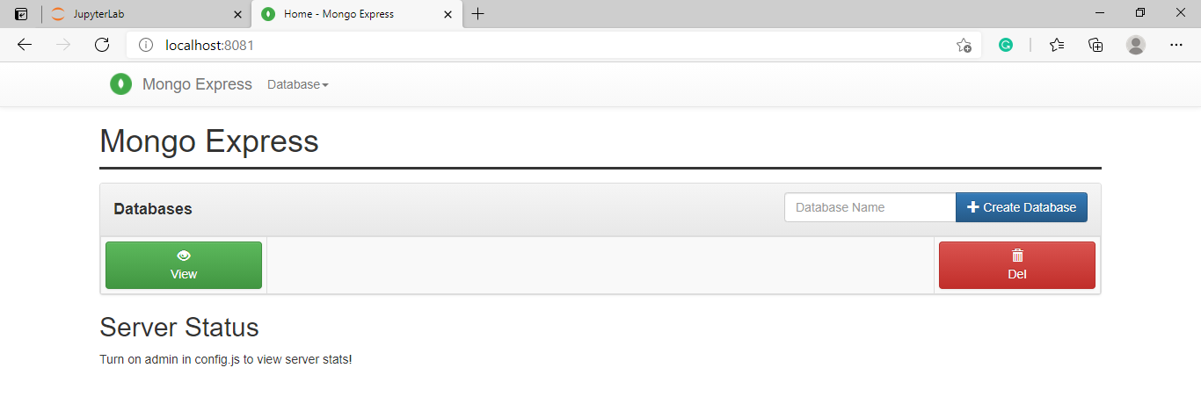
Push the json file to mongo db

