Slide 1
Q1 (csv to json using Nifi)
Work flow
By Asma Al-Fakhore

Slide 2
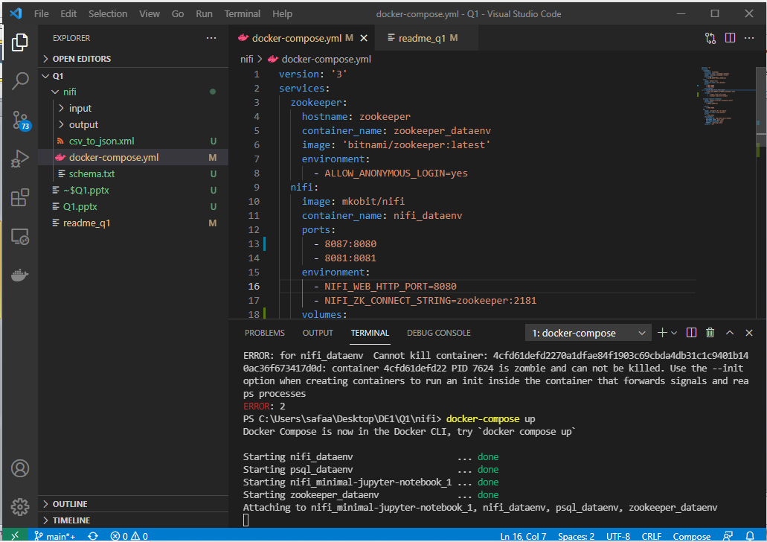
Run the compose file in VSC

Slide 3
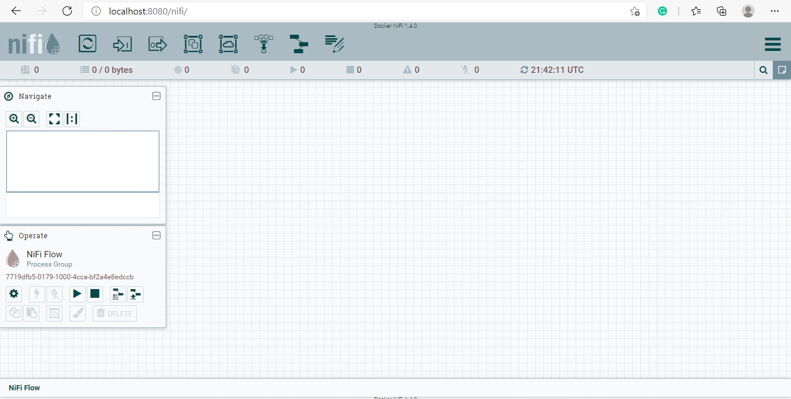
Open the Nifi(port8080)

Slide 4
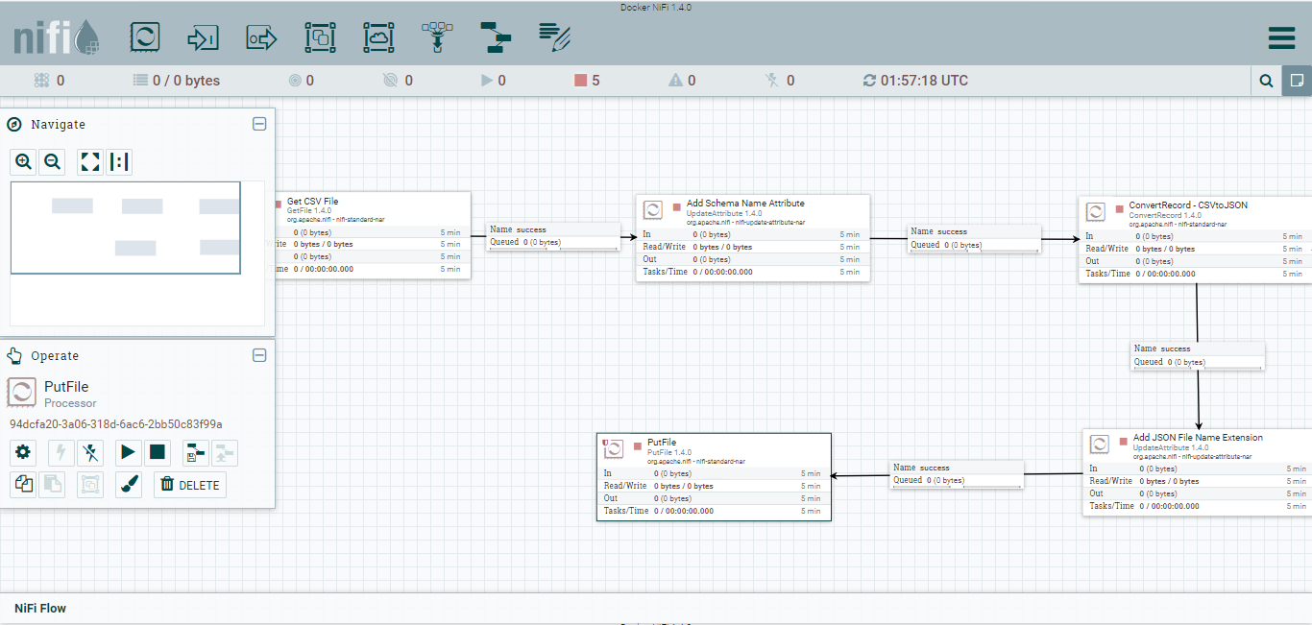
Biuld the pipline (covert csv to json)

Slide 5
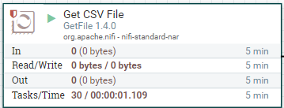
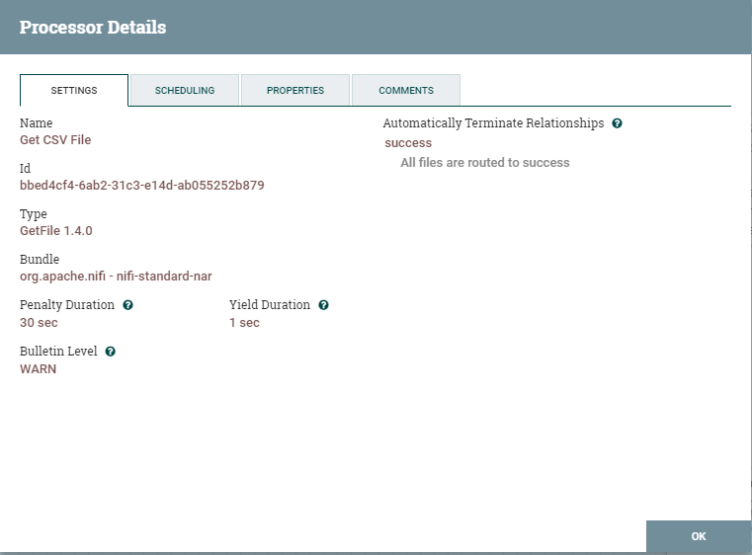
Get CSV File configure it and put the right path

Slide 6
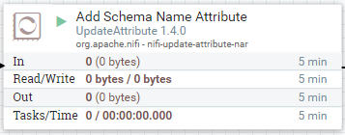
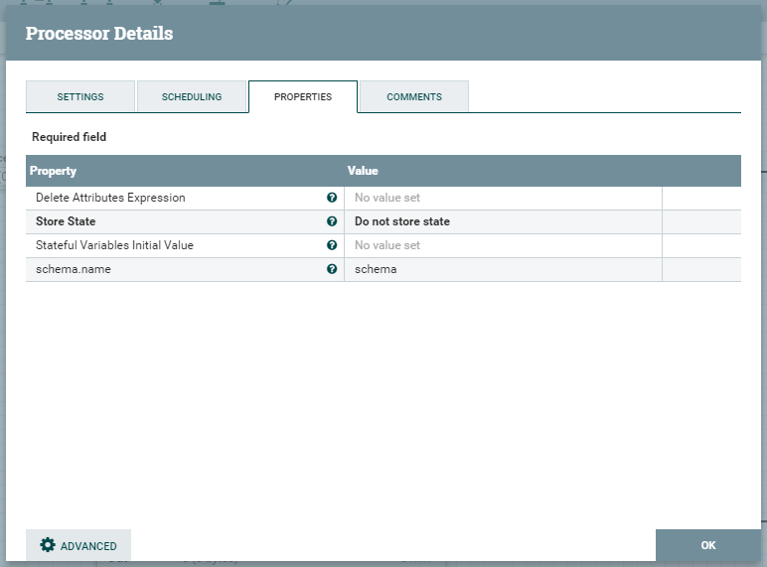
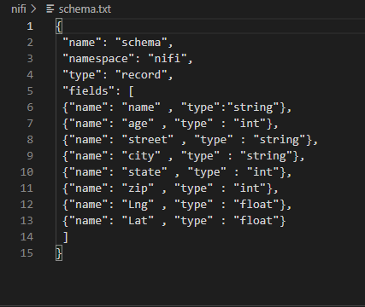
ADD Schema Name Attribute configure it and put the schema

Slide 7
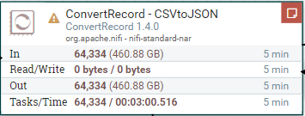
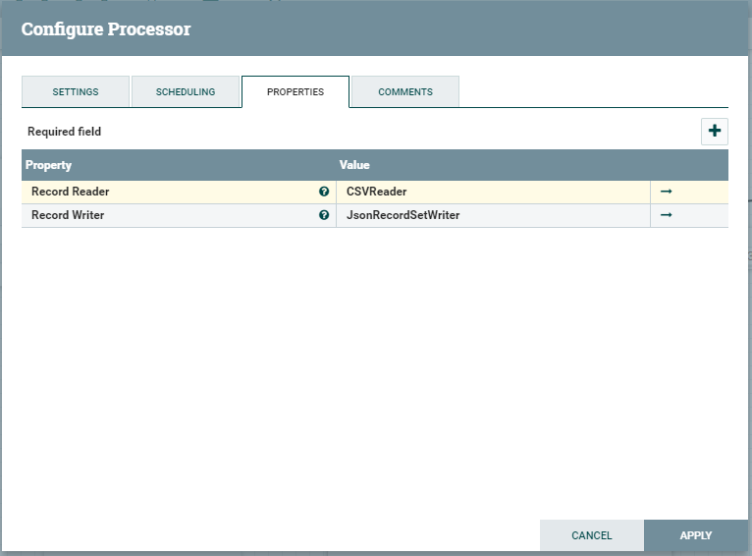
ConvertRecord – CSVtoJSON Record Reader(CSVReader), Record Writer(JsonRecordSetWriter)

Slide 8
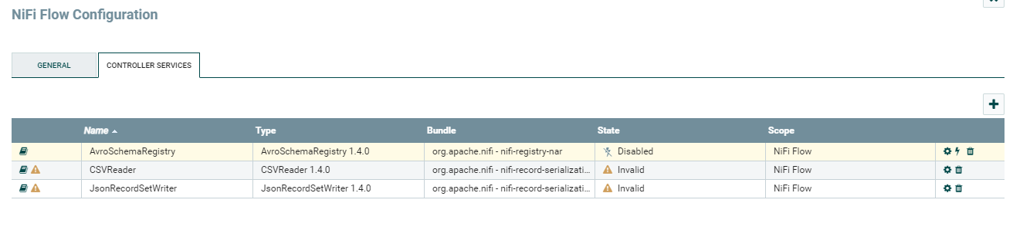
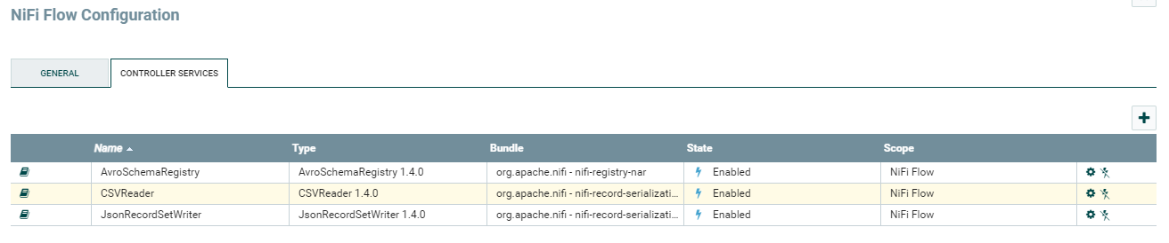
ConvertRecord – CSVtoJSON Enable the reader and the writer

Slide 9
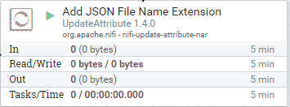
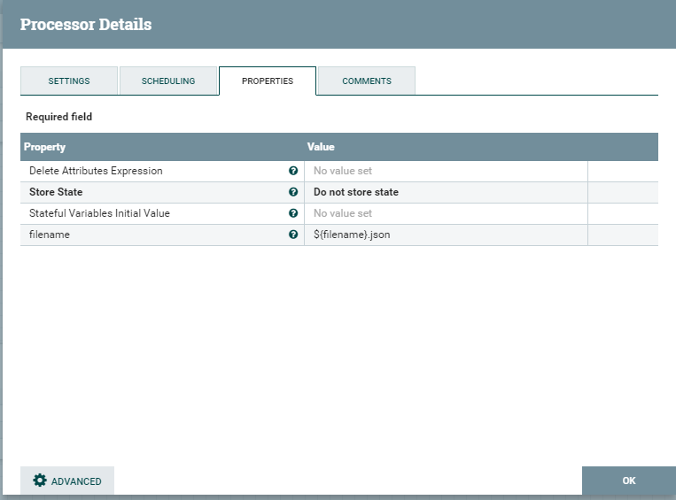
Add JSON File Name Extension to put the json file name

Slide 10
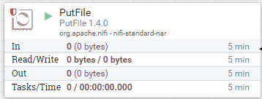
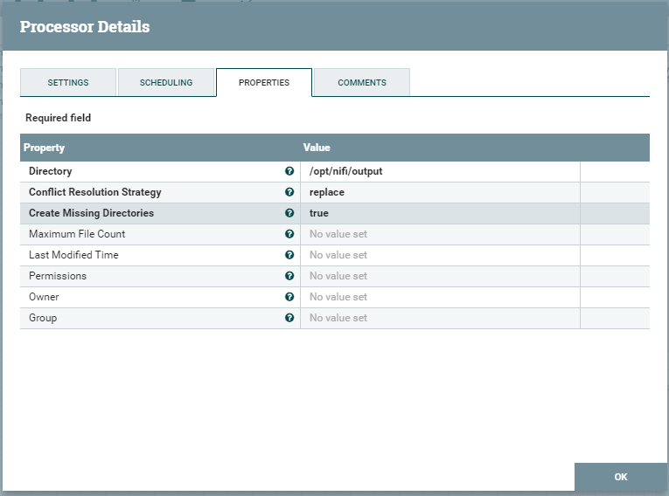
PutFile to put the converted file in the path

Slide 11
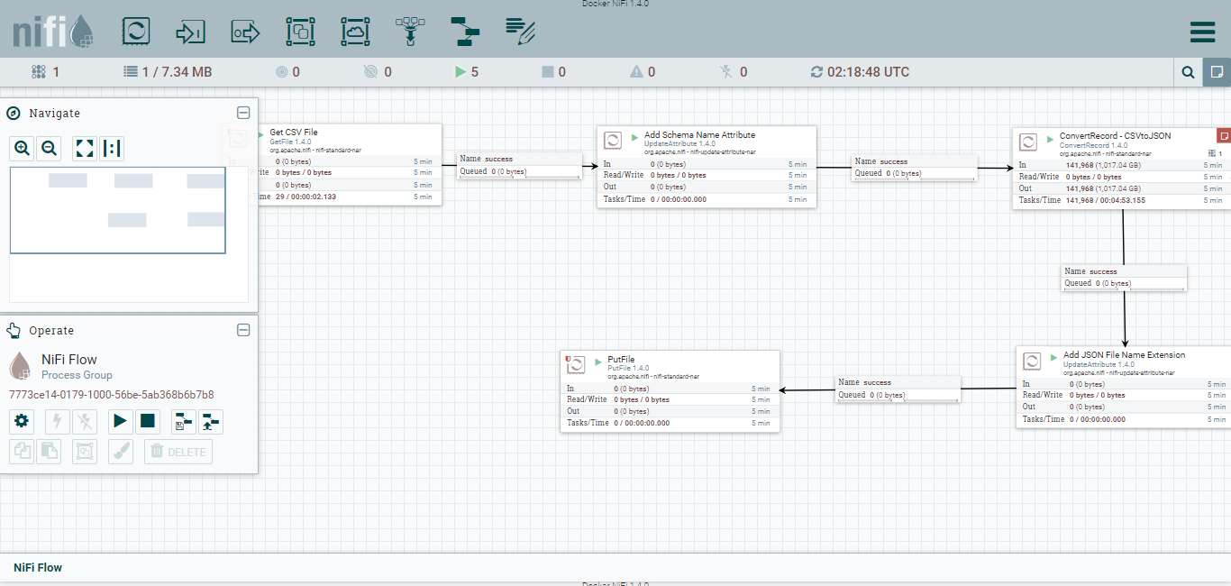
Run the pipline

