Slide 2
Introduction to Git and GitHub | Open-Source Contributions
Saad Fareed (Beta Ambassador)
Asma Butt (Alpha Ambassador)
Microsoft Learn Student Ambassadors
Notes:
Alright! Welcome everyone to our webinar “Introduction to Git and Github”. Let me first introduce myself. I am Jyoti Balodhi, a 3rd year Computer Science student studying in the University of Delhi and I’m an Alpha Microsoft Student Ambassador.
* Bhargav's introduction *

Slide 3
Agenda
Version Control Systems
Why Git?
Basics of Git
GitHub: An Overview
Collaborate and Contribute using GitHub
Open-Source Contributions
Hands on and some famous programs of OSC
Notes:
Okay! So first of all, the agenda for today’s webinar is as follows:

Slide 4
What is Version Control ?
It is a system that records changes to a file or a set of files over time so that you can recall specific versions later.
It allows you to –
Revert the selected files back to a previous state,
Revert the entire project back to a previous state,
Compare changes over time,
See who has modified your code and when
Who introduced an issue and when.
Notes:
Okay, so first of all, why do we need Version Control? So, the entire tech industry revolves around code. So where do we store the code? Take for example… Facebook. Facebook’s entire code cannot be stored on one computer, right? If some damage is done to this computer the platform’s code is lost. Now you might suggest to take a backup of this code by zipping it and storing it on Google Drive. But what if you want to edit that code sometime later? You’ll again have to download all that code, unzip it make the edits and then again zip it and store it on drive. This isn’t convenient for anyone, right? Specially when you’re working in a team of hundreds and thousands of people, this isn’t convenient at all. So, this is where Version Control comes in.

Slide 5
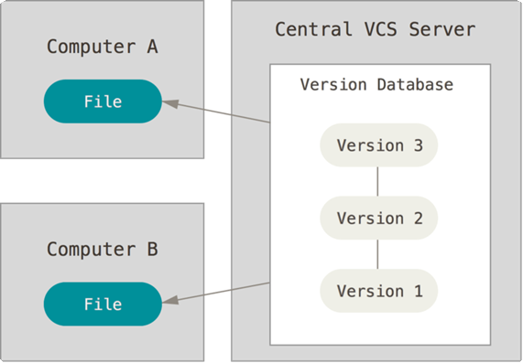
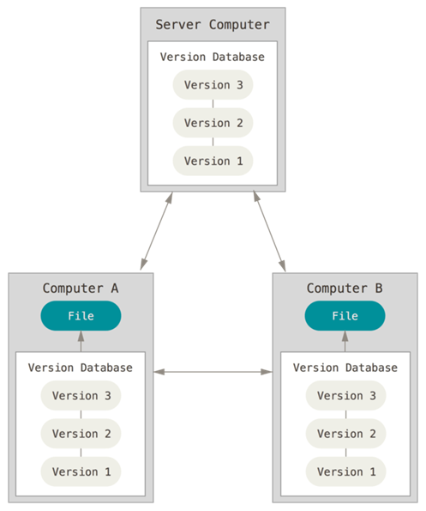
Types of Version Control Systems
Centralized VCS
Distributed VCS
Notes:
Centralized: Subversion and CVS
Distributed: Git, Mercurial

Slide 6
Why Git?
Distributed Version Controlling System
Ease in collaboration
No more tension on loosing of old code
Live code and development code kept in one place
Easy to manage with large codebases
Distributed Development

Slide 7
Basics of Git
Here are some basic git commands one should be familiar with:
git init
git add file_name
git status
git commit -m “Message”
git remote add origin repo_link
git push –u origin master
Notes:
git help
git status
git log
git init <projectname>
git add <filename>
git commit –m "message"
git checkout <filename>
git push
git pull
git rm –cached <file_name>
git branch <branch_name>

Slide 8

Hands on with Git

Slide 9
GitHub: An Overview of the Platform
GitHub is one of the most popular platforms for Version Control.
If Git is the ingredient, GitHub is the final product.
Largest hub of open-source software.
Github’s Logo – The Octocat
Notes:
So Github is basically a platform for developers to store their code in an organized manner. It can also be used as a collaborative tool for developers to reach out to other developers and collaborate on their projects. Git allows you a tree like structure where by default everything is stored in a branch called “master” and you can create as many branches as you like. Now that we’re talking about branches, why do we need branches? It’s kind of an extra security feature so that someone doesn’t accidentally make changes to the master branch (which is the main branch). Also, if you want to contribute to someone else’s project, it is good practice to create a new branch and make your edits over there.

Slide 10
Hands on with GitHub

Slide 11
Open-Source Contributions
A software for which the original source code is made freely available and maybe redistributed and modified according to the requirement of user is known as Open Source softwares and the developers who are contributing to these types of projects are called Open-Source Contributors.

Slide 12
Some famous Open-Source Projects
Apache Cassandra
TensorFlow
Kubernetes
Ansibl
Mozilla
RedHat etc. etc.

Slide 13
Why contribute ??
Improve software you rely on
Improve existing skills
Find mentors
Meet peoples who are interested in similar things
Learn people skills

Slide 14
Hands on with Open Source Contributions

Slide 15
Some famous Open-Source programs :-
GSoC ( Google Summer of Code )
MLH Fellowship
Google Season of Docs
Hacktober Fest
Open-Source Track Explorer
Educational Externship Track
Outreachy
Season of KDE
Linux Foundation Mentorship Program
Community Bridge Mentorship Program

Slide 16
Open Mainframe Project
Foss Asia Codeheat
Linux Kernel Mentorship Programme
Redox Summer of Code
Hyperledger Mentorship Program
Foss Asia Internship Program
Open Summer of Code for Students
Alibaba Summer of Code
Free Software Foundation Internship Program
Google Summer of Earth Engine
The Processing Foundation Fellowships

Slide 17
Q & A

Slide 18
Thank You!

