Slide 1

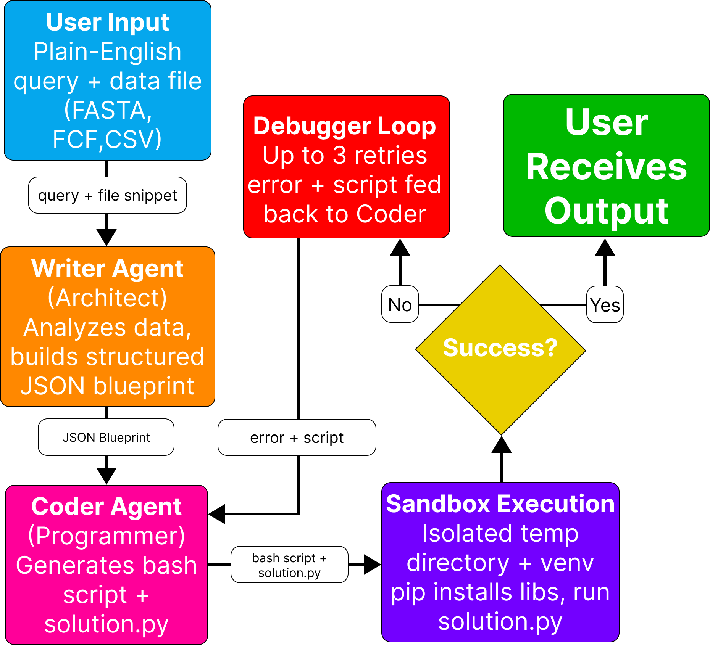
26-335
AI Agents for Bioinformatics
Team members: Carter Struck, Ozi Jawad, Mack Hicks, Sona James | Faculty adviser: Tomasz Arodz, Ph.D. | Partner: VCU College of Engineering | Mentor: Tomasz Arodz, Ph.D
Problem & Objective
Design Constraints
Example System Execution
Professionals in medicine, forensics, and pharmacology increasingly need to extract insights from genomic data, but doing so requires specialized bioinformatics training and programming expertise they do not have.
Existing tools like Biopython and Bioperl still demand manual setup and coding knowledge, leaving no private AI-driven solution for users who understand their data but cannot write analysis scripts from scratch.
We developed a multi-agent AI system that allows users to provide a genomic dataset and describe their analysis goal in plain English. This system automatically generates, debugs, and executes Python code, returning clear and interpretable results.
The system supports standard genomic file formats, and aims to reduce the time required to go from raw data to actionable insight by at least 50% compared to traditional bioinformatic workflows that depend on a specialist.
Model must run on a single NVDIA A100 GPU 40GB VRAM provided by VCU.
LLMs capped at 20 billion parameters to fit in memory.
Open Source, permissively license models only.
Autonomously generate, debug, and re-attempt code up to 3 times.
Handle FASTA, VCF, and CSV/TSV without data loss.
Analyses must complete in minutes, not hours.
Genomic Pattern Analysis: EcoRI Restriction Site Identification python3 main.py input/sequences.fasta ================================================== BioAgent - Multi-Agent LLM Analysis System ================================================== Loading checkpoint shards: 100%|██████████████████████| 5/5 [00:16<00:00, 3.39s/it] Detected file format: FASTA File: sequences.fasta ================================================== What type of analysis would you like to perform? [1] GC content analysis & restriction site detection [2] Sequence length statistics [3] Custom (describe your own) Select an option (number): 3 Describe what you want to do with the data: > Write a Python function that reads a sequences.fasta file and identifies sequences containing the EcoRI restriction site ("GAATTC"), returning the sequence IDs and positions of the sites for downstream genetic analysis. How would you like the output? [1] Print results to terminal [2] Save to an output file [3] Both Select (1, 2, or 3): 1 ================================================== Final query: Write a Python function that reads a sequences.fasta file and identifies sequences containing the EcoRI restriction site ("GAATTC"), returning the sequence IDs and positions of the sites for downstream genetic analysis. The input file is sequences.fasta. ================================================== ✔ Blueprint generated (11s) ✔ Code generated (9s) ✔ Attempt 1 failed (6s) Attempt 1 failed — asking AI to fix the code... ✔ Revised code generated (9s) ✔ Execution succeeded (6s) ================================================== RESULTS ================================================== Generated script saved to: output/solution.py --- Solution Output --- Sequence ID: seq1, EcoRI sites: [11, 34] Sequence ID: seq2, EcoRI sites: [14] Sequence ID: seq3, EcoRI sites: [12] Sequence ID: seq4, EcoRI sites: [16]
Implementation Choices
Llama 3.1 Pro Coder (8B parameters) powers bot the Writer and Coder agents.
One model, simpler deployment, lower memory footprint.
NF4 4-bit quantization via BitsAndBytes cuts memory usage ~75%.
Python as the target language for its dominance in bioinformatics (Biopython, pandas, NumPy).
All generated code runs in an isolated sandbox with its own virtual environment.
Final Design
Limitations
Only Supports FASTA, VCF, and CSV/TSV – no FASTQ or BAM files.
The LLM may generate incorrect code that passes execution but produces biologically wrong results – always verify outputs.
Limited to single-file inputs; multi-file or pipeline workflows are not supported
Large datasets may exceed memory or cause long runtimes.
Analyses are limited to what Python libraries can accomplish in a single script.
How to run
Place your data file in the input/ folder and run: python3 main.py input/<your_file>
Select a preset analysis or describe or own.
Results display in the terminal and the generate script saves to output/solution.py

