Slide 1
IBM University Engagement Project Submission
“Exploring the Power of Agentic AI with IBM Granite and LangFlow”

Slide 2

Project Title – Dharohar-AI
Domain of Project – Tourism & Heritage
Student Name | Recent Passport Photo | Email ID | Mobile number [WhatsApp]
Asma Khwaja |  | khwajaasmabibi@gmail.com | 9726544496

Slide 3
Problem Statement -
Problem Statement : Smart Heritage Conservation Platform for Ahmedabad's Walled City & Modhera
The Challenge
Gujarat's UNESCO heritage sites, including Ahmedabad's Walled City and Modhera Sun Temple, face conservation risks from urban encroachment, weathering, and unmanaged tourist footfall, alongside underutilized digital storytelling for visitors.
The Objective
Build Agentic AI solutions that monitor heritage site structural health, manage visitor flow, and deliver immersive, personalized cultural storytelling experiences.
Suggested AI Agents
Structural Health Monitoring Agent
Visitor Flow Management Agent
Personalized Heritage Storytelling Agent
Encroachment Detection Agent
Conservation Reporting Dashboard Agent
Technology to be used – IBM Bob + IBM Granite LLM + IBM cloud

Slide 4
Proposed Solution -
Proposed Solution: DHAROHAR AI — Heritage Guardian
A multi-agent AI platform built on IBM Granite LLM via watsonx.ai that monitors structural health, detects encroachment, manages visitor flow, and delivers personalized storytelling for Gujarat's heritage sites — Ahmedabad's Walled City and Modhera Sun Temple.
Every output is grounded in a curated heritage knowledge layer and real regulatory frameworks (AMASR Act 1958, Gujarat Heritage Regulation Act 2017), keeping Granite's reasoning fact-checked.
Five agents:
Structural Health Monitoring — condition & risk analysis with explainable scores
Encroachment Detection — buffer-zone violation detection + enforcement action plans
Visitor Flow Management — per-zone capacity tracking + routing recommendations
Heritage Storytelling — personalized, fact-grounded visitor narratives
Conservation Reporting — auto-generated network-wide action reports
A custom orchestration layer sequences these agents with transparent reasoning at each step, powered securely by IBM Granite via a backend proxy — turning heritage conservation from reactive to proactive, explainable, and AI-assisted.

Slide 5
Technology Used
React + TypeScript – For building the interactive Heritage Guardian dashboard and agent interfaces
Custom Multi-Agent Orchestrator – For designing and sequencing the five-agent conservation workflow (Structural, Encroachment, Visitor Flow, Storytelling, Reporting)
IBM Granite Model – e.g. ibm-granite-13b-instruct-v2 – For risk reasoning, regulatory analysis, and personalized storytelling
IBM watsonx.ai – For secure Granite model access, inference, and governed deployment
Curated Heritage Knowledge Layer – Verified site history, architecture, and legal frameworks (AMASR Act 1958, Gujarat Heritage Regulation Act 2017) grounding every AI output in fact
IBM Cloud – Target infrastructure for scalable, secure backend deployment (Code Engine) of the Granite proxy service

Slide 6
Orchestration Components Used –
Incident/Query Input – Interface where users submit site incidents, conditions, or storytelling requests
Agent Orchestrator – Sequences the 5 specialized agents (Structural, Encroachment, Visitor Flow, Storytelling, Reporting), each with defined role and reasoning step
IBM Granite Model – granite-13b-instruct-v2 → risk reasoning, regulatory analysis, personalized storytelling
Heritage Knowledge Layer – Curated site history, architecture, and legal-framework data (AMASR Act 1958, Gujarat Heritage Regulation Act 2017) that grounds every agent's output
Response Output – Explainable risk scores, action plans, and generated reports surfaced with visible agent-by-agent reasoning

Slide 7
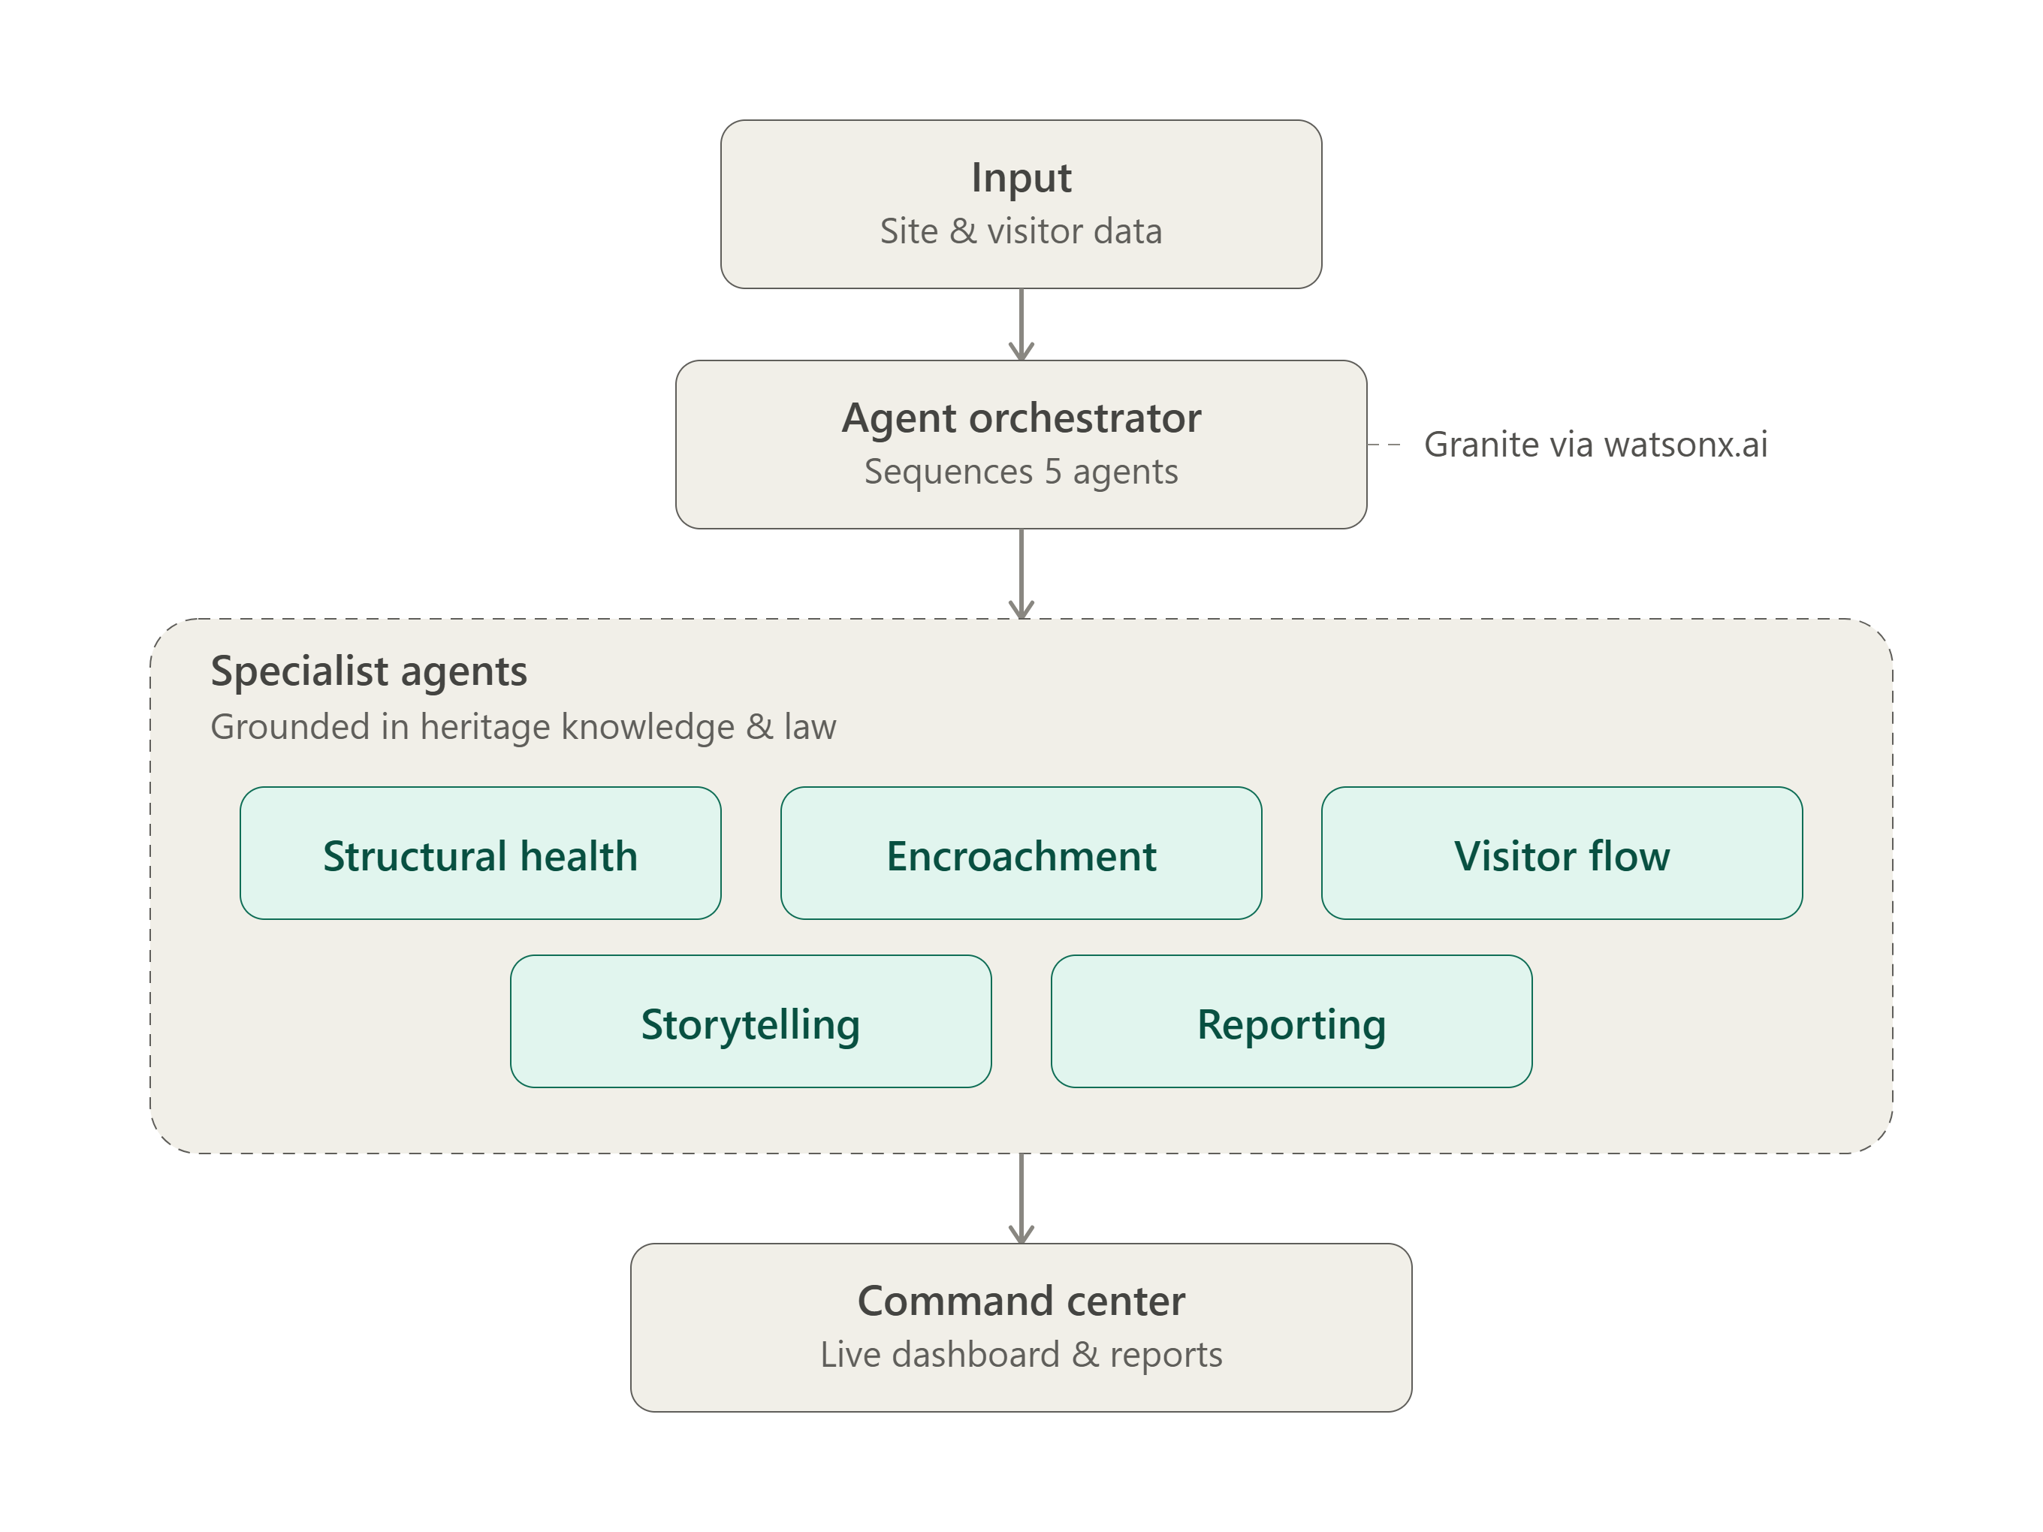
Workflow -

Slide 8

Role of Agentic AI in the solution
Role of Agentic AI in DHAROHAR AI
Agentic AI lets DHAROHAR AI act as an intelligent conservation system, not a simple assessment form. Powered by IBM watsonx.ai and Granite models, it coordinates specialized agents for structural risk, encroachment detection, visitor flow, storytelling, and reporting — each feeding into the next for transparent, evidence-based decisions.
The system understands site-specific context — heritage status, prior incidents, visitor pressure, and applicable legal frameworks — and adapts risk scores and action plans as new data comes in.
Overall, Agentic AI makes the platform proactive and explainable, acting like a digital conservation officer helping protect Gujarat's heritage before damage becomes irreversible.
That's about 95 words. Tell me the box's line/character limit if it still overflows and I'll cut further — the fastest next trim would be dropping the last sentence entirely, since the paragraph above it already carries the core point.

Slide 9
Novelty and Uniqueness
DHAROHAR AI stands out by combining multi-agent orchestration, verified knowledge grounding, and regulatory intelligence into a single heritage conservation system.
Multi-Agent Intelligence – Five specialized agents (structural health, encroachment, visitor flow, storytelling, reporting) work in sequence instead of a single generic model.
Verified Knowledge Grounding – Every output is anchored to curated site history, architecture, and conservation data, reducing hallucinated claims.
Regulatory Intelligence – Encroachment findings are mapped to real legal frameworks (AMASR Act 1958, Gujarat Heritage Regulation Act 2017) for actionable enforcement, not just a severity label.
Visual Evidence Integration – Drone feed simulation and historical (1985 vs. now) imagery comparison support visual site assessment.
Real-Time Risk Recalculation – A What-If simulator models how changing visitor pressure shifts heritage risk before it happens.
Explainable, Not a Black Box – Every assessment surfaces its agent-by-agent reasoning chain, not just a final score.
Secure, Enterprise-Ready Architecture – Built on IBM Granite via watsonx.ai through a credential-safe backend proxy, with a reliable demo mode for governance-conscious deployment.
This makes DHAROHAR AI a proactive digital heritage guardian, not just a condition-reporting tool.

Slide 10
Project Link
Git Hub Link
https://github.com/AsmaKhwaja/Dharohar-AI
Vercel Link
https://dharoharai.vercel.app/

Slide 11
Future Scope
Integration with IoT Sensors & Drone Surveys
The platform can integrate with real structural sensors (crack meters, vibration monitors, humidity sensors) and scheduled drone imagery capture across heritage sites. This would replace simulated condition data with live structural telemetry, enabling the Structural Health and Encroachment agents to detect deterioration and unauthorized construction as it happens, not just from reported incidents.
Multilingual & Voice-Enabled Storytelling
Extending Story Mode with voice narration and multilingual support (Gujarati, Hindi, and international languages) would make heritage storytelling accessible to a much wider range of visitors — domestic tourists, international travelers, and visitors with limited literacy — turning the platform into an inclusive on-site guide rather than a text-only experience.

Slide 12
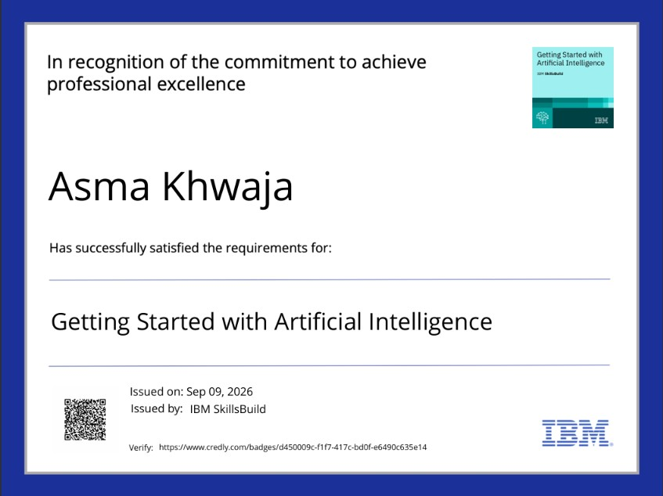
Certificates Earned:

Slide 13
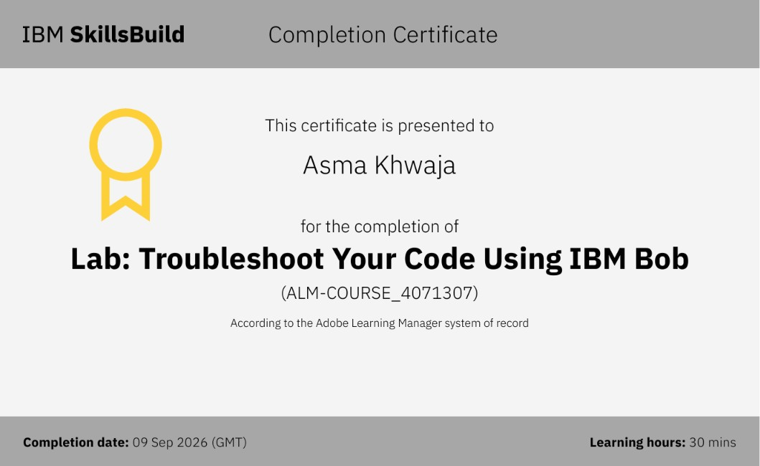
Certificates Earned:​

Slide 14


