Slide 1
Group-5 CSE715 – Spring 2021
Group Members:
1. Sanowar Hossain Raja (20266003) (section:01) 2. Sohel Rana (20366015) (section:01) 3. Iffat Immami Trisha (21166018) (section:02) 4. Asma Ul Hussna (21166030) (section:02) 5. Md. Sanaul Karim (21166032) (section:02) 6. Zawad Alam (21166035) (section:02)

Slide 2
NEURAL NETWORK to Detect and Identify Potato plant leaf diseases

Slide 3
Introduction
Potato - most cultivated and in-demand crops after rice and wheat
125 countries potato farming dominates as an occupation
Bangladesh known 7th largest country for producing potatoes
Several obstacles in developing potato farming
Leaf disease
Two major leaf diseases - late blight and early blight
Lead to damage the crop and decrease its production

Slide 4
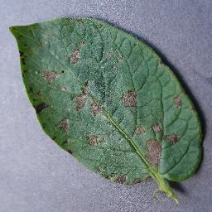
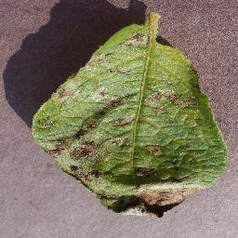
Introduction
Identifying the crops diseases
Main obstacle to produce good quality potato
Helping out the farmers by detecting and identifying potato leaf disease

Slide 5
Why NEURAL NETWORK
Neural network contains layers of interconnected nodes, we can refer that as multilayer perceptron
Input layer receives input patterns and output layer contains classifier, in which input patterns map
Neural network recognizes the relationships between data

Slide 6
Convolutional Neural Network
In our project we used Convolutional Neural Network to detect potato leaf disease
Convolutional Neural Network provides high accuracy compare to other neural networks
We used image processing concept in our project, Convolutional Neural Network is highly suitable for this concept

Slide 7
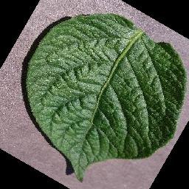
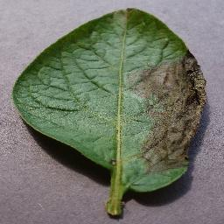
Dataset
Total 5702 images of Potato Leaves
Early Blight Infected leaves 1939 images
Healthy Leaves 1824 images
Late Blight infected Leaves 1939
Source : Plant Village Crops Disease Dataset https://github.com/spMohanty/PlantVillage-Dataset
For training 80% data used as training set and 20% data used as validation set
Early Blight
Healthy Leaf
Late Blight

Slide 8
State Of The Architectures For Image Classification
VGG16
Resnet
Efficient Net

Slide 9
Architecture Of The Neural Network
Activation Function: Relu
Optimizer: Adam
Loss Function: Sparse Categorical Crossentropy
input
2×2
Maxpooling
Dropout(0.2)
3×3
Convn(32)
3×3
Convn(64)
Fully Connected
Output
2×2
Maxpooling
2×2
Maxpooling
3×3
Convn(16)
Fully Connected
180×180×3

Slide 10
Technology Used To Implement Neural Network
Environment / Platform : Google Colab Gpu Environment
Programming Language : Python3(3.7.10)
Library : TensorFlow 2.4.1(gpu), PIL, Numpy, Matplotlib

Slide 11
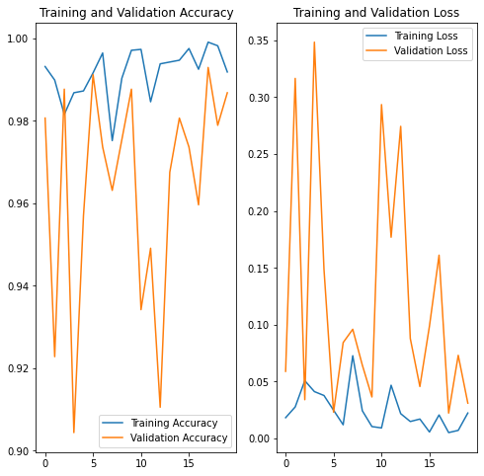
Training And Validation

Slide 12
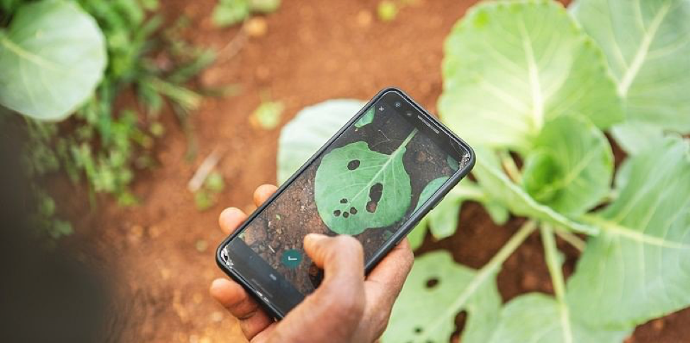
Future Plan

Slide 13
What about Fuzzy??

Slide 14
THANK YOU

