Slide 1
End-to-End Quality Assurance Testing for a Retail Web & API System
Presented by: Asma Khasawneh
Supervisor: eng. Ashraf smadi
Software Testing – Quality Assurance Track
11 February 2026
Notes:
It’s a pleasure to be here today
Self introduction
Tahaluf Al Emarat training
HTU Quality Assurance program
Final project overview

Slide 2

TABLE OF CONTENTS
01
05
02
06
03
07
Test Planning & Strategy
Performance Testing
Manual Testing
UI Automation Testing
API Testing
Mobile Testing
04
Newman Report
Notes:
The project consists of seven main parts
Through each part, I will explain how it was implemented in this project

Slide 3

Test Planning & Strategy
At the beginning of the project, a test plan was created to define the overall testing approach for the SauceDemo application. This test plan outlines the key components that guided the execution of all testing activities and supported the remaining phases of the project.
Key Test Plan Components:
System Under Test Test Scenarios
Test Scope Test Objectives
Test Environment Entry and Exit Criteria
Risks and Mitigation Plan Deliverables
Notes:
As a QA engineer, having a clear test plan is essential before starting any testing activities
A comprehensive test plan was created for the demo application

Slide 4
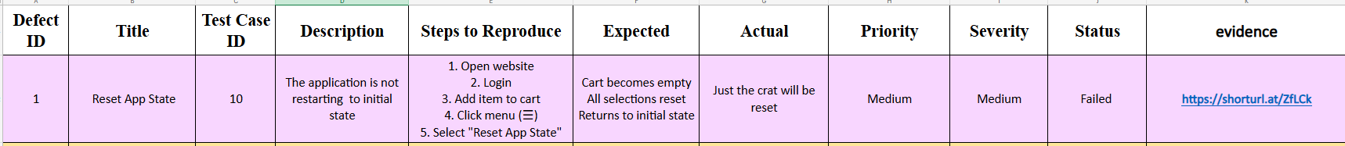
Manual Testing
Manual Testing Highlights:
Target: Web Application (SauceDemo)
Total Test Cases Executed: 59 Test Cases
Test Scenarios: Happy Paths and Negative Scenarios
Defects Identified: 22 Bug Reports
Notes:
Covered all user roles in the system
Created and executed 59 manual test cases
Reported 22 documented defects
As shown, test cases and bug reports followed a clear structure
Included all essential fields
Ensured traceability between test cases and defects

Slide 5
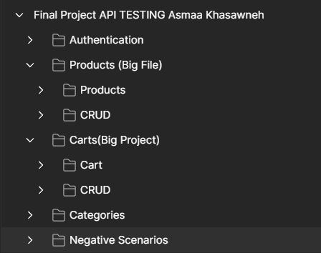
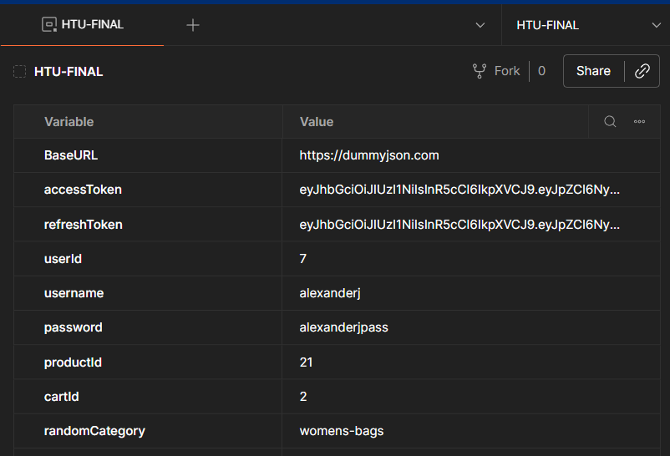
API Testing
API testing was performed using Postman to validate backend functionalitiesand ensure correct behavior across different business modules. All APIrequests were organized within a single collection and structured into foldersbased on functionality to improve readability and maintainability
Notes:
DummyJSON API
Postman collection structure
Environment variables configuration

Slide 6
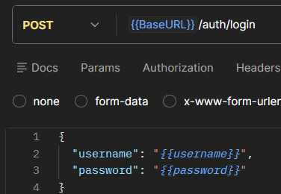
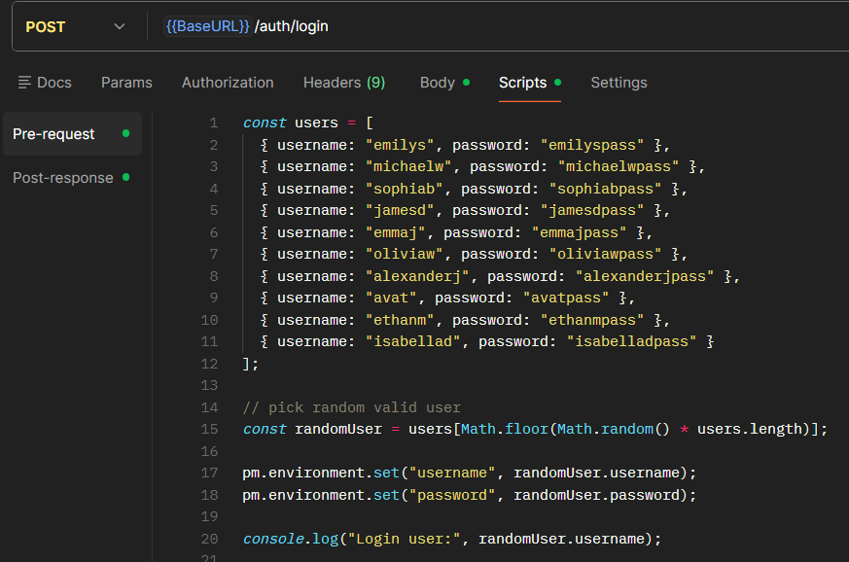
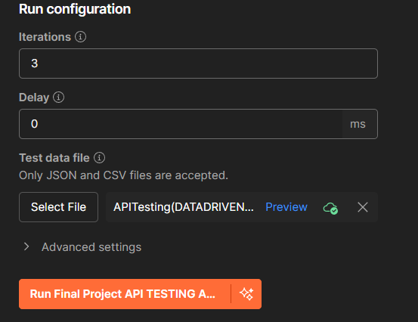
API Testing
Postman Testing Highlights:
Total Requests: 23 API Requests
Data-Driven Testing: CSV files used to support logic-based data-driven execution
Dynamic Data Handling: Response values stored as environment variables for reuse
Randomization: Random data generation applied where needed to increase test coverage
Notes:
23 API requests
Randomized test data
Data-driven testing using a CSV file

Slide 7
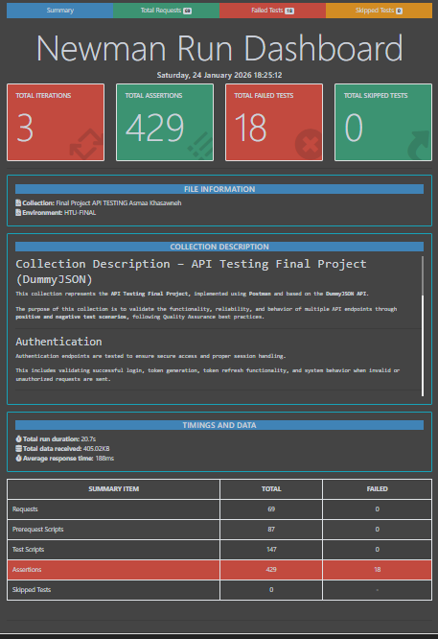
Newman Report
The Postman collection was executed using Newman to automate API testing and generate execution reports.
The Newman dashboard provided a clear summary of iterations, assertions, and test results based on the data-driven execution.
Newman Report Highlights:
Iterations: 3 Iterations
Total Assertions: 429 Assertions
Failed Assertions: 18 Assertions
Skipped Tests: 0
Notes:
A mandatory Newman test was generated to provide a clear execution summary
Three iterations were executed using the CSV file
429 assertions were performed
18 assertions failed as part of negative test scenarios
Zero skipped tests, indicating that all endpoints were fully tested

Slide 8
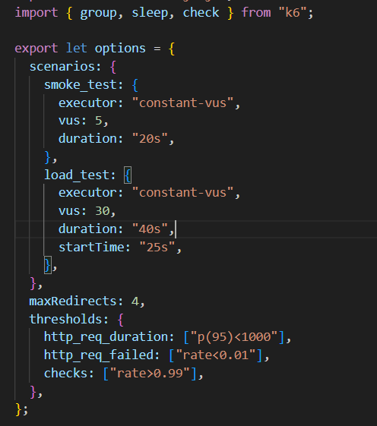
Performance Testing(k6)
Targeted Endpoints:
Cart-related API endpoints
Load Profiles:
Smoke Test: Low virtual users for basic stability validation
Load Test: Higher virtual users to simulate normal usage
Virtual users and test duration configured per scenario
Thresholds defined for response time and error rate
check and sleep functions applied to validate responses and simulate realistic behavior
Configuration & Enhancements​
Notes:
Current related API endpoints
Two test scenarios were conducted: smoke test and load test
Defined thresholds for HTTP request duration, HTTP request failures, and checks

Slide 9
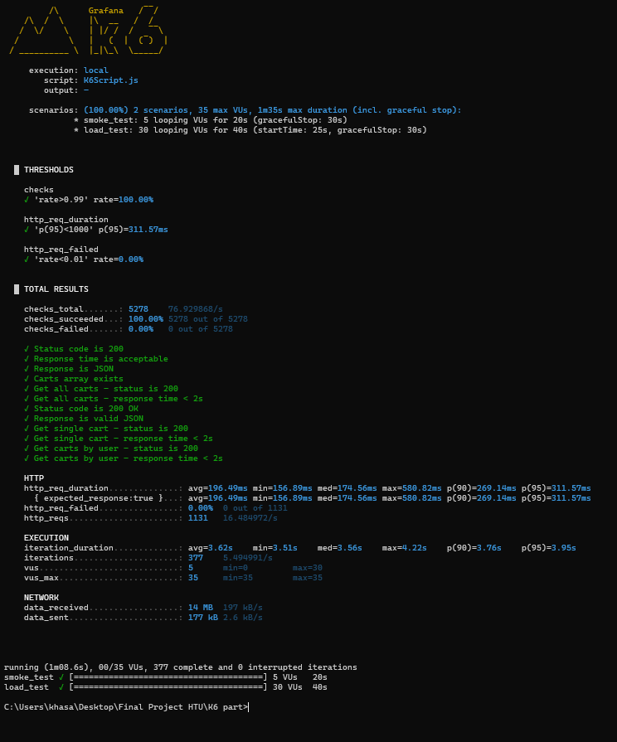
K6 Analysis
Analysis & Conclusion
The system remained stable under load
No failed requests were detected
Response times were acceptable and consistent
The system meets the defined performance acceptance criteria
Notes:
As a result, the system remained stable
No failed requests were detected
Response times were within acceptable limits
The system met the defined performance acceptance criteria

Slide 10
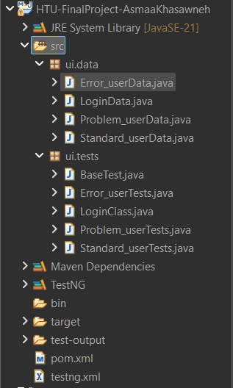
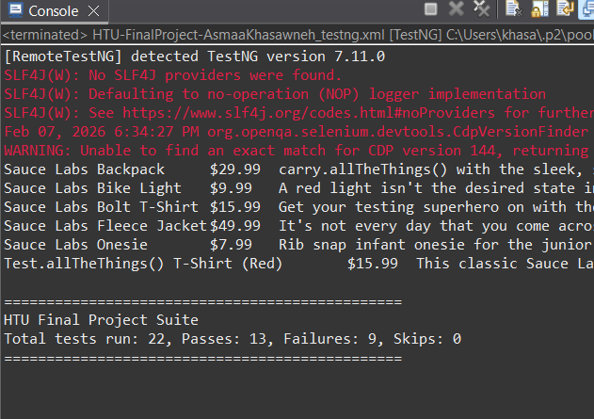
UI Automation Testing
Framework Structure:
Tests organized into separate classes based on functionality
User-related actions handled in dedicated classes
Test data separated into independent data classes
Design Approach:
Inheritance applied to reduce duplication
Centralized base/source class for setup and configuration
Test suite used to manage and execute tests
Total Automated Tests: 22 UI Test Cases
Notes:
Used Selenium framework with Eclipse
Implemented 22 automated test cases
Created a dedicated package for test data
Created a dedicated package for test cases
A test suite was implemented to execute tests for multiple users
Both happy path and negative scenarios were covered (7 scenarios)

Slide 11
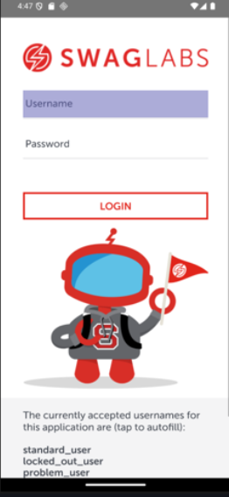
Mobile Testing
Mobile Testing Highlights:
Platform: Android
Tools: Android Studio, Appium
Execution Environment: Android Emulator
Test Coverage: Basic mobile system functionality
Total Test Cases Executed: 3 Mobile Test Cases
Testing Scope: Simple and targeted validation scenarios
Notes:
تمام 👌 هاي صياغة مصقولة واحترافية وجاهزة للسلايد:
Mobile testing was performed using Android Studio and Appium Inspector
A total of three basic mobile test cases were executed
Testing was conducted on the SwagLabs mobile application
The test cases included login, add to cart, and remove from cart
إذا

Slide 12
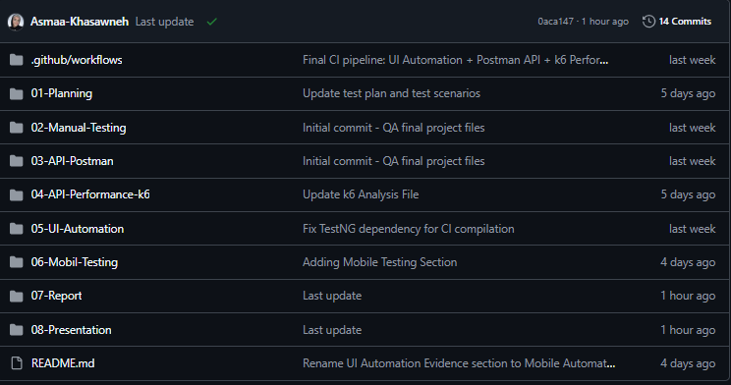

GITHUB
CI/CD
Notes:
GitHub was used for version control and project collaboration
CI/CD workflow was implemented using GitHub Actions
Automation flow for Selenium, K6 and Postman

Slide 13
THANKS!
Do you have any questions?​
Khasawnehasmaa@gmail.com​
+962 797248869​
Github
asmaa-khasawneh
Notes:
“In conclusion, this project demonstrates my ability to apply a complete QA process using different testing approaches and tools. Thank you for your time, and I’m happy to answer any questions.”

