Slide 1
improve the performance

Slide 2

Now we are facing some problem related to performance
Of our application
If you face some delay in your code for example when you try to get set of data
The first thing you do to inspect F+12 to determine which the end point which make the delay and how much time it’s takes
Press F+12 and choose network tab then make your request and it will show you details about request

Slide 3
Start read to understand the business and the logic of the code
Carefully understand the database tables and it’s relationship which I will manipulate or deal with them
Try to determine from which the slowness come from
In our example we deal with function which get the requests with it’s last status and some additional data
We get requests based on user role if the user is admin or engineer or asset owner and so on .

Slide 4
Important
The Most Problem in our Application which I Notices that is Make the issue of slowness is “Doing Mapping to All Data After Get It”
Try As Possible Not To Map All Data

Slide 5
IEnumerable VS IQueryable
I queryable inherit form I enumerble which mean that it’s extends it’s functionality
IEnumberable | IQueryable
Using System.Collections | Using System.Linq
Filter in Memory Side | Filter At Server Side
Good When Deal With in memory data | Good when deal with external data
Context.Employees.Tolist() Fetch All Data to memory | Fetch data with filteration it’s good to make it queryable Context.Employees.Where(e=>e.name.StartWith(‘a’));

Slide 6
Continue Ienumerable VS IQueryable
If your intent to select All Data As Fast as Possible without any Filteration or any process use Ienumerable
If your intent to select data based on Filteration criteria it’s good and faster to use Iqueryable
Iqueryable Perform All The Statement on the server Side “SQL Server”
Then Fetch Data
IQEnumberable just Fetch data and then perform the filter statements in memory side .

Slide 7
Tracking and No Tracking
We select records from data base for two reason
For Edit or For View
If your intent is to select record and then edit ASTracking is Suitable
If your intent to select and view then AsNOTracking Is suitable
The entityframework by default is AsTracking style
If your intent is to select and view add .AsNoTracking() to your code to no track the objects

Slide 8
Delegates
There are some thing in C# helps you one of them is delegate
Delegate is pointer to function
If you declare string employeeName=“Ahmed”;
Them employeeName Is Variable refer to Ahmed value
If I Declare Fuction Which Take String paramerter and make some action
Public void SayHello(string str)
{
Console.WriteLine($”Helllo Mr {str}”);
}

Slide 9
Continue delegate
Access Modeifer (delegate) (return type) nameOfType (parameter)
Public delegte void MyDelegate(string str);
Then we Can say that “MyDelegate” is Type
MyDelegate myDelegate=printString;
myDelegate is pointer to function called printString
Invokation by
myDelegate.Invoke(“myname”); or myDelegate(“myname”).
You can pass the delegate as a parameter to function
We have three Predefined deleagates in C#
Func, Predicate and Action

Slide 10
Predefined delegate
Predicate<T> return bool
Func<T1,outPut>
Func<output> => non generic
Fuc<T1,T2……,T16,Out T> 17 parameter
Take 17 parameter the last one is the output
Take from one parameter to 16 parameter
Action from it’s name it make some action
Return void
Action void() => non Generic
Action<T1,T2…..T16>

Slide 11
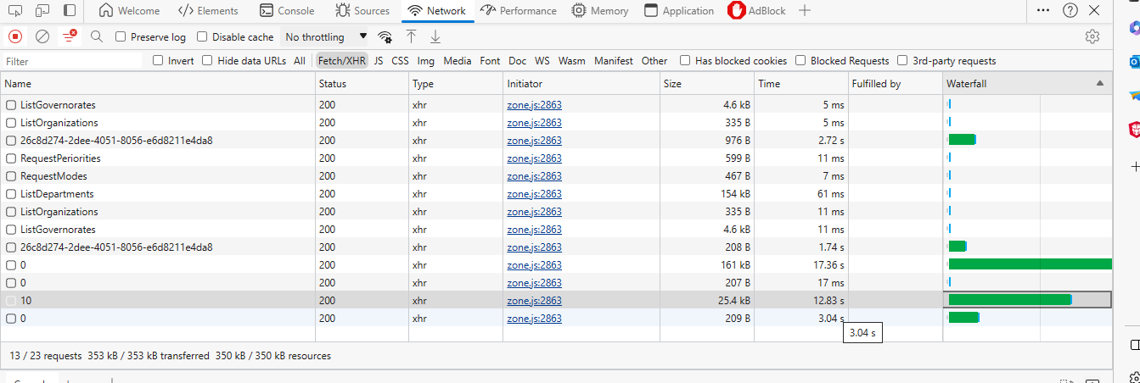

Slide 12
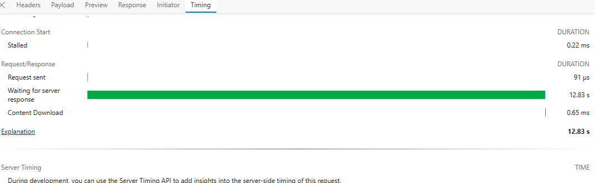

Slide 13
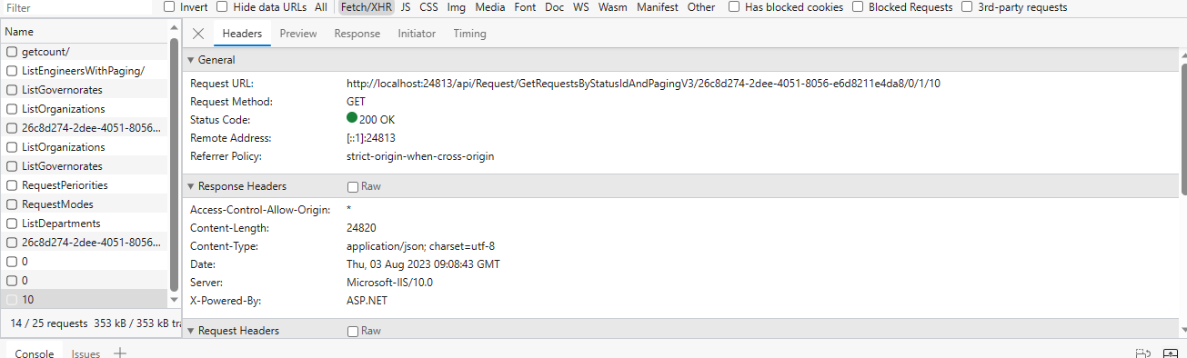

Slide 14
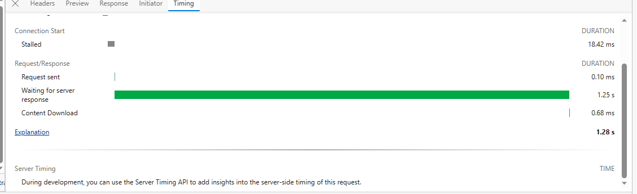

Slide 15
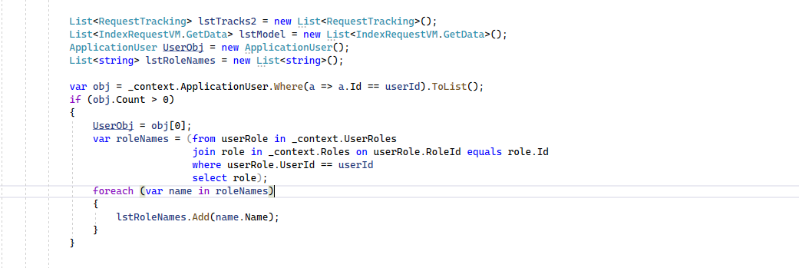

Slide 16
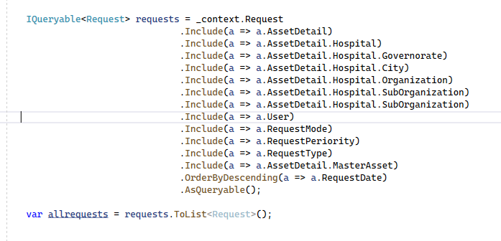

Slide 17
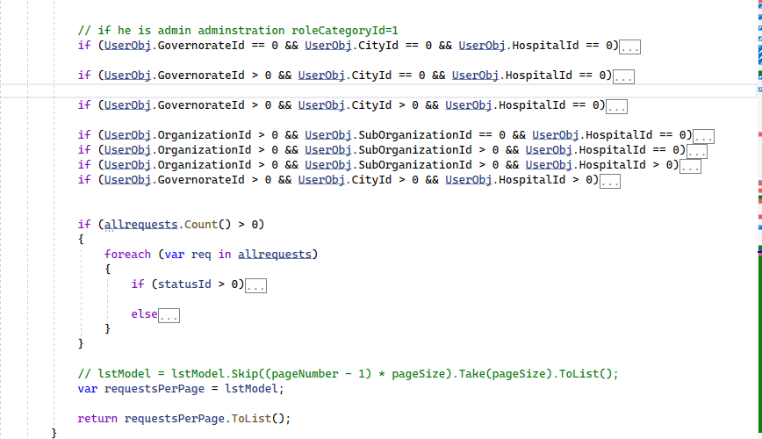

Slide 18
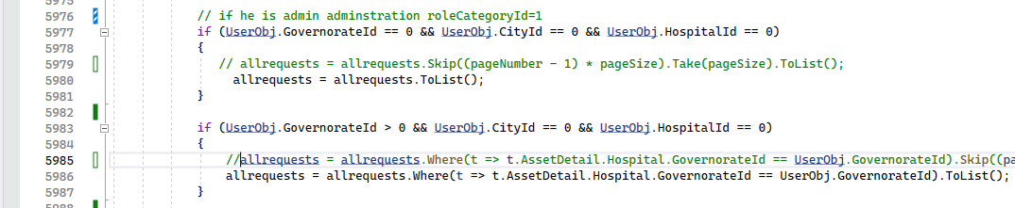

Slide 19
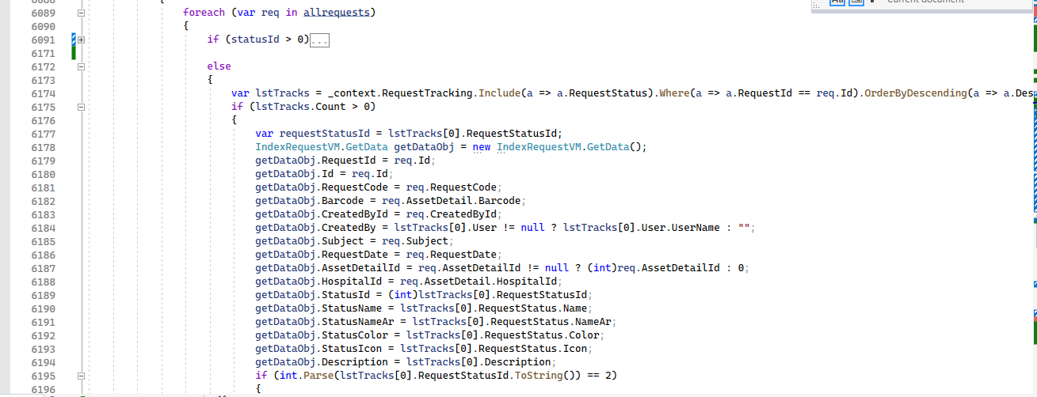

Slide 20
There are a lot of process in Foreach statement which affect the performance
The solution is trying to write code aim to the same result with less time
First You Should Understand The Database
Trying not to make mapping to all data just 10 record which you want

Slide 21
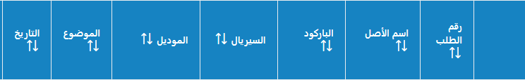
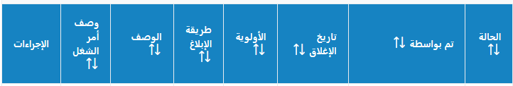
What I want fetch

Slide 22
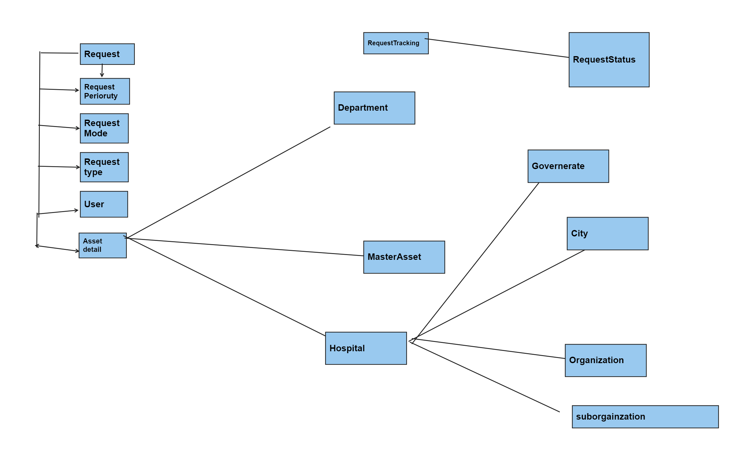
Finding the solution

Slide 23
Think about it what I want I want to select last status foreach Request
Foreach Request in Requesttracking I want catch last request and get it’s sratus
We can translate this into group by and order statement
Group by RequestId and Select Max(Date)

Slide 24
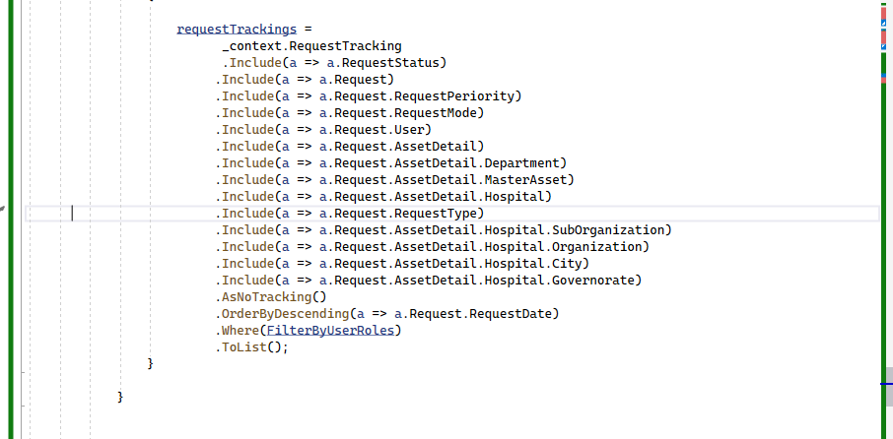

Slide 25
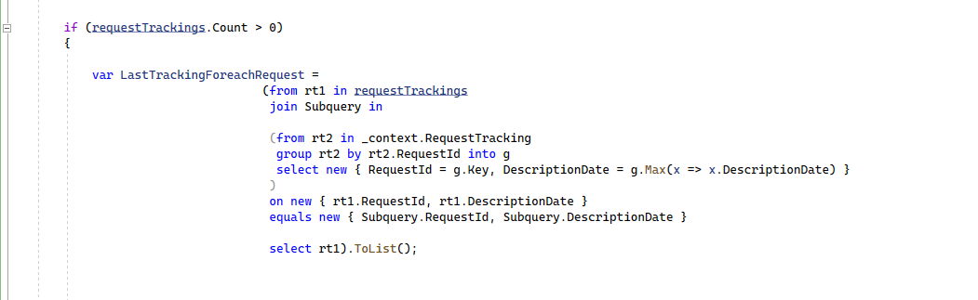

Slide 26
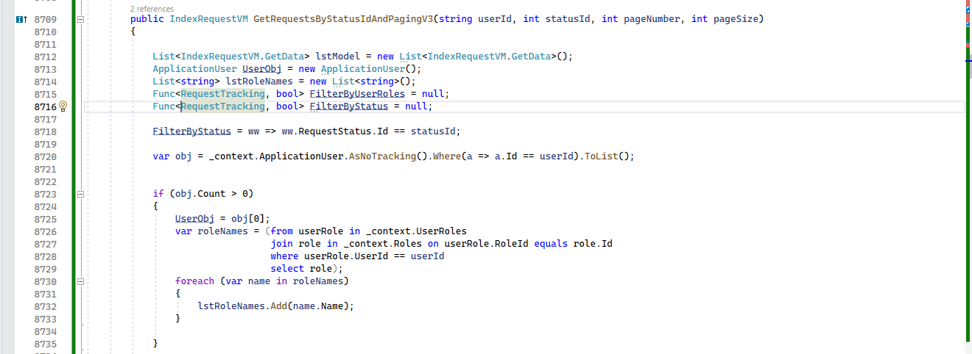
My new code

Slide 27
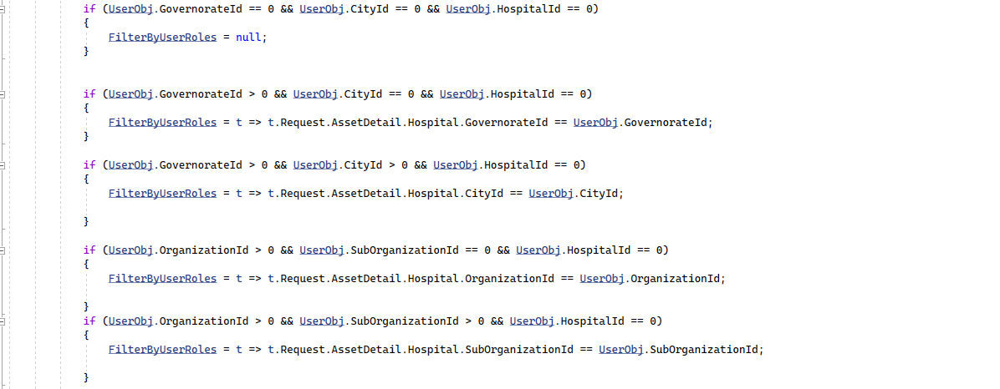

Slide 28
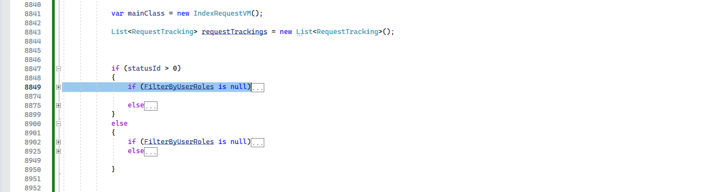

Slide 29
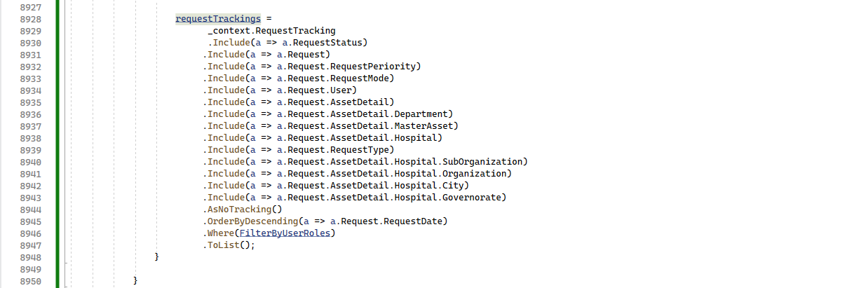

Slide 30
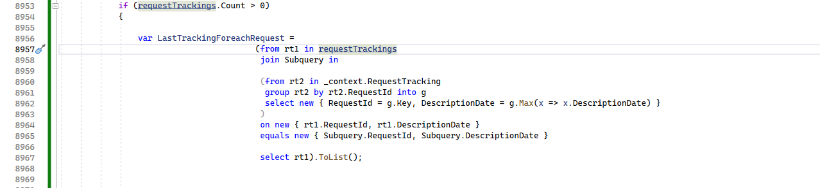

Slide 31
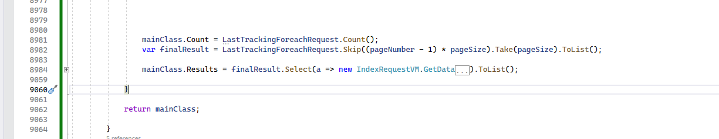

Slide 32
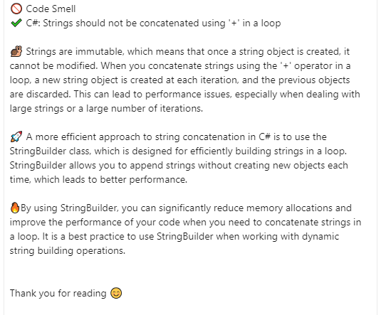

Slide 33
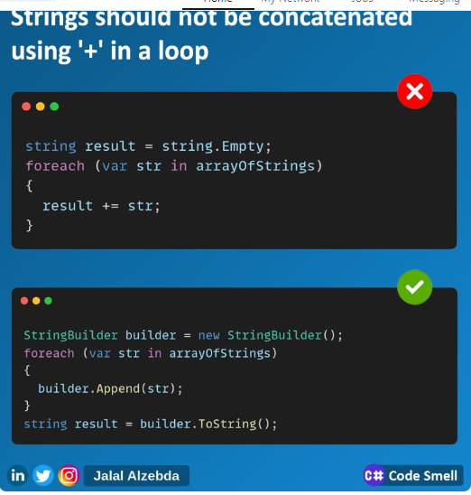

Slide 34
To improve your code performance there are topics should take in your
Consideration such how to write clean code and what is design pattern but when you get into these topics you read about common and popular principles you should follow up
Which is Solid Principles
Let’s talk about it .

Slide 35
Solid Principles
(S) for Single Responsibility principle => SRP
(O) For Open / Closed Principle => OCP
(L) Liskov Substitution Principle =>LSP
(I) Interface Segregation Principle => ISP
(D) Dependency Inversion Principle => DIP

Slide 36
Soild is Desing Principles Is first introduced by Michael Feather
And then Promoted by Robert C.Martin
Solid help us manage most software design problems
The intent of solid is to make software more Extensible , maintainable and
Testable

Slide 37
Single Responsibility Principle
Robert C.Martin “the class should have only one reason to change”

Slide 38
Open / Closed Principle
Good software should open for extension closed for modification which mean
My Functionality should added with minimum change of existing code
Keeping the existing code unchanged as possible

Slide 39
Liskov Substitution principle
objects of a superclass should be replaceable with objects of its subclasses without breaking the application
If a program module is using a Base class, then the reference to the Base class can be replaced with a Derived class without affecting the functionality of the program module

Slide 40
Interface segregation Principle
Many client-specific interfaces are better than one general-purpose interface” 2.We should not enforce clients to implement interfaces that they don't use. Instead of creating one big interface we can break down it to smaller interfaces
Break fat interface with small interface

Slide 41
Dependency Inversion Principle
High-level modules should not depend on low level modules
One should “depend upon abstractions, [not] concretions"

Slide 42
references
https://www.youtube.com/watch?v=-hbWDYRSjqk&list=PLnqAlQ9hFYdflFSS4NigVB7aSoYPNwHTL

