Slide 1
Best Price
IT IS OUR PLEASURE TO HELP YOU SAVE MONEY

Slide 2
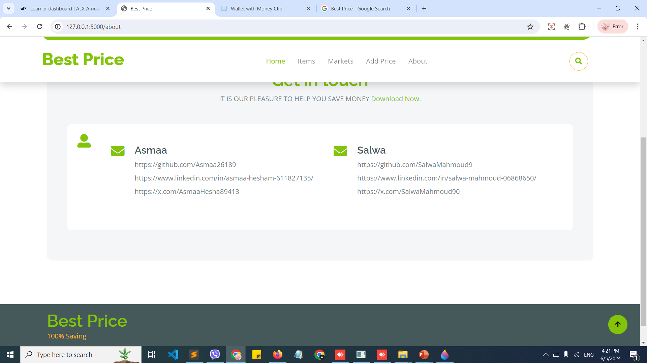
Our Team

Slide 3
Outline
Features
Technologies
Pages
Screenshots
Live demo

Slide 4
Who is “BestPrice” for?
This project aims to compare item prices between different markets, to help the user to get the lowest price for the desired item.

Slide 5
Features
Main core Feature:
Adding Items
Adding Their Prices
Responsive Design
Search Functionality
Interactive Navigation

Slide 6
Technologies
Front-end: HTML, CSS, JS, Bootstrap
Back-end: Python with Flask
framework, MySQL
Version-control: Git

Slide 7
Pages
Home Page
About
Search
Item
Market
Add Price

Slide 8
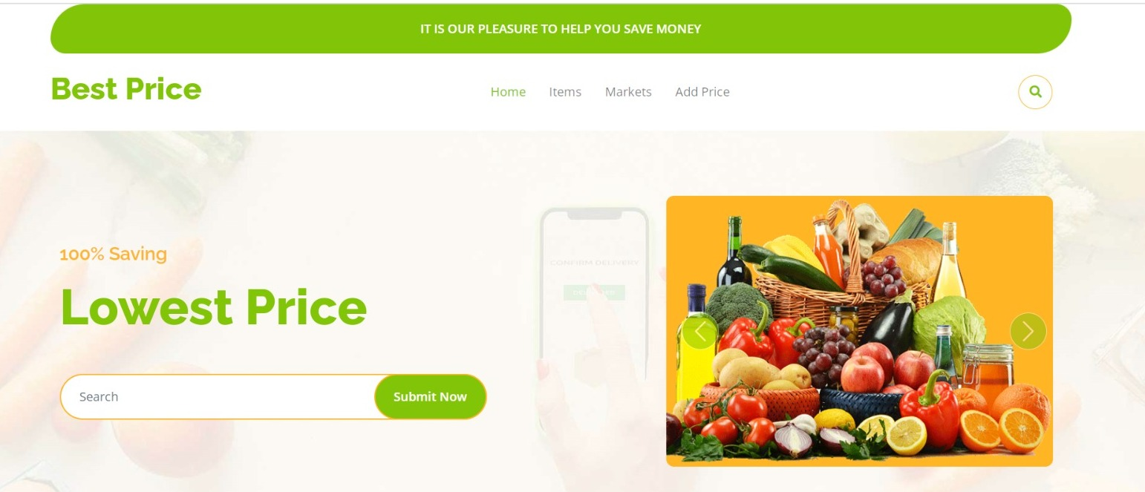
Screenshots

Slide 9
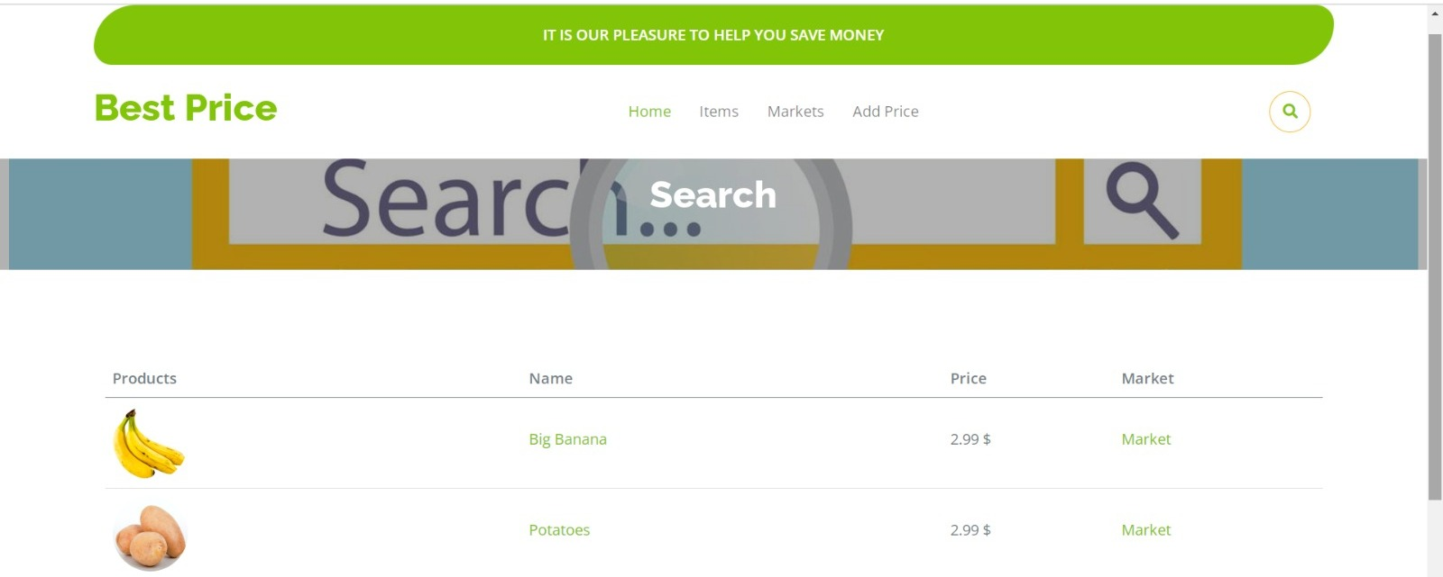
Screenshots

Slide 10
Live Demo
https://github.com/Asmaa26189/BestPrice/blob/main/BestPrice_0.webm

Slide 11
New Release
As a new extension for this website we will Make it work for different countries to help people all over the world.

Slide 12
Questions

