Slide 1
Zynq-7000 SoC
Eng /Keroles Shenouda
made by/ Asmaa Ahmed Mohamed.

Slide 2
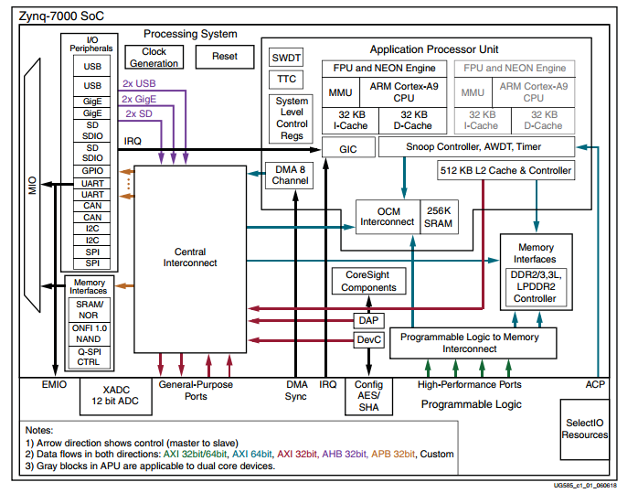
Block Diagram
GPIO
BUS
Processor
Notes:
-The interrupt structure is closely associated with the CPUs and accepts interrupts from the I/O peripherals (IOP) and the programmable logic (PL).
-The bus contain register.

Slide 3
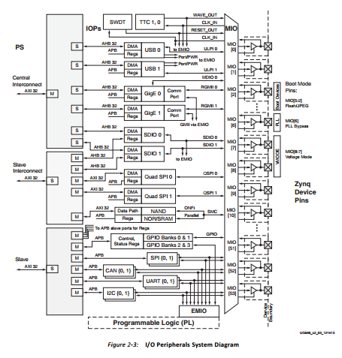
Pin Configration
Notes:
-Every module its pin is come out .

Slide 4
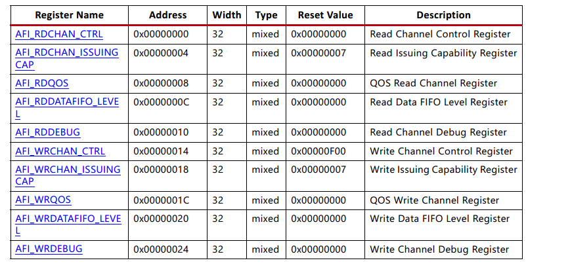
Registers

