Slide 1

TechME .. private Online lessons

Slide 2
types of users :
Students
Teachers
Admin

Slide 3
Programing Language
PHP
HTML5
CSS 3
bootstrap 5
JavaScript
Database Technology (MYSQL)

Slide 4
Tools
Visual Studio Code
Miro
Trello
GitHub

Slide 5
Features
Login
Student Side
Teacher Side
Admin Side

Slide 6
Student Side
Home(Landing Page)
About
Classes
Subjects
Teachers
Teacher Profile
Booking Page
Blog
Contact
Student Account

Slide 7
Teacher Side
Dashboard
Schedule
Available Times
Students
History
Your Earnings
comments
My Profile

Slide 8
Admin Side
Dashboard
Grades
Subjects
Teachers
Users
Schedule
Active Students
Comments
Messages
Budget
My Profile

Slide 9
Business Model TechMe
Key Partners
Key Activities
Value
Propositions
Customer
Relationships
Customer Segments
Students
Teachers
Internal Management
Marketing
Teachers
24/7 customer service assistance
value
suggestions
Teacher suggestion
Wide range of booking options
worldwide
Key
Resources
Channels
Technology
Internal integration capacity
social media
Website
Cost Structure
Revenue Streams
Internal management expenses including marketing
Taxes ,General administration
salaries for teachers
Reservation of classes

Slide 10
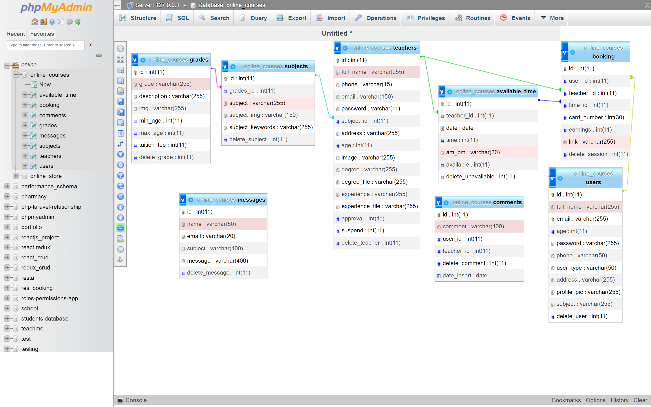
Table relationships

Slide 11
Demonstration

