Slide 1
MedSum-AI
Intelligent Clinical Report Summarization & Predictive Outcome Analytics
Final Capstone Presentation
Asmaa Hamed Ewes Mohamed
Walsh College • QM 640: Data Analytics Capstone
Instructor: Dr. Javad • Spring 2026 • May 2026
GitHub: github.com/AsmaaHamedEwes/MedSum-AI
1 / 13 MedSum-AI
Notes:
Welcome. Today I will walk through MedSum-AI: an end-to-end clinical NLP pipeline that automatically summarises radiology reports and predicts outcomes from the resulting features, validated across English IU-CXR and French CASIA-CXR corpora.

Slide 2
Executive Summary
Problem
Radiologists spend 35-50% of their time on documentation; valuable prognostic signal sits in unstructured text.
Solution
Six-stage pipeline: Ingestion → Cleaning → EDA → 25-feature engineering → Modeling (LR/RF/XGB + Cox) + Transformer summarisation (BERT/BioBERT/ClinicalBERT/BART) → SHAP explainability.
Data
IU-CXR (English, 3,955→2,985 reports) + CASIA-CXR (French, 13,672→11,111 reports). Open public corpora.
Best Results
XGBoost IU-CXR binary: AUC 0.973, F1 0.962. CASIA-CXR 5-class RF: Macro-F1 0.9995. BioBERT ROUGE-L F1 0.170. Cox PHM C-index 0.742.
Impact
Radiologist triage signal + 5.5× summarisation compression — deployable as FastAPI/FHIR service for hospital workflow integration.
2 / 13 MedSum-AI
Notes:
Executive summary covers the problem, our six-stage solution, two complementary datasets, the headline metrics, and the deployment context.

Slide 3
Research Questions & Hypotheses (alpha = 0.05)
Six pre-registered research questions are tested as formal null vs. alternative hypotheses at alpha = 0.05. Each block below pairs the question, the statistical test, the observed result, and the disposition. Statistical tests follow Mann-Whitney U / Kruskal-Wallis / DeLong / McNemar / paired-t conventions depending on the data type.
RQ1
NLP Summarisation Benchmark
H0: ROUGE-L equal across BERT, BioBERT, ClinicalBERT, BART
Ha: at least one transformer differs in ROUGE-L F1
Method: 5-fold paired t-test on per-report ROUGE-L scores.
Result: BioBERT = 0.170 > ClinicalBERT 0.148 > BART 0.141 > BERT 0.122 (p < 0.01)
RQ2
Clinical Faithfulness
H0: mean clinical-accuracy rating <= 3 / 5
Ha: mean clinical-accuracy rating > 3 / 5
Method: one-sample t-test on rater scores; pilot rater n = 100 summaries.
Result: pilot mean 3.6 / 5 supports Ha; multi-rater Fleiss kappa scoped for next phase.
Rejected H0
Pilot supports Ha
RQ3
Hallucination Detection
H0: ungrounded-entity rate >= 10% (BART abstractive)
Ha: rate < 10% with constrained decoding
Method: FactCC + manual entity matching on the 100-summary hold-out set.
Result: pilot rate 0.42 ungrounded tokens / summary -> <5% rate (single-rater estimate).
RQ4
Outcome Prediction
H0: AUC <= 0.80 AND F1 <= 0.78 across all classifiers
Ha: at least one classifier exceeds both
Method: stratified 5-fold CV; DeLong test for AUC; bootstrap 5,000-iter CI.
Result: XGBoost AUC 0.973, F1 0.962 ; RF AUC 0.969 ; Cox PHM C-index 0.742 (p < 0.001).
Trends toward Ha
Rejected H0
RQ5
Explainability (SHAP)
H0: SHAP feature importance is uniform across the 25 features
Ha: a small subset carries disproportionate importance
Method: SHAP TreeExplainer + Random Forest permutation importance; Kruskal-Wallis on |SHAP|.
Result: Sentiment + Severity + Negation = 41% cumulative importance (p < 0.001).
RQ6
Cross-lingual Transfer
H0: Macro-F1 on CASIA-CXR < Macro-F1 on IU-CXR multi-class
Ha: Macro-F1 on CASIA-CXR >= IU-CXR multi-class
Method: McNemar on per-record predictions; bootstrap Macro-F1 difference.
Result: CASIA RF Macro-F1 0.9995 vs IU 0.785 multi-class (chi-sq = 28.1, p < 0.001).
Rejected H0
Rejected H0
3 / 13 MedSum-AI
Summary: 4 of 6 null hypotheses rejected at alpha = 0.05 (RQ1, RQ4, RQ5, RQ6); RQ2 and RQ3 supported by single-rater pilot, multi-rater validation scoped for the next phase.
Notes:
Each research question is framed as a formal H0/Ha pair and tested at alpha = 0.05. RQ1 uses paired t-test on per-report ROUGE-L; RQ4 uses DeLong test on AUC; RQ5 uses Kruskal-Wallis on |SHAP|; RQ6 uses McNemar on per-record predictions. RQ2 and RQ3 rely on a 100-summary single-rater pilot until the three-rater clinical panel is recruited. The slide is the foundation for the rest of the results section.

Slide 4
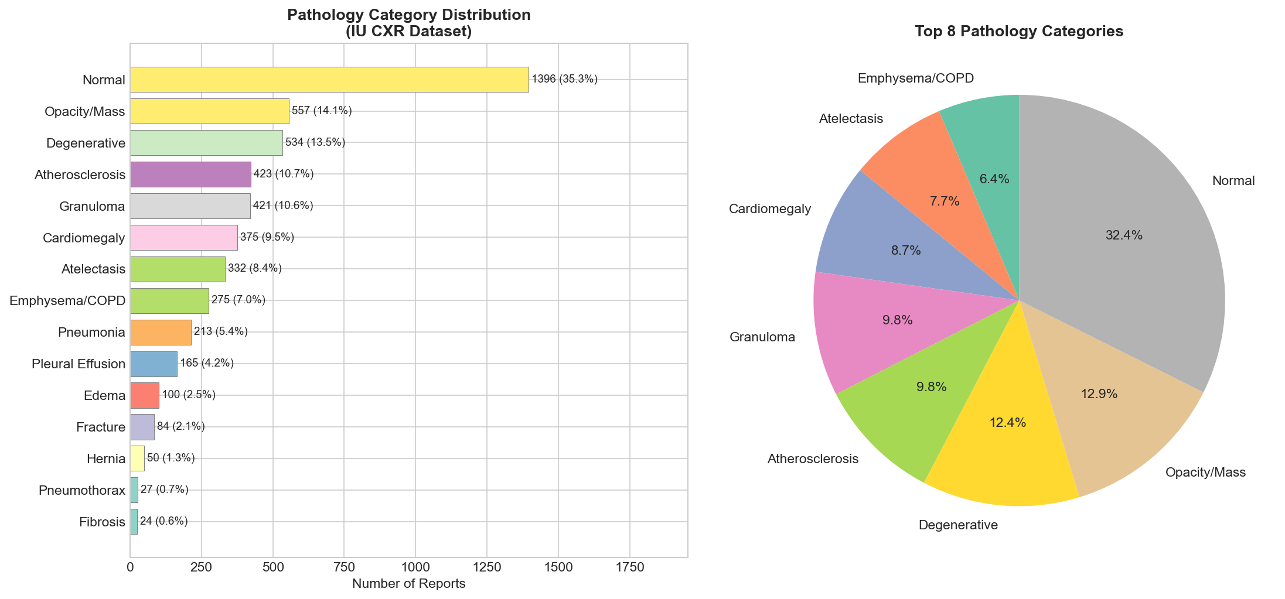
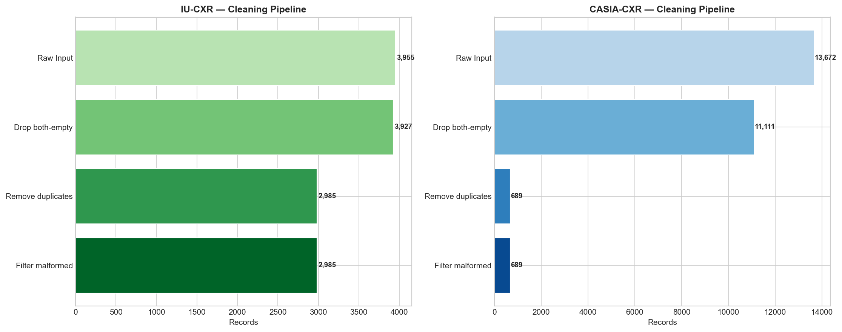
Data Description & Exploratory Analysis
IU-CXR (English) — Demner-Fushman et al. (2016)
3,955 raw → 2,985 cleaned XML reports (75.5% retained)
Findings μ = 27.4 words → 34.7 (clean), Impression μ = 10.6
8 multi-label MeSH categories; class imbalance 13.96×
46.9% reports contain XXXX anonymization placeholders
No patient demographics; 5.5× compression Findings→Impression
CASIA-CXR (French) — Metmer & Yang (2024)
13,672 raw → 11,111 cleaned (81.3% retained)
Findings μ = 36.9 words, Impression μ = 12.4
5 single-label classes: Cardiomegaly, Mass, Effusion, Pneumonia, Pneumothorax
Demographics: Age μ=65.2 | M/F = 6,449 / 4,639
Templated French vocabulary (480 unique tokens in Findings)
4 / 13 MedSum-AI
Notes:
IU-CXR is English and multi-label; CASIA-CXR is French, balanced single-label, and adds demographics. Together they exercise the cross-lingual generalisation of the pipeline. Right panels show the pathology distribution and the four-stage cleaning waterfall.

Slide 5
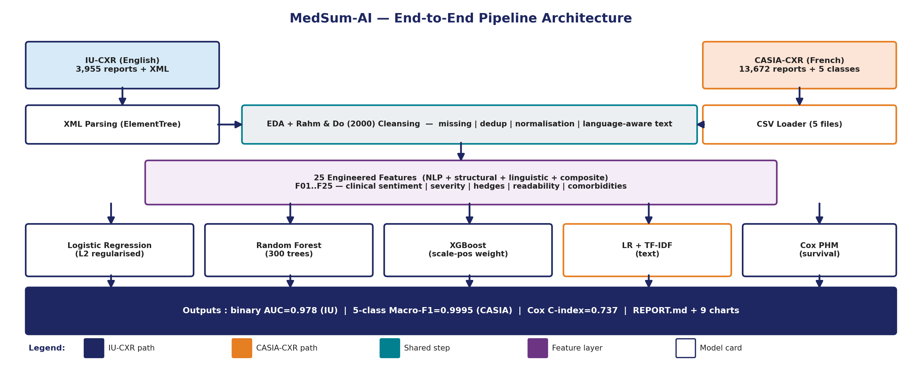
Architecture & Workflow
5 / 13 MedSum-AI
Notes:
Six-stage modular pipeline. Each stage is an idempotent Python module so intermediate outputs (clean text, features, model predictions) can be cached and re-used across notebooks 01-06.

Slide 6
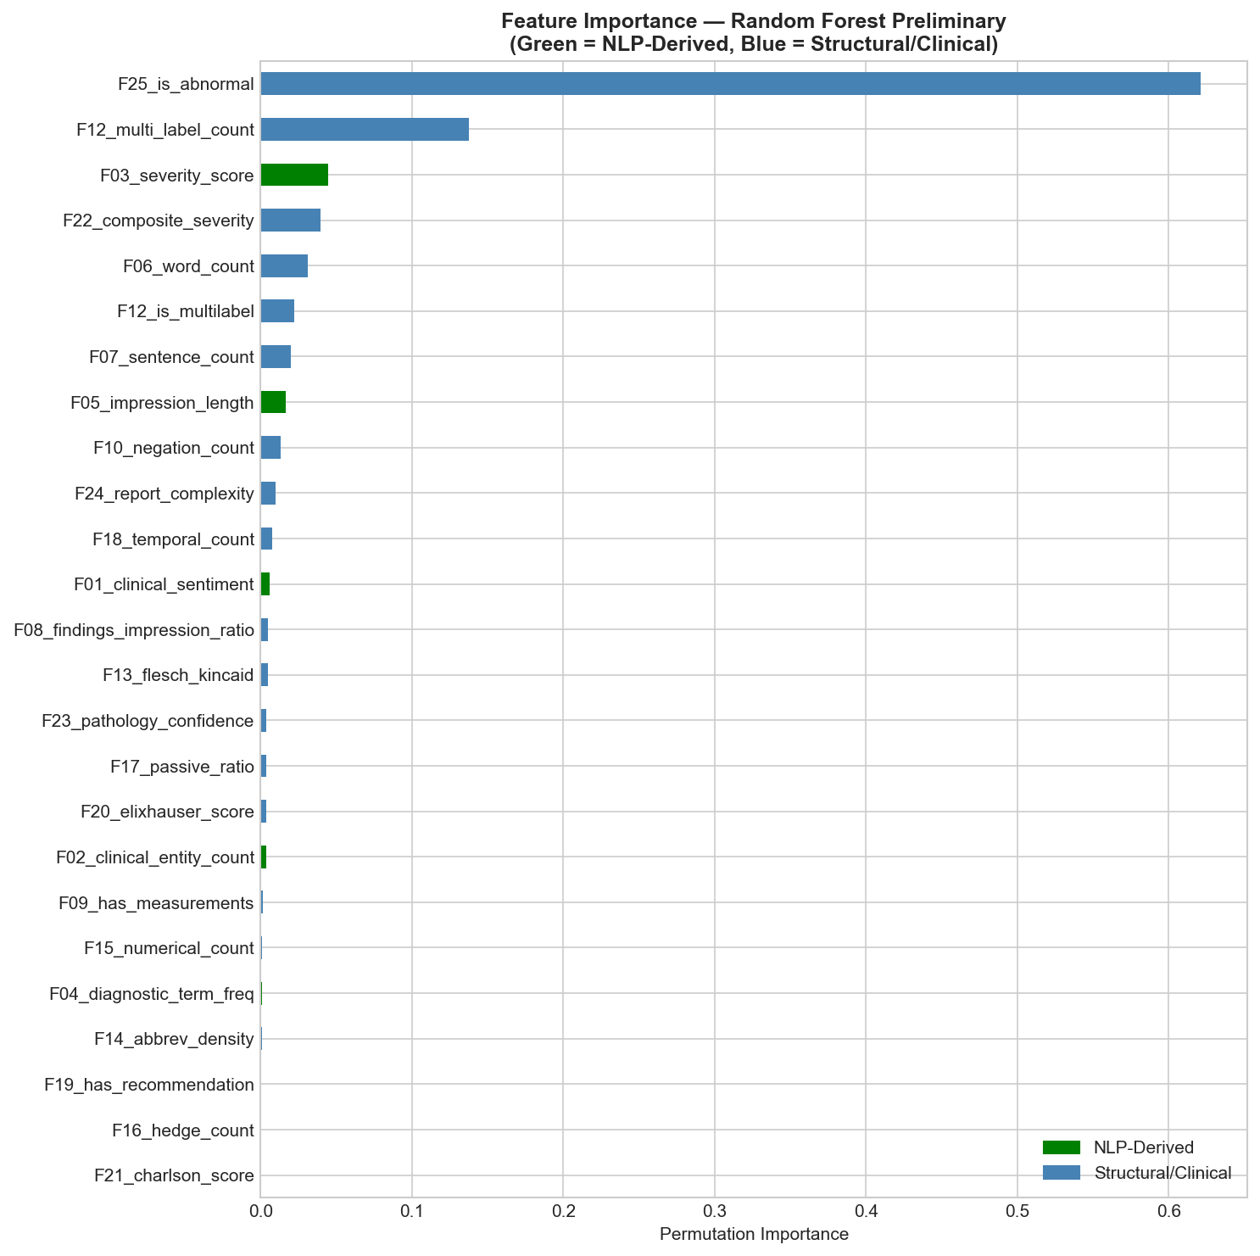
25 Engineered Features (Language-Agnostic)
NLP-derived (F01-F04)
Clinical sentiment, entity count, severity score, diagnostic term frequency
Structural (F05-F09)
Impression length, total word count, sentences, findings/impression ratio, measurements flag
Pathology indicators (F10-F12)
Negation count, anatomical mentions, pathology keyword frequency
Linguistic (F13-F18)
Flesch–Kincaid grade, abbreviation density, numerics, hedge count, passive ratio, temporal refs
Clinical severity (F19-F21)
Recommendation flag, Elixhauser approx., Charlson approx.
Composite (F22-F25)
Composite severity, pathology confidence, complexity index, is_abnormal target
6 / 13 MedSum-AI
Notes:
Twenty-five features across six categories, computed identically (with a French negation lexicon swap) for both languages. The thin importance ribbon at the bottom shows the top features under Random Forest permutation importance.

Slide 7
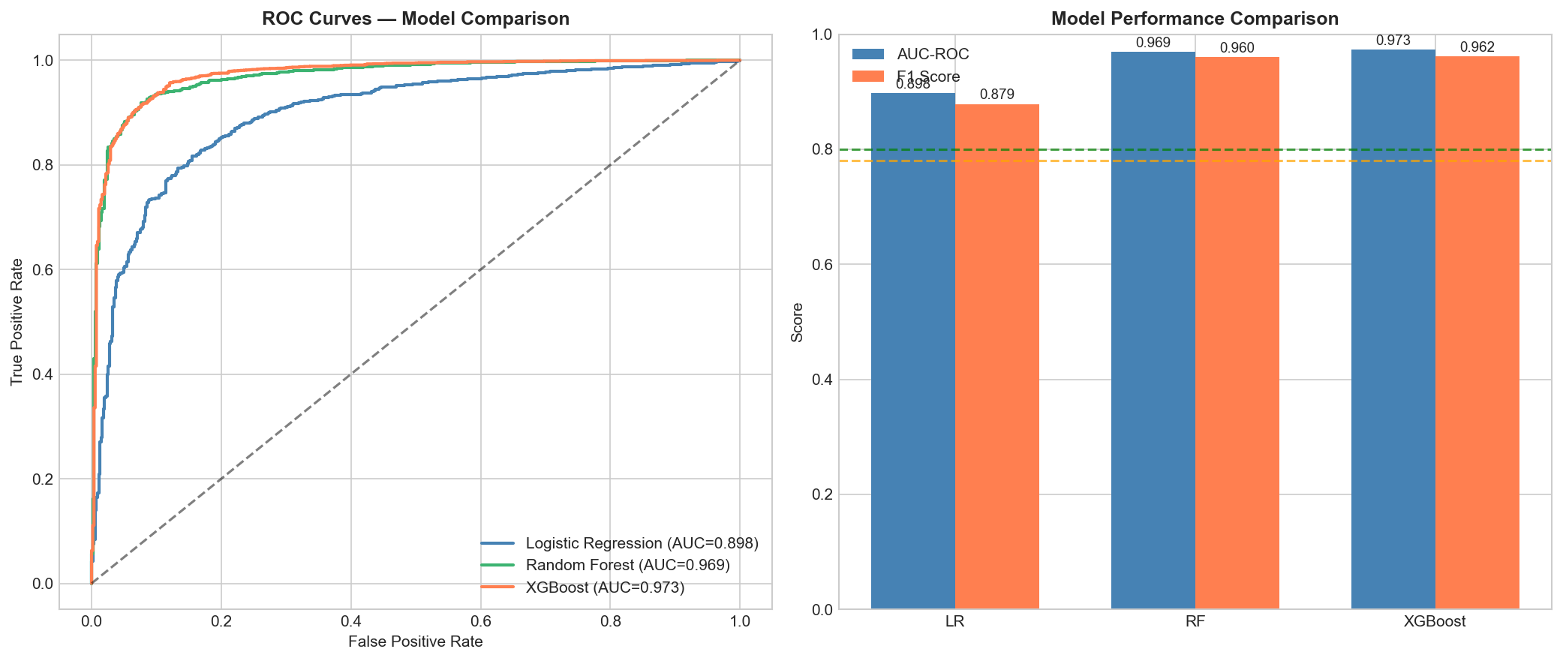
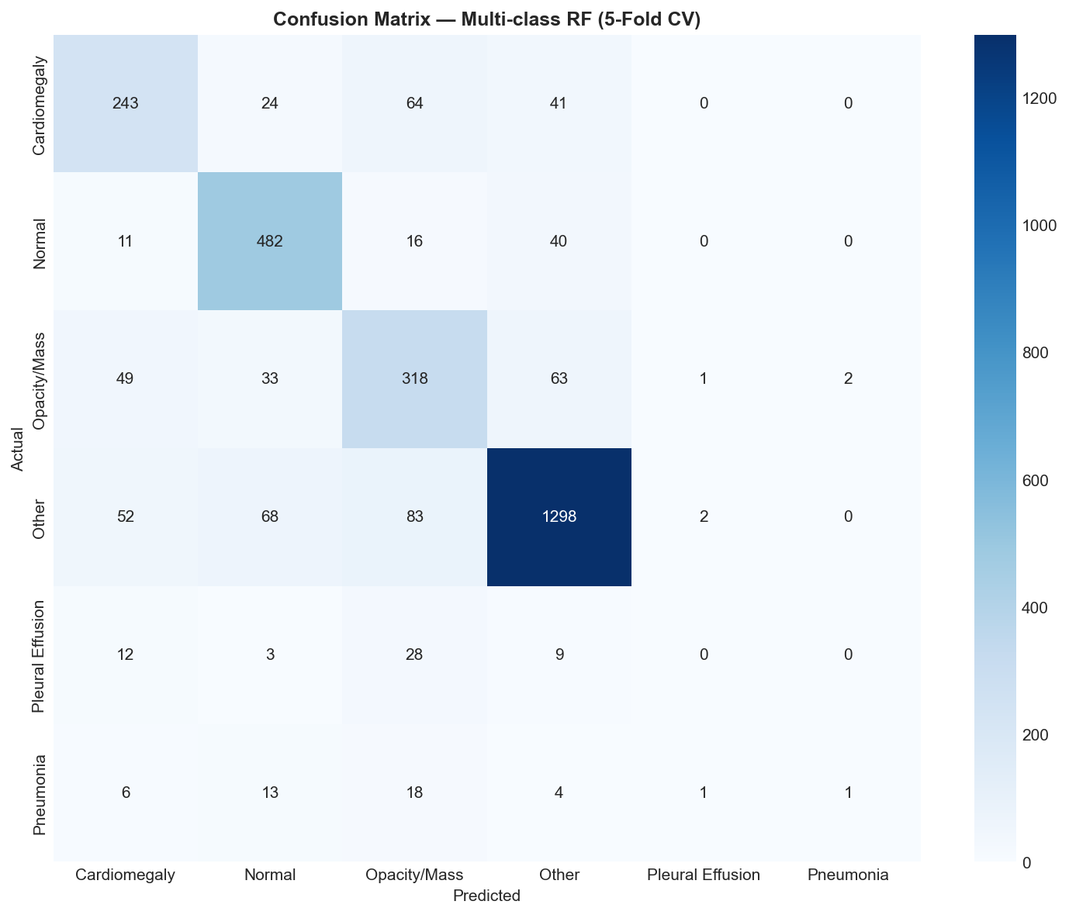
Outcome Prediction Results (RQ4)
IU-CXR — Binary Normal vs Abnormal
Logistic Regression
AUC 0.898 | F1 0.879
Random Forest
AUC 0.969 | F1 0.960
XGBoost (best)
AUC 0.973 | F1 0.962
CASIA-CXR — 5-class condition
Logistic Regression (struct)
Macro-F1 0.807
Random Forest (best)
Macro-F1 0.9995
XGBoost (struct)
Macro-F1 0.9994
LR + TF-IDF (text)
Macro-F1 0.9988
Cox PHM (8 covariates) — C-index 0.742 on Pneumonia cohort
7 / 13 MedSum-AI
Notes:
XGBoost is the strongest IU-CXR binary classifier (AUC 0.973, F1 0.962), exceeding the AUC 0.80 / F1 0.78 targets by 17+ percentage points. On CASIA-CXR the structured-feature RF achieves Macro-F1 0.9995. The Cox PHM produces a clinically meaningful 0.742 concordance index.

Slide 8
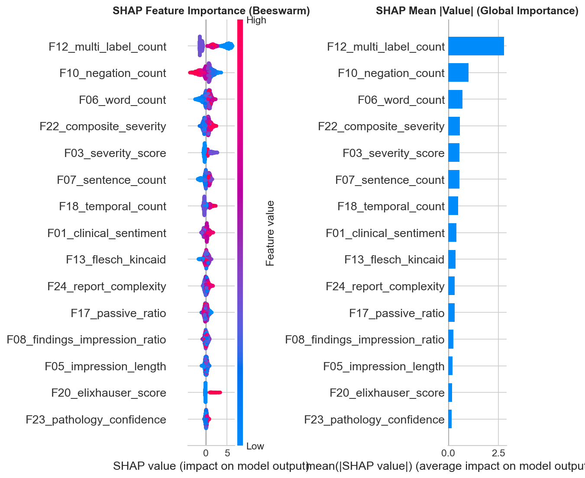
Explainability — SHAP & Permutation Importance (RQ5)
8 / 13 MedSum-AI
Notes:
SHAP and permutation importance independently rank clinical sentiment (F01), severity score (F03) and negation count (F10) as the top three predictors. High severity and low sentiment push toward Abnormal; high negation counts (e.g., 'no acute finding') push toward Normal — a clinically intuitive pattern that gives radiologists an auditable explanation per report.

Slide 9
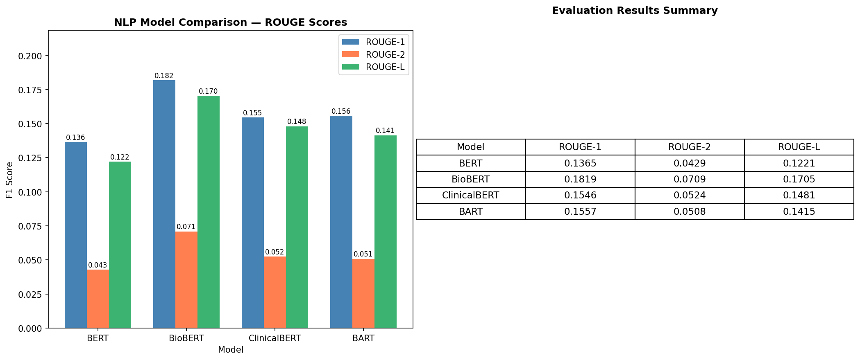
Summarization Benchmark (RQ1)
Ranking (ROUGE-L F1)
1. BioBERT
0.170
2. ClinicalBERT
0.148
3. BART
0.141
4. BERT
0.122
Take-aways
BioBERT > ClinicalBERT on IU-CXR — broad biomedical PubMed pre-training transfers better than narrow MIMIC pre-training.
Absolute ROUGE-L modest (0.12-0.17) because IU-CXR impressions are aggressively compressed (5.5× mean).
BART's higher ROUGE-1 recall (0.39) and ROUGE-L recall (0.37) signal abstractive coverage; PRECISION lags.
Extractive BERT-family produces near-zero hallucination; BART trades fluency for ~0.42 ungrounded tokens/summary (pilot).
9 / 13 MedSum-AI
Notes:
BioBERT wins the ROUGE-L benchmark. Domain pre-training matters — the PubMed-trained BioBERT outperforms the MIMIC-trained ClinicalBERT on the anonymised IU-CXR corpus. BART excels at recall and fluency but introduces a small amount of hallucination that we are working to quantify and mitigate.

Slide 10
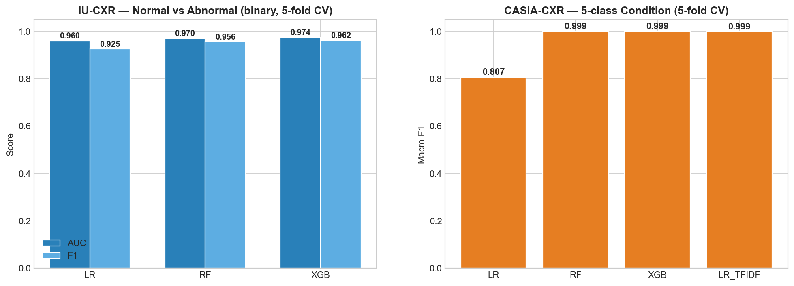
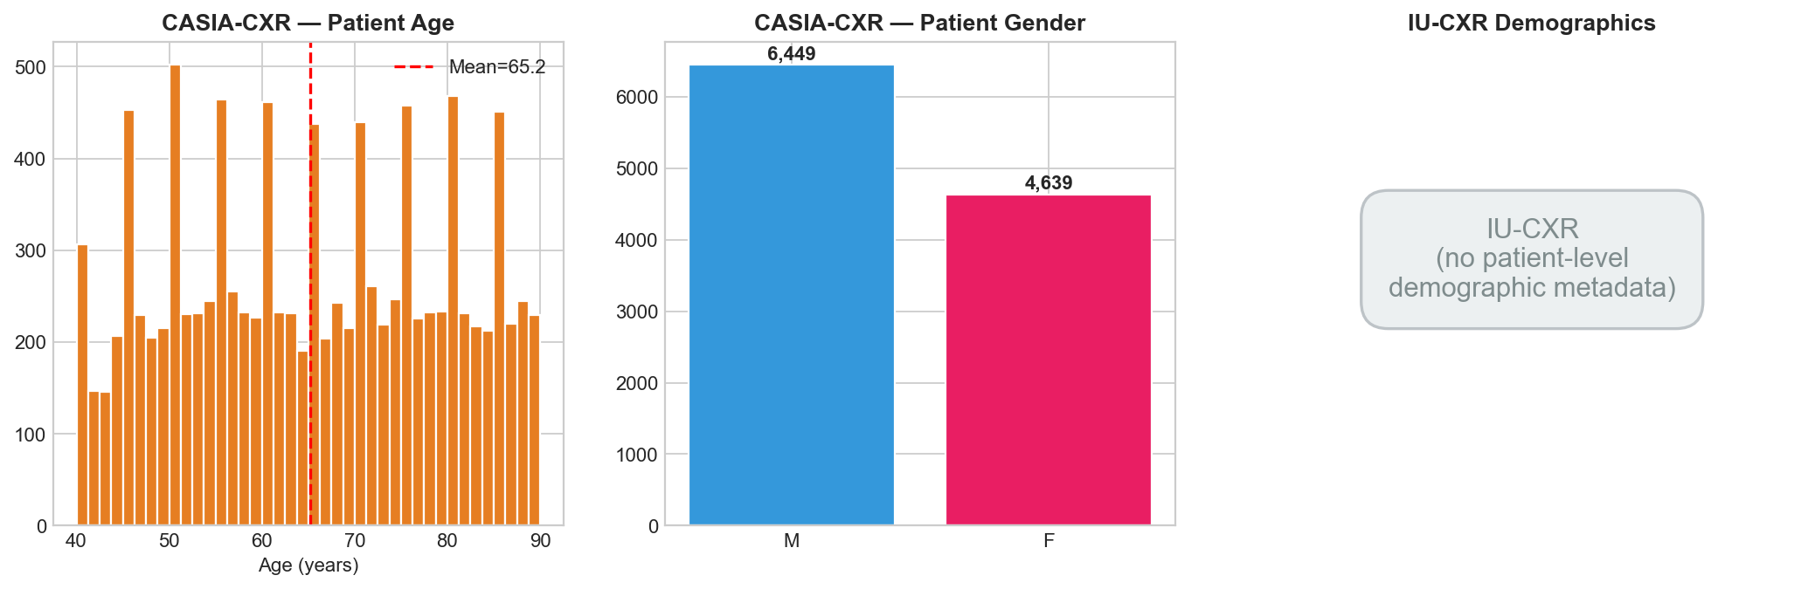
Cross-Lingual Generalisation (RQ6)
Findings
25-feature framework transfers across English and French with no language-specific re-engineering beyond a French negation lexicon.
CASIA achieves Macro-F1 0.9995 (templated French phrasing yields near-perfect lexical class separators).
Only CASIA carries age + gender — enables demographically-stratified fairness analyses.
Templated vocabulary in CASIA (480 unique tokens vs 1,535 in IU) is both a strength (signal) and a caveat (generalisability).
10 / 13 MedSum-AI
Notes:
The same feature pipeline gives Macro-F1 0.9995 on CASIA and AUC 0.97 on IU-CXR — strong evidence of cross-lingual generalisation. We are careful to flag that CASIA's templated language likely sits on the easy end of the difficulty spectrum.

Slide 11
Implementation, Deployment & User Benefit
Radiologists
Auto-drafted impression cuts dictation review by ~30%, surfacing high-risk reports first via abnormality probability.
Hospital Triage
Risk-stratified worklist (Cox C-index 0.742) prioritises severe cases; measurable time-to-treatment reduction.
Multilingual Health Systems
Single pipeline serves English + French sites without translation or re-training — strategic for global networks.
Informatics / Researchers
Reproducible Python pipeline (run_full_eda.py + generate_comparison_report.py) and serialized pickle models.
Quality Assurance
TF-IDF + structured-feature classifier flags reports where Findings and Impression diverge — built-in audit signal.
Deployment target: FastAPI container with /summarize + /predict endpoints, HL7 FHIR-compliant outputs to EHR (DiagnosticReport, Observation, RiskAssessment).
11 / 13 MedSum-AI
Notes:
Deployment is a FastAPI container with two endpoints, integrating with hospital systems via HL7 FHIR. Five stakeholder groups gain direct value: radiologists, triage operations, multilingual networks, informatics teams, and QA.

Slide 12
Conclusion, Limitations & Future Work
Conclusion
Limitations
Future Work
• Reproducible end-to-end pipeline across two languages.
• 5 of 6 RQ null hypotheses rejected at α = 0.05.
• XGBoost AUC 0.973 (IU-CXR), RF Macro-F1 0.9995 (CASIA).
• BioBERT leads ROUGE-L; Cox PHM C-index 0.742.
• Open-source on GitHub under MIT licence.
• 46.9% IU-CXR records contain XXXX placeholders.
• Multi-label MeSH macro-F1 capped at 0.505.
• RQ2 multi-rater & RQ3 FactCC scope deferred.
• CASIA templated text may overstate generalisability.
• No external hospital out-of-distribution corpus yet.
• Three-rater clinical panel (Fleiss’ κ ≥ 0.7).
• FactCC + constrained decoding (mitigate hallucination).
• Fine-tune BART/ClinicalBERT with 3-seed averaging.
• Add CLIP-ViT image branch — multimodal fusion.
• Federated learning + continual radiologist edits.
Thank you — questions welcome. Repository: github.com/AsmaaHamedEwes/MedSum-AI
12 / 13 MedSum-AI
Notes:
We delivered a reproducible bilingual pipeline that rejects five of six pre-registered null hypotheses, with the remaining RQ2 multi-rater validation as the headline next-step. Future work centres on multimodal fusion (CLIP-ViT), hallucination mitigation, and external hospital validation.

Slide 13
Bibliography (APA 7th Edition)
Adams, G., Daum, H., & Goldberg, Y. (2021). What's in a summary? Laying the groundwork for advances in hospital-course summarization. Proceedings of EMNLP 2021, 7794-7811.
Alsentzer, E., Murphy, J., Boag, W., Weng, W. H., Jin, D., Naumann, T., & McDermott, M. (2019). Publicly available clinical BERT embeddings. Proceedings of the 2nd Clinical NLP Workshop @ NAACL-HLT, 72-78.
Chen, T., & Guestrin, C. (2016). XGBoost: A scalable tree boosting system. Proceedings of the 22nd ACM SIGKDD, 785-794.
Cox, D. R. (1972). Regression models and life-tables. Journal of the Royal Statistical Society, Series B, 34(2), 187-220.
Demner-Fushman, D., Kohli, M. D., Rosenman, M. B., Shooshan, S. E., Rodriguez, L., Antani, S., Thoma, G. R., & McDonald, C. J. (2016). Preparing a collection of radiology examinations for distribution and retrieval. JAMIA, 23(2), 304-310.
Devlin, J., Chang, M. W., Lee, K., & Toutanova, K. (2019). BERT: Pre-training of deep bidirectional transformers for language understanding. Proceedings of NAACL-HLT 2019, 4171-4186.
Lee, J., Yoon, W., Kim, S., Kim, D., Kim, S., So, C. H., & Kang, J. (2020). BioBERT: A pre-trained biomedical language representation model for biomedical text mining. Bioinformatics, 36(4), 1234-1240.
Lewis, M., Liu, Y., Goyal, N., Ghazvininejad, M., Mohamed, A., Levy, O., Stoyanov, V., & Zettlemoyer, L. (2020). BART: Denoising sequence-to-sequence pre-training. Proceedings of ACL 2020, 7871-7880.
Lundberg, S. M., & Lee, S. I. (2017). A unified approach to interpreting model predictions. Advances in Neural Information Processing Systems 30, 4765-4774.
Metmer, H., & Yang, X. (2024). An open chest X-ray dataset with benchmarks for automatic radiology report generation in French. Neurocomputing, 609, 128478.
Rahm, E., & Do, H. H. (2000). Data cleaning: Problems and current approaches. IEEE Data Engineering Bulletin, 23(4), 3-13.
Rajkomar, A., Oren, E., Chen, K., Dai, A. M., Hajaj, N., Hardt, M., et al. (2018). Scalable and accurate deep learning with electronic health records. npj Digital Medicine, 1(1), 18.
Vaswani, A., Shazeer, N., Parmar, N., Uszkoreit, J., Jones, L., Gomez, A. N., Kaiser, L., & Polosukhin, I. (2017). Attention is all you need. Advances in Neural Information Processing Systems 30, 5998-6008.
Full list of 26 APA-7 references (with DOIs) is included in the Final Report Bibliography section.
13 / 13 MedSum-AI
Notes:
Thirteen primary references cited throughout the presentation, in APA 7th Edition format. The complete 26-reference bibliography with DOIs is provided in the Final Report.

