Slide 1







Game Development
with
Notes:
1

Slide 2

Content
Today we will learn about:
What is Coding / Programming?
Game Development
Introduction to PictoBlox
Notes:
2

Slide 3

What Languages Do You Speak?
We all speak different languages like Arabic, English, French...
What languages do you speak?
Think about all the languages people use to communicate
with each other every day!
Notes:
6

Slide 4

LET’S THINK!
Can Computers Understand Us?
Can computers understand human languages like Arabic or English?
Notes:
6

Slide 5
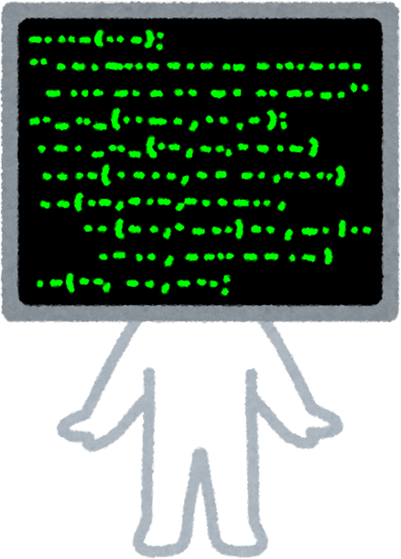
The answer is NO!
Computers have their own languages called Programming Languages.
We need to learn these languages to talk to computers!
Notes:
6

Slide 6
What is Coding / Programming?
Coding : is the way we give instructions to computers so they can understand us.
Programming : helps us solve problems, finish tasks, and build amazing things!
With coding, we can tell the computer exactly what to do - step by step
just like following a recipe!
Notes:
6

Slide 7
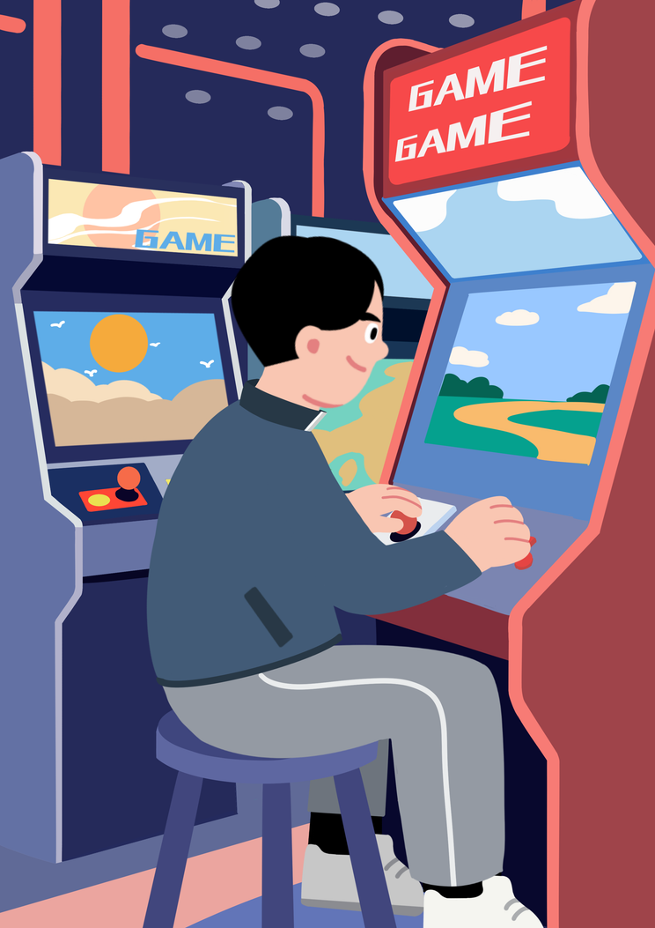
What is your favorite game?
Think about how it was made !
Notes:
7

Slide 8

we need to learn about
PictoBlox
Notes:
9

Slide 9
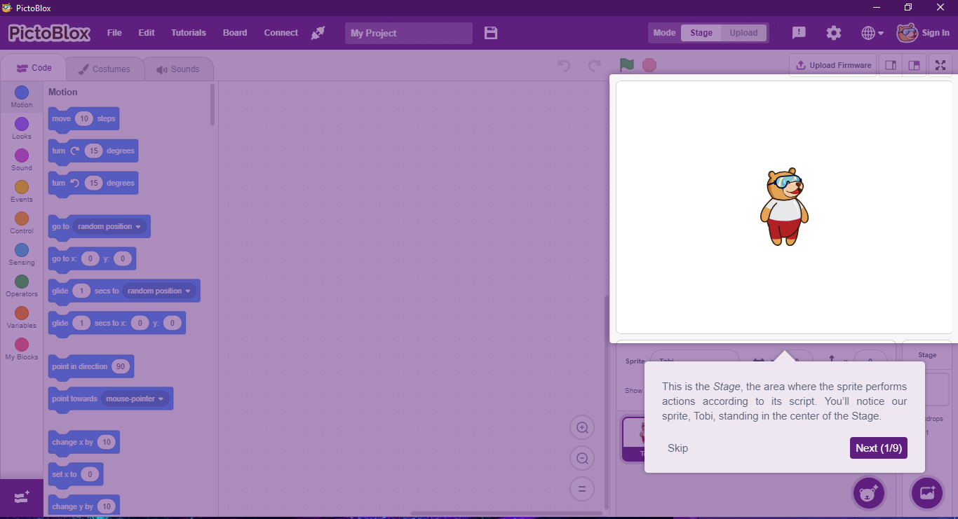
Stage
The area where we can see our game!
Notes:
10

Slide 10
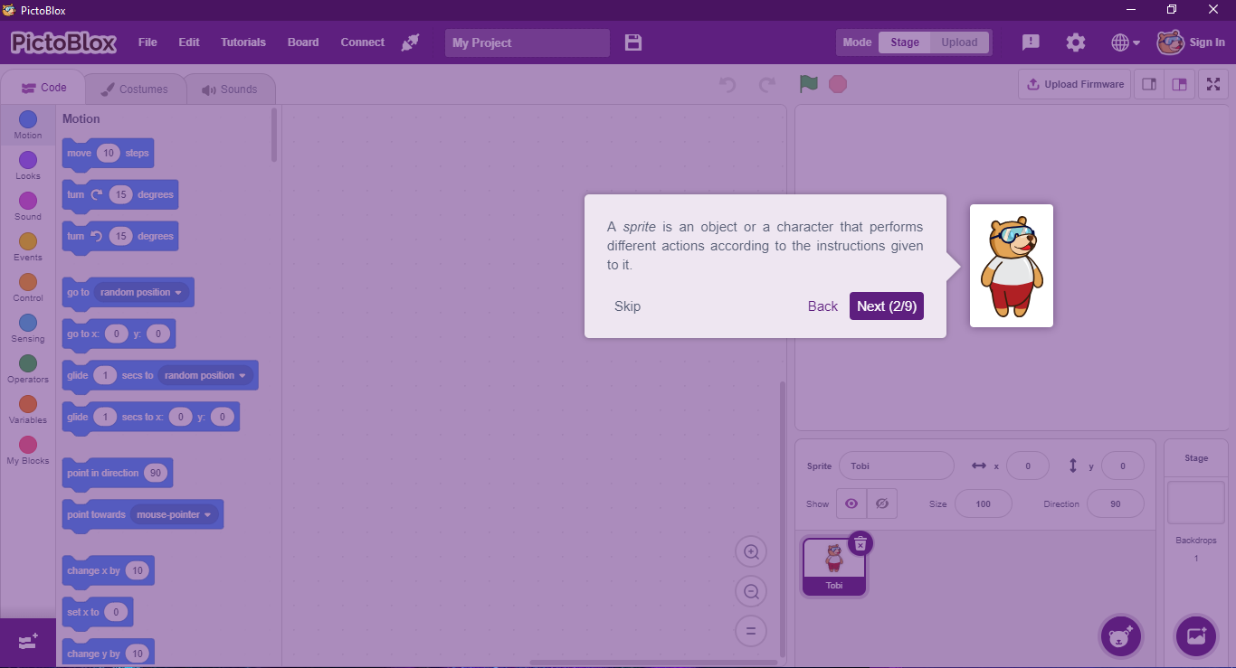
Sprite
A Sprite is an object or character that performs actions
Notes:
11

Slide 11
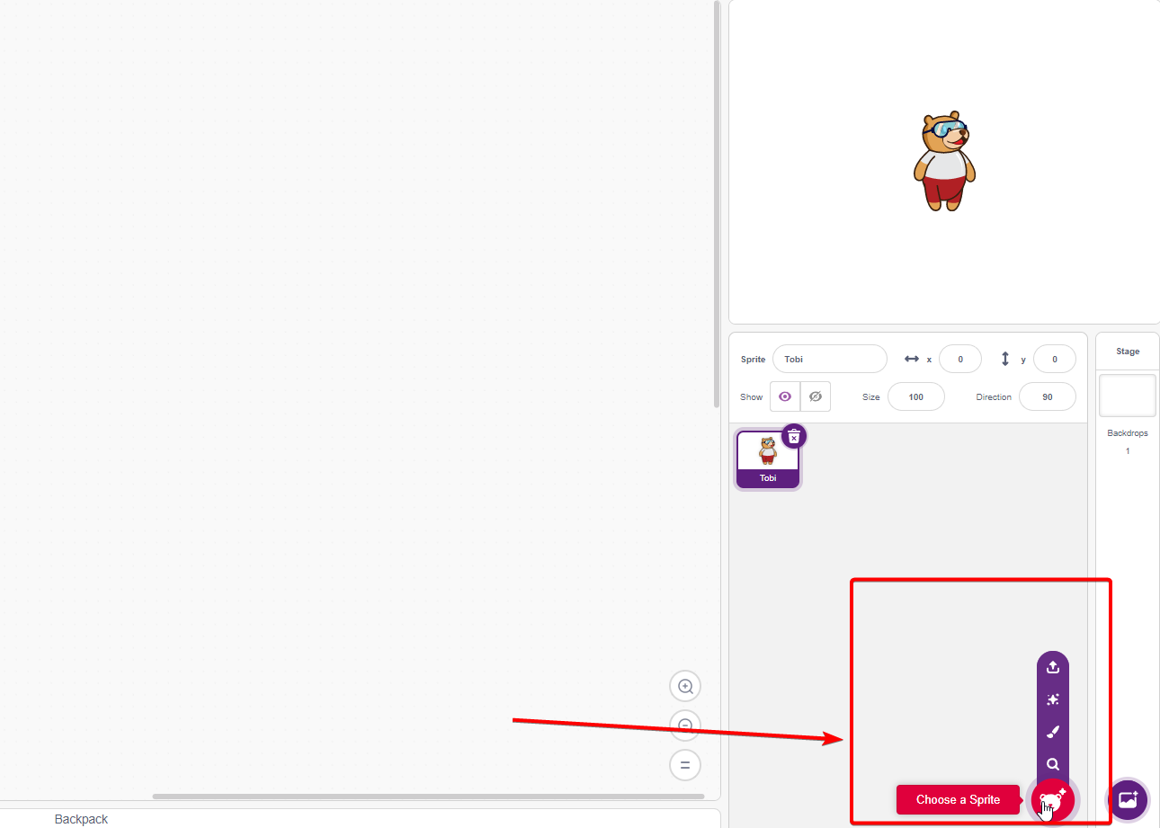
Sprite
We can change the sprite or draw or upload a sprite
Notes:
6

Slide 12
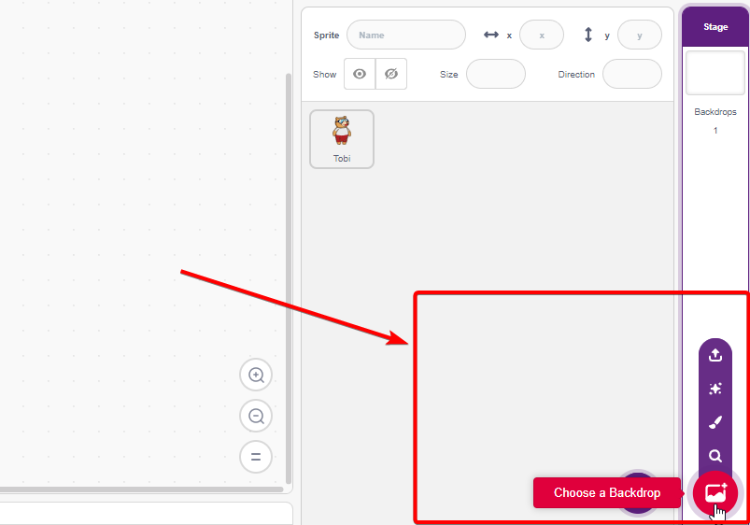
Backdrop
We can also upload a backdrop or paint a new one
Notes:
12

Slide 13
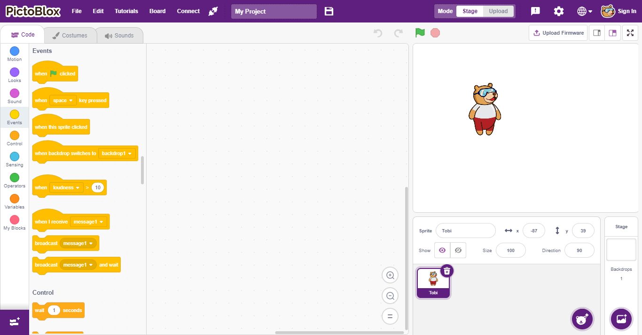
Maximize/Minimize
Maximize/Minimize the stage
Notes:
14

Slide 14
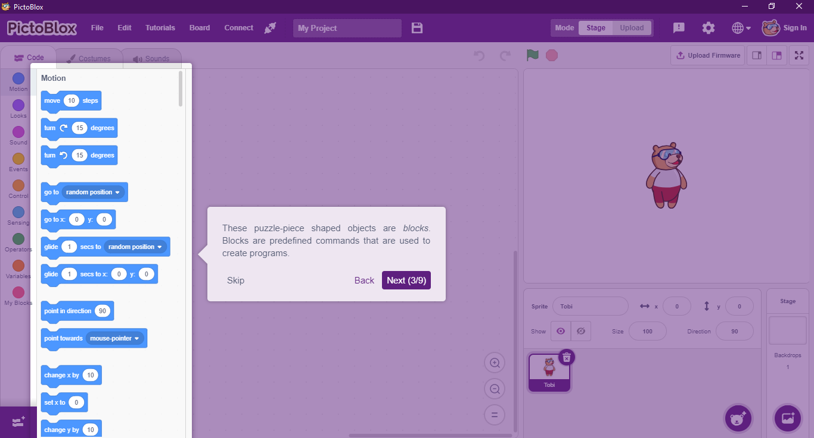
ToolBox
Notes:
15

Slide 15
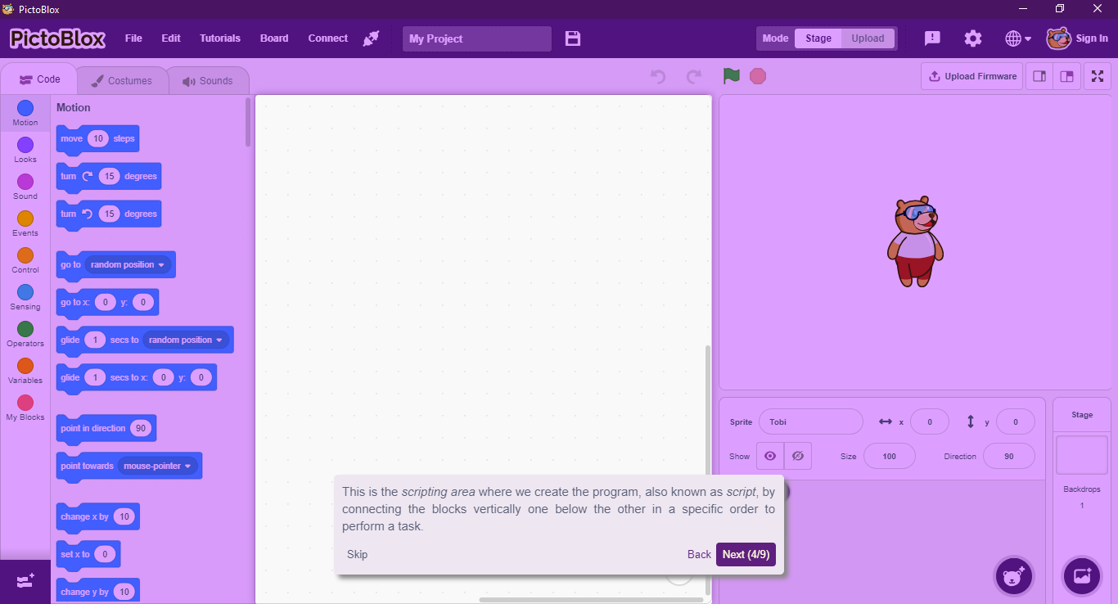
Scripting Area
Notes:
16

Slide 16
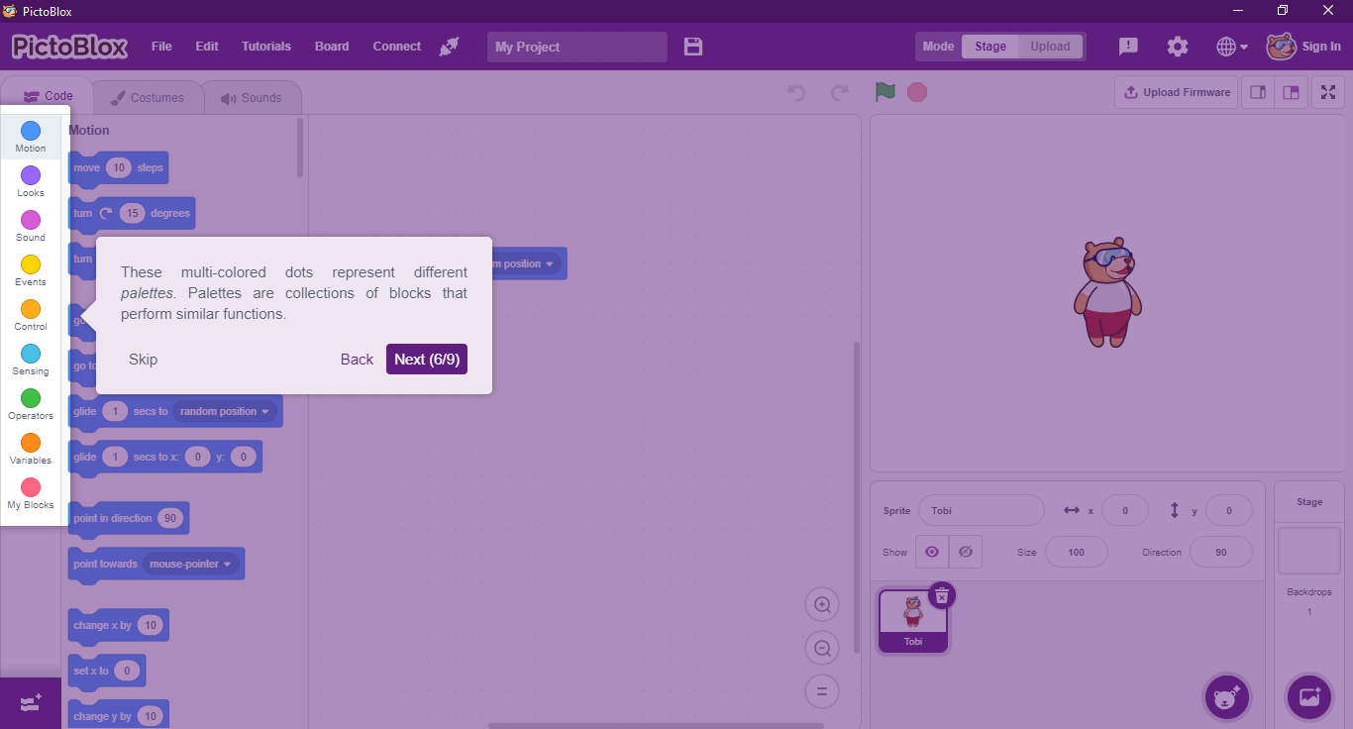
Palettes
Notes:
17

Slide 17

Let’s make a game!
Notes:
19

Slide 18



Thank you
Contact Us
+966 563716559
Notes:
20

