Slide 1
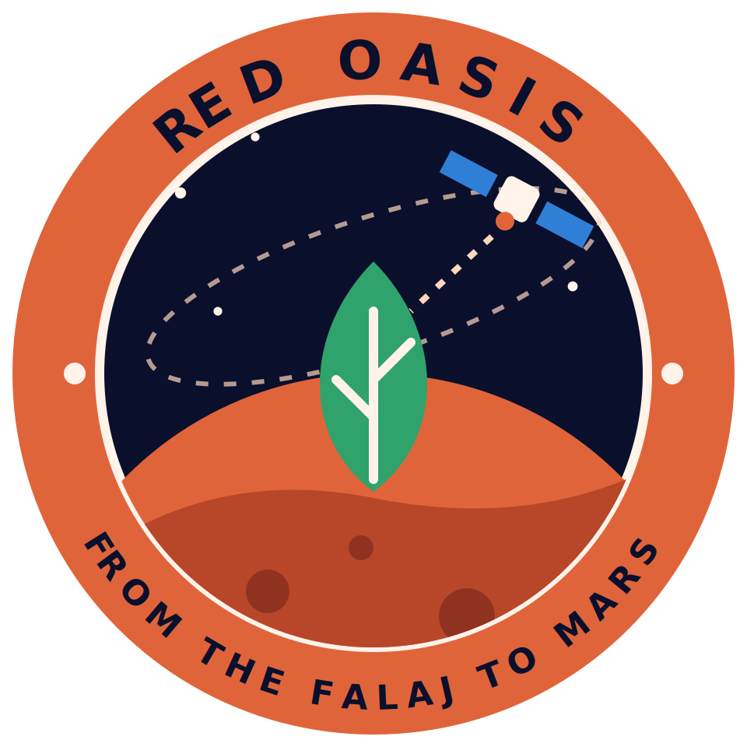
Red Oasis
NASA INTERNATIONAL SPACE APPS CHALLENGE 2026 · THE NEXT FRONTIER
An AI farming advisor from the Omani desert to Mars
FROM THE FALAJ TO MARS
Amna · Yaqeen · Asmaa · Sharifa · Jumana

Slide 2
The Problem
On Earth
In space
10.6%
At Falaj al-Dariz, annual date-palm water demand exceeded supply by approximately 10.6% (3,620 mm vs. 3,235 mm per year).
On long Moon and Mars missions, food cannot rely on Earth. Every liter of water and every plant counts.
of 3,620 mm/year demand vs. 3,235 mm/year supply water water-demand shortfall. Source: Al-Ghafri (2006)
Red Oasis · NASA Space Apps 2026
2

Slide 3
Our Solution
A web app that uses NASA satellite data and AI to tell a farmer when to irrigate, and why.
When
Why
Irrigate today, or wait [X] days.
A plain-language reason behind every recommendation.
Red Oasis · NASA Space Apps 2026
3

Slide 4
NASA Data
NASA dataset | What it gives us
SMAP | Soil moisture
VIIRS / MODIS (NDVI) | Plant health and vegetation cover
GPM | Rainfall
NASA POWER | Temperature and solar radiation
ECOSTRESS | Plant water stress
Final list to be confirmed from the official challenge text on 28 October.
Red Oasis · NASA Space Apps 2026
4

Slide 5
How It Works
01
02
03
04
Collect
Predict
Explain
Recommend
NASA data for the pilot farm in Oman.
A machine learning model forecasts crop water stress.
SHAP shows which factors drove the result.
Map, dashboard and advice in Arabic and English.
Red Oasis · NASA Space Apps 2026
5

Slide 6
AI Model
Model and data
[XX]
[XX]
[XGBoost or LSTM: final choice]. Inputs: soil moisture, NDVI, rainfall, temperature, solar radiation. Output: crop water-stress level for the coming days.
Accuracy: [metric, e.g. RMSE or R²]
Test area and period: [name, dates]
Red Oasis · NASA Space Apps 2026
6

Slide 7
Explainable AI
“Soil moisture is low and temperature is high, so irrigate today.”
[Insert SHAP chart: top factors for one recommendation]
Red Oasis · NASA Space Apps 2026
7

Slide 8
The App
[Insert screenshot: map, dashboard and recommendation]
Farm map
Simple dashboard
Advice in Arabic and English
Mars Mode button
Red Oasis · NASA Space Apps 2026
8

Slide 9
Mars Mode
One button switches the system to a closed greenhouse: recycled water, artificial light and Mars conditions.
A conceptual prototype with simulated sensors, not a flight-ready product.
Red Oasis · NASA Space Apps 2026
9

Slide 10
Impact
[XX]%
[XX]
Next steps
Test with real farmers, add more crops, refine Mars Mode.
estimated water saving. Add after calculation.
[farm or region tested in Oman]
FROM THE FALAJ TO MARS
Red Oasis · NASA Space Apps 2026
10

