Slide 1
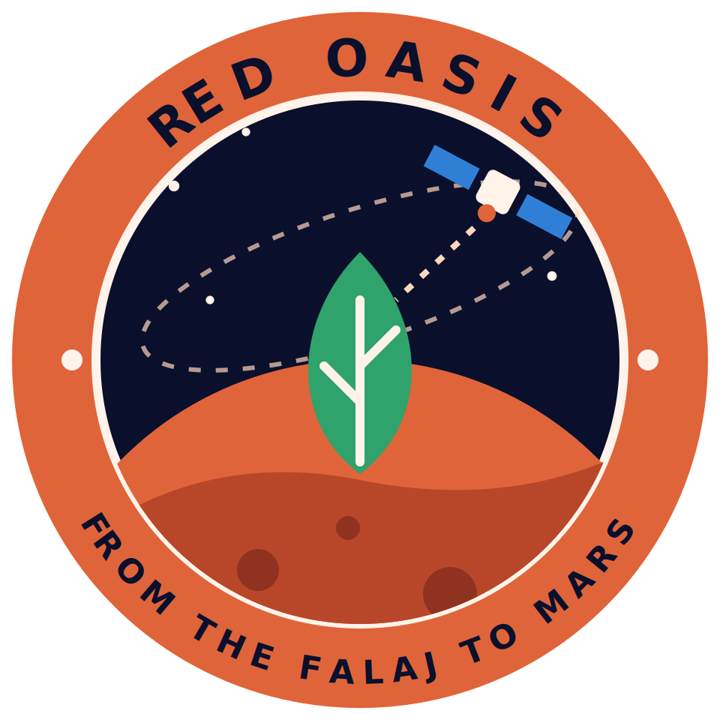
NASA SPACE APPS CHALLENGE 2026 · FIELD SHIFT: ADAPTING FARMS WITH NASA DATA
Red Oasis
An irrigation decision-support prototype for date-palm oases
FROM THE FALAJ TO MARS
Team Red Oasis, Oman
Asma · Amna · Yaqeen · Shareefa · Jumana
Notes:
Hello, judges. We are Team Red Oasis, from Oman, working on Field Shift. Our idea is simple: help farmers use every drop of water wisely, from the falaj to Mars.

Slide 2
The Problem
1.12
demand/supply for the year: 3,620 mm needed, 3,235 mm supplied. Demand exceeds supply April to November; December to February has a surplus.
In space
On long Moon and Mars missions, food cannot rely on Earth, so every litre of water counts.
Source: Al-Ghafri (2006), observations from 2002-2003 (field research by Shareefa). Historical site-study values, not current measurements.
Notes:
At Falaj al-Dariz, a published study found that date palms needed more water than arrived from April to November, with a surplus from December to February. Over the year, demand was 3,620 millimetres against 3,235 supplied. Astronauts will face the same question: how to grow food with less water?

Slide 3



Our Solution
Red Oasis forecasts soil moisture, suggests when to irrigate and explains why. It uses NASA Earth observation data.
When to irrigate
Why
Earth and Mars
One of three levels: irrigate today, monitor closely, or no irrigation needed. The rule is provisional.
Every forecast shows the factors behind it, using SHAP, in English or Arabic.
The same decision logic is shown for a closed, water-recycling greenhouse.
WORKING
WORKING (EXPERIMENTAL)
CONCEPT
Trained model and SHAP explanation: working (experimental).
WORKING (EXPERIMENTAL)
Notes:
So we built Red Oasis. It forecasts soil moisture, suggests when to irrigate, and shows why. The same logic is adapted for a greenhouse on Mars.

Slide 4
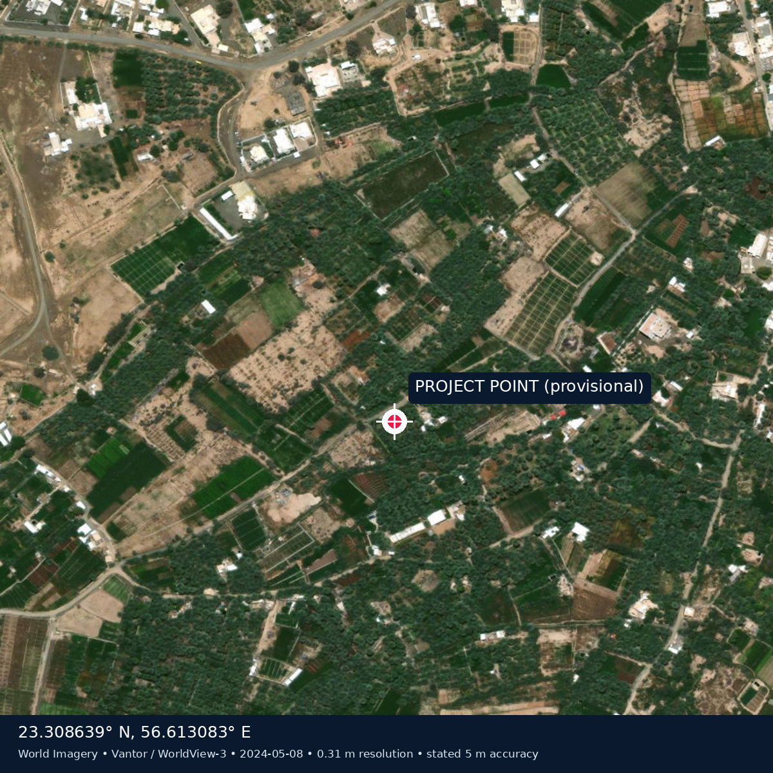
Pilot Site: Ad Dariz Area
Why Dariz?
Ad Dariz area
An arid oasis irrigated by a falaj, where date palm is the main crop.
Published, site-specific evidence that irrigation demand exceeds supply.
A real place for the advisor, instead of an invented farm.
Ibri, Ad Dhahirah, Oman
CROP
Date palm (Phoenix dactylifera)
COORDINATES
23.30864 N, 56.61308 E
Honest limits
The grove boundary still needs GIS or field confirmation. The Dariz study values are historical (2002-2003).
SITE
Ad Dariz agricultural area, Ibri
Image: Esri World Imagery (Vantor / WorldView-3, 8 May 2024). The project point is provisional.
Notes:
Our pilot site is the Ad Dariz agricultural area in Ibri, where real published research already exists.

Slide 5
NASA Data
NASA source | Variable | Use in the model | Status
SMAP | Soil moisture | Forecast target and input | Used (Dariz, 2024-2026)
MODIS / VIIRS | Vegetation index (NDVI) | Vegetation condition (16-day composite) | Used (Dariz, 2024-2026)
GPM IMERG | Precipitation | Rain in the last 7 days | Used (Dariz, 2024-2026)
NASA POWER | Temperature and solar radiation | Air temperature and ET0 | Used (Dariz, 2024-2026)
Regional, not field-level
Data period
A SMAP pixel is about 9 km wide, far larger than the Ad Dariz grove, so it gives regional context, not field-level truth.
1,004 daily rows from January 2024 to September 2026. A longer 2015 to 2026 record was also tested and did not change the conclusion.
Notes:
We use four NASA sources for Dariz, from 2024 to 2026: SMAP for soil moisture, MODIS and VIIRS for vegetation, GPM for rain, and NASA POWER for weather.

Slide 6
How It Works
Pipeline
NASA data
Preprocessing
Prediction model
SHAP explanation
Advisor app
SMAP, MODIS/VIIRS, GPM, NASA POWER
Daily table for the Dariz site
Random Forest: soil moisture in 3 days
Shows why the model gave its forecast
English and Arabic interface
USED
WORKING
WORKING (EXPERIMENTAL)
WORKING (EXPERIMENTAL)
WORKING
Not done yet
Rule validation
Water-saving estimate
Field validation
The irrigation levels are a provisional rule, not validated advice.
Planned by simulation, labelled as an estimate. No result yet.
No field measurements or grower logs yet.
PLANNED
PLANNED
PLANNED
Solid boxes are in the repository today; experimental ones do not reliably beat a no-change forecast. Dashed boxes are not done.
Notes:
NASA data feeds a Random Forest model, SHAP explains it, and the app shows it. The model forecasts soil moisture three days ahead. It is experimental, and the dashed boxes are not done yet.

Slide 7
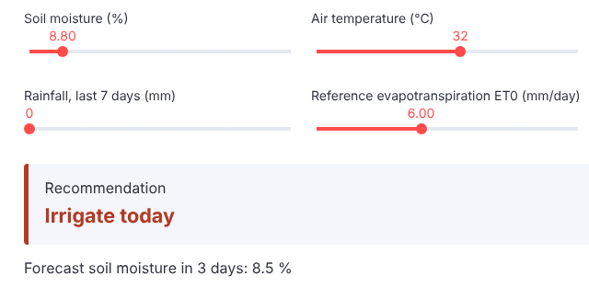
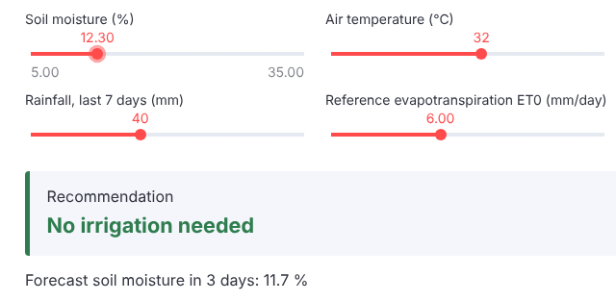
The Prototype
Dry case: soil moisture 8.8%, no rain
Result: Irrigate today (forecast in 3 days: 8.5%)
After-rain case: soil moisture 12.3%, 40 mm rain in 7 days
Result: No irrigation needed (forecast: 11.7%)
Forecast error (mean absolute error, points of soil moisture). Final test, 122 days: model 1.20, no-change forecast 1.31. Cross-validation: model 1.18, no-change 1.03. The levels come from a provisional rule, not validated advice.
WORKING (EXPERIMENTAL)
Notes:
Here is the running app. In a dry case it says irrigate today. After heavy rain it says no irrigation needed. These levels come from a provisional rule, not validated advice.

Slide 8
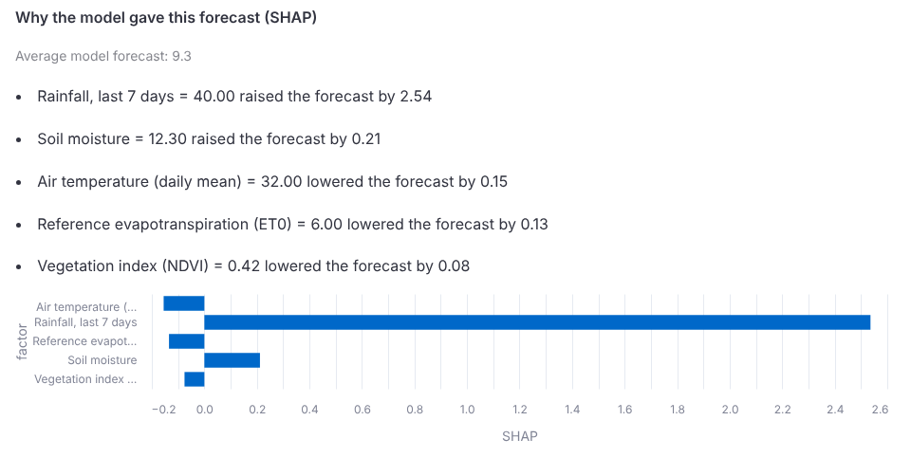
Explainable Advice
Why the model gave this forecast (SHAP), after-rain case
1.20
Model error, final test (122 days)
1.31
"No change" forecast, same test
1.18 vs 1.03
Cross-validation: model vs "no change"
Bars to the right raised the forecast; bars to the left lowered it. SHAP shows how the model uses each input and is not proof of cause.
WORKING (EXPERIMENTAL)
Better than "no change" on the final test only, so we call it experimental.
Notes:
SHAP shows why the model gave each forecast. On our final test of 122 days, its error was 1.20 points against 1.31 for a no-change forecast. But in cross-validation it was 1.18 against 1.03. So we call it experimental, and we say so openly.

Slide 9
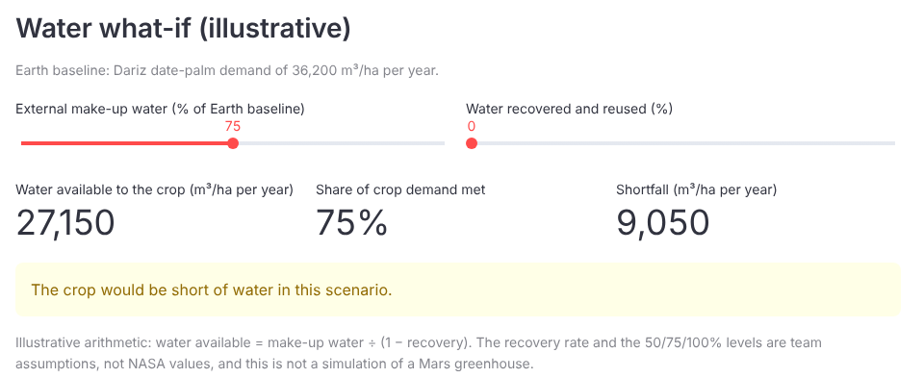
Mars Mode (Concept)
A concept, not a product
Water what-if
Tested at 50%, 75% and 100% make-up water: demand met 50%, 75% and 100%, shortfall 50%, 25% and 0%. The percentages are team assumptions, not NASA values.
Light and temperature
NASA ISS lettuce and plant-growth references, not validated for Mars or date palm.
Evidence
NASA MarsOASIS is a lettuce greenhouse concept. It does not show that date palms can grow on Mars.
CONCEPT
Illustrative arithmetic only. It does not simulate a greenhouse.
Notes:
Mars mode is a concept. Our water what-if tests fifty, seventy-five and one hundred percent make-up water. These are team assumptions, not NASA values.

Slide 10
Evidence and Next Steps
Next steps
PLANNED
1
Test the rule with growers and field data
2
Calibrate palm thresholds in the field
3
Estimate water saving by simulation, labelled as an estimate
Published evidence, not our result
Yield was 79.0 kg per palm with bubblers and 78.3 kg with drip, with no significant difference reported. In the app, the farmer sets the yield loss they would accept.
4
Confirm the grove boundary
Source: Dhehibi et al. (2022); Al Kamil and Al Wafi, 2015-2016. A different site from Dariz and not a Red Oasis result.
FROM THE FALAJ TO MARS
Notes:
Next: test the rule with growers, calibrate palm-specific thresholds in the field, estimate water saving by simulation, and confirm the grove boundary. Red Oasis: from the falaj to Mars. Thank you.

