Slide 1
Balance and Posture
Andrew L. McDonough

Slide 2
What is Balance?
Technically defined as the ability to maintain the center-of-gravity (COG) of an object within its base-of-support (BOS)

Slide 3
What is Posture?
The stereotypical alignment of body/limb segments
  Types
    Standing (static)
    Walking - running (dynamic)
    Sitting
    Lying
    Lifting

Slide 4
Relationship - Balance & Posture
Postural alignment (and the changes/adjustments made due to perturbations) is the way balance is maintained
Maintaining the COG within the BOS
  If this relationship isn’t maintained then a system will be unbalanced

Slide 5
Base of Support
Static
Dynamic
x
TM-L TM-R
x
Walking
H-H
x - Vertical projection of COG

Slide 6
Transition - Static to Dynamic BOS
Heel-to-heel distance will decrease
  Feet come together toward midline
Toe-to-midline distance will decrease
  Reflects “toe-in”
Overall effect - BOS narrows

Slide 7
The Effect of a Narrowed BOS
Chances of COG falling within BOS decrease
  Subject becomes less (un-) balanced
COG moves forward of BOS - precursor event to walking
  Foot will be advanced to extend the dynamic BOS

Slide 8
Center-of-Gravity
The point about which the mass is evenly distributed
The balance point
If an object is symmetrically loaded the COG will be at the geometric center

Slide 9
Center of Gravity of Human Limbs and Segments
Limbs/segments are usually asymmetrically loaded
COG tends to be “off-center”
  Closer to the “heavier end”
Sources
  Dempster (1955)
  Braune and Fischer (1889)
  Winter (1990s)

Slide 10
Dempster
Subjects were 150 lbs. males (astronauts - NASA)
COG located at a point as a percentage of total limb length
Ankle
Knee
43.3% 56.7%
Total limb length

Slide 11
Location of COG
Entire body
Suprapedal mass
Suprafemoral mass
HAT
Head
S₁ - S₂
ASIS
Umbilicus
Xiphoid process
Occiput

Slide 12
Example: Change in the Location of the COG of Body - Right Unilateral AK Amputee
COG will shift upward and to the left
Question: How will this change affect the patient’s perception of balance?
Answer: Profoundly!

Slide 13
General Rule
As COG shifts upward the object/subject becomes more “top-heavy”
Increases the “tendency to be over-thrown”
Moment arm
Moment arm

Slide 14
Role of Anti-gravity Postural Muscles
Generate torque across joints to: “Resist the tendency to be over-thrown”
  Keep limbs, joints, body segments in proper relationship to one another so that the COG falls within the BOS

Slide 15
Some Examples - Questions
What happens to the COG & BOS in:
  Someone walking along a sidewalks and encounters a patch of ice
  The toddler just beginning to walk
  The surfer coming down off of a wave
  The tight-rope walker who loses her balance

Slide 16
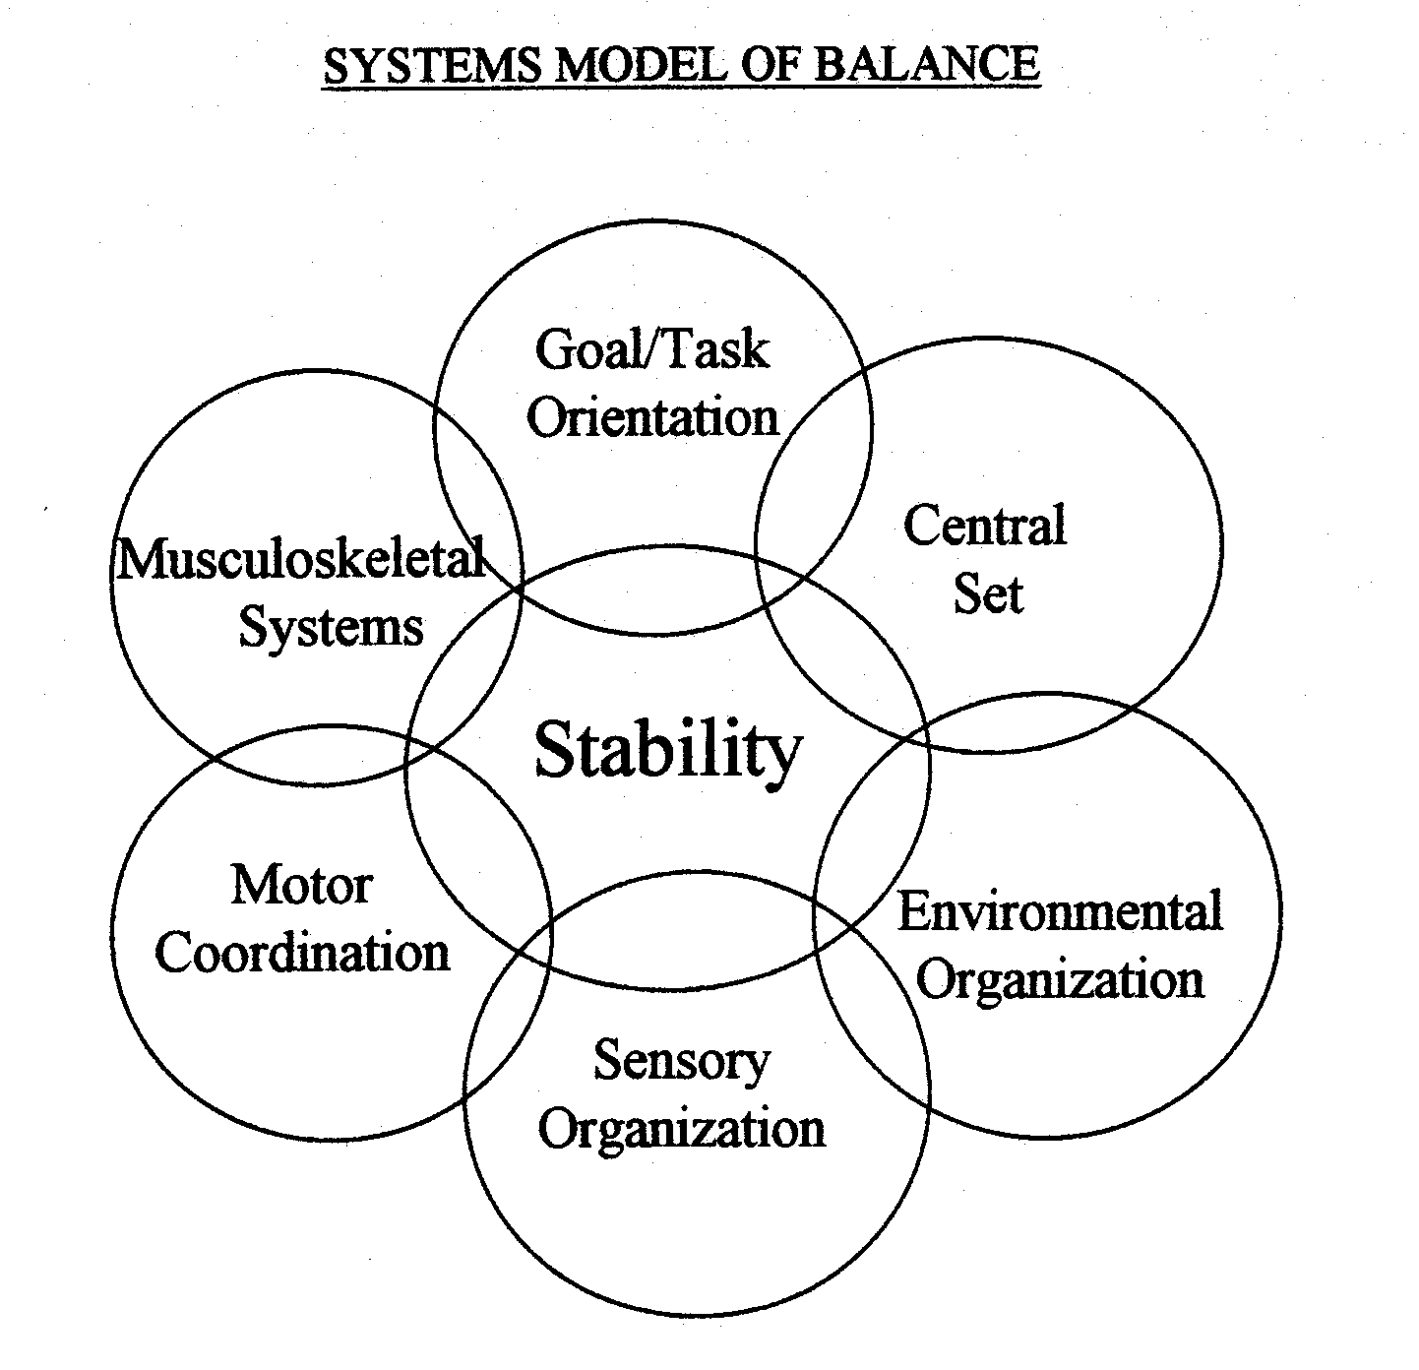
A Systems Model of Balance¹
¹Courtesy of Sandra Rader, PT, Clinical Specialist

Slide 17
Stability & Balance
Result of interaction of many variables (see model)
Limits of Stability - distance in any direction a subject can lean away from mid-line without altering the BOS
Determinants:
  Firmness of BOS
  Strength and speed of muscular responses
  Range: 8⁰ anteriorly; 4⁰ posteriorly

Slide 18
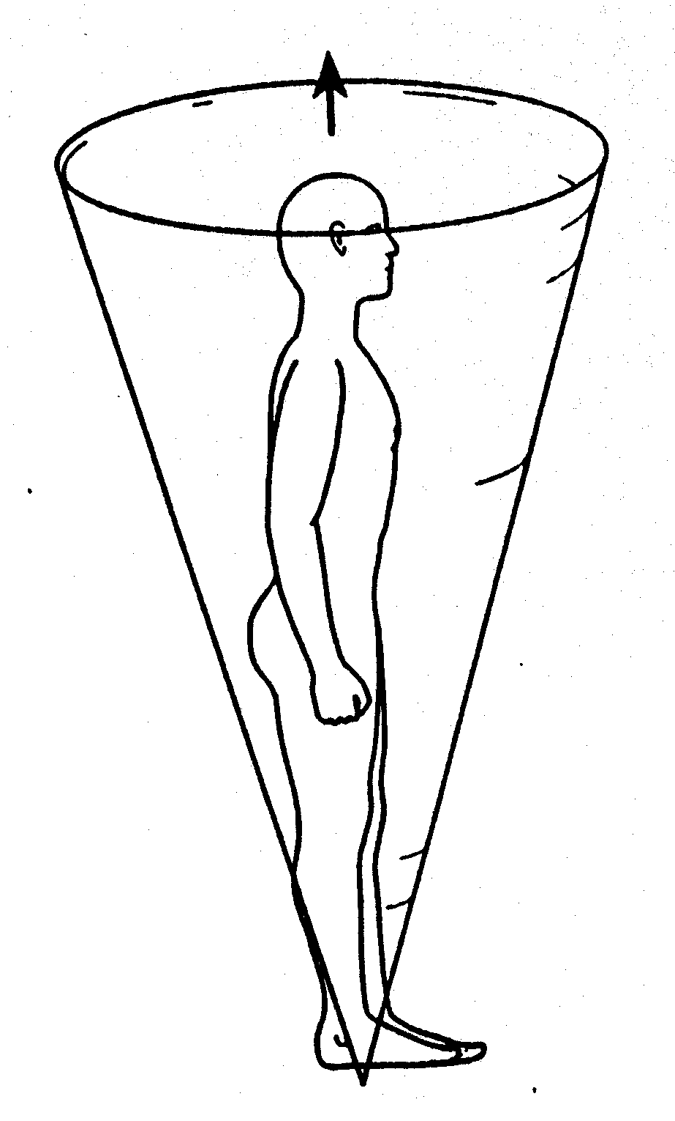
Limits of Stability

Slide 19
Model Components
Musculoskeletal System
ROM of joints
Strength/power
Sensation
  Pain
  Reflexive inhibition
Abnormal muscle tone
  Hypertonia (spasticity)
  Hypotonia

Slide 20
Model Components
Goal/Task Orientation
What is the nature of the activity or task?
What are the goals or objectives?

Slide 21
Model Components
Central Set
Past experience may have created “motor programs”
CNS may select a motor program to fine-tune a motor experience

Slide 22
Model Components
Environmental Organization
Nature of contact surface
  Texture
  Moving or stationary?
Nature of the “surrounds”
  Regulatory features of the environment (Gentile)

Slide 23
Model Components
Motor Coordination
Movement strategies
  Based on repertoire of existing motor programs
Feedback & feedforward control
Adjustment/tuning of strategies

Slide 24
Strategies to Maintain/Restore Balance
Ankle
Hip
Stepping
Suspensory
Strategies are automatic and occur 85 to 90 msec after the perception of instability is realized

Slide 25
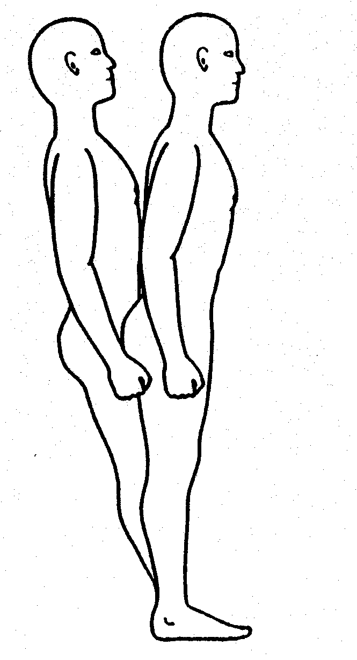
Ankle Strategy
Used when perturbation is
  Slow
  Low amplitude
Contact surface firm, wide and longer than foot
Muscles recruited distal-to-proximal
Head movements in-phase with hips

Slide 26
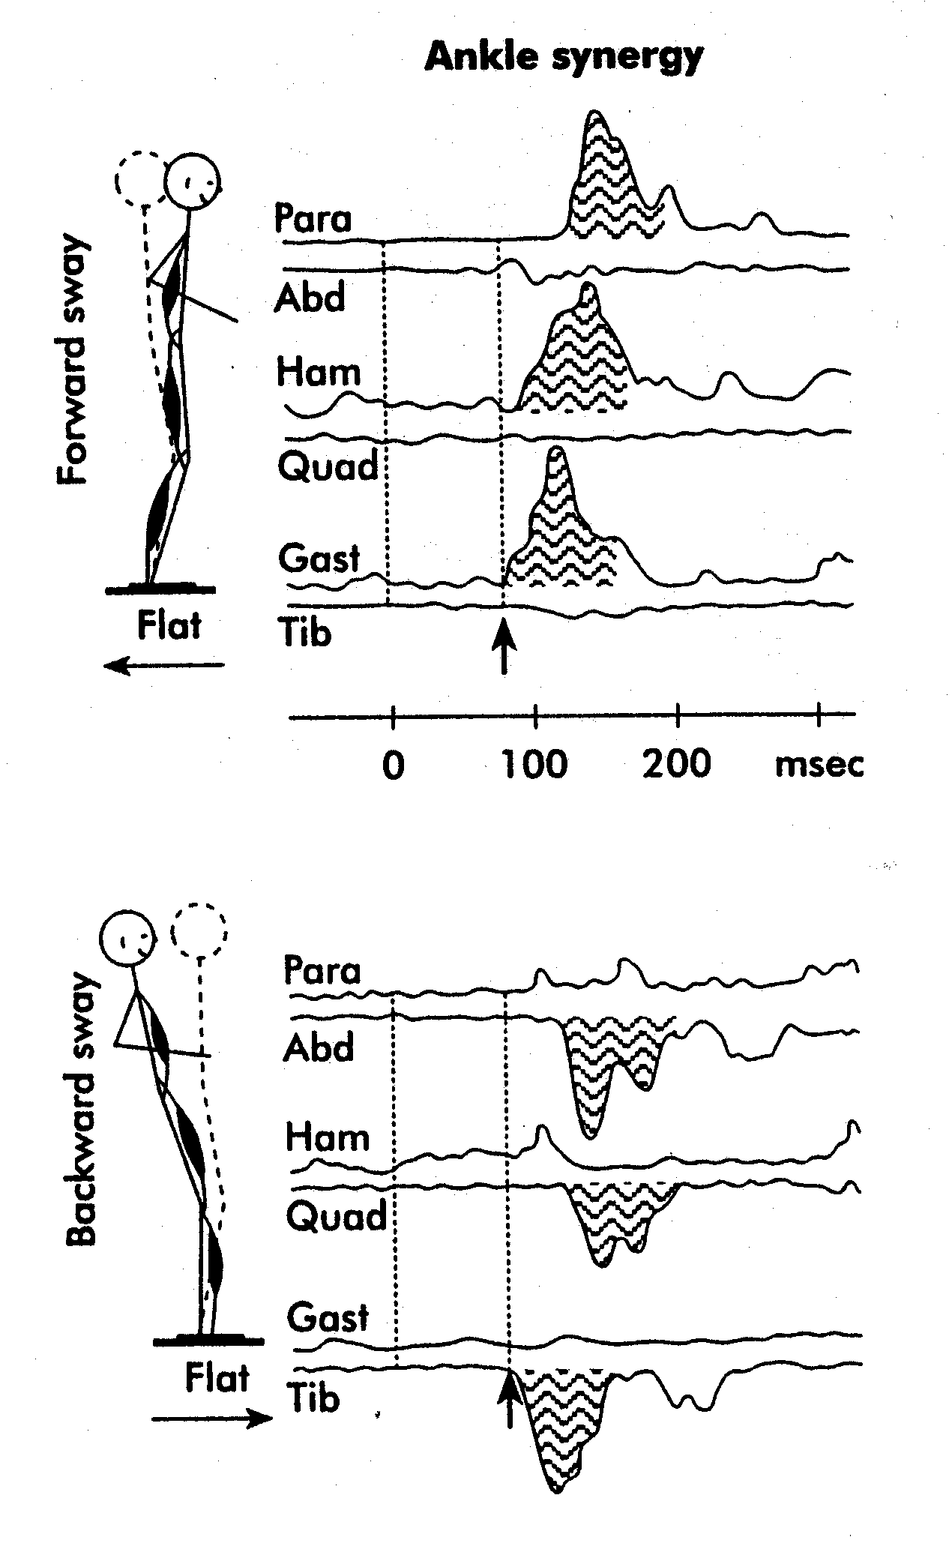
Ankle Strategy

Slide 27
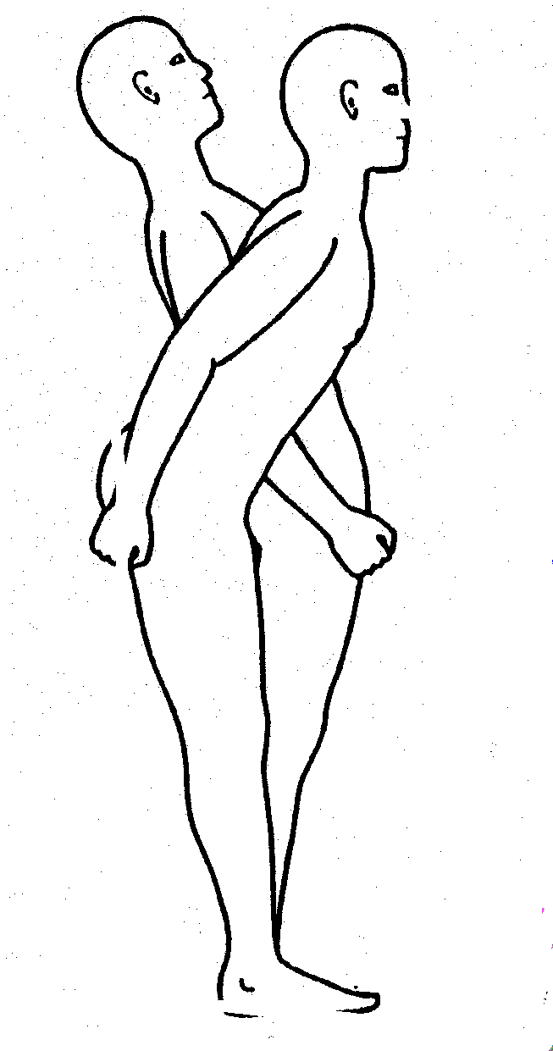
Hip Strategy
Used when perturbation is fast or large amplitude
Surface is unstable or shorter than feet
Muscles recruited proximal-to-distal
Head movement out-of-phase with hips

Slide 28
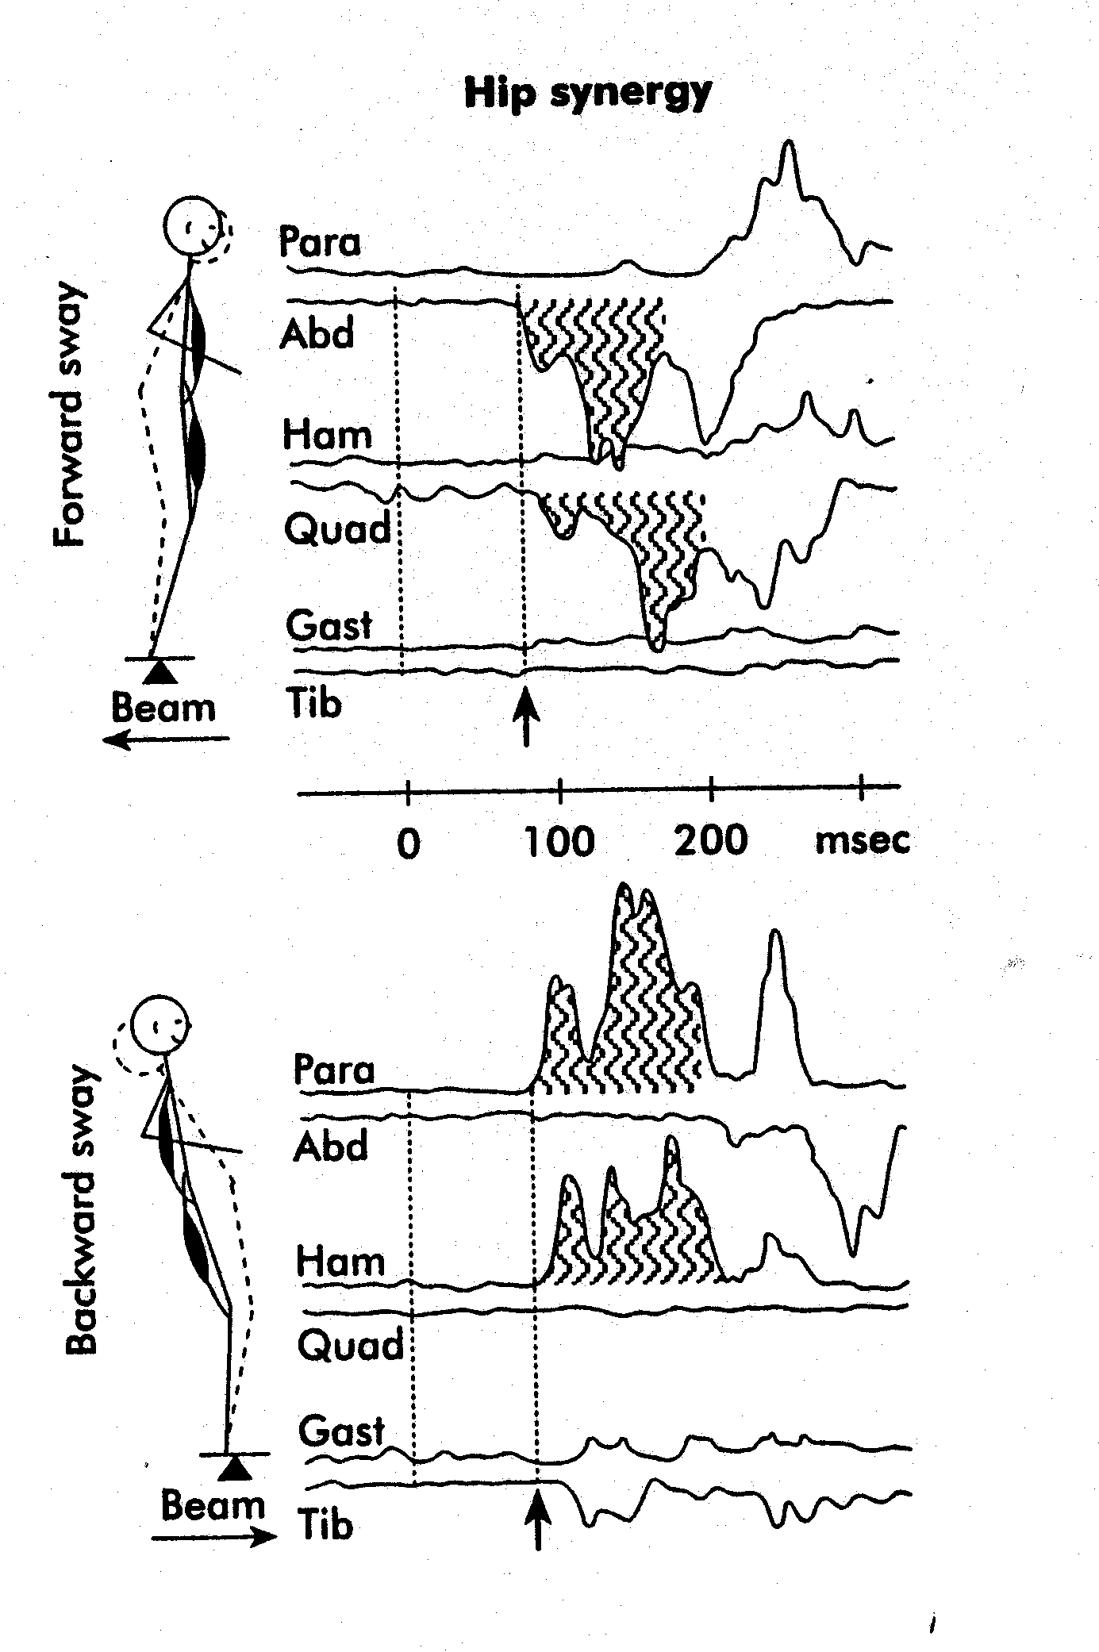
Hip Strategy

Slide 29
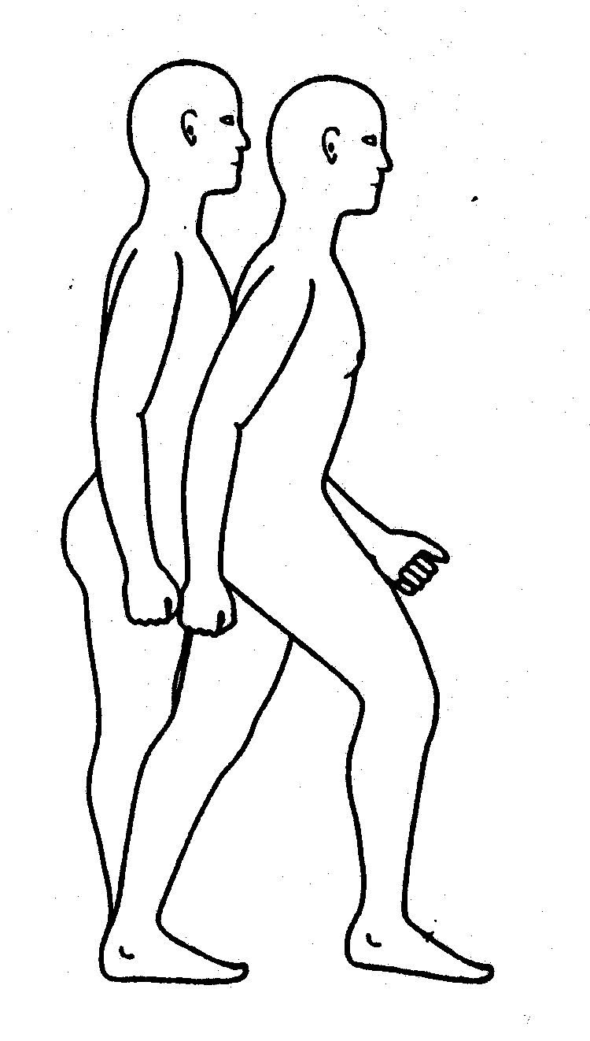
Stepping Strategy
Used to prevent a fall
Used when perturbations are fast or large amplitude -or- when other strategies fail
BOS moves to “catch up with” BOS

Slide 30
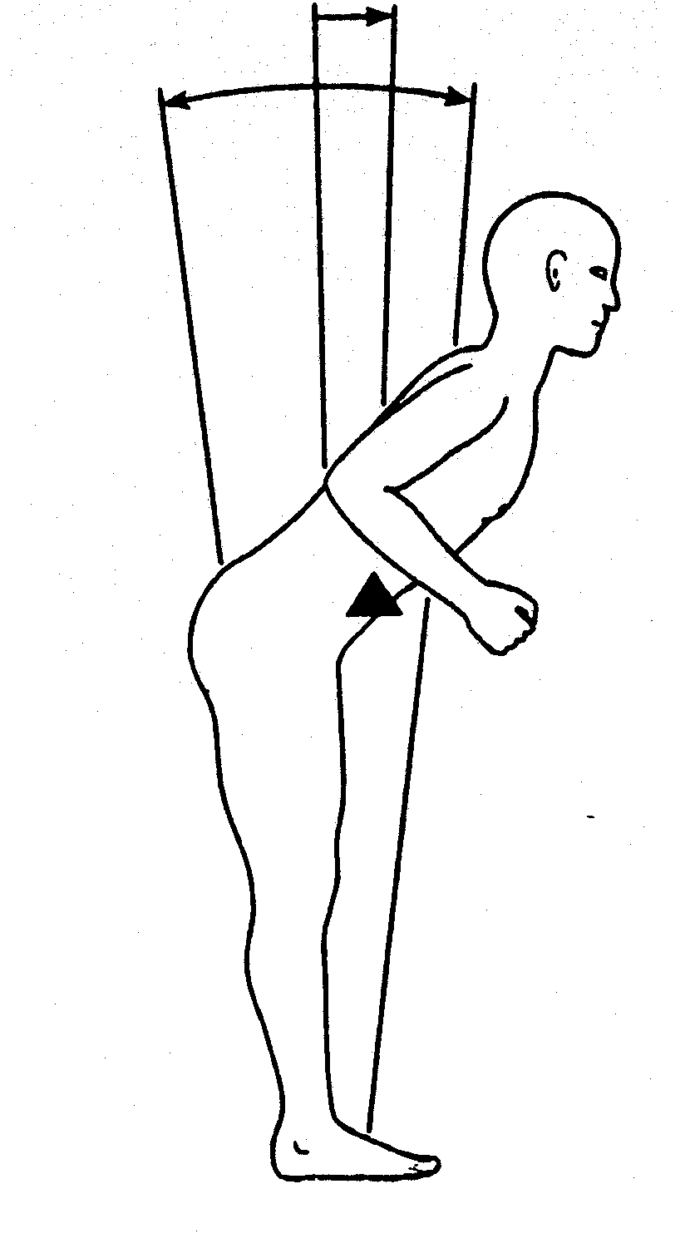
Suspensory Strategy
Forward bend of trunk with hip/knee flexion - may progress to a squatting position
COG lowered

Slide 31
Model Components
Sensory Organization
Balance/postural control via three systems:
  Somatosensory
  Visual
  Vestibular

Slide 32
Somatosensory System
Dominant sensory system
Provides fast input
Reports information
  Self-to-(supporting) surface
  Relation of one limb/segment to another
Components
  Muscle spindle
    Muscle length
    Rate of change
  GTOs (NTOs)
    Monitor tension
  Joint receptors
    Mechanoreceptors
  Cutaneous receptors

Slide 33
Visual System
Reports information
  Self-to-(supporting) surface
  Head position
    Keep visual gaze parallel with horizon
Subject to distortion
Components
  Eye and visual tracts
  Thalamic nuclei
  Visual cortex
    Projections to parietal and temporal lobes

Slide 34
Vestibular System
Not under conscious control
Assesses movements of head and body relative to gravity and the horizon (with visual system)
Resolves inter-sensory system conflicts
Gaze stablization
Components
  Cerebellum
  Projections to:
    Brain stem
    Ear

Slide 35
Sensory-Motor Integration
Sensory Input
Processing
Motor Response
Somatosensory
Vestibular
Visual
1⁰ Processor
Motoneurons
2⁰ Processor
Cerebellum
Eye Movements
Postural Movements

Slide 36
What is Posture?
The stereotypical alignment of body/limb segments
  Types
    Standing (static)
    Walking - running (dynamic)
    Sitting
    Lying
    Lifting

Slide 37
Posture
Position or attitude of the body
‘Postural sets’ are a means of maintaining balance as we’ve defined it
  Standing (static)
  Walking - running (dynamic)
  Sitting
  Lying
  Lifting

Slide 38
What Does Posture Do for Us?
Allows body to maintain upright alignment
Permits efficient movement patterns
Allows joints to be loaded symmetrically
  Decreases or distributes loads on
    Ligaments and other CT
    Muscle
    Cartilage and bone
‘Good posture’ usually results in the least amount of energy expended

Slide 39
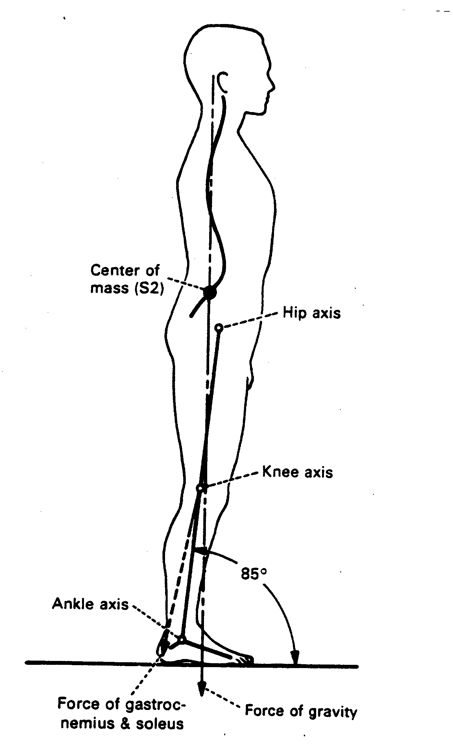
Erect Standing Posture & the ‘Gravity Line’ (Sagittal Analysis)
‘Gravity line falls:
  Forward of ankle
  Through or forward of the knee
  Through of behind the hip (common hip axis)
  Behind or through thoracic spine
  Through acromium
  Through or forward of atlanto-occipital jt.

Slide 40
Erect Standing Posture & the ‘Gravity Line’ (Frontal Analysis)
Gravity line falls:
  Symmetrically between two feet
  Through the umbilicus
  Through the xiphoid process
  Through the chin & nose
  Between the eyes

Slide 41
The ‘Gravity Line and Anti-gravity Muscles (Sagittal Plane)
Gravity line falls:
  Forward of ankle
  Through or forward of the knee
  Through of behind the hip (common hip axis)
  Behind or through thoracic spine
  Through acromium
  Through or forward of atlanto-occipital
Anti-gravity muscle:
  Gastroc-soleus
  Quadriceps
  Hip extensors
  Paraspinals
  Neck extensors

Slide 42
Relaxed vs. ‘Military’ Standing Posture
The ‘Military Posture’ requires ~30% more energy expenditure compared with a more relaxed upright standing posture

Slide 43
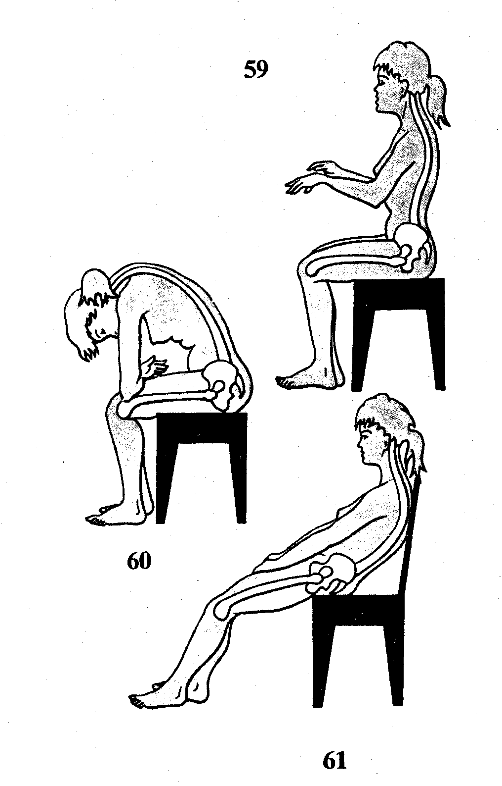
Sitting Posture
Disc patients often cannot sit
  Increased intra-disc pressure compared with standing
  Often loss of lordotic curve - may reverse leading to asymmetrical disc loading

Slide 44
Sitting Posture - Elements
Back against chair
  Lumbar support
Seat height
  Don’t allow feet to dangle or knees too high
Seat length
  Too long forces loss of lordosis
Feet flat with hips & knees at ~90⁰
Forearms supported

Slide 45
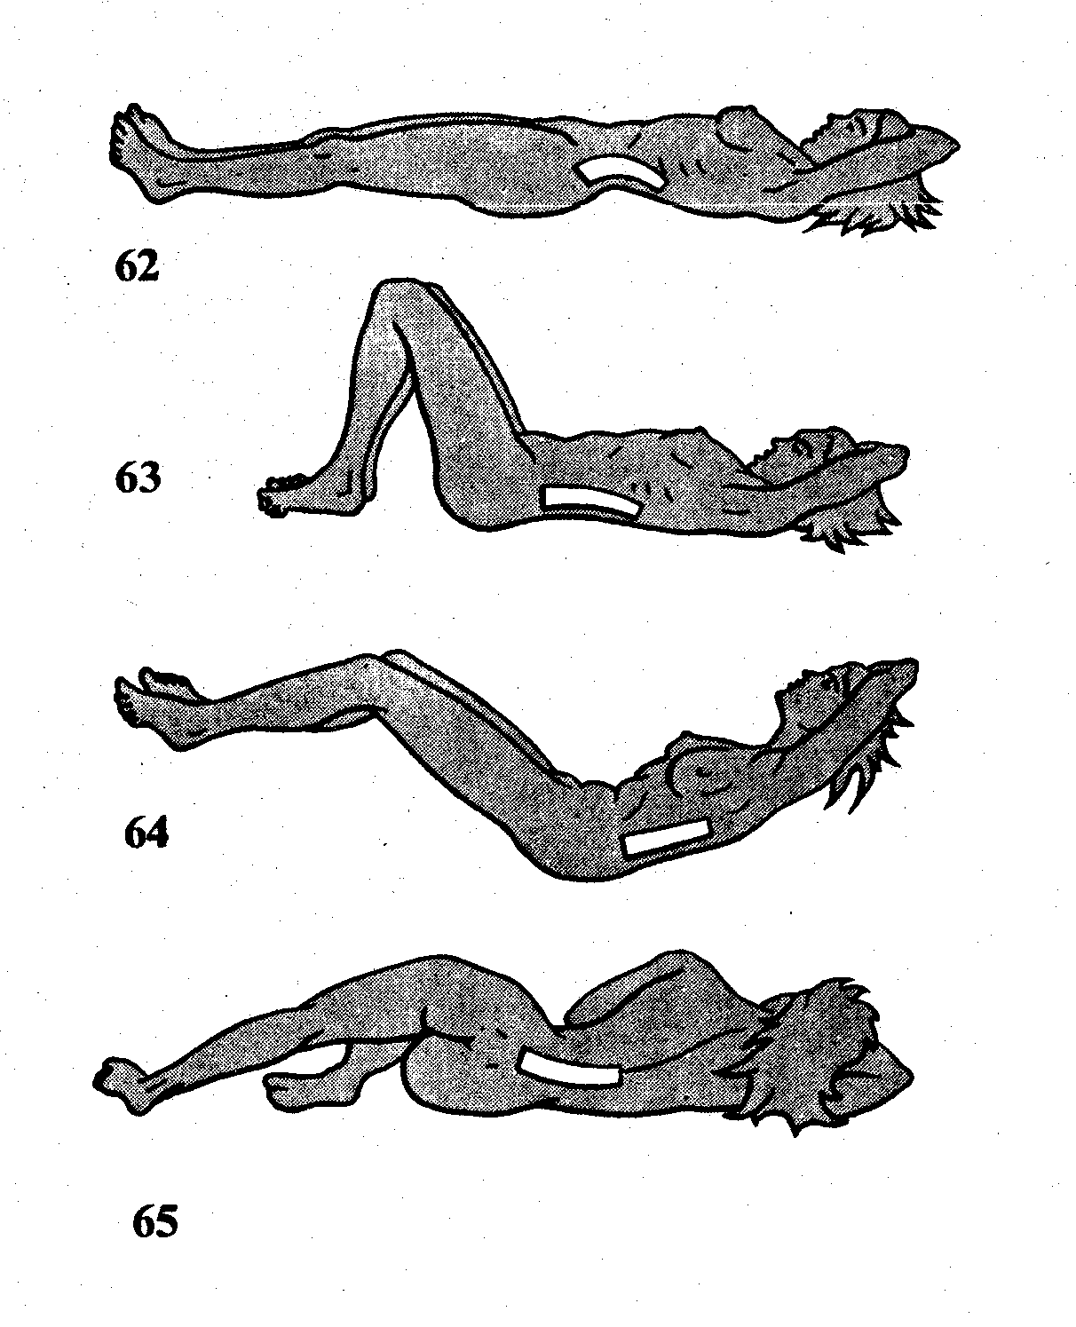
Lying (Sleeping) Posture
Elements
  Firm mattress for support
  Not too many pillows - Maybe none
  Lying flat on back may decrease lordosis
  Hook-lying may preserve lordosis
  Side-lying may be more comfortable

Slide 46
‘Lifting Posture’ - PT’s vs. Patient’s
Control COG (PT’s & patient’s) vs. BOS
  Don’t over-extend while reaching for patient
Load LEs symmetrically - NO rotation!
Maintain correct spinal curvature - especially lumbar spine
  Spine should NOT be straight - maintain lordosis
  Think about a ‘power lifter’
Leverage vs. brute force

Slide 47
Remember...
Get Help!

Slide 48
Remember...
Get Help!
Most SuperPTs have LBP & disc disease!

