Slide 1
Multi-layer perceptron:
A multilayer perceptron (MLP) is a type of artificial neural network that consists of more than one layer of neurons. Unlike a single- layer perceptron, which can only learn linearly separable patterns, a multilayer perceptron can learn more complex, non-linear functions. This makes it a fundamental model in the field of deep learning and neural networks.

Slide 2
Structure
1. Input layer: receives the input signal (data). These inputs are passed on to the next layer.
2. Hidden layers: one or more hidden layers, where the actual processing is done through a system n of weighted "connections." The number of hidden layers and the number of neurons in each hidden layer are adjustable parameters and can significantly influence the model's ability to capture complex patterns in the data.
3.Output layer: produces the final output. The design of the output layer depends on the default specific task (e.g., Regression, classification).

Slide 3
How it Works?
Forward Propagation:
Signals travel from the input layer forward to the output layer in the hidden and output layers processes the input signal using an activation function, which introduces non-linear properties to the network.
BACK PROPAGATION:
After the output is generated, the MLP uses a method called backpropagation to update the weights of the weights of the neurons. During backpropagation, the error (difference between the predicted and actual output) is calculated and distributed back through the network, allowing the weights to be updated accordingly.
LEARNING RATE:
This is a key parameter in training an MLP. It controls how much the weights are adjusted during backpropagation.

Slide 4
Activation Functions:
Functions like sigmoid, Relu (rectified linear unit), or tanh (hyperbolic Tangent) are used to introduce non-linear properties, allowing the MLP to Learn more complex patterns.

Slide 5
Multi-layer perceptron: Types Based on Number of Hidden Layers:
Shallow Neural Networks
Deep Neural Networks
One hidden layer
Basic pattern recognition, simple Classification and regression tasks
Multiple hidden layers
Complex pattern recognition, image AND speech recognition, natural language processing

Slide 6
Type of MLP BASED ON TASK:
Classification MLPs
Regression MLPs
Output a discrete label or class
Typical use cases LIKE image classification, text categorization, medical diagnosis
Predict a continuous output
Real estate pricing, stock market Forecasting, temperature prediction

Slide 7
Type of MLP Based on Activation Functions
Sigmoid MLPs
ReLU MLPs
Use sigmoid functions in hidden layers
Early neural network applications, binary classification tasks (less common now due to vanishing gradient issues)
Utilize rectified linear unit (relu) activation function
Modern deep learning tasks, including complex neural networks used in various fields

Slide 8
Type of MLP Based on NETWORK TOPOLOGY
Feedforward MLPs
Recurrent Neural Networks
Standard form, no cycles in connections
Most common use cases of neural networks, including both classification and regression
Loops in connections, allowing information persistence
Time series analysis, sequential data processing, language modeling, speech recognition

Slide 9
Type of MLP Based on output
Softmax MLPs
Linear Output MLPs
Softmax function in the output layer for categorical probability distributions
Linear activation function in the output layer
Multi-class classification problems such as digit recognition, text classification
Regression tasks where the output is continuous

Slide 10
Multi-layer perceptron Applications:
Mlps are versatile and can be used for various tasks, including but not limited to:
Classification problems, both binary and multi-class.
Regression problems.
Pattern recognition.
Time series prediction.

Slide 11
The multilayer perceptron is a foundational neural network model that paved the way for the development of deep learning. Its ability to learn from complex, non-linear datasets has made it a vital tool in the machine learning toolbox. However, MLPs can be prone to overfitting and may require careful tuning of parameters and architecture design.

Slide 12

Deep learning libraries
Keras:
Initially developed as an interface for tensorflow, keras Is known for its user-friendliness, modularity, and ease Of extensibility. It's excellent for beginners and allows for Fast experimentation with neural networks.

Slide 13

TensorFlow:
• Developed by google brain, TensorFlow is one of the most widely used libraries for deep learning. It offers flexible tools for designing and deploying machine learning models, including neural networks.

Slide 14

PyTorch:
Developed by face book's AI research lab, PyTorch known for its flexibility and dynamic computational graph, which allows changes to the network on the fly. It is particularly popular in research due to its ease and pythonic integration.

Slide 15
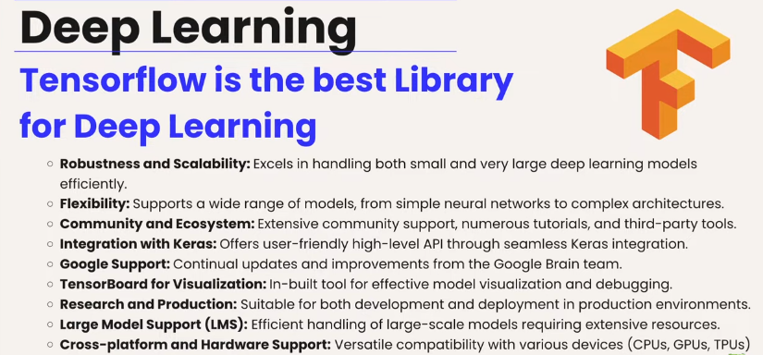

Slide 16
