Slide 1


SMART WEATHER(WITH JIRA)

Slide 2
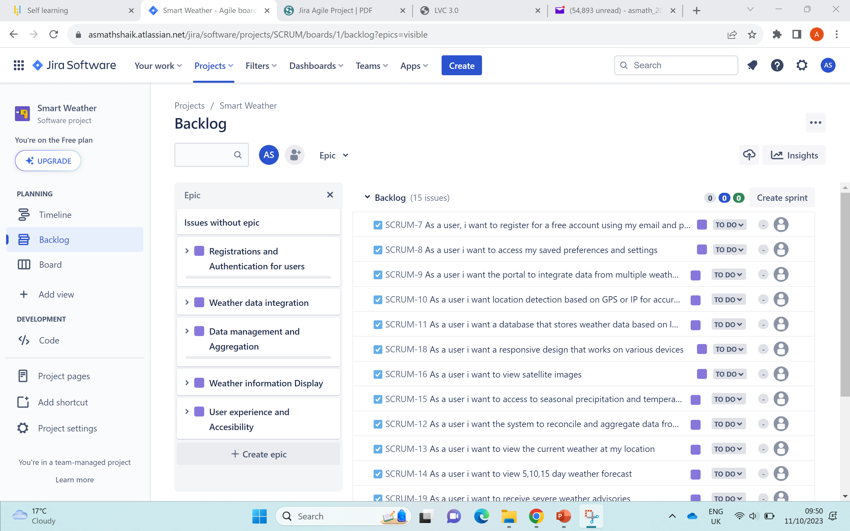
PROJECT TASK

Slide 3
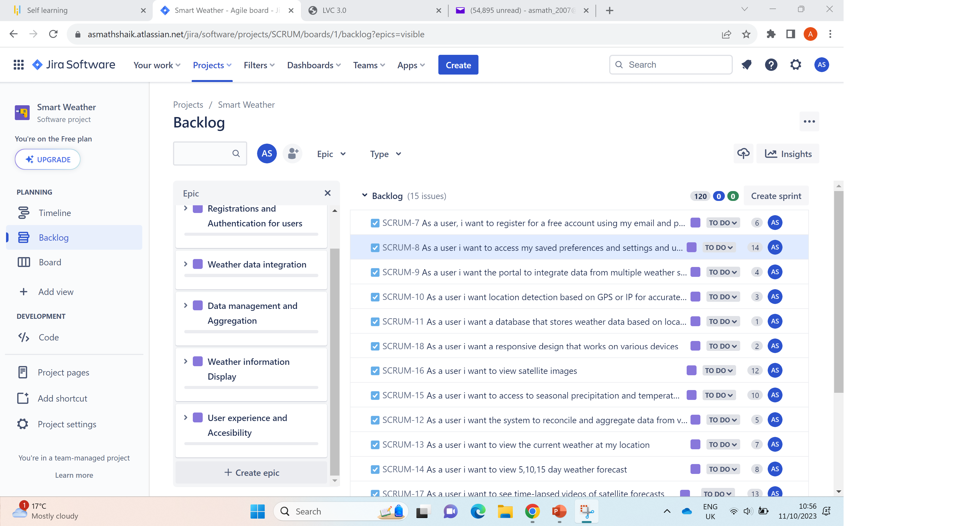
FIVE EPICS 15 USER STORIES

Slide 4
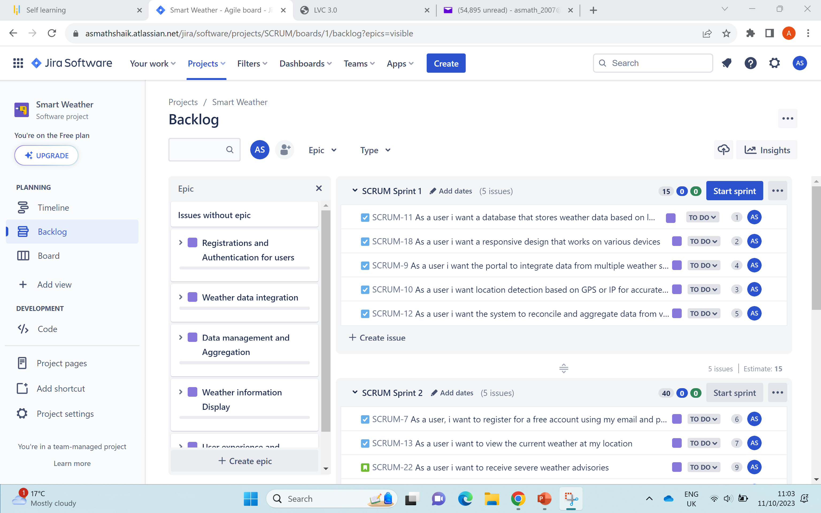
CREATING THREE SPRINTS

Slide 5
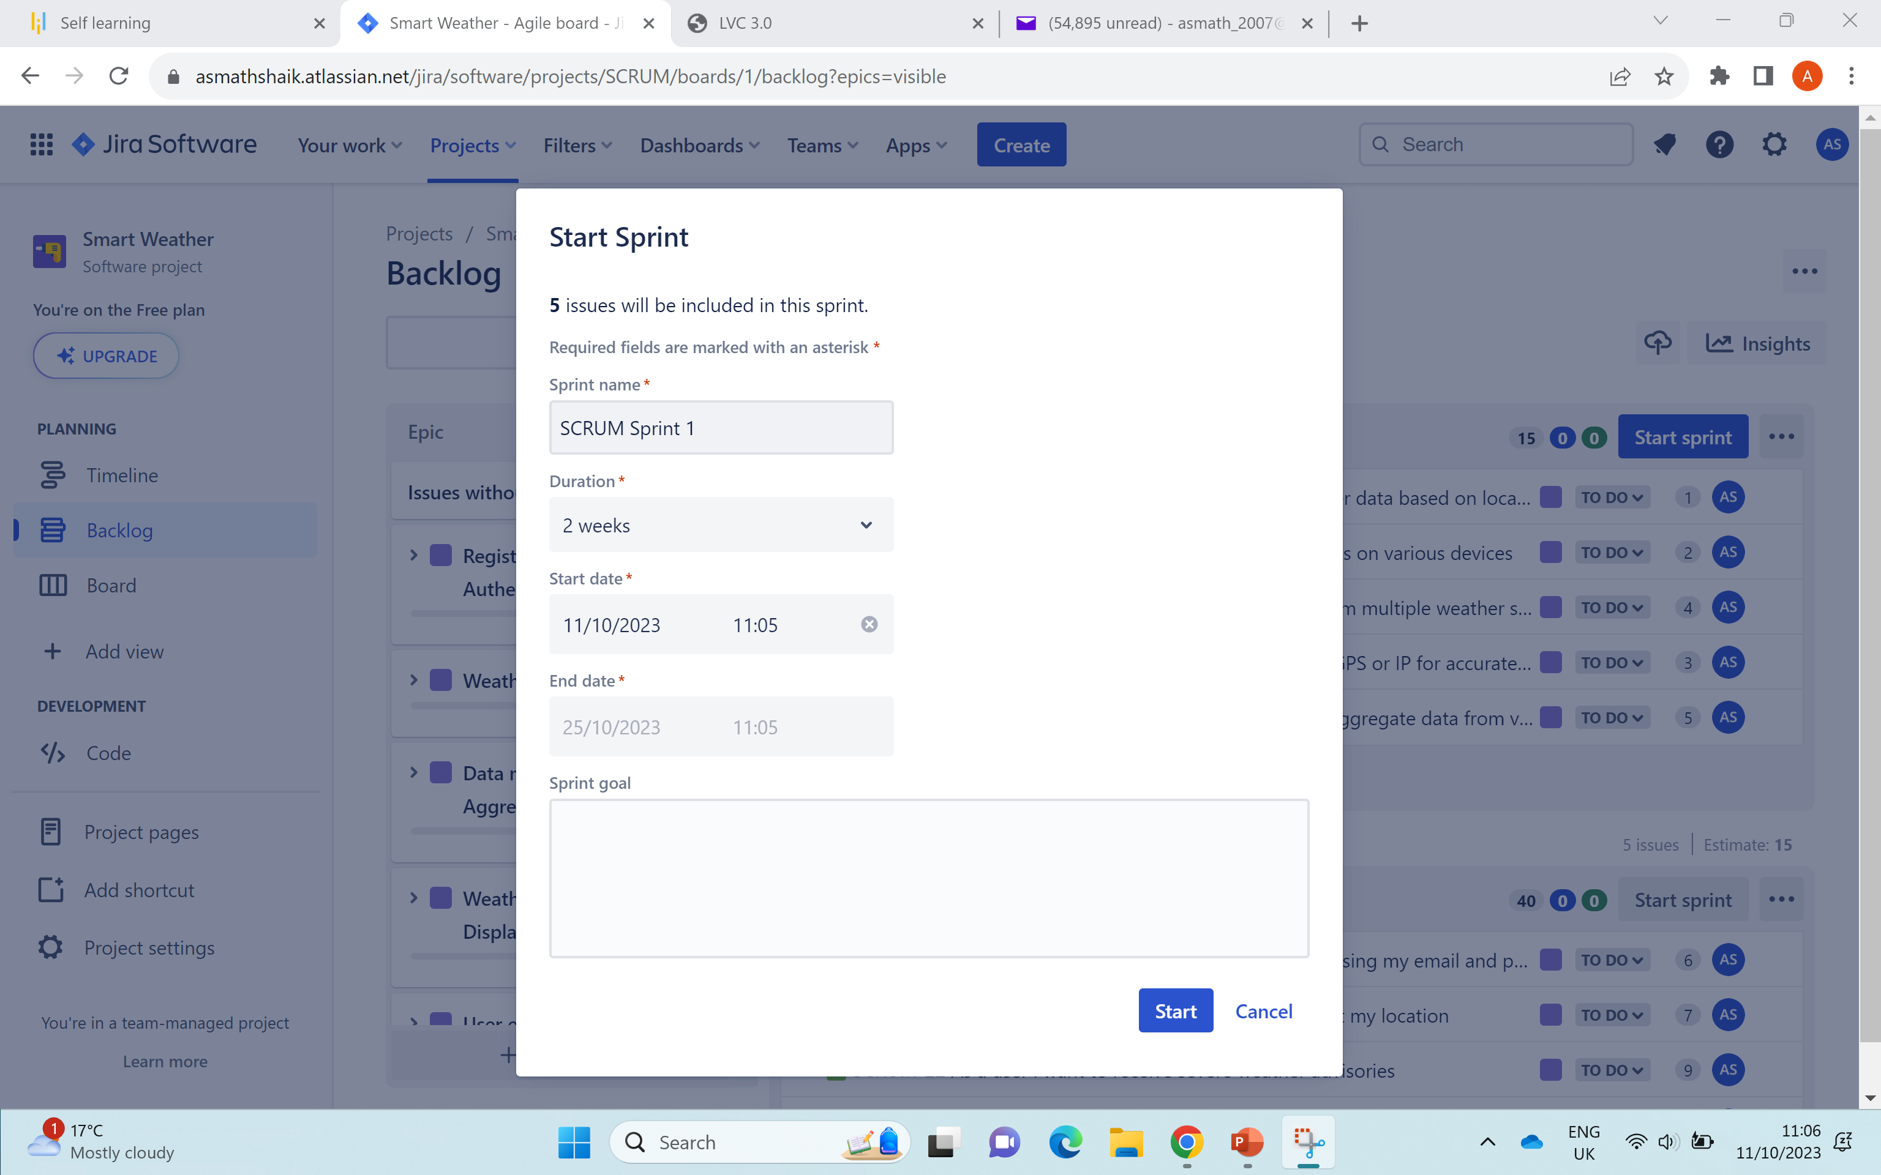
START SPRINT

